Slide 1



Crossing Language Barriers with , SciPy, and thon
Steven G. Johnson
MIT Applied Mathematics

Slide 2
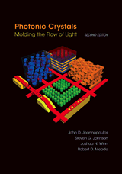

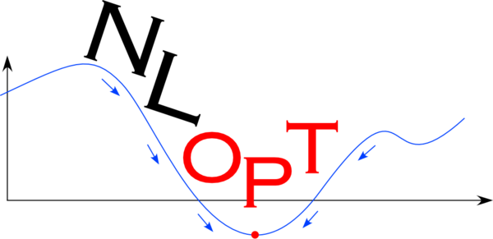

Where I’m coming from… [ google “Steven Johnson MIT” ]
Computational software you may know…
… mainly C/C++ libraries & software …
… often with Python interfaces …
(& Matlab & Scheme & …)
Nanophotonics
jdj.mit.edu/nlopt
www.fftw.org
jdj.mit.edu/meep
erf(z) (and erfc, erfi, …)
in SciPy 0.12+
& other EM simulators…
jdj.mit.edu/book
Confession: I’ve used Python’s internal C API more than I’ve coded in Python…

Slide 3




A new programming language?
Viral Shah
Jeff Bezanson
Alan Edelman
julialang.org
Stefan Karpinski
[begun 2009, “0.1” in 2013, ~20k commits]
[ 17+ developers with 100+ commits ]
First reaction: You’re doomed.
[ usual fate of all
new languages ]
… subsequently:
… probably doomed
… still might be doomed

Slide 4
but, in the meantime, I’m having fun with it… … and it solves a real problem with technical computing in high-level languages.

Slide 5
The “Two-Language” Problem
Want a high-level language that you can work with interactively
= easy development, prototyping, exploration
⇒ dynamically typed language
Plenty to choose from: Python, Matlab / Octave, R, Scilab, …
(& some of us even like Scheme / Guile)
Historically, can’t write performance-critical code (“inner loops”)
in these languages… have to switch to C/Fortran/… (static).
[ e.g. SciPy git master is ~70% C/C++/Fortran]
Workable, but Python → Python+C = a huge jump in complexity.

Slide 6
Just vectorize your code? = rely on mature external libraries, operating on large blocks of data, for performance-critical code
Good advice! But…
• Someone has to write those libraries.
• Eventually that person may be you.
— some problems are impossible or
just very awkward to vectorize.

Slide 7
Dynamic languages don’t have to be slow.
Lots of progress in JIT compilers, driven by web applications.
& excellent free/open-source JIT via LLVM.
Javascript in modern browsers achieves C-like speed.
Many other efforts to speed up dynamic languages, e.g. PyPy,
Numba / Cython (really 2nd lower-level language embedded in Python).
What if a dynamic language were designed for JIT from the beginning, with the goal of being as high-level as possible while staying within 2× C speed?

Slide 8
(and it’s easier to call SciPy from Julia than from PyPy)

Slide 9
Today
A brief introduction to Julia,
its key features,
and how it gets performance.
How Julia leverages Python and IPython
to lessen the “infrastructure problem” of new languages
time permitting:
How tools can flow in the other direction too…

Slide 10
Julia
[ julialang.org ]
Dynamically typed
Multiple dispatch: a generalization of OO
Metaprogramming (code that writes code)
Direct calling of C and Python functions
Coroutines, asychronous I/O
Designed for Unicode
Distributed-memory parallelism
User-defined types == builtin types … extensible promotion and conversion rules, etc.
Large built-in library: regex, linear algebra, special functions, integration, etcetera…
git-based package manager
Most of Julia (70%+)
is written in Julia.

Slide 11
goto live Julia REPL demo…

Slide 12
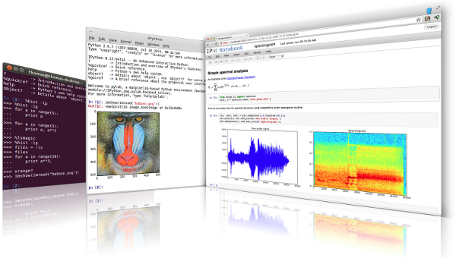
This command line is so 1990…
[e.g. GNU Readline, 1989]
vs.
Come back in 5 years
once you implement something more modern…
[ ipython.org ]

Slide 13

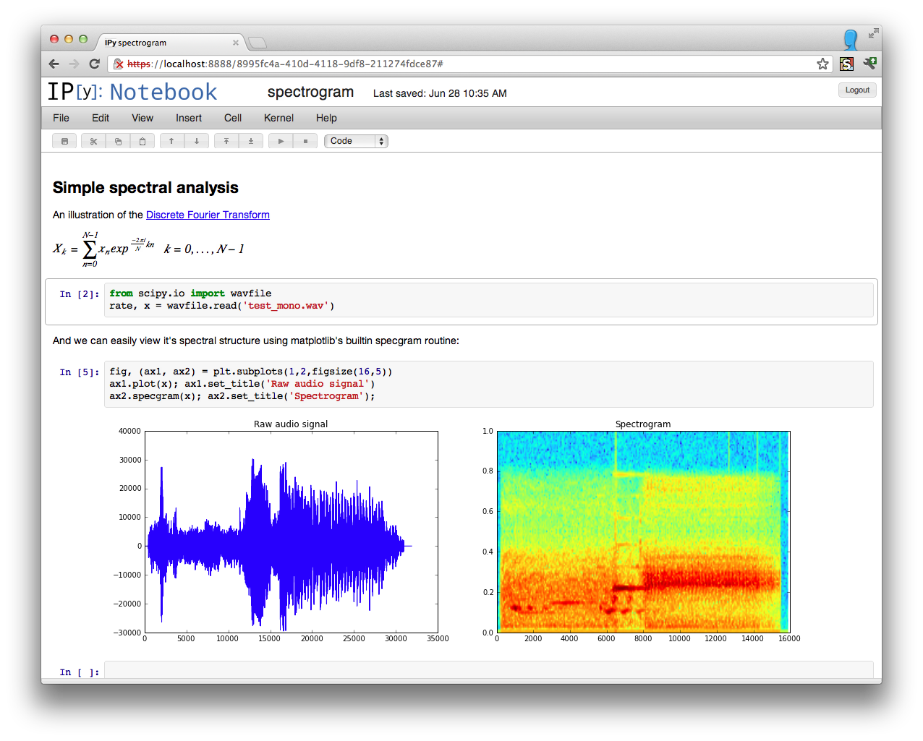
(roughly) How IPython Notebooks Work
programmer
enter Python code
ZeroMQ
HTTP
IPython
Web
Server
IPython
kernel
code
code
HTML
+ JS
multi-
media
results
Web browser:
Notebook Display/Interaction

Slide 14

How IJulia Notebooks Work
programmer
enter Julia code
ZeroMQ
HTTP
IPython
Jupyter
Web
Server
IJulia
kernel
code
code
HTML
+ JS
multi-
media
results
Web browser:
Notebook Display/Interaction

Slide 15
goto live IJulia notebook demo…

Slide 16
Why is Julia fast?

Slide 17
Why is Julia fast?

Slide 18
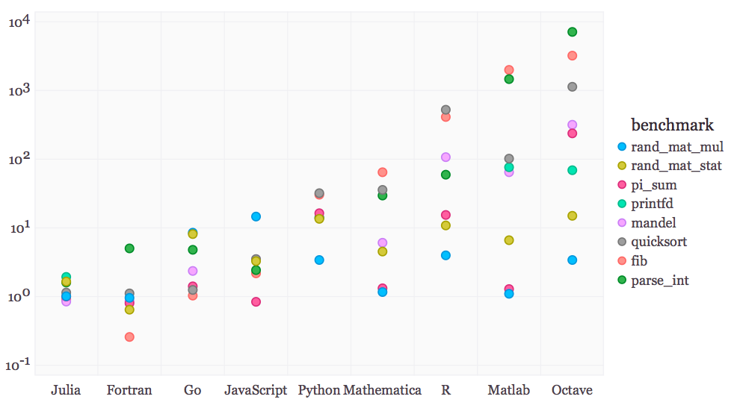
Julia performance on synthetic benchmarks
[ loops, recursion, etc., implemented in most straightforward style ]

Slide 19
What about real problems, compared to highly optimized code?

Slide 20
Special Functions in Julia
Special functions s(x): classic case that cannot be vectorized well
… switch between various polynomials depending on x
Many of Julia’s special functions come from the usual C/Fortran libraries,
but some are written in pure Julia code.
Pure Julia erfinv(x) [ = erf^{–1}(x) ]
3–4× faster than Matlab’s and 2–3× faster than SciPy’s (Fortran Cephes).
Pure Julia polygamma(m, z) [ = (m+1)^{th} derivative of the ln Γ function ]
~ 2× faster than SciPy’s (C/Fortran) for real z
… and unlike SciPy’s, same code supports complex argument z
Julia code can actually be faster than typical “optimized”
C/Fortran code, by using techniques [metaprogramming/code generation] that are hard in a low-level language.

Slide 21
Pure-Julia FFT performance
(FFTW, MKL: “unfair” factor of ~2 from manual SIMD)
already comparable to FFTPACK
[ probably some tweaks to
inlining will make it better ]
FFTPACK
Julia
FFTW w/o SIMD
FFTW 1.0-like code generation
+ recursion in Julia
~ 1/3 lines of code compared to
FFTPACK, more functionality

Slide 22
Why is Julia fast?

Slide 23
Why can Julia be fast?
Why is Julia fast?
(You can write slow code in any language, of course.)
… and couldn’t Python do the same thing?

Slide 24
Type Inference
To generate fast code for a function f(x,y), the compiler needs to be able to infer the types of variables in f, map them to hardware types (registers) where possible, and call specialized code paths for those types (e.g. you want to inline +, but this depends on types).
At compile-time, the compiler generally only knows types of x,y, not values, and it needs to be able to cascade this information to infer types throughout f and in any functions called by f.
Julia and its standard library are designed so type inference is possible for code following straightforward rules.
… sometimes this requires subtle choices that would be
painful to retrofit onto an existing language.

Slide 25
Type Stability
Key to predictable, understandable type inference:
• the type of function’s return value
should only depend on the types of its arguments
A counter-example in Matlab and GNU Octave:
sqrt(1) == 1.0 — real floating-point
sqrt(–1) == 0.0+1.0i — complex floating-point
Hence, any non-vector code that calls sqrt(x) in Matlab cannot be compiled to fast code even if x is known to be real scalar — anything “touched” by the sqrt(x) is “poisoned” with an unknown type — unless the compiler knows x ≥ 0.
Better to throw an exception for sqrt(–1), requiring sqrt(-1+0i).

Slide 26
Type Stability
Key to predictable, understandable type-inference:
• the type of function’s return value
should only depend on the types of its arguments
Common counter-examples in Python
Typical idiom:
foo(x) returns y, or None if [exceptional condition]
[e.g. numpy.ma.notmasked_edges, scipy.constants.find, …]
Better: Throw an exception.

Slide 27
Type Stability
Key to predictable, understandable type-inference:
• the type of function’s return value
should only depend on the types of its arguments
A counter-example in Python
integer arithmetic
Integer arithmetic in Python automatically uses bignums
to prevent overflow. Unless the compiler can detect that
overflow is impossible [which may be detectable sometimes!],
integers can’t be compiled to integer registers & hw arithmetic.
Julia tradeoff: default integers are 64-bit, overflow possible
… use explicit BigInt type if you are doing number theory.

Slide 28
goto live IJulia notebook demo…

Slide 29
Julia: fun, fast, and you don’t lose your Python stuff. New languages are always a risk… …but maybe not doomed?

Slide 30



Acknowledgements
Julia core team:
Jeff Bezanson (MIT)
Stefan Karpinski (MIT)
Viral Shah
…(17+ developers with 100+ commits)…
Prof. Alan Edelman (MIT)
julialang.org
& Shashi Gowda
(GSoC)
ipython.org
& Jake Bolewski
(pyjulia)
Fernando
Perez
Matthias
Bussonier
Min RK

