Slide 1
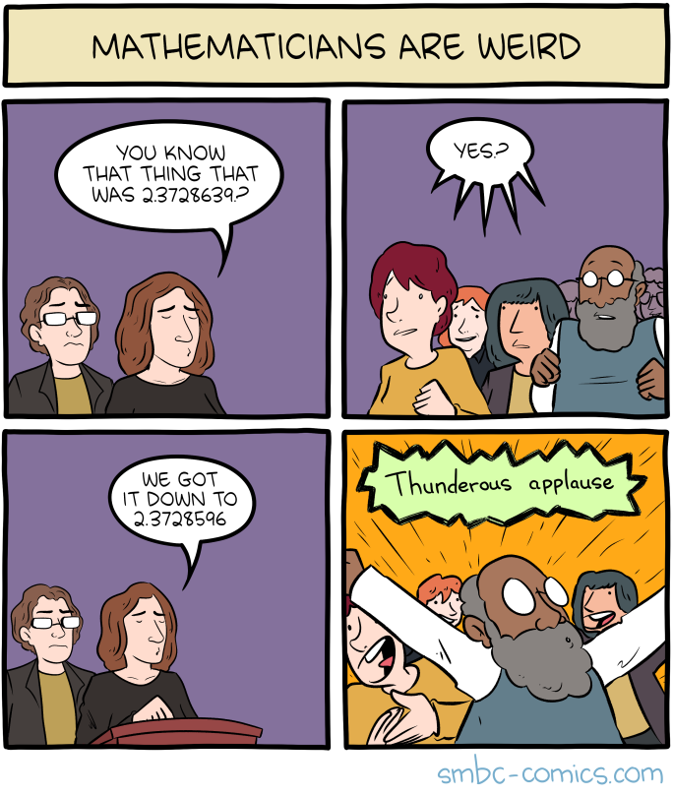
A Refined Laser Method and Faster Matrix Multiplication
Josh Alman (Harvard)
Virginia Vassilevska Williams (MIT)
Thanks to Josh Alman for his slides!

Slide 2


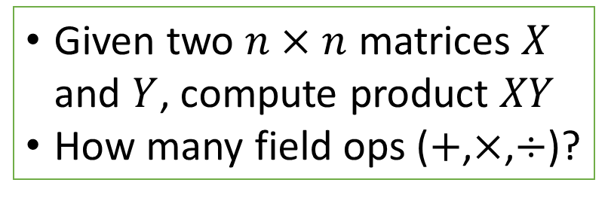


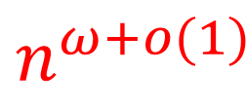


Matrix Multiplication (MM)
Given two $n×n$ matrices $X$ and $Y$, compute product $XY$
How many field ops ($+$,$×$,$÷$)?
$$n^{ω+o(1)}$$
$$O(n^{3})$$
$$ω$$
$$O(n^{2.81})$$
$$O(n^{2.37287})$$
$$O(n^{2.37288})$$
$$O(n^{2.37286})$$

Slide 3
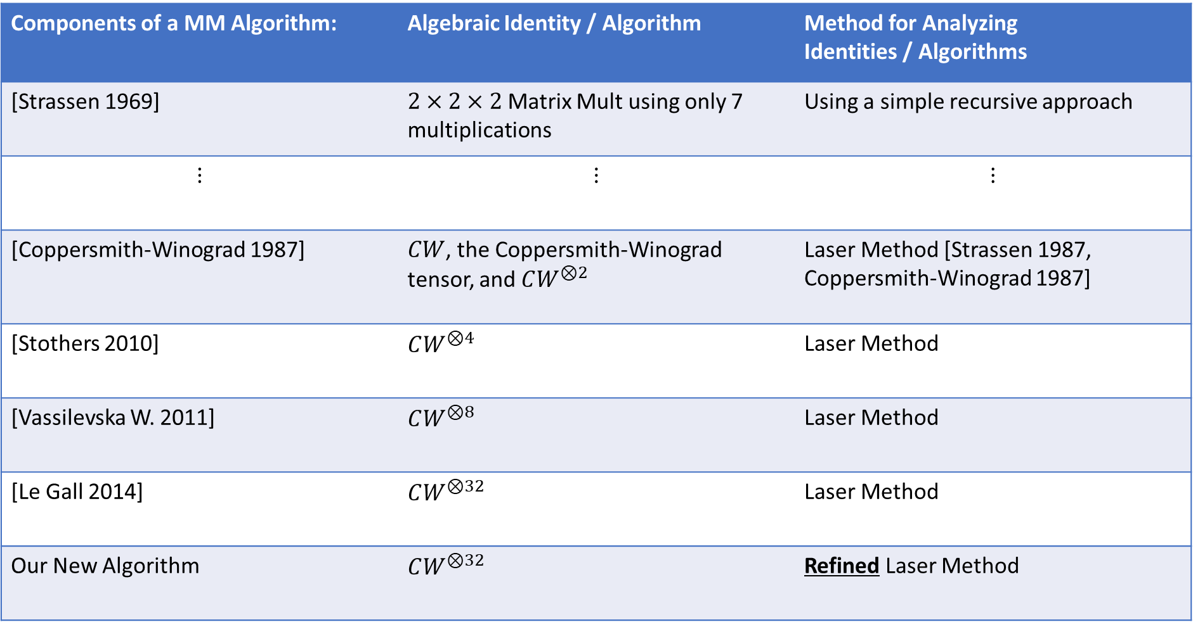
How MM Algorithms are Designed
Components of a MM Algorithm: | Algebraic Identity / Algorithm | Method for Analyzing Identities / Algorithms
[Strassen 1969] | $2×2×2$ Matrix Mult using only 7 multiplications | Using a simple recursive approach
$$⋮$$ | $$⋮$$ | $$⋮$$
[Coppersmith-Winograd 1987] | $CW$, the Coppersmith-Winograd tensor, and $CW^{⊗2}$ | Laser Method [Strassen 1987, Coppersmith-Winograd 1987]
[Stothers 2010] | $CW^{⊗4}$ | Laser Method
[Vassilevska W. 2011] | $CW^{⊗8}$ | Laser Method
[Le Gall 2014] | $CW^{⊗32}$ | Laser Method
Our New Algorithm | $CW^{⊗32}$ | Refined Laser Method

Slide 4
Talk Plan
Part 1: Overview of past work & Intro to the Laser Method
Part 2: Our refined Laser Method

Slide 5
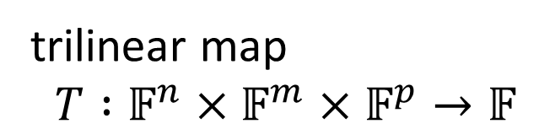

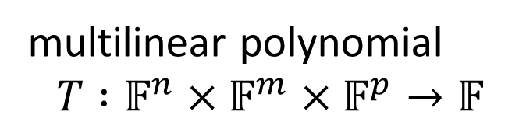
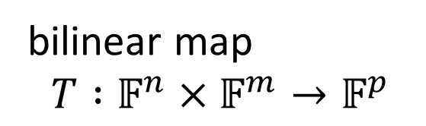
Tensors
hypermatrix $${\left(T_{ijk}\right)}_{ijk}∈𝔽^{n×m×p}$$
trilinear map $$T :𝔽^{n}×𝔽^{m}×𝔽^{p}→𝔽$$
bilinear map $$T :𝔽^{n}×𝔽^{m}→𝔽^{p}$$
multilinear polynomial $$T :𝔽^{n}×𝔽^{m}×𝔽^{p}→𝔽$$

Slide 6
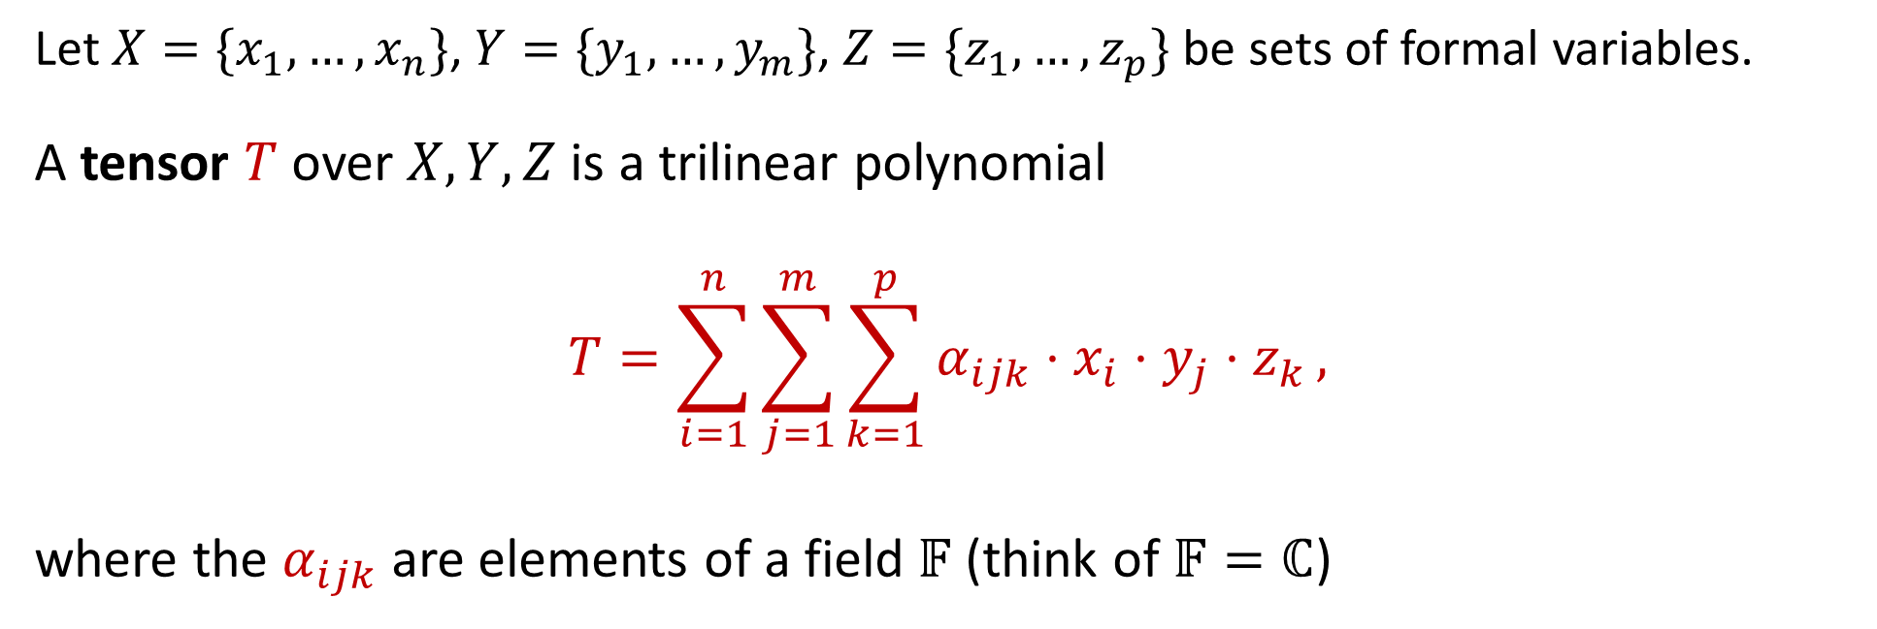
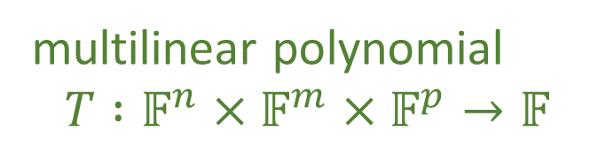
Tensors
hypermatrix $${\left(T_{ijk}\right)}_{ijk}∈𝔽^{n×m×p}$$
trilinear map $$T :𝔽^{n}×𝔽^{m}×𝔽^{p}→𝔽$$
bilinear map $$T :𝔽^{n}×𝔽^{m}→𝔽^{p}$$
multilinear polynomial $$T :𝔽^{n}×𝔽^{m}×𝔽^{p}→𝔽$$
Let $X=\{x_{1},…,x_{n}\}$, $Y=\{y_{1},…,y_{m}\}$, $Z=\{z_{1},…,z_{p}\}$ be sets of formal variables.
A tensor $T$ over $X,Y,Z$ is a trilinear polynomial
$$T=\sum_{i=1}^{n}{\sum_{j=1}^{m}{\sum_{k=1}^{p}{α_{ijk}⋅x_{i}⋅y_{j}⋅z_{k}},}}$$ where the $α_{ijk}$ are elements of a field $𝔽$ (think of $𝔽=ℂ$)

Slide 7

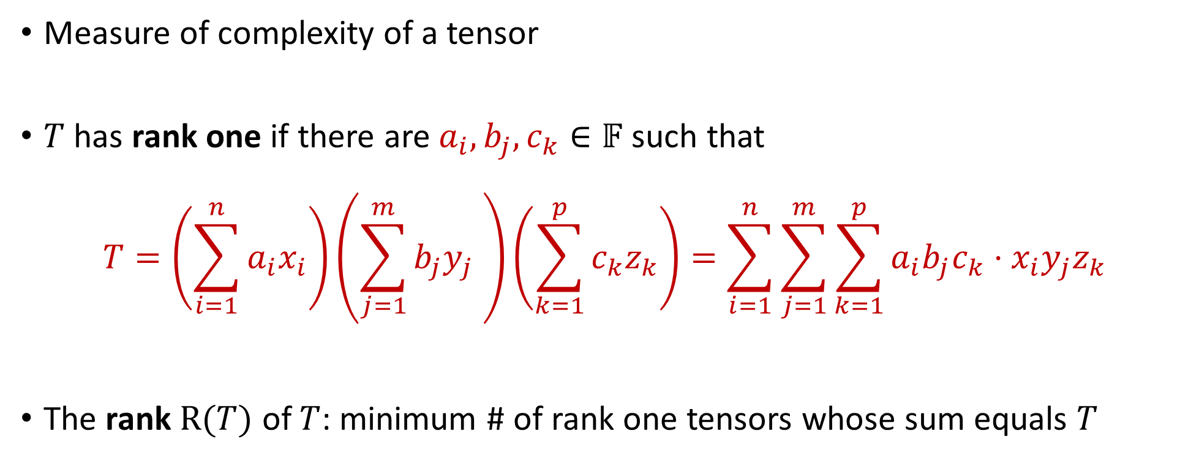
Tensor rank
Measure of complexity of a tensor
$T$ has rank one if there are $a_{i}, b_{j}, c_{k}∈𝔽$ such that
$$T=\left(\sum_{i=1}^{n}{a_{i}x_{i}}\right)\left(\sum_{j=1}^{m}{b_{j}y_{j} }\right)\left(\sum_{k=1}^{p}{c_{k}z_{k}}\right)=\sum_{i=1}^{n}{\sum_{j=1}^{m}{\sum_{k=1}^{p}{a_{i}b_{j}c_{k}⋅x_{i}y_{j}z_{k}}}}$$
The rank $R(T)$ of $T$: minimum # of rank one tensors whose sum equals $T$
$$a⊗b⊗c$$

Slide 8
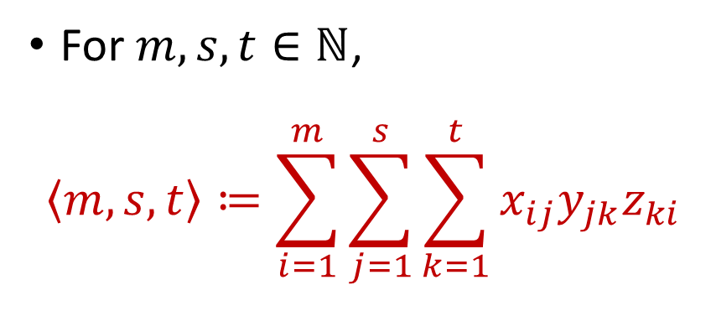
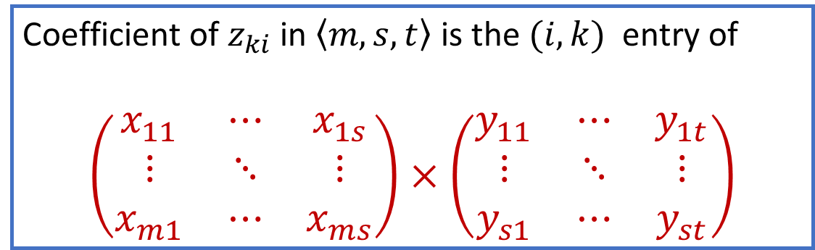
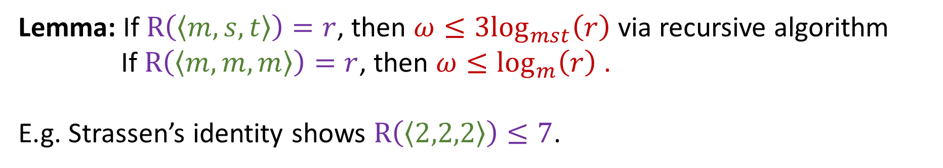
Matrix Multiplication Tensor
For $m,s,t∈ℕ$,
$$\left\langle m,s,t\right\rangle ≔\sum_{i=1}^{m}{\sum_{j=1}^{s}{\sum_{k=1}^{t}{x_{ij}y_{jk}z_{ki}}}}$$
Coefficient of $z_{ki}$ in $〈m,s,t〉$ is the $(i,k)$ entry of
$$\left(\begin{matrix}x_{11} & ⋯ & x_{1s} \\ ⋮ & ⋱ & ⋮ \\ x_{m1} & ⋯ & x_{ms}\end{matrix}\right)×\left(\begin{matrix}y_{11} & ⋯ & y_{1t} \\ ⋮ & ⋱ & ⋮ \\ y_{s1} & ⋯ & y_{st}\end{matrix}\right)$$
Lemma: If $R\left(\left\langle m,s,t\right\rangle \right)=r$, then $ω≤{3log}_{mst}\left(r\right)$ via recursive algorithm
If $R\left(\left\langle m,m,m\right\rangle \right)=r$, then $ω≤\log_{m}\left(r\right)$ .
E.g. Strassen’s identity shows $R\left(\left\langle 2,2,2\right\rangle \right)≤7$.

Slide 9

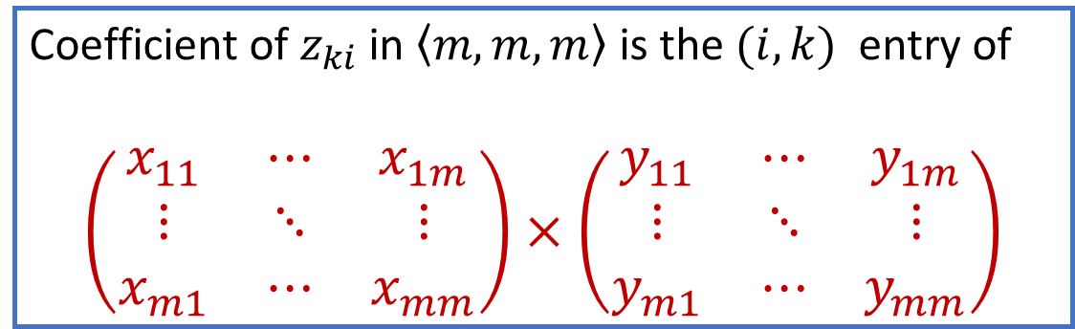
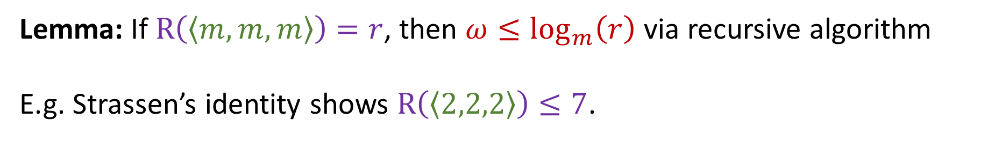
Matrix Multiplication Tensor
For $m∈ℕ$,
$$\left\langle m,m,m\right\rangle ≔\sum_{i,j,k=1}^{m}{x_{ij}y_{jk}z_{ki}}$$
Coefficient of $z_{ki}$ in $〈m,m,m〉$ is the $(i,k)$ entry of
$$\left(\begin{matrix}x_{11} & ⋯ & x_{1m} \\ ⋮ & ⋱ & ⋮ \\ x_{m1} & ⋯ & x_{mm}\end{matrix}\right)×\left(\begin{matrix}y_{11} & ⋯ & y_{1m} \\ ⋮ & ⋱ & ⋮ \\ y_{m1} & ⋯ & y_{mm}\end{matrix}\right)$$
Lemma: If $R\left(\left\langle m,m,m\right\rangle \right)=r$, then $ω≤\log_{m}\left(r\right)$ via recursive algorithm
E.g. Strassen’s identity shows $R\left(\left\langle 2,2,2\right\rangle \right)≤7$.

Slide 10
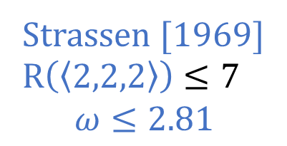
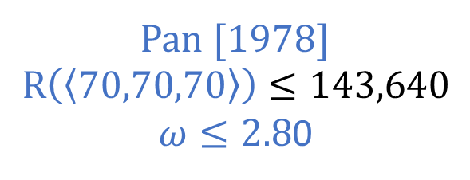
Matrix Multiplication Rank Bounds
Strassen [1969] $R\left(\left\langle 2,2,2\right\rangle \right)≤7$ $$ω≤2.81$$
Pan [1978] $$R\left(〈70,70,70〉\right)≤143,640$$ $ω≤2.8$0

Slide 11

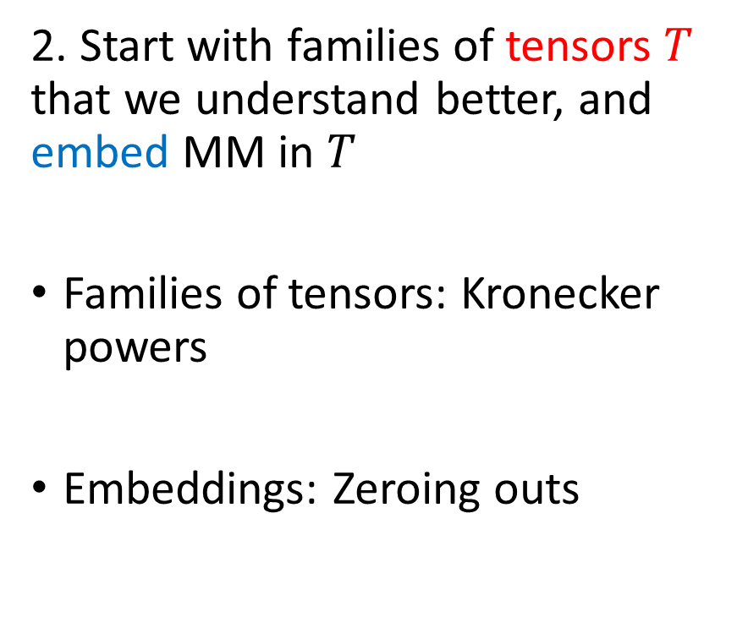


Two Key Ideas since 1980 (Very Oversimplified)
1. Schönhage’s inequality
Rank upper bounds for direct sums of many MM tensors also yield upper bounds on $ω$
If the direct sum of $k$ copies of $⟨m,s,t⟩$ has rank $≤r$, then $ω≤3\log_{mst}\left(\frac{r}{k}\right)$
2. Start with families of tensors $T$ that we understand better, and embed MM in $T$
Families of tensors: Kronecker powers
Embeddings: Zeroing outs
$$T=x_{1}y_{1}z_{1}+x_{1}y_{2}z_{2}$$
Sum of two copies of $T$:
$$A=(x_{1}y_{1}z_{1}+x_{1}y_{2}z_{2}) \\ + {(x}_{2}y_{2}z_{2}+x_{2}y_{3}z_{3})$$
(both copies share $y_{2}$)
Direct sum of two copies of $T$:
$$B={(x}_{1}y_{1}z_{1}+x_{1}y_{2}z_{2}) \\ +(x_{3}y_{3}z_{3}+x_{3}y_{4}z_{4})$$
Recall: If $R\left(\left\langle m,s,t\right\rangle \right)≤r$, then $ω≤{3log}_{mst}\left(r\right)$

Slide 12
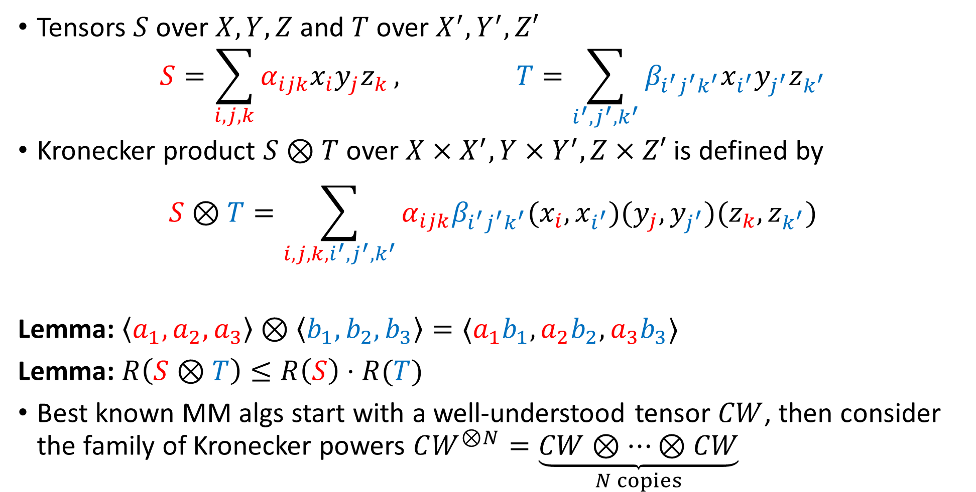
Kronecker product
Tensors $S$ over $X,Y,Z$ and $T$ over $X^{′},Y^{′},Z′$ $S=\sum_{i,j,k}{α_{ijk}x_{i}y_{j}z_{k}}, T=\sum_{i^{′},j^{′},k^{′}}{β_{i^{′}j^{′}k^{′}}x_{i^{′}}y_{j^{′}}z_{k^{′}}}$
Kronecker product $S⊗T$ over $X×X^{′},Y×Y^{′},Z×Z′$ is defined by
$$S⊗T=\sum_{i,j,k,i^{′},j^{′},k^{′}}{α_{ijk}β_{i^{′}j^{′}k^{′}}(x_{i},x_{i^{′}})(y_{j},y_{j^{′}})(z_{k},z_{k^{′}})}$$
Lemma: $\left\langle a_{1},a_{2},a_{3}\right\rangle ⊗\left\langle b_{1},b_{2},b_{3}\right\rangle =⟨a_{1}b_{1},a_{2}b_{2},a_{3}b_{3}⟩$
Lemma: $R\left(S⊗T\right)≤R\left(S\right)⋅R(T)$
Best known MM algs start with a well-understood tensor $CW$, then consider the family of Kronecker powers $CW^{⊗N}=\underset{N copies}{\underbrace{CW⊗⋯⊗CW}}$

Slide 13

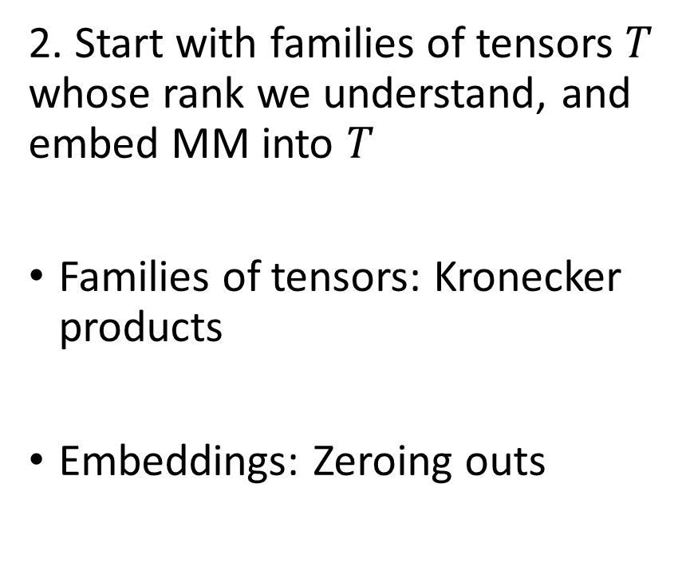
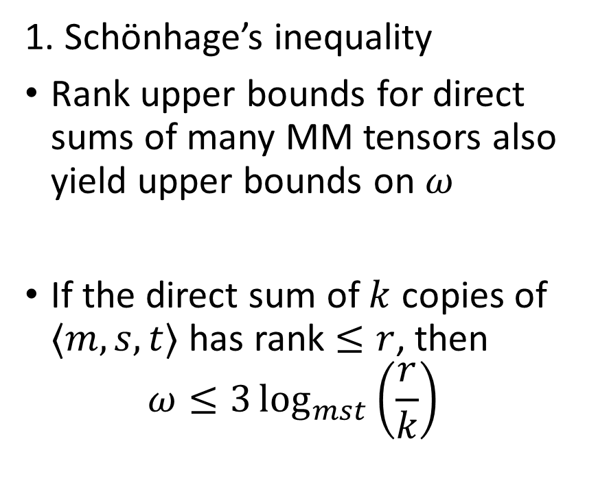
Two Key Ideas since 1980 (Very Oversimplified)
1. Schönhage’s inequality
Rank upper bounds for direct sums of many MM tensors also yield upper bounds on $ω$
If the direct sum of $k$ copies of $⟨m,s,t⟩$ has rank $≤r$, then $ω≤3\log_{mst}\left(\frac{r}{k}\right)$
2. Start with families of tensors $T$ whose rank we understand, and embed MM into $T$
Families of tensors: Kronecker products
Embeddings: Zeroing outs

Slide 14

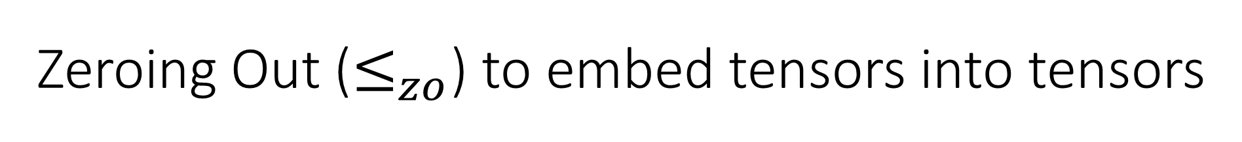
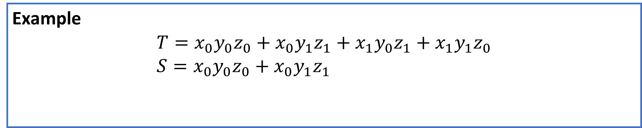
Zeroing Out ($≤_{zo}$) to embed tensors into tensors
$S≤_{zo}T$ if can get to $S$ from $T$ by removing all occurrences of some variables
Example
$$T=x_{0}y_{0}z_{0}+x_{0}y_{1}z_{1}+x_{1}y_{0}z_{1}+x_{1}y_{1}z_{0} \\ S=x_{0}y_{0}z_{0}+x_{0}y_{1}z_{1}$$

Slide 15
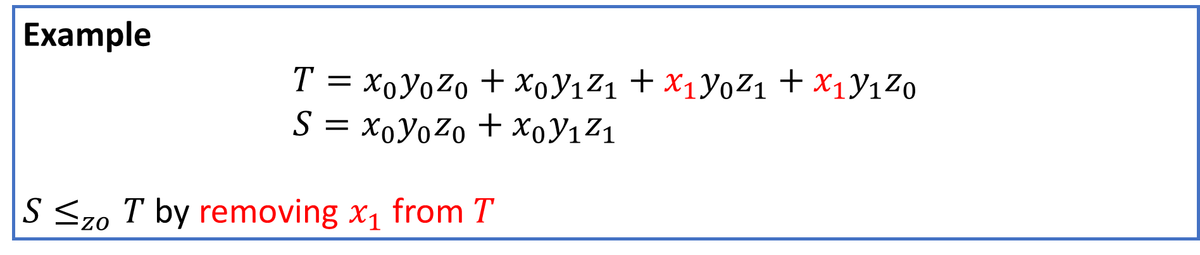

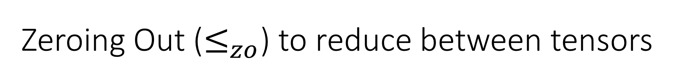
Zeroing Out ($≤_{zo}$) to reduce between tensors
$S≤_{zo}T$ if can get to $S$ from $T$ by removing all occurrences of some variables
Lemma: If $S≤_{zo}T$ then $R\left(S\right)≤R\left(T\right)$.
Example
$$T=x_{0}y_{0}z_{0}+x_{0}y_{1}z_{1}+x_{1}y_{0}z_{1}+x_{1}y_{1}z_{0} \\ S=x_{0}y_{0}z_{0}+x_{0}y_{1}z_{1}$$
$S≤_{zo}T$ by removing $x_{1}$ from $T$

Slide 16
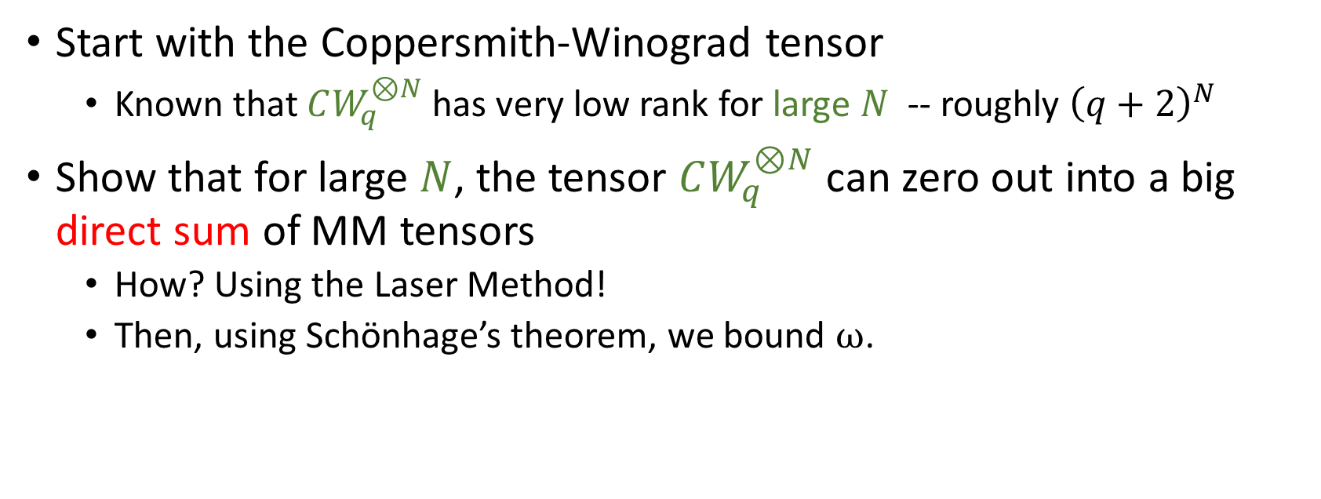
MM Algorithm Outline
Start with the Coppersmith-Winograd tensor
Known that $CW_{q}^{⊗N}$ has very low rank for large $N$ -- roughly ${\left(q+2\right)}^{N}$
Show that for large $N$, the tensor $CW_{q}^{⊗N}$ can zero out into a big direct sum of MM tensors
How? Using the Laser Method!
Then, using Schönhage’s theorem, we bound $ω$.

Slide 17
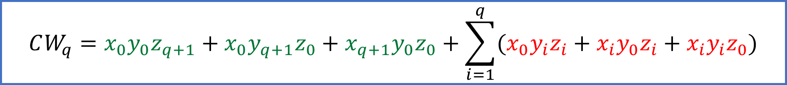

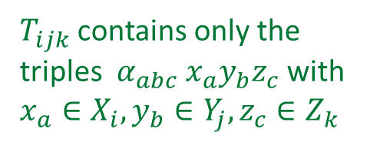
The Laser Method: Partition the variable sets
$$\left\langle 1,1,1\right\rangle + \left\langle 1,1,1\right\rangle + \left\langle 1,1,1\right\rangle + ⟨1,1,q⟩+⟨q,1,1⟩+⟨1,q,1⟩$$
$T_{002} +{ T}_{020} +{ T}_{200} +$ $T_{011} +{ T}_{101} +{ T}_{110}$
Start with a tensor $T$ $T=\sum_{a=1}^{n}{\sum_{b=1}^{m}{\sum_{c=1}^{p}{α_{abc}⋅x_{a}⋅y_{b}⋅z_{c}}}}$
Partition its variable sets $X=X_{1}∪⋯∪X_{ℓ}$, $Y=Y_{1}∪⋯∪Y_{ℓ}$, $Z=Z_{1}∪⋯∪Z_{ℓ}$
For $i,j,k∈[ℓ]$ define $T_{ijk}$ to be $T$ with $X∖X_{i}$, $Y∖Y_{j}$, $Z∖Z_{k}$ zeroed out, so $T=\sum_{i=1}^{ℓ}{\sum_{j=1}^{ℓ}{\sum_{k=1}^{ℓ}{T_{ijk}}}}$
Let’s assume each nonzero $T_{ijk}$ is a MM tensor
$T$ is a sum of MM tensors, but we need a direct sum of MM tensors
$$CW_{q}=x_{0}y_{0}z_{q+1}+x_{0}y_{q+1}z_{0}+x_{q+1}y_{0}z_{0}+\sum_{i=1}^{q}{(x_{0}y_{i}z_{i}+x_{i}y_{0}z_{i}+x_{i}y_{i}z_{0})}$$
$T_{ijk}$ contains only the triples $α_{abc} x_{a}y_{b}z_{c}$ with $x_{a}∈X_{i},y_{b}∈Y_{j}, z_{c}∈Z_{k}$

Slide 18
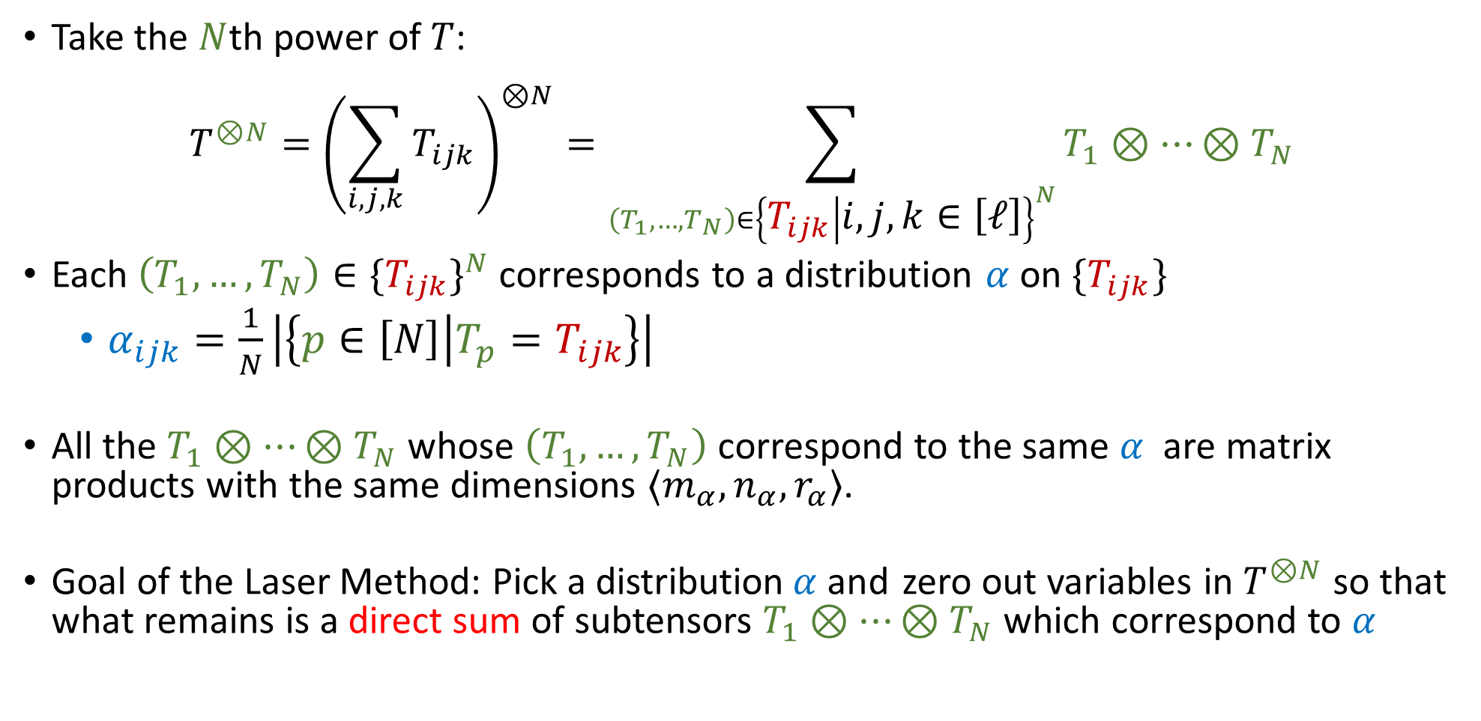
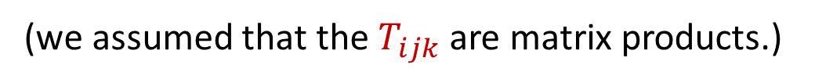
The Laser Method: Take a large power
(we assumed that the $T_{ijk}$ are matrix products.)
Take the $N$th power of $T$:
$$T^{⊗N}={\left(\sum_{i,j,k}{T_{ijk}}\right)}^{⊗N}=\sum_{\left(T_{1},…,T_{N}\right)∈{\left\{T_{ijk} | i,j,k∈\left[ℓ\right]\right\}}^{N}}{T_{1}⊗⋯⊗T_{N}}$$
Each $\left(T_{1},…,T_{N}\right)∈{\{T_{ijk}\}}^{N}$ corresponds to a distribution $α$ on $\{T_{ijk}\}$
$α_{ijk}=\frac{1}{N}\left|\left\{p∈\left[N\right] | T_{p}=T_{ijk}\right\}\right|$
All the $T_{1}⊗⋯⊗T_{N}$ whose $\left(T_{1},…,T_{N}\right)$ correspond to the same $α$ are matrix products with the same dimensions $⟨m_{α},n_{α},r_{α}⟩$.
Goal of the Laser Method: Pick a distribution$α$and zero out variables in $T^{⊗N}$ so that what remains is a direct sum of subtensors $T_{1}⊗⋯⊗T_{N}$ which correspond to $α$
$${\left\langle a,b,c\right\rangle }^{⊗t}⊗{\left\langle p,q,r\right\rangle }^{⊗u}≅⟨a^{t}p^{u},b^{t}q^{u},c^{t}r^{u}⟩$$

Slide 19
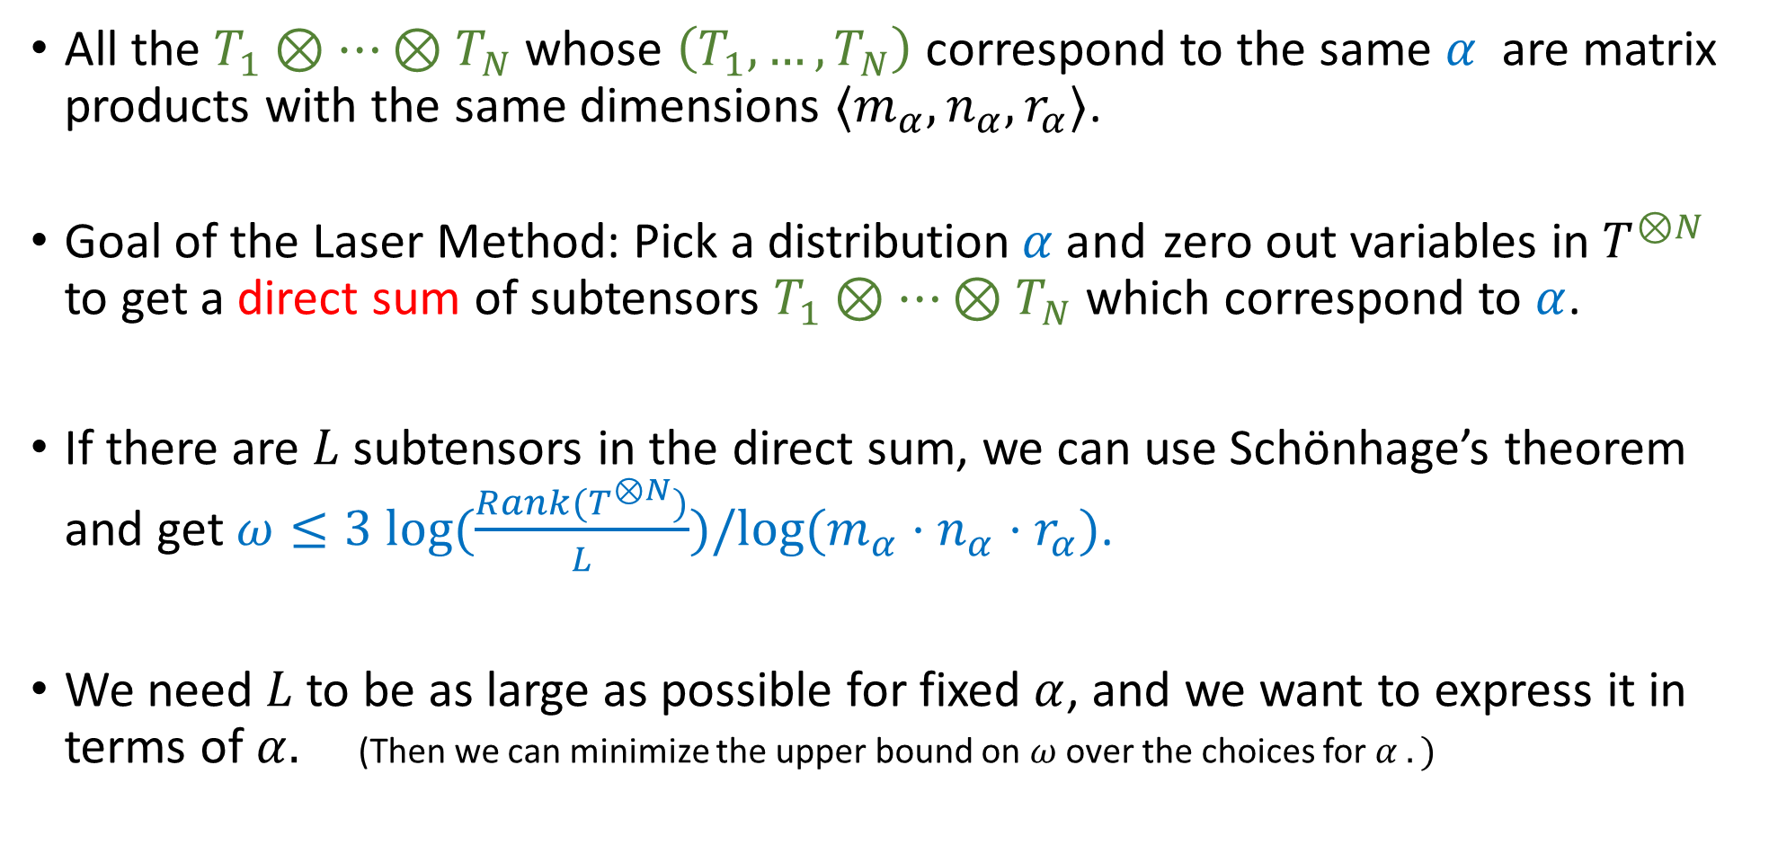
The Laser Method: Take a large power
All the $T_{1}⊗⋯⊗T_{N}$ whose $\left(T_{1},…,T_{N}\right)$ correspond to the same $α$ are matrix products with the same dimensions $⟨m_{α},n_{α},r_{α}⟩$.
Goal of the Laser Method: Pick a distribution$α$and zero out variables in $T^{⊗N}$ to get a direct sum of subtensors $T_{1}⊗⋯⊗T_{N}$ which correspond to $α$.
If there are $L$ subtensors in the direct sum, we can use Schönhage’s theorem and get $ω≤3 log(\frac{Rank(T^{⊗N})}{L})/log⁡(m_{α}⋅n_{α}⋅r_{α})$.
We need $L$to be as large as possible for fixed $α$, and we want to express it in terms of $α.$ (Then we can minimize the upper bound on $ω$ over the choices for $α .)$

Slide 20
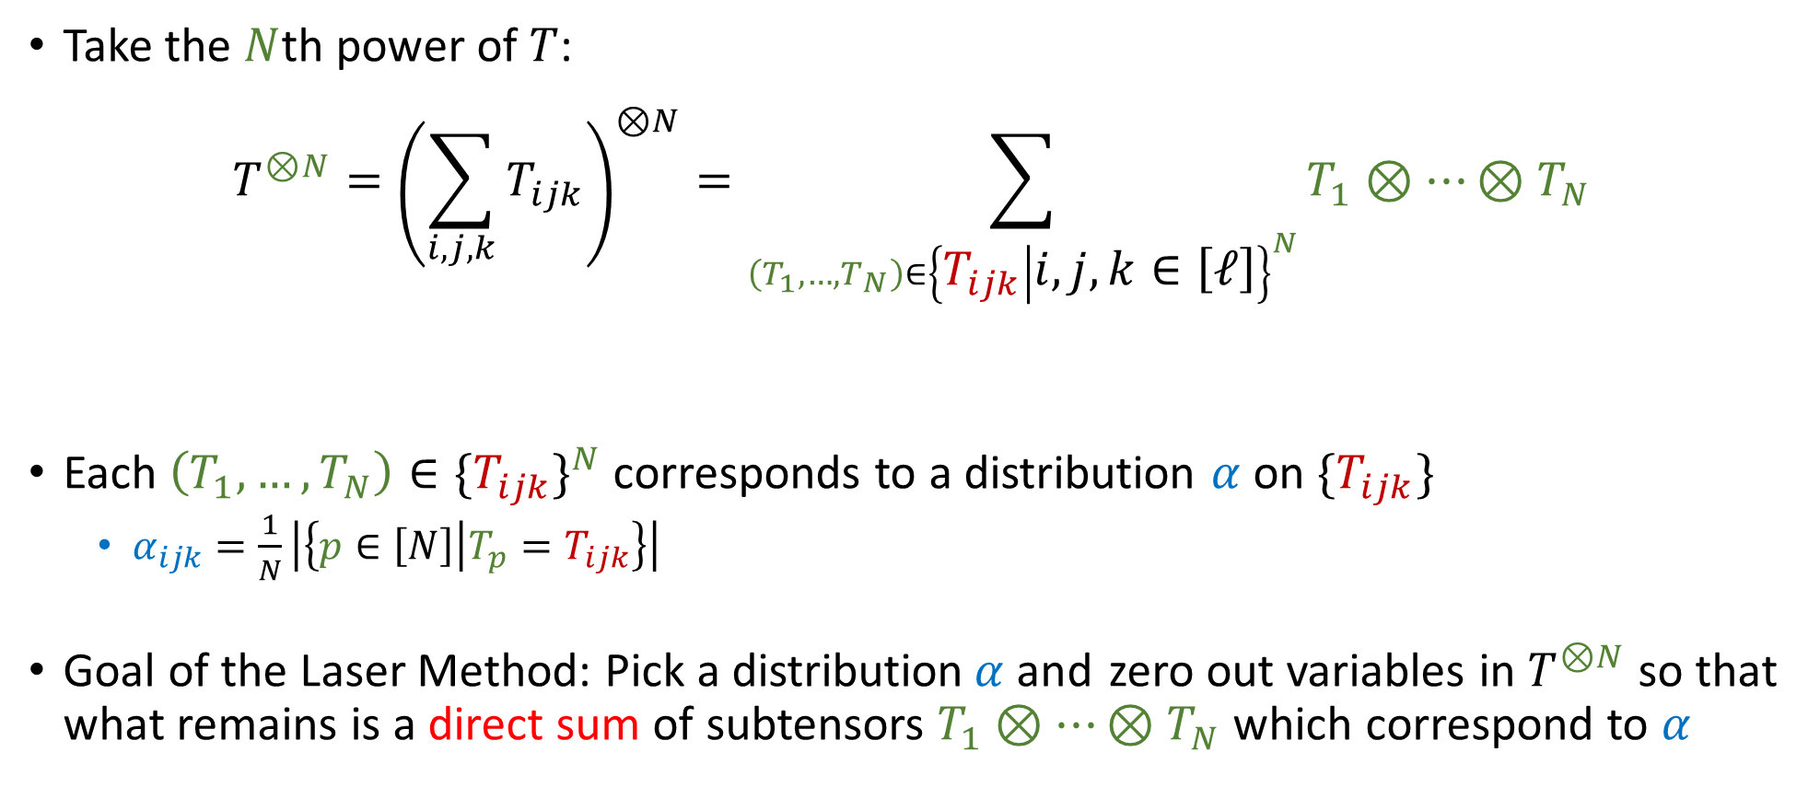
The Laser Method: Take a large power
Take the $N$th power of $T$:
$$T^{⊗N}={\left(\sum_{i,j,k}{T_{ijk}}\right)}^{⊗N}=\sum_{\left(T_{1},…,T_{N}\right)∈{\left\{T_{ijk} | i,j,k∈\left[ℓ\right]\right\}}^{N}}{T_{1}⊗⋯⊗T_{N}}$$
Each $\left(T_{1},…,T_{N}\right)∈{\{T_{ijk}\}}^{N}$ corresponds to a distribution $α$ on $\{T_{ijk}\}$
$α_{ijk}=\frac{1}{N}\left|\left\{p∈\left[N\right] | T_{p}=T_{ijk}\right\}\right|$
Goal of the Laser Method: Pick a distribution$α$and zero out variables in $T^{⊗N}$ so that what remains is a direct sum of subtensors $T_{1}⊗⋯⊗T_{N}$ which correspond to $α$
$${\left\langle a,b,c\right\rangle }^{⊗t}⊗{\left\langle p,q,r\right\rangle }^{⊗u}≅⟨a^{t}p^{u},b^{t}q^{u},c^{t}r^{u}⟩$$

Slide 21
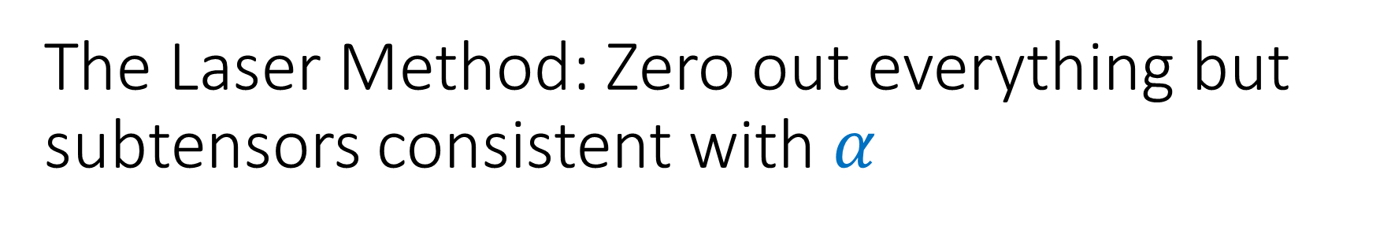
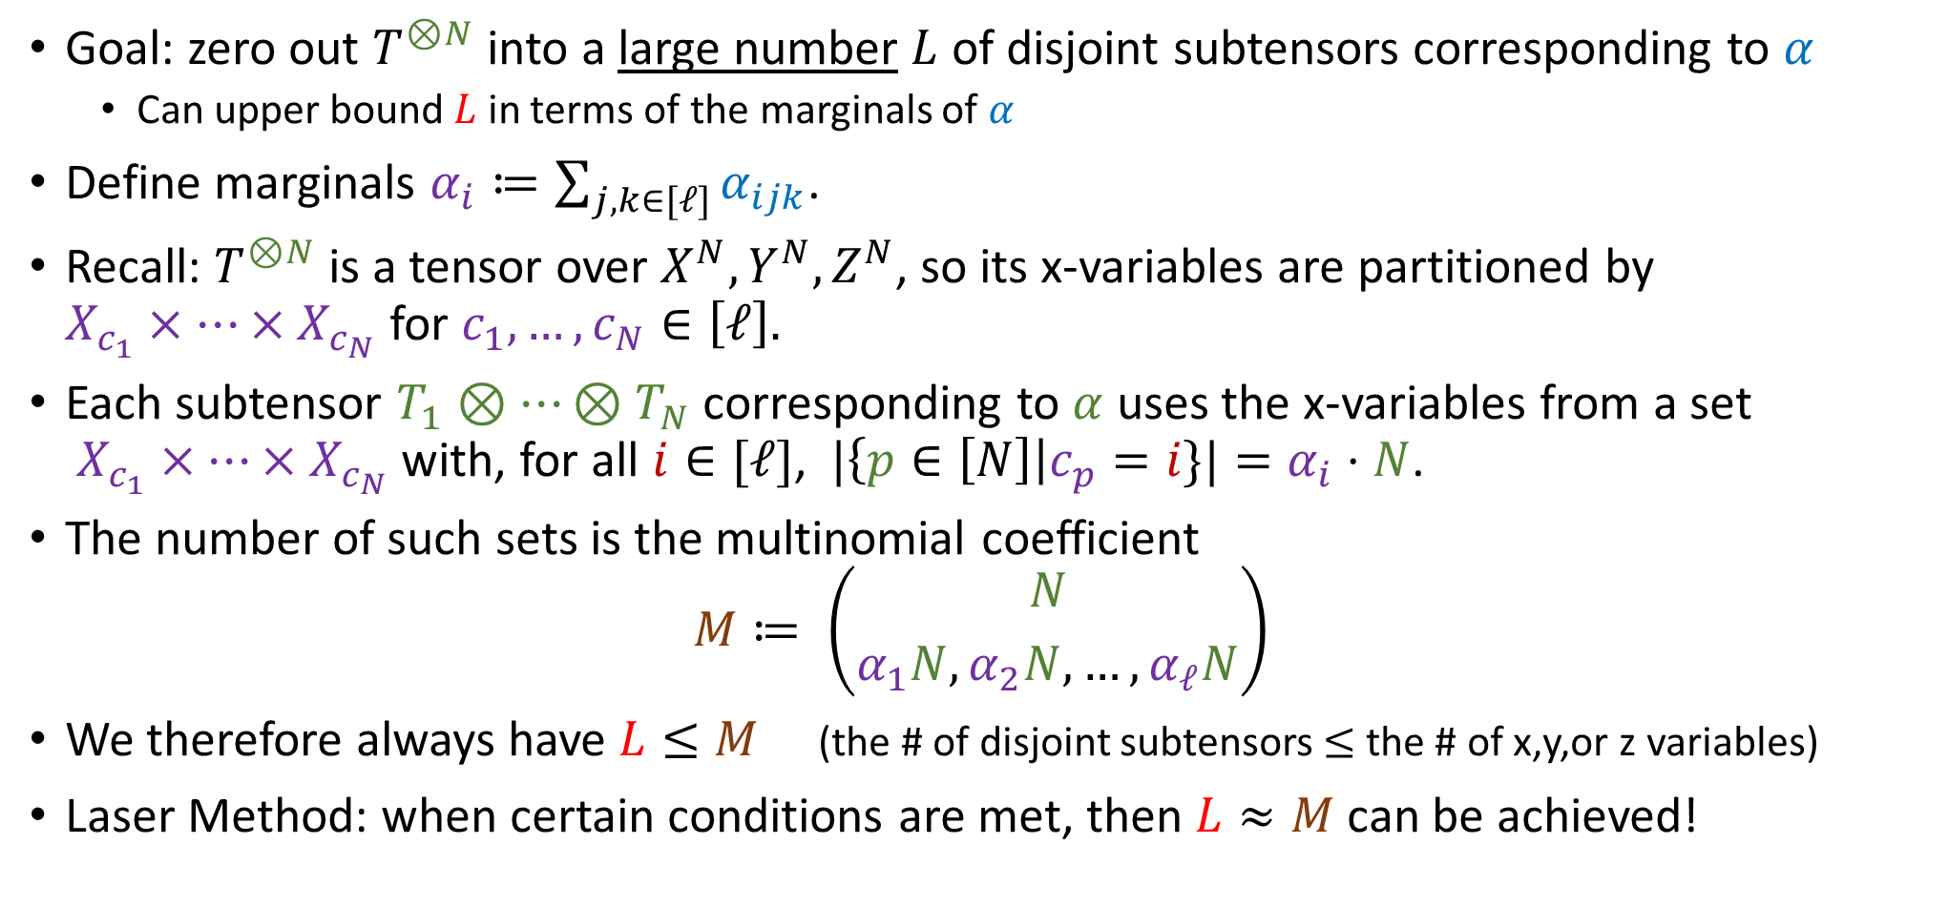
The Laser Method: Zero out everything but subtensors consistent with $α$
Goal: zero out $T^{⊗N}$ into a large number $L$ of disjoint subtensors corresponding to $α$
Can upper bound $L$ in terms of the marginals of $α$
Define marginals $α_{i}≔\sum_{j,k∈[ℓ]}{α_{ijk}}$.
Recall: $T^{⊗N}$ is a tensor over $X^{N},Y^{N},Z^{N}$, so its x-variables are partitioned by $X_{c_{1}}×⋯×X_{c_{N}}$ for $c_{1},…,c_{N}∈\left[ℓ\right].$
Each subtensor $T_{1}⊗⋯⊗T_{N}$ corresponding to $α$ uses the x-variables from a set $X_{c_{1}}×⋯×X_{c_{N}}$ with, for all $i∈[ℓ]$, $|\left\{p∈\left[N\right]\right|c_{p}=i\}|=α_{i}⋅N$.
The number of such sets is the multinomial coefficient $M≔ \left({N \atop α_{1}N,α_{2}N,…,α_{ℓ}N}\right)$
We therefore always have $L≤M$ (the # of disjoint subtensors $≤$ the # of x,y,or z variables)
Laser Method: when certain conditions are met, then $L≈M$ can be achieved!

Slide 22
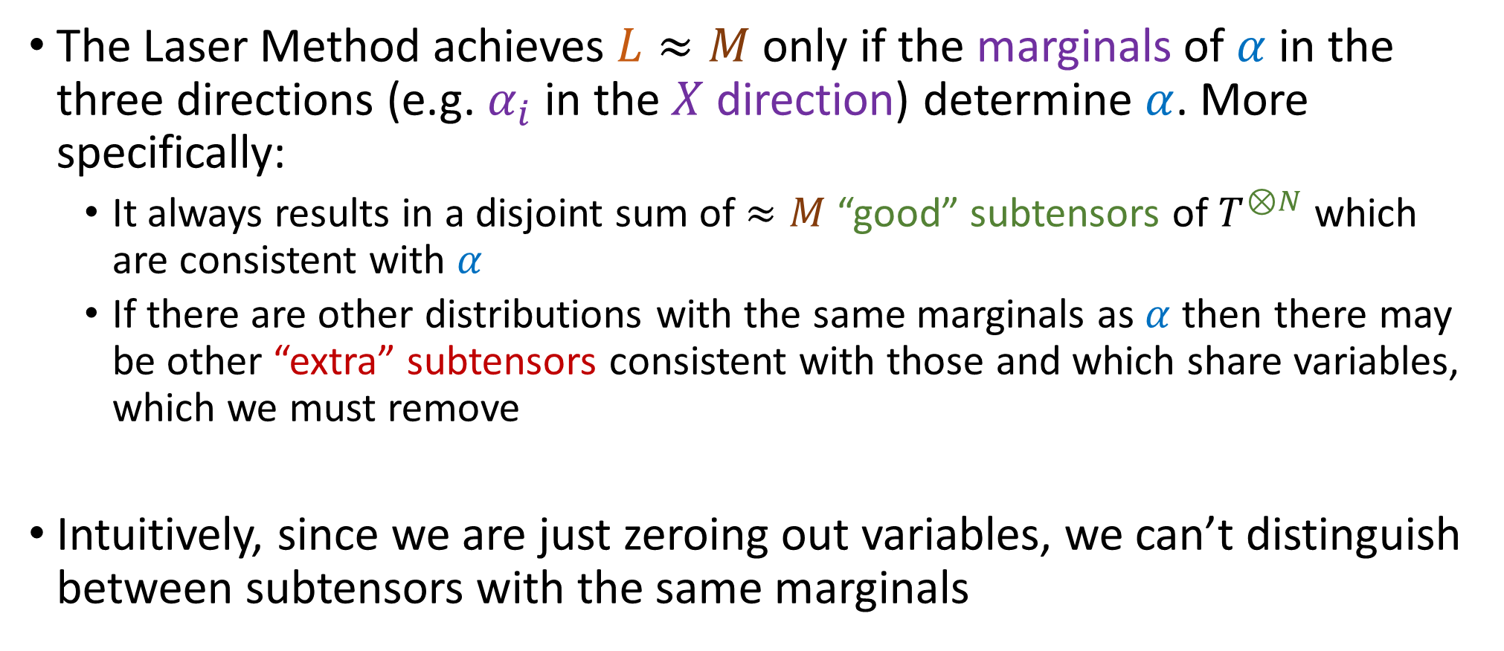
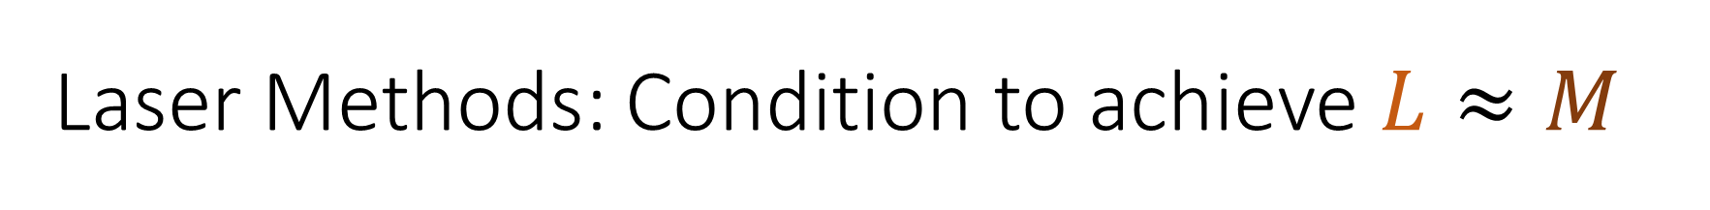
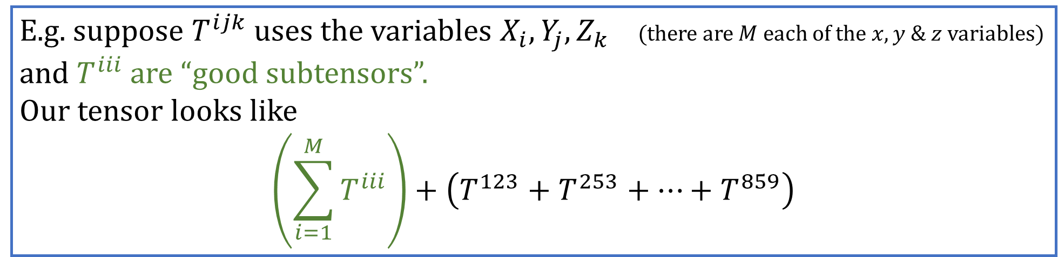
Laser Methods: Condition to achieve $L≈M$
E.g. suppose $T^{ijk}$ uses the variables $X_{i},Y_{j},Z_{k}$ (there are $M$ each of the $x,y$ & $z$variables) and $T^{iii}$are “good subtensors”. Our tensor looks like $$\left(\sum_{i=1}^{M}{T^{iii}}\right)+\left(T^{123}+T^{253}+…+T^{859}\right)$$
The Laser Method achieves $L≈M$ only if the marginals of $α$ in the three directions (e.g. $α_{i}$ in the $X$ direction) determine $α$. More specifically:
It always results in a disjoint sum of $≈M$ “good” subtensors of $T^{⊗N}$ which are consistent with $α$
If there are other distributions with the same marginals as $α$ then there may be other “extra” subtensors consistent with those and which share variables, which we must remove
Intuitively, since we are just zeroing out variables, we can’t distinguish between subtensors with the same marginals

Slide 23
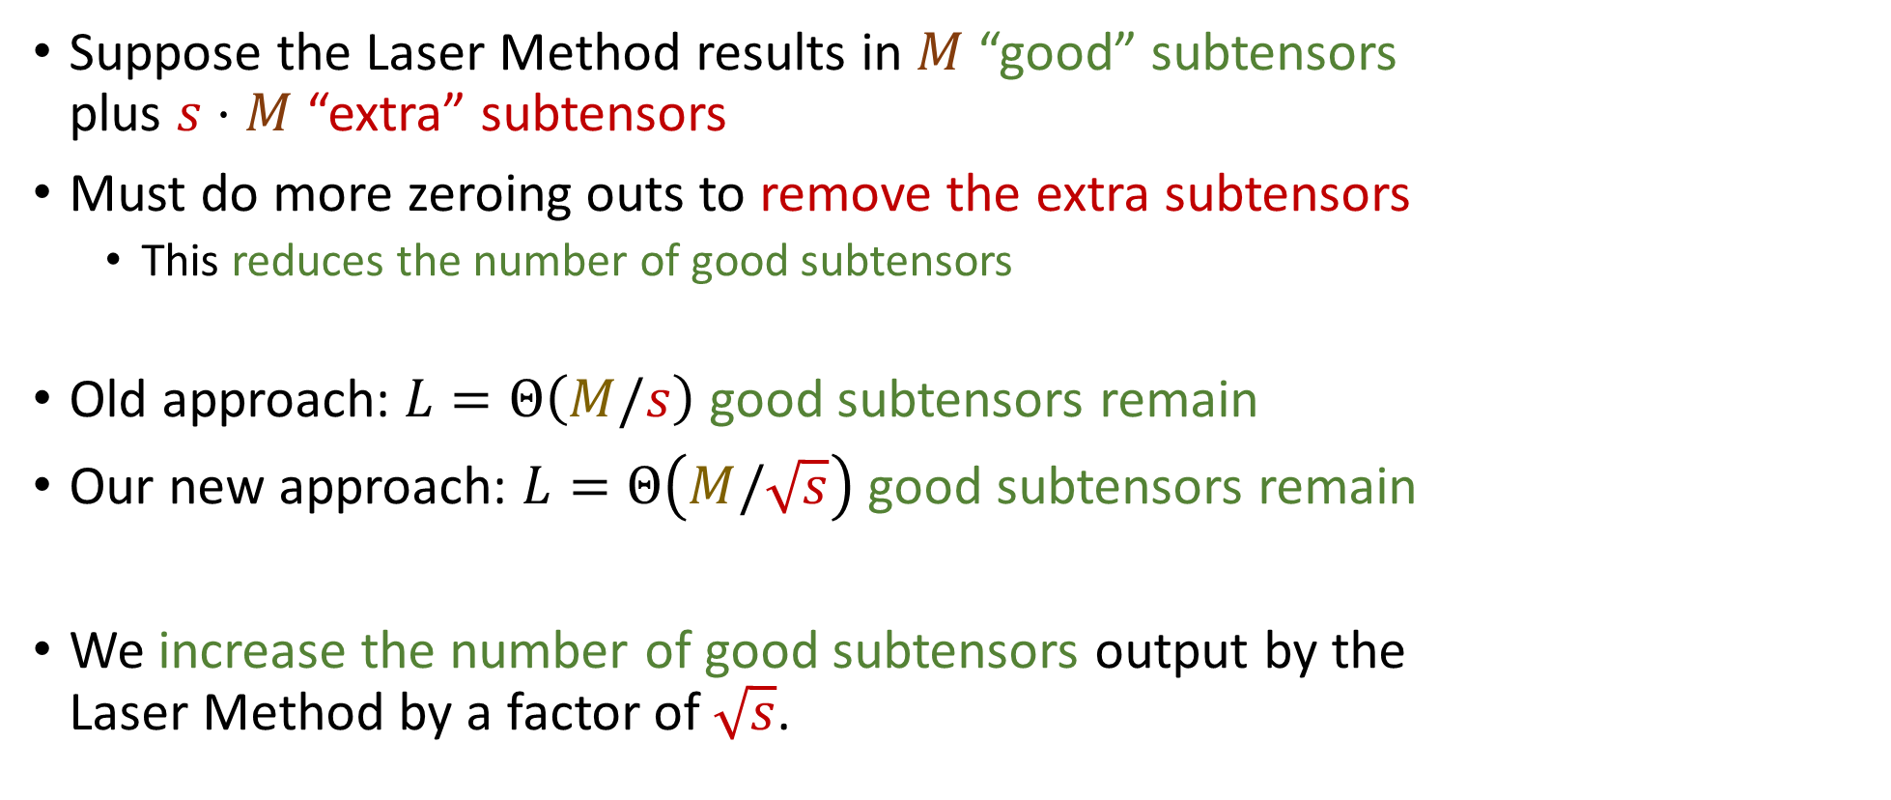

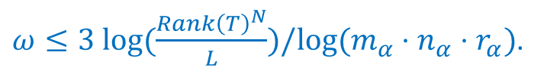
Laser Method: Our New Way to Remove Extra Subtensors
Suppose the Laser Method results in $M$ “good” subtensors plus $s⋅M$ “extra” subtensors
Must do more zeroing outs to remove the extra subtensors
This reduces the number of good subtensors
Old approach: $L=Θ\left(M/s\right)$ good subtensors remain
Our new approach: $L=Θ\left(M/\sqrt{s}\right)$ good subtensors remain
We increase the number of good subtensors output by the Laser Method by a factor of $\sqrt{s}$.
$ω≤3 log(\frac{Rank{\left(T\right)}^{N}}{L})/log⁡(m_{α}⋅n_{α}⋅r_{α})$.
$L$and $s$ depend on $α.$

Slide 24
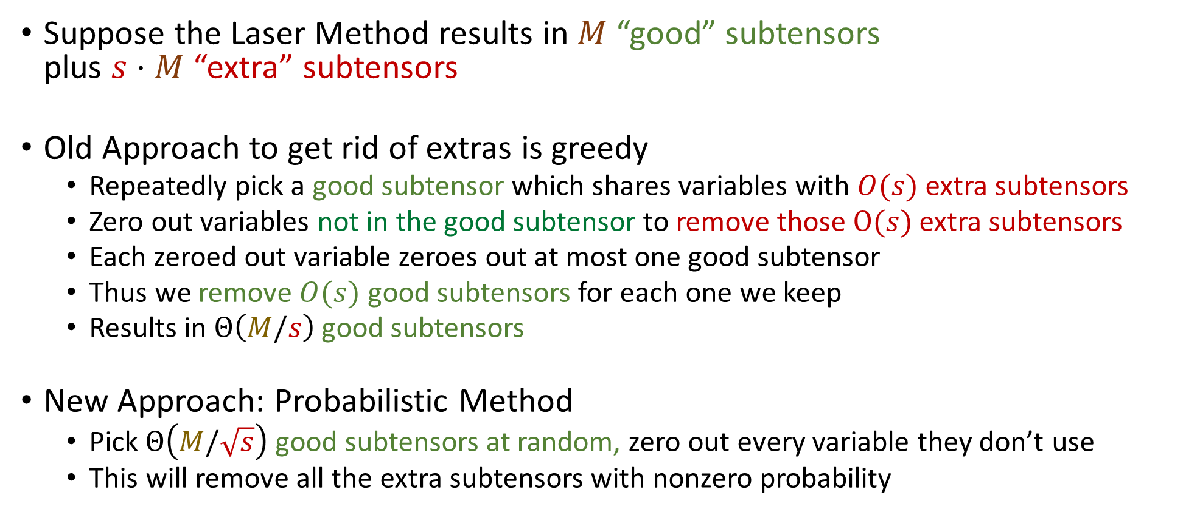
Laser Method: Our New Way to Remove Extra Subtensors (Details)
Suppose the Laser Method results in $M$ “good” subtensors plus $s⋅M$ “extra” subtensors
Old Approach to get rid of extras is greedy
Repeatedly pick a good subtensor which shares variables with $O(s)$ extra subtensors
Zero out variables not in the good subtensor to remove those $O(s)$ extra subtensors
Each zeroed out variable zeroes out at most one good subtensor
Thus we remove $O(s)$ good subtensors for each one we keep
Results in $Θ\left(M/s\right)$ good subtensors
New Approach: Probabilistic Method
Pick $Θ\left(M/\sqrt{s}\right)$ good subtensors at random, zero out every variable they don’t use
This will remove all the extra subtensors with nonzero probability

Slide 25
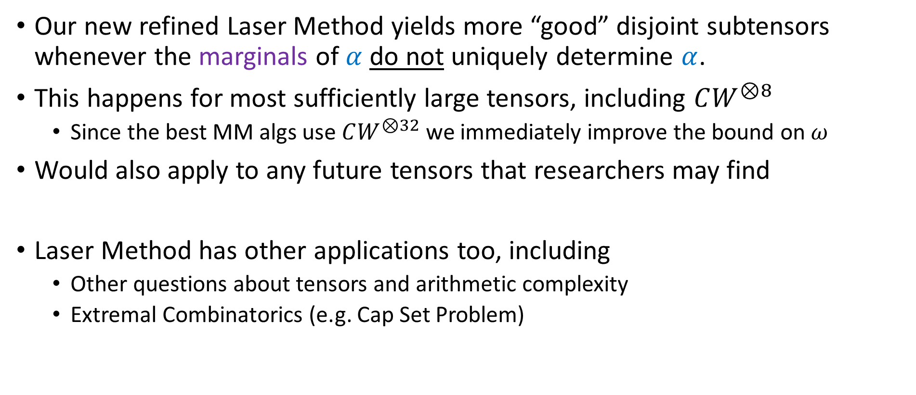
How useful is this improved Laser Method?
Our new refined Laser Method yields more “good” disjoint subtensors whenever the marginals of $α$ do not uniquely determine $α$.
This happens for most sufficiently large tensors, including $CW^{⊗8}$
Since the best MM algs use $CW^{⊗32}$ we immediately improve the bound on $ω$
Would also apply to any future tensors that researchers may find
Laser Method has other applications too, including
Other questions about tensors and arithmetic complexity
Extremal Combinatorics (e.g. Cap Set Problem)

Slide 26
2.37288 [Vassilevska W. ‘12]
2.37287 [Le Gall ‘14]
2.37286 (our new bound)

Slide 27
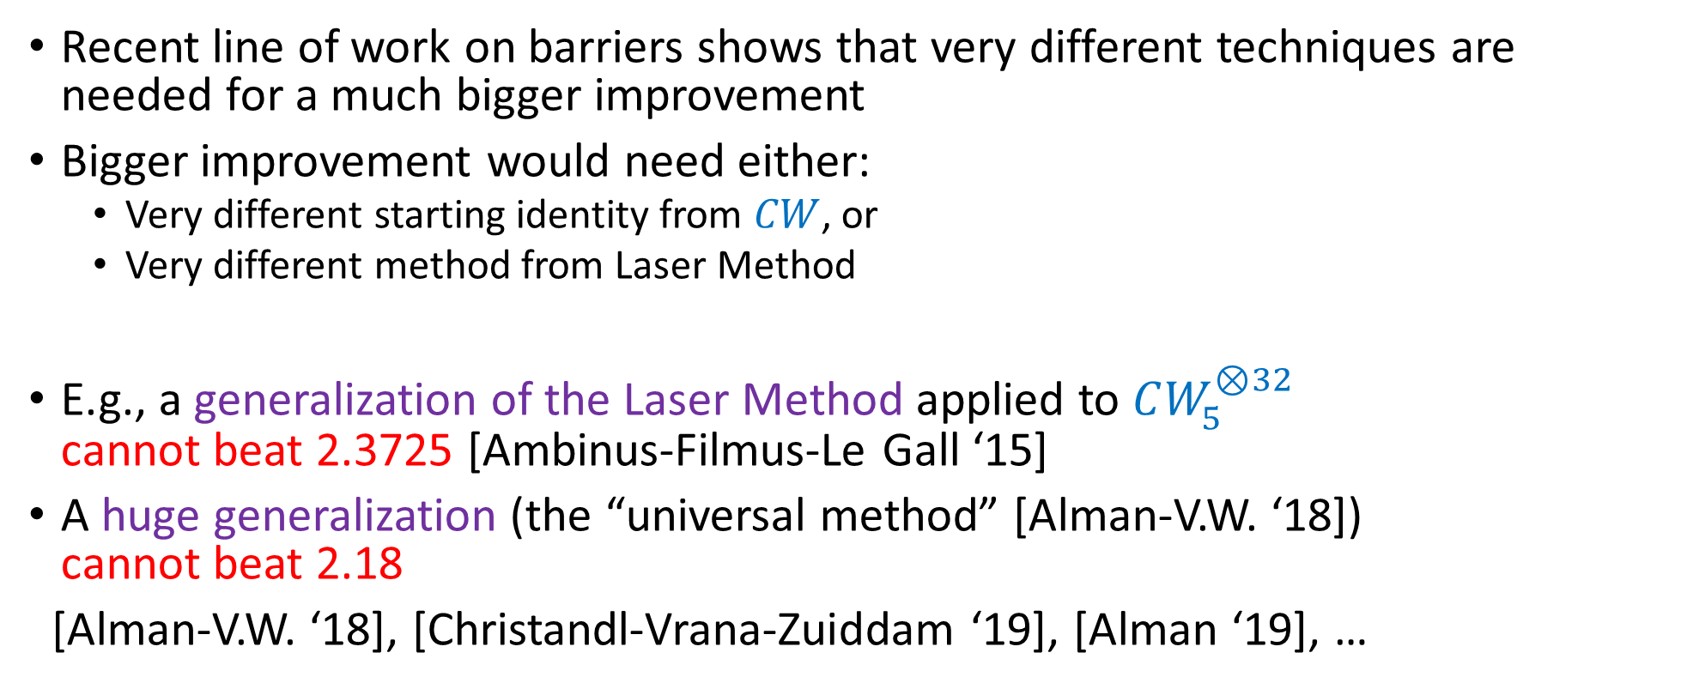
What’s Next?
2.37288 [VW. ‘12]
2.37287 [Le Gall ‘14]
2.37286 (our new bound)
Recent line of work on barriers shows that very different techniques are needed for a much bigger improvement
Bigger improvement would need either:
Very different starting identity from $CW$, or
Very different method from Laser Method
E.g., a generalization of the Laser Method applied to $CW_{5}^{⊗32}$ cannot beat 2.3725 [Ambinus-Filmus-Le Gall ‘15]
A huge generalization (the “universal method” [Alman-V.W. ‘18]) cannot beat 2.18
[Alman-V.W. ‘18], [Christandl-Vrana-Zuiddam ‘19], [Alman ‘19], …

Slide 28
THANK YOU!

