Slide 1
CO226 : DATABASE SYSTEMS
DATABASE MANAGEMENT SYSTEM FOR :
INTERNSHIP ALLOCATION FOR DEPARTMENT OF COMPUTER ENGINEERING
DATABASE PROJECT
GROUP 7
FERNANDO K.A.I – E/18/098
FERNANDO K.N.A. – E/18/100
JAYASUNDARAJ.W.K.R.B – E/18/155

Slide 2
PROJECT DESCRIPTION
DBMS for the internship allocation in the department.
To make an interface between STUDENTS, COMPANIES, and the STAFF.
Through creating Student profiles, Company profiles and Staff review.
Advancing the internship allocation, creating an efficient platform to:
Students to identify companies
Companies to identify students
Staff to recommend and guide
Better communication
Arrangement of Workshops, Interviews, Meetings
Students to show their skills and identify companies
Companies to advertise for internship opportunities
Staff to interact with companies and students review, recommend and guide
Make identity for the instructors, supervisors in the process
Upon success, to be implemented on department level.
Notes:
Under the course CO226 : Database Systems, the database project is about designing and developing a database system that interfaces with a backend database. As per the task of the project out team has decided to create a database management system for the internship allocation for the department of computer engineering. The main aim of project is to learn how to implement a DBMS and as real and extra challenge we have chosen to implement a useful application to out department. The need for a DBMS for the internship allocation in the department would surely improve and ease the internship allocation process while creating a much more efficient and advanced interface between the main entities involved in the process. Upon successful completion of the project, we would try implementing the interface on a department level for the benefit of the department.

Slide 3
USERS AND REQUIRMENTS
The internship allocation mainly involves three parties namely;
STUDENT
Maintaining a profile including CV, portfolio, projects and skills
To learn the opportunities in the given companies per individual interests and skills
Seek for guidance and recommendation from the staff
COMPANY (HR Managers, Supervisors)
Maintaining a profile including available internship opportunities, areas of working, available projects, resources and identification( Achievements, Rankings, Projects)
View student profiles for selecting for internship, communication etc..
STAFF (Lecturers, Instructors)
Manage the process of internship allocation by linking the Companies and Students and recommending, guiding and reviewing.
Notes:
The platform may be available for third parties under given access levels. (Other department lecturers, students, other companies)

Slide 4
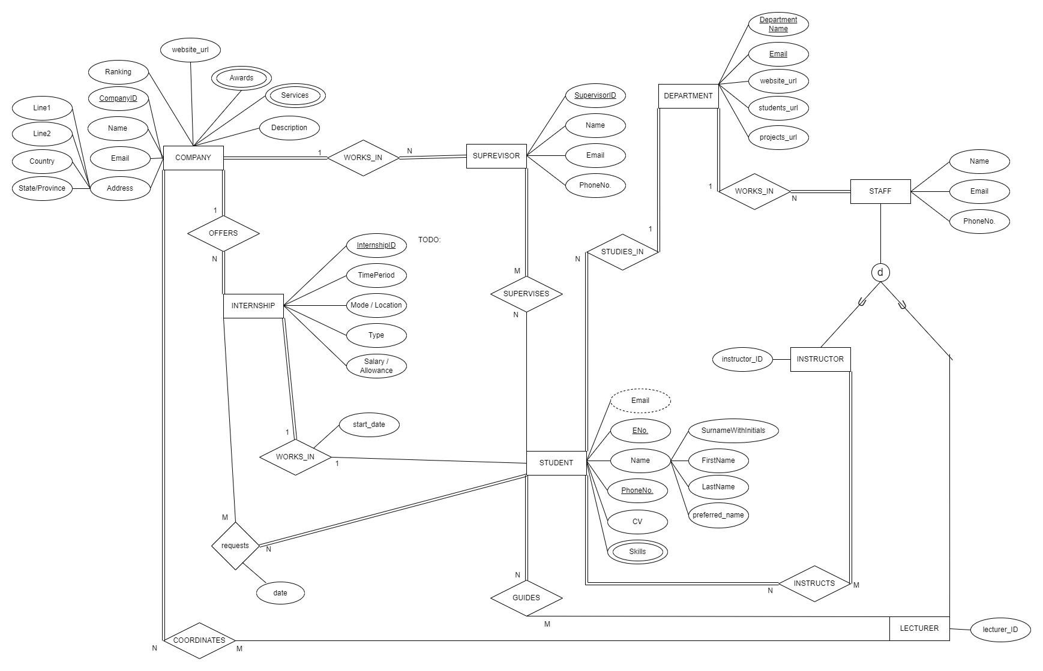
CONCEPTUAL MODEL

Slide 5
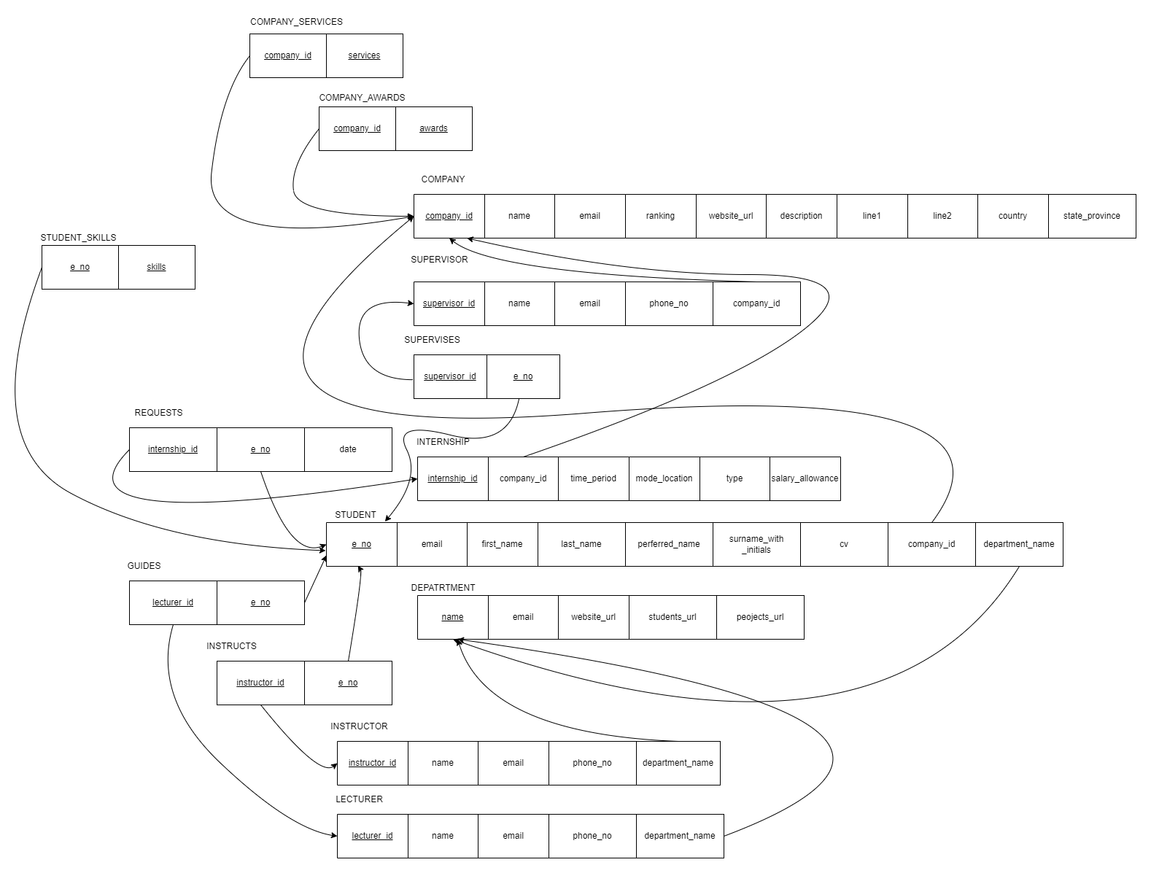
LOGICAL MODEL

