Slide 1
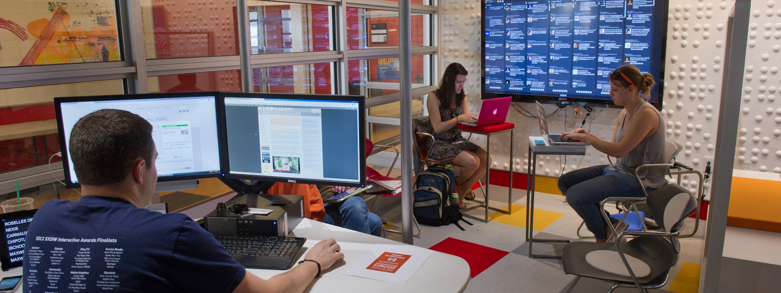
Internationalization of
GROUP 6

Slide 2
Overview
About Company
Project Description
Benefits
Deliverables
Timeline
Challenges

Slide 3
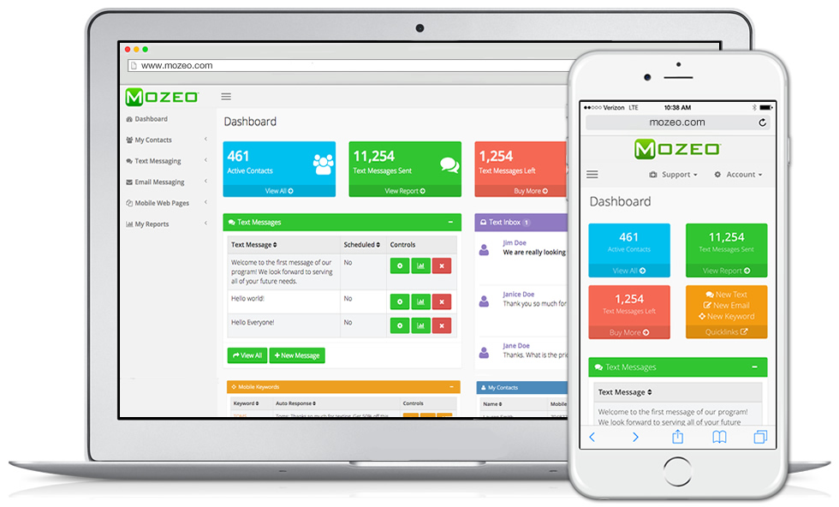
About Mozeo
Services
Mobile Keywords
Text Messaging
Text to win
Text Conversation
Text Messaging API
24X7 Email Support
Notes:
Started in 2007, Mozeo was created to help businesses communicate better. With a very solid and proven platform our clients get services that will help them be more successful. There are 25,000+ businesses who use Mozeo, from household names like Lego and Dewalt to the local burrito shop down the road. Mozeo can be found in New York with offices in Syracuse and Manhattan.

Slide 4
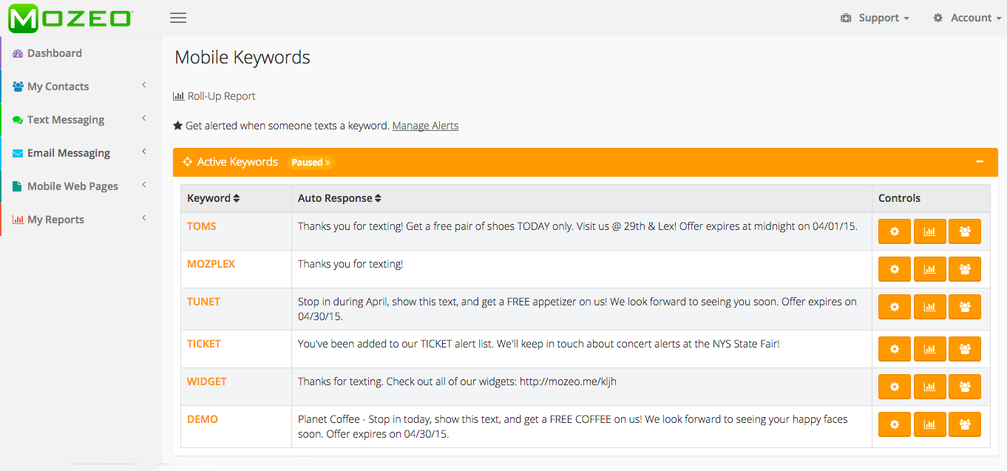
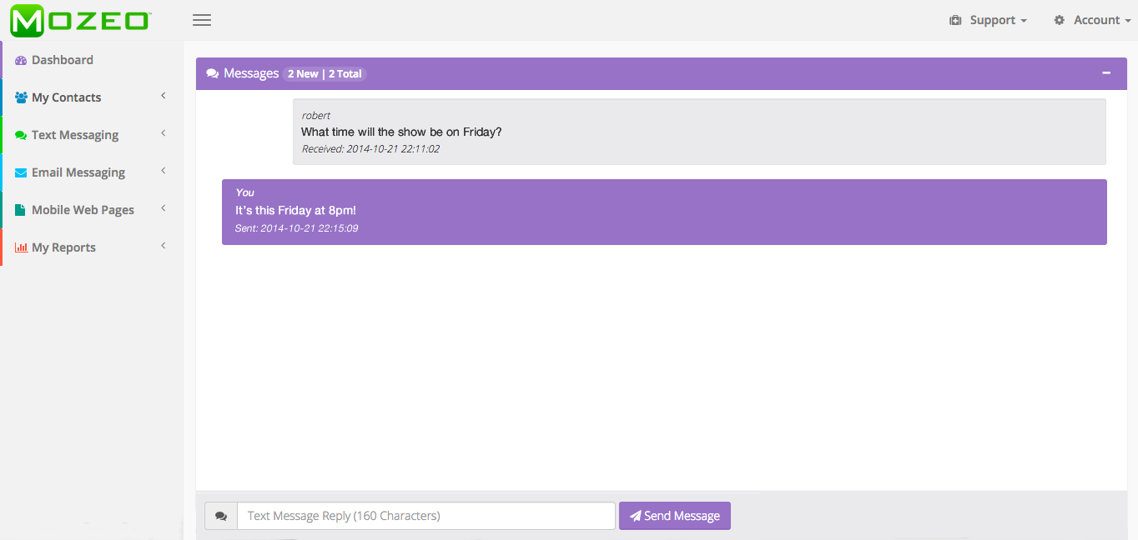
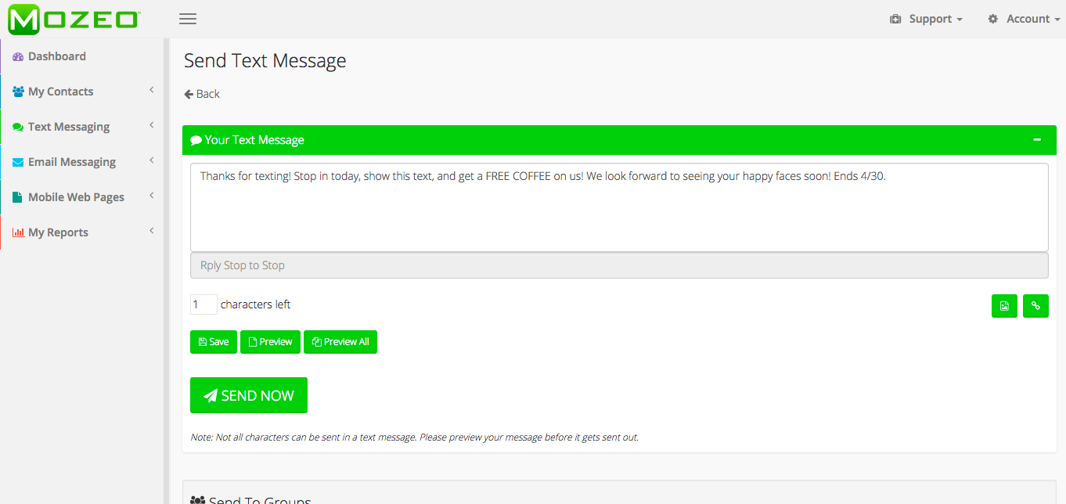
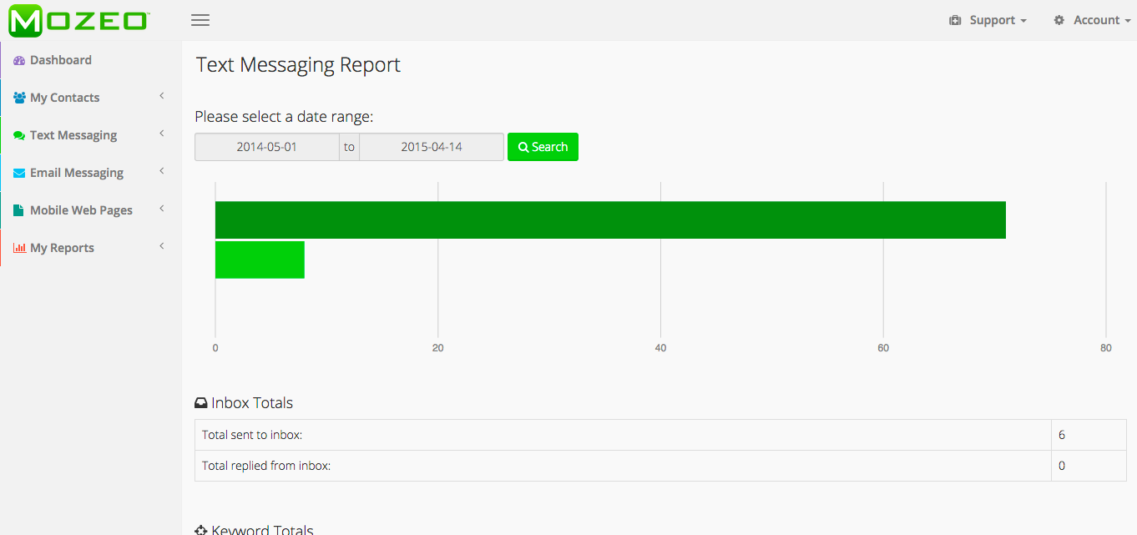
Mobile Keywords
Text Conversations
Text Messaging
Text Messaging Report

Slide 5

Project
To step in Global Market
Multilingual Web Framework
24X7
Customer
Support
Text Messaging
Global Marketing Strategy
Legal/Licensing

Slide 6
bENEFITS
Marketing
Returns
ROI
Financial Benefits
Operations
In Global Market

Slide 7
Deliverables
Multilingual Framework
Marketing Strategy
Costs
Schedule
Staffing
Risk

Slide 8
Timeline
Nov
Mar
Apr
Dec
Jan
Feb
May
Gather Requirements
Legal Entities
Establish Design
Build Technical Framework
Generate Other Contents
Conduct Test
Deploy
Training
Marketing
Sign Off

Slide 9
Challenges
Customer Support
Competitive Pricing
Communication Difficulties and Cultural Differences

Slide 10
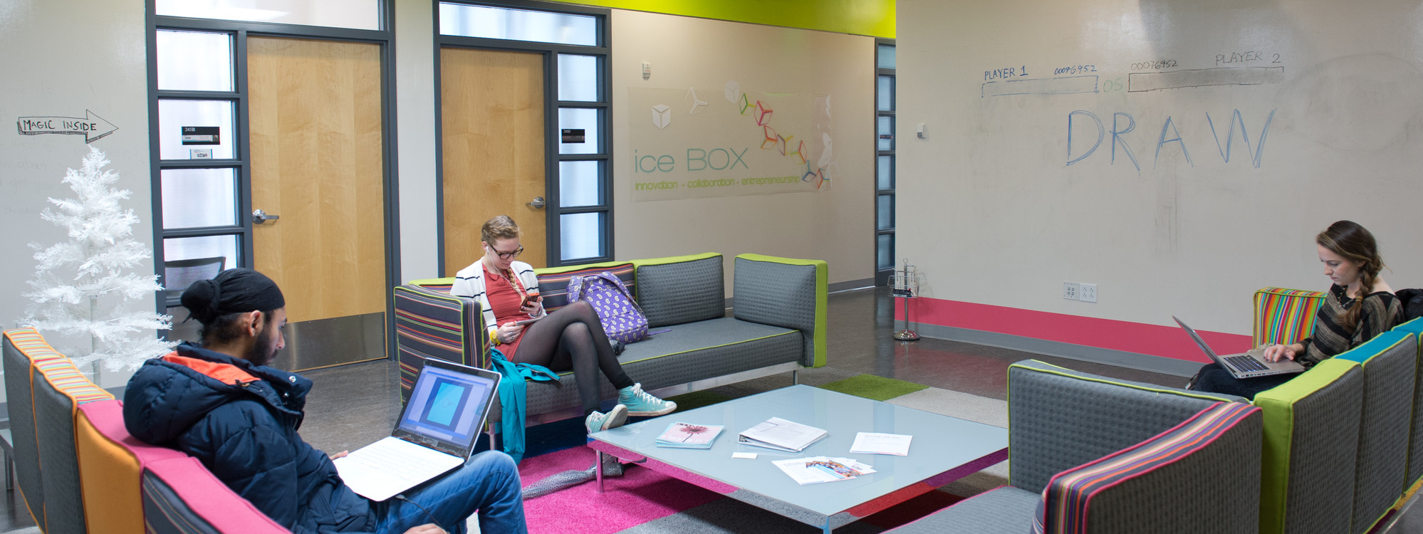
Ishani Jariwala
Tushar Karia
Tushar Badlani
Abhinav Dewan
Temitope Aladesanmi
THANK YOU !

