Slide 1
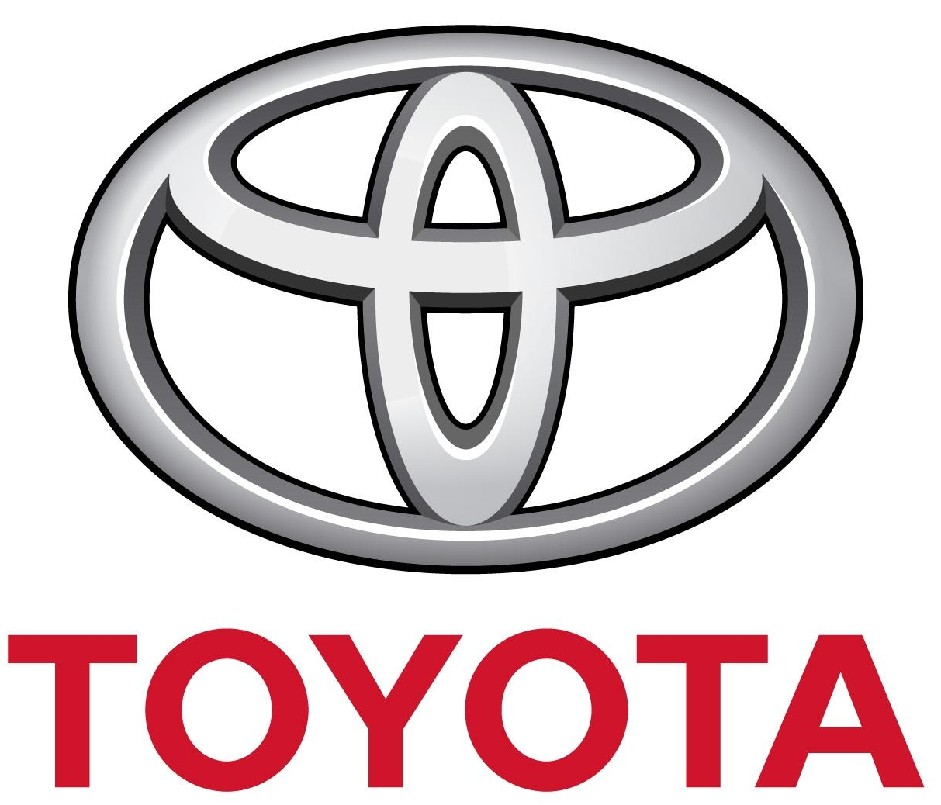
Strategic Management and Technology Adoption
Team 3
Presented to: Prof. Frank Murullo
Team Members: Ishani Jariwala, Manas Sikri, Reeva Bhatkal, Sahil Walia, Shashank Arora

Slide 2
Agenda
Introduction/Background
Industry Analysis - Porter Five Forces
Business Strategies
Information Systems Strategies
Organization Structures
Alignment
Technology Adoption/Solution
Alignment with Business Strategy?/Why toyota should pursue it?
Lessons Learned

Slide 3
Introduction
Toyota Motor Corporation headquartered in Toyota, Aichi, Japan
World’s second-largest automotive manufacturer after Volkswagen Group
Market leader in hybrid vehicles
US market share as of Jan, 2017 - 12.5%
Global market share - 12.19%

Slide 4
Porter’s 5 Forces
Threat of New Entry- LOW
High capital costs
High cost of brand development
High supply chain costs
Supplier Power- LOW
Competitive Rivalry-HIGH
Buyer Power-HIGH
Moderate population of suppliers
High overall supply
Low forward integration of supplier
High aggressiveness of firms
High variety and differentiation of firms
Low number of large firms
Low switching costs
High quality of information
Moderate substitute availability
Threat of Substitutes- MODERATE
Low switching costs
Moderate availability of substitutes
Low convenience in using substitutes

Slide 5
Business Strategies
Operational Efficiency
Strategic weapon for Toyota
Toyota Production System - a benchmark in the industry
Hassle free hybrid cars
Applications
Assembly Line Control System (ALCS) software (Just-in-time)
Activplant's Performance Management System (Jidoka)
Dealer Daily (Kaizen)

Slide 6
Business Strategies
Operational Excellence
Strong dealer and service center network
Toll-free telephone helpline
Website - Customer dedicated
Track and schedule service
Forum - Inter customer communication
Media and other content
Applications
Entune
Smart Fueling System (SAP-HANA)

Slide 7
Business Strategies
Customer Segmentation
Loyalty Bonus
Loyalty Discounts
Exchange offers/Vehicle Upgrades
Applications
Business Intelligence

Slide 8
Business Strategies
Product Innovation
Alternative energy sources
Interconnected traffic & safety systems
Human assisting robots
Hybrid vehicles
Application
CAELUM CAD (Computer Aided Design)

Slide 9
Organization - Divisions
Global Hierarchy
Geographic Divisions
North America, Japan, Europe, East Asia, China, Asia and Middle East, Africa, Latin America and Carribean
Product Based Divisions
Lexus, Toyota 1, Toyota 2, Unit Center

Slide 10
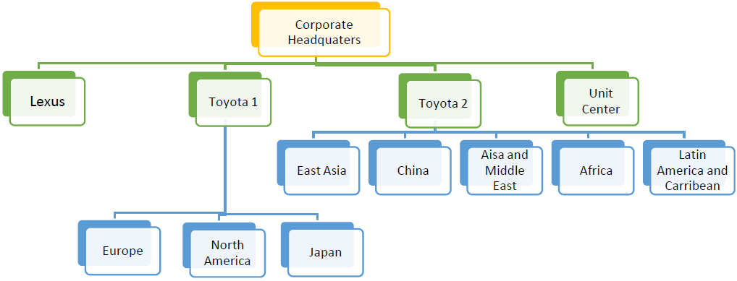
Organizational Structure - Product Based Divisions
Notes:
Global hierarchy
Geographic divisions
Product-based divisions
Toyota still maintains its global hierarchy despite its reorganization in 2013
Product Based: Lexus International
Toyota 1
Toyota 2
Unit Center - Responsible for engine, transmission and other related operations

Slide 11
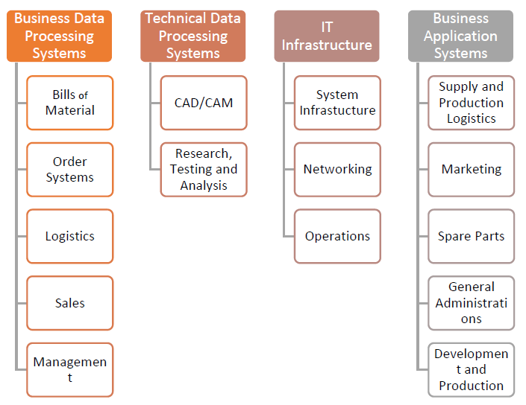
Organizational Structure - Information

Slide 12
Alignment
Business Strategy | Information Systems | Organizational Structure
Operational Efficiency | Performance Management Systems (Jidoka) Control Systems (Just in Time) | Geography Based Divisions: Europe, East Asia, Japan, North America, China, Middle East, Africa, Latin America and Caribbean
Operational Excellence | Entune SAP HANA | Global Hierarchy
Product Innovation | CAELUM CAD (Computer Aided Design) | Research and Development Department (R&D) with each business units
Customer Segmentation | Business Intelligence | Product Based Divisions Toyota 1 - Europe, North America, Japan Toyota 2 - Asia, China, Africa

Slide 13
Resource Based View
Tangible Resources
In March 2016, Toyota’s equipment and property plants stood at 9,740,417 (yen in million)
In 2016, Toyota’s revenues amounted to 28,403,118 (yen in million). The company recorded a net income of 2,312,694
Intangible Resources
Patents, copyrights, brand – SUV, Lexus, Celsior, Corolla, Hilux, Probox, and RAV 4
TPS, SCM, ERP, e-CRM
Core Competency
The Prius, an electric-and-petrol hybrid car. The Prius was sold in over 90 markets, with Japan and the United States being its largest markets.
Distinctive Competency
Toyota’s production system - the “Toyota Production System” or TPS. TPS is based on the Lean Manufacturing concept.
Notes:
The Resource Based View(RBV) argues that success depends on having a mix of resources that enable the firm to outperform its competitors.
Capabilities of the firm in utilizing the resources have a big impact on how a firm will be able to stand out among other competitors.
Organization’s capabilities may actually allow it to create new markets and add value for the consumer, such as Toyota’s Hybrid cars.
Toyota’s much admired manufacturing system manages inbound logistics in the form of excellent material and inventory control systems. This ensures that inventory levels are sufficient to meet customer demand by having parts delivered prior to their assembly.
Tangible resources refer to the physical assets that an organization possesses and can be categorized as physical resources, financial resources, and human resources.
Intangible resources comprise intellectual resources, technological/technical resources and reputation/goodwill.
Competencies can be defined as the attributes that firms require in order to be able to compete in the marketplace.
Toyota certainly created a market share for themselves with Hybrid cars. It gave them competitive advantage (Henry, 2011). The Prius first went on sale in Japan in 1997, and was available at all four Toyota Japan dealerships, making it the first mass-produced hybrid vehicle.
Toyota’s distinctive competence is its production system known as the “Toyota Production System” or TPS. TPS is based on the Lean Manufacturing concept. This concept also includes innovative practices like Just in Time, Kaizen, and Six Sigma.

Slide 14
Dynamic capabilities
Learning
Toyota reinvented manufacturing and supply chain management in automobile industry by creating a lean production system.
Toyota and Suzuki have collaborated to develop environment friendly technologies, safety systems, information technology and mutual supply of products and components.
Transformation of existing assets
Toyota’s “next-generation demand management ”. Toyota leveraged the potential of existing IT along with transforming it into an enterprise level initiative which helped Toyota enormously including expansion in various countries.
Co-specialization
Toyota promotes a leading example in co-specialization through its product range. But what makes co-specialization a competitive advantage for Toyota is the whole process and ideology of manufacturing combined with its product range.
Notes:
According to David J Teece, dynamic capability of a firm “the firm’s ability to integrate, build, and reconfigure internal and external competences to address rapidly changing environments”
Dynamic capability for a firm is determined by how readily these routine activities can be replicated or imitated as it determines the distinctive of the competence. Toyota reinvented manufacturing and supply chain management in automobile industry by creating a lean production system.
According to Teece, collaborations and partnerships could be the source of new learning. Toyota has various collaborations in different spheres of its industry to promote learning. Firstly, Toyota and Suzuki have collaborated to develop environment friendly technologies, safety systems, information technology and mutual supply of products and components.
Toyota used information systems that fulfilled the usual ‘order-taker’ role i.e. supporting the traditional demand management. Traditional demand management refers to receiving handoffs from the business side or requests from individual units. But, Toyota has moved to a new model referred to as ‘next-generation demand management’. This effort by Toyota is to meet corporate goals rather than individual project needs.
According to Teece, combination of assets such as physical assets, human resources and any other intellectual property may become valuable for a firm over time .
Toyota promotes a leading example in co-specialization through its product range. But what makes co-specialization a competitive advantage for Toyota is the whole process and ideology of manufacturing combined with its product range.

Slide 15
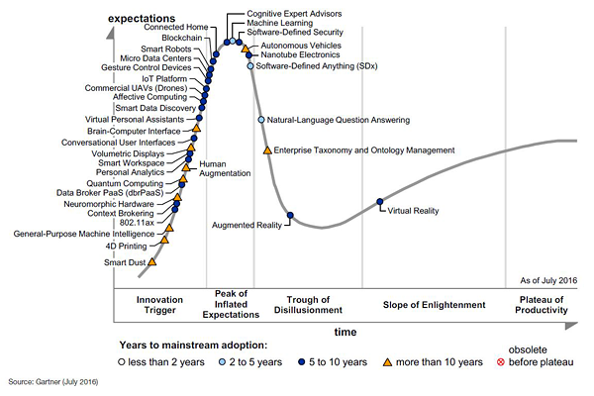
Technology Adoption - Autonomous Cars
Notes:
Gartner Hype Cycle methodology gives you a view of how a technology or application will evolve over time, providing a sound source of insight to manage its deployment within the context of your specific business goals.
Looking at 2016 Technology Hype Chart by Gartner, we believe Toyota should adopt the concept of Autonomous Vehicles
Autonomous Vehicle is almost at the end of peak of inflated expectations, and is now inescapably poised to fall to the Trough of Disillusionment. Peak of Inflated Expectations is when people start thinking the new technology will change the world as we know it, Trough of Disillusionment is when we realize that the new technology has flaws and many give up on it. For autonomous Vehicle, the impending slide through Negative Hype and into the Trough of Disillusionment has started.

Slide 16
Autonomous Vehicles
An autonomous vehicle is one that can drive itself from a starting point to a predetermined destination in “autopilot” mode.
The vehicle uses in-vehicle technologies and sensors, including adaptive cruise control, active steering (steer by wire), anti-lock braking systems (brake by wire), GPS navigation technology, lasers and radar.
No individual organization in the automobile or IT industries are close to achieving true Level 5 autonomy.
Highest level of autonomy achieved till date is - Level 2 for commercial sale (example is Tesla).
Notes:
http://spectrum.ieee.org/cars-that-think/transportation/self-driving/toyota-gill-pratt-on-the-reality-of-full-autonomy
Level 2: In level 2, at least one driver assistance system of "both steering and acceleration/ deceleration using information about the driving environment" is automated, like cruise control and lane-centering. It means that the "driver is disengaged from physically operating the vehicle by having his or her hands off the steering wheel AND foot off pedal at the same time," according to the SAE. The driver must still always be ready to take control of the vehicle, however.
Level 5: This refers to a fully-autonomous system that expects the vehicle's performance to equal that of a human driver, in every driving scenario—including extreme environments like dirt roads that are unlikely to be navigated by driverless vehicles in the near future.

Slide 17
Why Toyota should Adopt - Autonomous Vehicles
Autonomous cars are believed to bring disruption in the car industry
Other companies are already researching in this space and we can expect fully functional autonomous cars by 2021
Up to 15 percent of new cars sold in 2030 could be fully autonomous.
Easy to enter or explore the space as Toyota has resources and technology that can be utilized to focus on autonomous vehicle industry
Autonomous cars are efficient and efficient travel also means fuel savings, cutting costs.
By 2035, the sale of autonomous vehicles is expected to reach 12 million and 18 million per year for partially autonomous cars
By 2035, 25% of new car market will be of autonomous cars
Notes:
http://www.mckinsey.com/industries/automotive-and-assembly/our-insights/disruptive-trends-that-will-transform-the-auto-industry

Slide 18
Toyota - Today
Toyota spends $10 billion a year on research - Akio Toyoda, is spending $1 billion for a new Toyota Research Institute with offices in Michigan, Silicon Valley, and Cambridge, Massachusetts, that will focus on autonomous cars and robotics.
Toyota lags behind several of its fellow carmakers and Silicon Valley upstarts such as Google and Tesla Motors.
As car technologies usually have a long adoption curve, this gives Toyota the time it needs to catch up.

Slide 19
Conclusion - Takeaways
Toyota has started to adopt and should continue to develop autonomous vehicles technology as part of their product innovation business strategy.
Growth of Autonomous vehicles as a whole also depends on other technologies like Artificial Intelligence.
Showing progress in Autonomous vehicles is necessary as a current marketing strategy for automobile manufacturers.

Slide 20
Reference
https://www.technologyreview.com/s/601504/toyota-makes-a-u-turn-on-autonomous-cars/
https://www.brookings.edu/research/securing-the-future-of-driverless-cars/
http://www.grandviewresearch.com/industry-analysis/driverless-cars-market
http://www.delcotimes.com/article/DC/20130509/NEWS/305099979
http://www.toyota-global.com/sustainability/report/ar-smr/pdf/sustainable_management_report16_fie.pdf
http://www.toyota.com.au/toyota/sustainability/

Slide 21
Thank you!
Questions?

