Slide 1

Develop a state-of-the-art question-answering model leveraging the Quora Question Answer Dataset.
Problem Statement

Slide 2

OUR BIG IDEA
The objective is to create an AI system capable of understanding and generating accurate responses to a variety of user queries, mimicking a human-like interaction.

Slide 3

INDUSTRY OUTLOOK
$143 B | 73.3% | $1.3 T
By 2027 | CAGR | By 2032
SUCCESS

Slide 4



To Do:
Data set:
https://huggingface.co/datasets/toughdata/quora-question-answer-dataset
1. Data Exploration, Cleaning, and Preprocessing:
2. Model Selection and Evaluation:
3. Visualization:
4. Insights and Recommendations:
5. Presentation and Documentation/Report:

Slide 5
1. Data Exploration, Cleaning, and Preprocessing:
Explore the dataset
Input : print(dataset)
print(dataset['train'][2])
Output : DatasetDict({ train: Dataset({ features: ['question', 'answer'], num_rows: 56402 }) })
{'question': 'What song has the lyrics "someone left the cake out in the rain"?', 'answer': "MacArthur's Park\n"}
Cleaning
There is no any irrelevant information or columns in dataset.
Preprocessing
Input : print(dataset['train'][2])
Output :
{'question': 'What song has the lyrics "someone left the cake out in the rain"?', 'answer': "MacArthur's Park\n“}

Slide 6
2. Model Selection and Evaluation:
BERT, T5, and GPT
models = ['BERT', 'T5', 'GPT-2']
rouge1 = [1.0, 1.0, 0.0541]
rouge2 = [0.0, 0.0, 0.0]
rougeL = [1.0, 1.0, 0.0541]
rougeLsum = [1.0, 1.0, 0.0541]
bleu_scores = [0.0, 0.0, 0.0]
f1_scores = [0.5, 1.0, 0.0526]

Slide 7
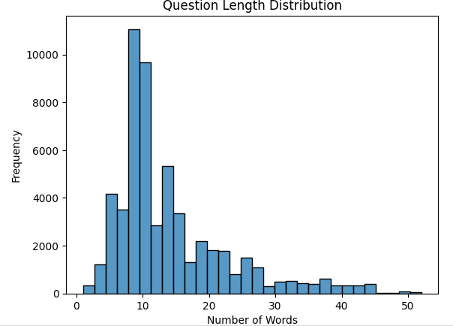
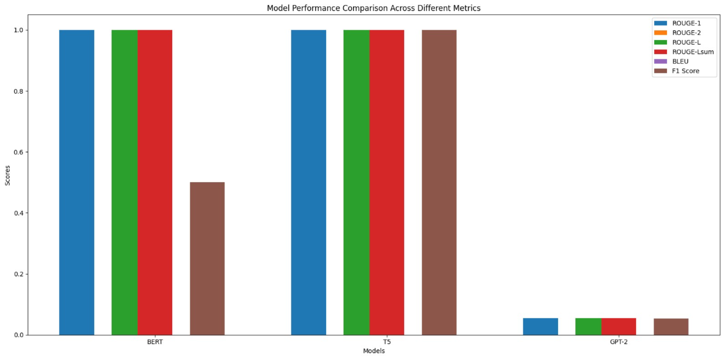
3. Visualization:

Slide 8
4. Insights and Recommendations:
Insights:ROUGE Scores: BERT and T5 both achieve perfect scores (1.0) for ROUGE-1, ROUGE-L, and ROUGE-Lsum, indicating high performance in these metrics. GPT-2's ROUGE scores are significantly lower, suggesting lower performance in capturing relevant information compared to BERT and T5.
BLEU Scores: All models have a BLEU score of 0.0, which suggests that none of the models produced n-grams that match the reference translations.
F1 Score: T5 has the highest F1 score of 1.0, indicating the best balance of precision and recall. BERT's F1 score is 0.5, while GPT-2's F1 score is much lower at 0.0526, reflecting poorer overall performance.
Overall, T5 seems to have the best performance across the board, especially in terms of F1 scores. BERT performs well on ROUGE metrics but shows a lower F1 score. GPT-2's performance is weaker compared to the other two models.

Slide 9
5. Presentation and Documentation/Report:
Link of the project :
https://github.com/ishanjayswal/Question-answering-model/tree/main

Slide 10




Ishan Jayswal
apjishan@yahoo.com
9049994298
THANK YOU!

