Slide 1
Peer to Peer Technology

Slide 2

History
Before Peer to Peer (P2P) network was implemented, a more simple simple architecture was used in the form of Client Server architecture.
In this architecture multiple clients are connected to a server. The server component provides a function or service to one or many clients, which initiate requests for such services.
Eg: A web server serves web pages and a file server serves computer files

Slide 3
Disadvantages
Number of clients are much higher than servers.
High latency.
High work load on server.
Unable to serve large number of clients due to traffic congestion.

Slide 4
Solution?
Peer to Peer (P2P) Networking

Slide 5
What is P2P?
Peer to Peer as the name suggests is communication between peers without the intervention of a sever.
Peer
Peer
Peer
Peer

Slide 6
Applications
Communication:
The P2P model covers a wide spectrum of communication paradigms. At one end of the spectrum are desktop machines mostly connected via stable, high-speed links over the Internet [Saroiu et al. 2002]. At the other end of the spectrum, are small wireless devices such as smartphones or even sensor-based devices that are connected in an ad-hoc manner via a wireless medium.
Group Management:
Peer group management includes discovery of other peers in the community and location and routing between those peers. Discovery of peers can be highly centralized such as in Napster [Napster 2001], highly distributed such as in Gnutella [Gnutella 2001].
Notes:
Explain what Napster and Gnutella is.
Napster is a p2p music sharing site which allowed to share mp3 files between files. It was closed due to copyright infringement.
Gnutella is a file sharing protocol which is similar to napster but was used to share files over the network not restricting to mp3 file. It too was shut down to copyright infringement.

Slide 7
Applications
Peercasting:
Like broadcasting, peercasting is a method of streaming content to consumers. But it differs from traditional broadcasting because the consumers of peercasted content are simultaneously broadcasters. The Peer Distributed Transfer Protocol (PDTP) specification is a peer-to-peer system that provides streaming downloads of content which originates from a central server.
Tor:
Tor is an application that shields its user's identities by sending their traffic through a network of relays set up by volunteers around the world. In other words “it prevents somebody watching your Internet connection from learning what sites you visit, and it prevents the sites you visit from learning your physical location.”
Notes:
These files are shared amongst the peer network which allows the aggregate bandwidth capacity of the network to grow naturally with the number of clients connected.
Tor is used by everyday ordinary Internet users who wish to avoid advertiser's behavioural targeting, citizen journalists in countries without safe access to media, law enforcement setting up anonymous tip lines, activists, and whistleblowers.
Some more examples like bittorrent

Slide 8
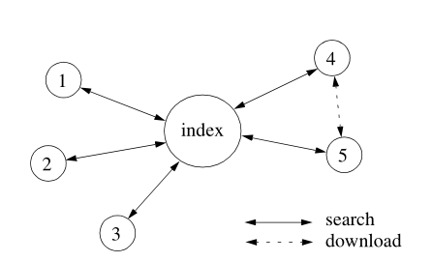
Algorithms
Centralized directory model:
This model was made popular by Napster. The peers of the community connect to a central directory where they publish information about the content they offer for sharing.

Slide 9
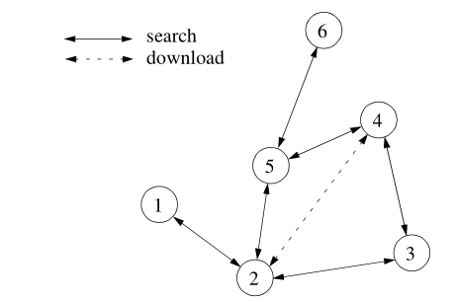
Algorithms
Flooded Request Model:
This is a pure P2P model in which each request from a peer is flooded (broadcast) to directly connected peers until the request is answered or a maximum number of flooding steps (typically 5 to 9)
Notes:
Flooded request model is used by Gnutella and requires a lot of bandwidth and so it is not efficient.

Slide 10
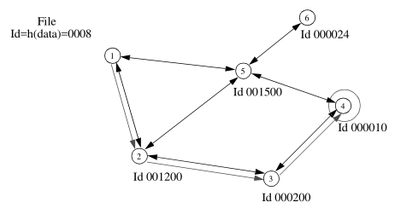
Algorithms
Document Routing Model:
The document routing model, used by FreeNet, is the most recent approach. Each peer from the network is assigned a random ID and each peer also knows a given number of peers. When a document is published (shared) on such a system, an ID is assigned to the document based on a hash of the document’s contents and its name.
Notes:
Flooded request model is used by Gnutella and requires a lot of bandwidth and so it is not efficient.

Slide 11
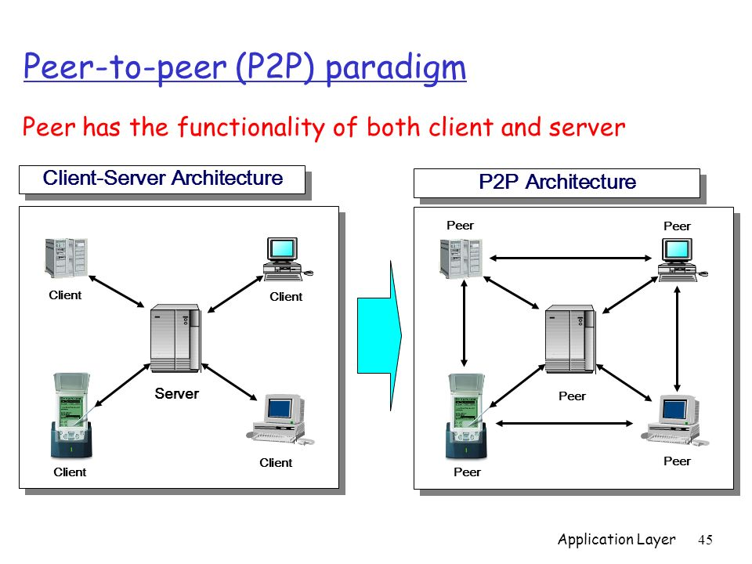
Advantages
Each peer acts as a client as well as a server. Due to this, there is minimum load.
Server is not present in P2P, which results in increased speed, reliability, reduced latency and maximum efficiency.

