Slide 1

Implementing blockchain
For
Document Sharing
Ishan Joshi 3154166
Kishlaya Kunj 3154174
Neeraj Lagwankar 3154175

Slide 2


Slide 3
What is Blockchain?
A blockchain is a continuously growing list of records, called blocks, which are linked and secured using cryptography.

Slide 4

Each block typically contains a cryptographic hash of the previous block, a timestamp and transaction data. By design, a block chain is inherently resistant to modification of the data.

Slide 5
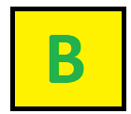
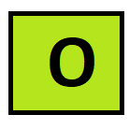


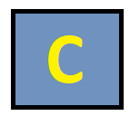

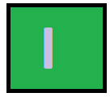

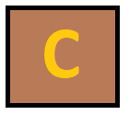

OPEN,DECENTRALISED DATABASE
OF EVERY TRANSACTION INVOLVING VALUE
Challenging the Status Quo
In a radical way

Slide 6

GOODS
MONEY
PROPERTY
DATA SHARING
ELECTION
EDUCATION

Slide 7
The Decentralised Web
Since the advent of Web 2.0, the way people communicate with each other has revolutionized.
Video hosting, podcast, blogging ,P2P interaction, RSS, Social Networking etc. all have changed the way Internet was.
But everywhere, there was a middleman : a platform acting as a trusted intermediary between A and B who did not know or trust each other.
While these platforms have done an amazing job at creating a P2P economy, with an ever more sophisticated content discovery layer, they also dictate all rules of the transactions, and these platforms own all of our data.

Slide 8
In this context, Blockchain seems to be a driving force of the next generation Internet, the Decentralized Web, or Web3. Blockchain can bring us true P2P transactions without a middleman.

Slide 9
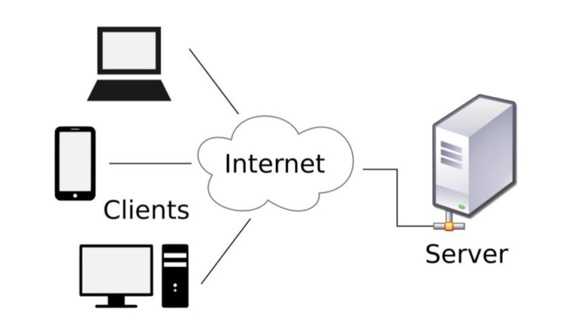
Killing the Server: Redesigning Data Structures
Our data architectures are mostly still client-server based. Which means that our data is centrally stored on one computer, and retrieved via the Internet by another computer over the Internet.
It raises issues of trust: Can I trust those people and institutions that store my data against any form of corruption: internal or external, man-made or machine failure, on purpose or by accident? Such centralized data structures have a unique point of failure points of failure.

Slide 10
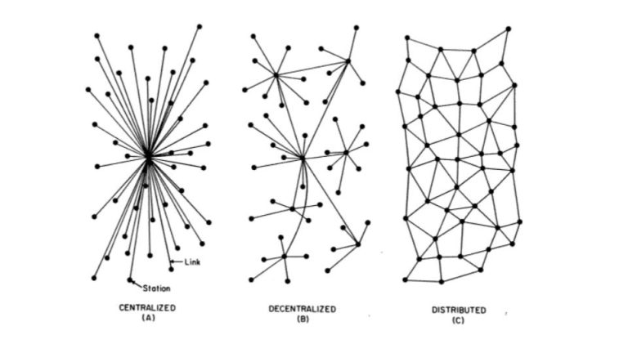
CENTRALISED
VS
DECENTRALISED
WEB
POINTS
OF
FAILURE

