Slide 1
Intrusion Detection/Prevention Systems

Slide 2
Definitions
Intrusion
  A set of actions aimed to compromise the security goals, namely
    Integrity, confidentiality, or availability, of a computing and networking resource
Intrusion detection
  The process of identifying and responding to intrusion activities
Intrusion prevention
  Extension of ID with exercises of access control to protect computers from exploitation

Slide 3
Elements of Intrusion Detection
Primary assumptions:
  System activities are observable
  Normal and intrusive activities have distinct evidence
Components of intrusion detection systems:
  From an algorithmic perspective:
    Features - capture intrusion evidences
    Models - piece evidences together
  From a system architecture perspective:
    Various components: audit data processor, knowledge base, decision engine, alarm generation and responses

Slide 4

Components of Intrusion Detection System
Audit Records
system activities are observable
Audit Data Preprocessor
Activity Data
Detection
Models
normal and intrusive activities have distinct evidence
Detection Engine
Alarms
Action/Report
Decision
Table
Decision Engine

Slide 5
Intrusion Detection Approaches
Modeling
  Features: evidences extracted from audit data
  Analysis approach: piecing the evidences together
    Misuse detection (a.k.a. signature-based)
    Anomaly detection (a.k.a. statistical-based)
Deployment: Network-based or Host-based
  Network based: monitor network traffic
  Host based: monitor computer processes
Notes:
Need “both” on all these.

Slide 6
Misuse Detection
pattern matching
Intrusion Patterns
intrusion
activities
Example: if (src_ip == dst_ip) then “land attack”
Can’t detect new attacks

Slide 7
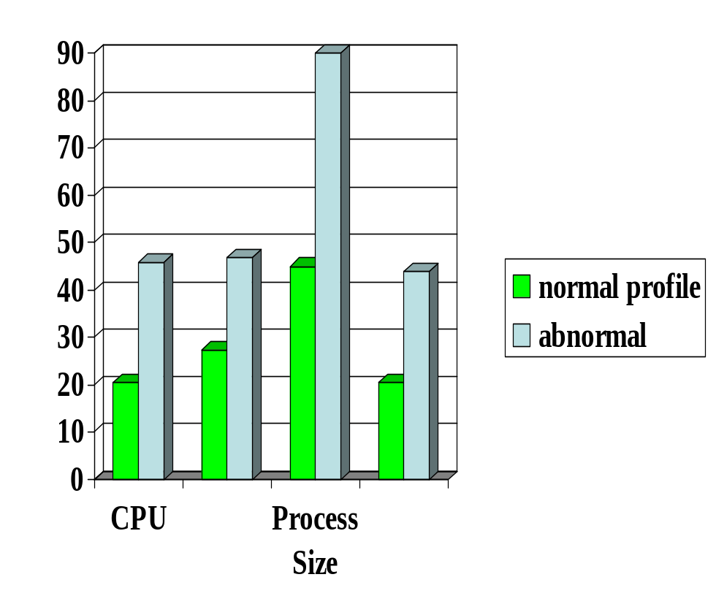

Anomaly Detection
probable intrusion
activity measures
Any problem ?
Relatively high false positive rate
Anomalies can just be new normal activities.
Anomalies caused by other element faults
  E.g., router failure or misconfiguration, P2P misconfiguration

Slide 8


Host-Based IDSs
Using OS auditing mechanisms
  E.G., BSM on Solaris: logs all direct or indirect events generated by a user
  strace for system calls made by a program (Linux)
Monitoring user activities
  E.G., analyze shell commands
Problems: user dependent
  Have to install IDS on all user machines !
  Ineffective for large scale attacks
Notes:
BSM: Basic Security Module

Slide 9
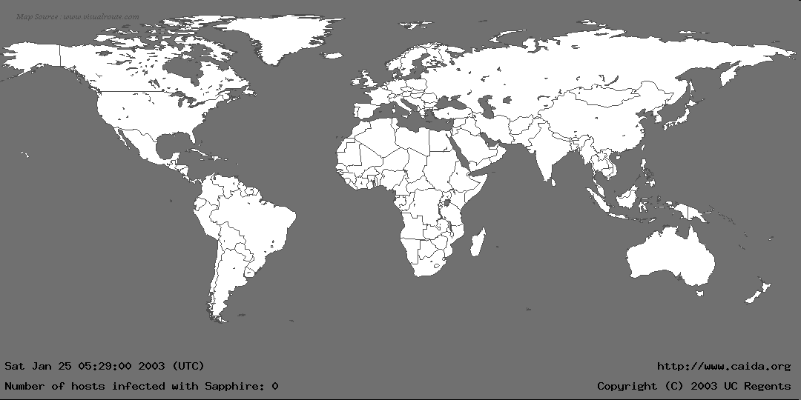
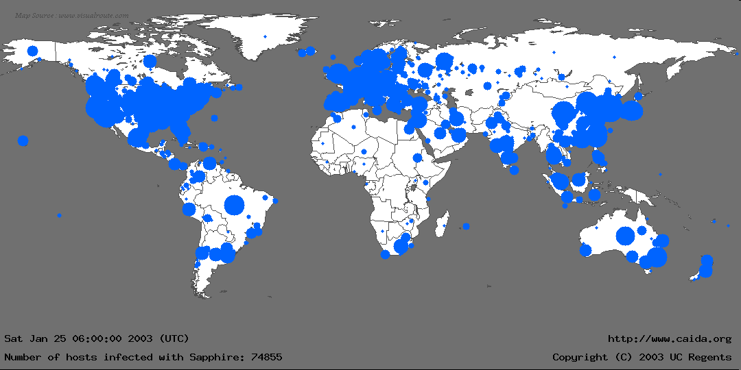
The Spread of Sapphire/Slammer Worms
Notes:
In the first 30 minutes of Sapphire’s spread, we recorded nearly 75,000 unique infections. As we will detail later, most of these infections actually occurred within 10 minutes.
This graphic is more for effect rather than technical detail: We couldn’t determine a detailed location for all infections, and the diameter of each circle is proportional to the lg() of the number of infections, underrepresenting larger infections. Nevertheless, it gives a good feel for where Sapphire spread.
We monitored the spread using several “Network Telescopes”, address ranges where we had sampled or complete packet traces at single sources. We also used the D-shield distributed intrusion detection system to determine IPs of infected machines, but we couldn’t use this data for calculating the scanning rate.

Slide 10


Network Based IDSs
Internet
Gateway routers
Our network
Host based
detection
At the early stage of the worm, only limited worm samples.
Host based sensors can only cover limited IP space, which might have scalability issues. Thus they might not be able to detect the worm in its early stage

Slide 11


Network IDSs
Deploying sensors at strategic locations
  E.G., Packet sniffing via tcpdump at routers
Inspecting network traffic
  Watch for violations of protocols and unusual connection patterns
Monitoring user activities
  Look into the data portions of the packets for malicious code
May be easily defeated by encryption
  Data portions and some header information can be encrypted
  The decryption engine may still be there, especially for exploit
Notes:
Problems: mainly accuracy

Slide 12
Key Metrics of IDS/IPS
Algorithm
  Alarm: A; Intrusion: I
  Detection (true alarm) rate: P(A|I)
    False negative rate P(¬A|I)
  False alarm (aka, false positive) rate: P(A|¬I)
    True negative rate P(¬A|¬I)
Architecture
  Throughput of NIDS, targeting 10s of Gbps
    E.g., 32 nsec for 40 byte TCP SYN packet
  Resilient to attacks

Slide 13
Architecture of Network IDS
Signature matching
(& protocol parsing when needed)
Protocol identification
TCP reassembly
Packet capture libpcap
Packet stream

Slide 14
Firewall/Net IPS VS Net IDS
Firewall/IPS
  Active filtering
  Fail-close
Network IDS
  Passive monitoring
  Fail-open
IDS
FW
Notes:
Protection is not free/cheap. For example, an intrusion detection system (IDS) needs to analyze each packet. This requires a lot of computing power, usually a dedicated high-end workstation. If the IDS is real-time then its response time must be short.
When there is insufficient resources, some protection mechanisms will simply not let data in (fail-close). For example, a firewall, which filters each packet, will simply drop packets when it is overloaded. The dropped packet will not be able to reach beyond the firewall into the internal network. The user experience may not be a happy one because of data loss. However, other protection mechanisms will check/analyze as much as they can but will effectively let all data (fail-open) when there is insufficient resources. For example, an IDS, which simply copies a packet and analyzes it (while the packet continues to reach its target), may only be able to check a packet after a lengthy delay when it is overloaded, letting the packet to complete its potentially malicious actions.
When assessing the protection mechanisms, we will develop models and evaluate under what conditions they will fail-close or fail-open.

Slide 15
Related Tools for Network IDS (I)
While not an element of Snort, Ethereal is the best open source GUI-based packet viewer
www.ethereal.com offers:
  Windows
  UNIX, e.g., www.ethereal.com/download.html
  Red Hat Linux RPMs: ftp.ethereal.com/pub/ethereal/rpms/

Slide 16
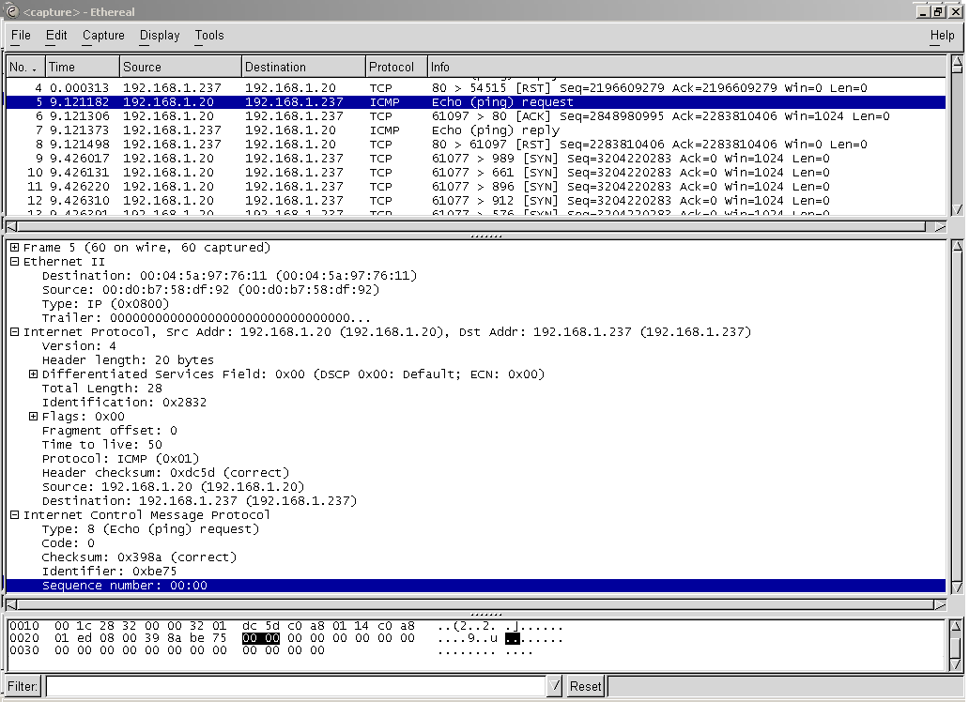

Slide 17
Related Tools for Network IDS (II)
Also not an element of Snort, tcpdump is a well-established CLI packet capture tool
  www.tcpdump.org offers UNIX source
  http://www.winpcap.org/windump/ offers windump, a Windows port of tcpdump
    windump is helpful because it will help you see the different interfaces available on your sensor

Slide 18
Case Study: Snort IDS

Slide 19
Problems with Current IDSs
Inaccuracy for exploit based signatures
Cannot recognize unknown anomalies/intrusions
Cannot provide quality info for forensics or situational-aware analysis
  Hard to differentiate malicious events with unintentional anomalies
    Anomalies can be caused by network element faults, e.g., router misconfiguration, link failures, etc., or application (such as P2P) misconfiguration
  Cannot tell the situational-aware info: attack scope/target/strategy, attacker (botnet) size, etc.

Slide 20
Limitations of Exploit Based Signature
Signature: 10.*01
1010101
Internet
Traffic Filtering
10111101
X
Our network
X
11111100
00010111
Polymorphism!
Polymorphic worm might not have exact exploit based signature

Slide 21



Vulnerability Signature
Vulnerability
signature traffic filtering
Internet
X
X
Our network
X
X
Vulnerability
Work for polymorphic worms
Work for all the worms which target the
same vulnerability

Slide 22
Example of Vulnerability Signatures
At least 75% vulnerabilities are due to buffer overflow
Sample vulnerability signature
Field length corresponding to vulnerable buffer > certain threshold
Intrinsic to buffer overflow vulnerability and hard to evade
Overflow!
Protocol message
Vulnerable buffer

Slide 23
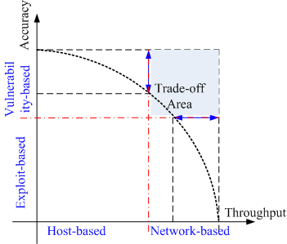
Next Generation IDSs
Vulnerability-based
Adaptive
  - Automatically detect & generate signatures for zero-day attacks
Scenario-based for forensics and being situational-aware
  Correlate (multiple sources of) audit data and attack information

Slide 24
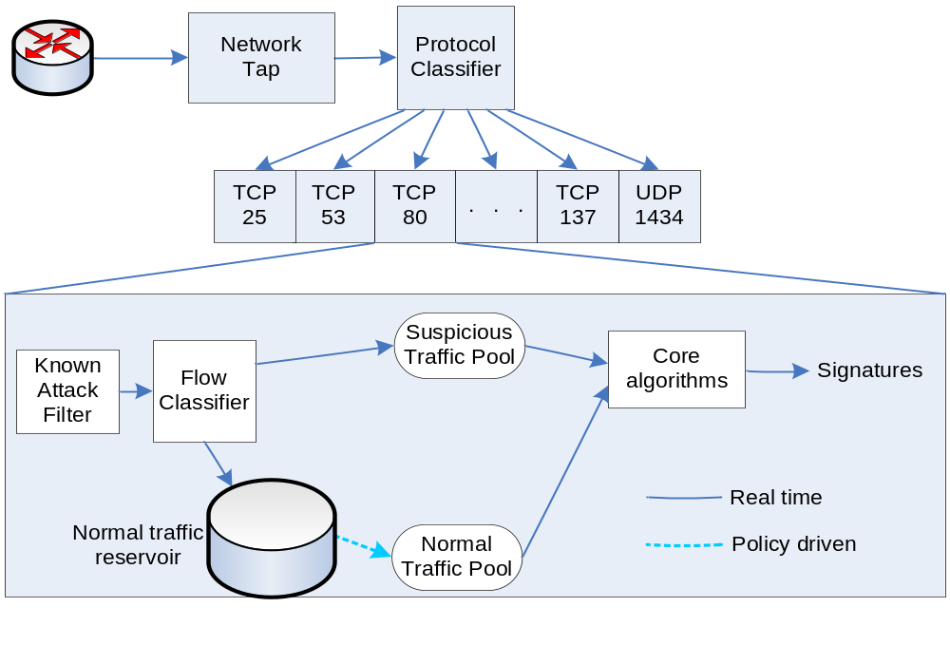
Counting Zero-Day Attacks
Honeynet/darknet, Statistical detection

Slide 25
Security Information Fusion
Internet Storm Center (aka, DShield) has the largest IDS log repository
Sensors covering over 500,000 IP addresses in over 50 countries
More w/ DShield slides

Slide 26
Backup Slides

Slide 27
Requirements of Network IDS
High-speed, large volume monitoring
  No packet filter drops
Real-time notification
Mechanism separate from policy
Extensible
Broad detection coverage
Economy in resource usage
Resilience to stress
Resilience to attacks upon the IDS itself!

Slide 28
Architecture of Network IDS
Policy script
Alerts/notifications
Policy Script Interpreter
Event control
Event stream
Event Engine
tcpdump filters
Filtered packet stream
libpcap
Packet stream
Network

