Slide 1
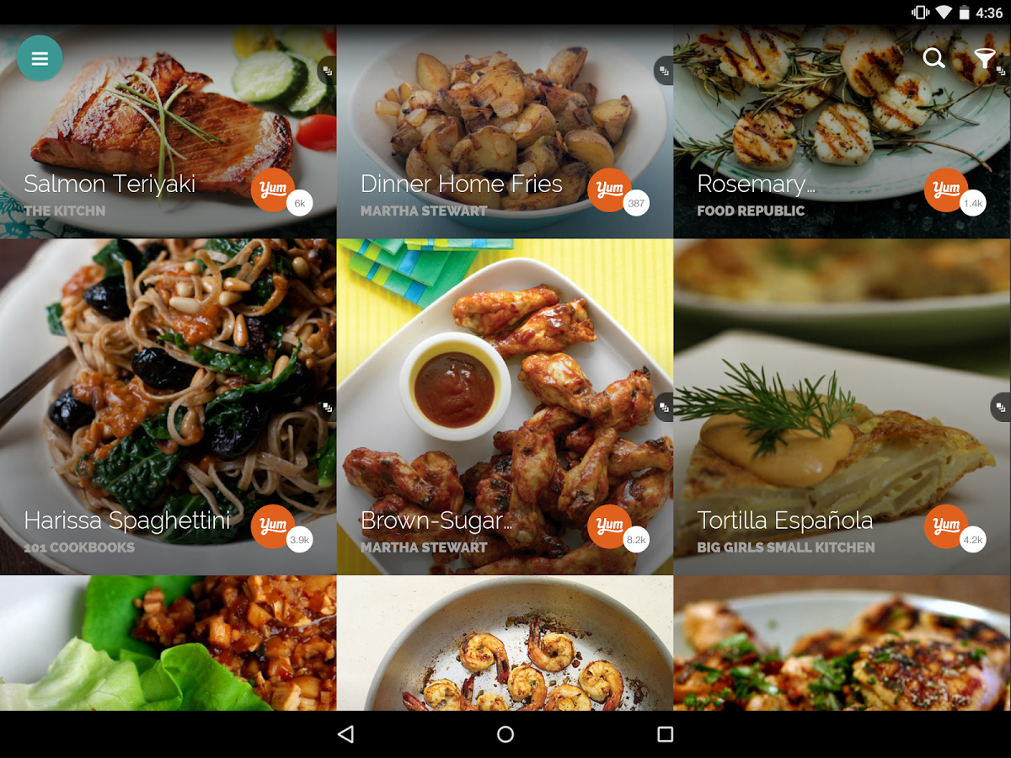
Cuisine Analyser
Ishank Aggarwal (15103041)
Sarthak Joshi (15103102)
Udit Goel (15103376)
Osheen Singh (15103189)
Under the guidance of: -
Prof. Yamuna Prasad and Prof. Shikha Mehta

Slide 2
Abstract & Keywords
Abstract--Over the years, people have tried to explore new ingredients and incorportate them into recipes or produce new recipes all together. In this research project, we explore the patterns related to the ingredients of a cuisine.
Keywords--Classification, SVC, TF-IDF, k-Nearest Neighbors, KNN, Yummly, K-means, Random Forests, Cuisines, Ingredients, Bag of words

Slide 3
Introduction
Recipes tend to encourage a slavish devotion to the recipe and divert attention from the more important part of cooking, the physical abilities (or, in my case, the lack thereof) of the chef. Foodies tend to privilege the provenance of obscure ingredients ("coulis of feather saffron hand-picked from a seaside village in Morocco").
We are curious how much variation exists between dishes, and whether such variation is warranted. Are there really 5000 ways to cook a steak, or are many of these variations superfluous? We hope to use a data-science approach to see if the cooking wisdom of the crowds have arrived at the same answers, and if they match those of traditional experts.
To answer questions like most common ingredients for a particular cuisine and most unique recipe for each cuisine based on its ingredients, this repository was initiated and we have chosen this repository to analyse the performance of the existing code present there and to implement our advancements as a part of our research project.

Slide 4
Dataset
Data Collection:
Chosen Yummly API compared to Spoonacular API due to access over 1-million recipes and Yummly having better-formatted ingredients for each recipe.
Yummly's API is accessed by querying an API endpoint and returns JSON-encoded recipe data. JSON data was translated to Pandas dataframe structures using the Requests package and Pandas.
25 Separate CSV files for each cuisines have been used which are concatenated together into a master cuisines.csv at the end
Each row of data contained:
Yummly Recipe ID (string)
Recipe Name (string)
Yummly Rating (integer, 0-5)
Cooking Time in Seconds (integer)
Course (string)
Cuisine (string)
Ingredients (string)

Slide 5
Cuisine Dataset basic stats:
8037 recipes
25 cuisines: Asian is the most well-represented, with 1414 recipes. English the least, with just 32 recipes.
Ratings: overwhelmingly 4-star (4988 of the 8037), some 3-star (1517) and 5-star (1379), very few 0, 1, or 2 stars (153 combined recipes)
Cooking Time: mean of 65 minutes, max of 1970 minutes (33 hours), min of 1 minute, median of 40 minutes
Ingredients per recipe: mean of 10.1, max of 35 (Thai chicken tacos), min of 1, median of 9
3958 unique ingredients:
Most common ingredients: Salt (3325 occurences, 0.41 frequency), garlic (0.22), onions (0.20), olive oil (0.18)
Least common ingredients: 1401 unique ingredients are only used in one recipe throughout the dataset. Examples: chocolate candy, melon seeds, canned tuna, vegan yogurt, tarragon vinegar, unsalted almonds

Slide 6
Data Preprocessing (on master data CSV cuisines):
Ingredient Parsing- transformation of single unseparated string of ingredient into list of ingredient strings separated by commas.
Ingredient Counts-calculating the number of ingredients in each recipe by creating a new column named "ingredCount" and setting each value to len(ingredients).
Time conversion- converted each recipe's cooking time from seconds to minutes by dividing by 60 and populated a column named "timeMins".
Munging:
For master cusines data.csv- dropped any rows of cuisines data that had empty “cuisine” value and also dropped any empty recipes without an explicit(forced) cuisine.
For cuisines_data, empty course values were filled with “Unknown”
Finally, duplicate recipes were dropped from the dataset.

Slide 7
Prediction Task & Features
What was already existing?
Took training set as 0.8, testing set as 0.2
Ingredient frequency using the formula , Ingredient frequency = (# of recipes with the ingredient) / (# of recipes) was calculated
List of unique ingredients and their value counts for the given dataframe were calculated by following this strategy : Sum all ingredients, convert to Pandas dataframe, take value_counts()
Uniqueness score 1(mean) and Uniqueness score 2 (product) were calculated:
Score #1 = (sum of recipe's unique ingredient frequencies) / (# of ingredients in the recipe)
Score #2 = (product of recipe's unique ingredient frequencies)
These scores indicated that score 2 method tends to reward recipes with extremely rare ingredients whereas score 1 method rewards these recipes to far lower extent.

Slide 8
Data relationships between cooking time & rating, ingredient counts & ratings, ingredient counts & cooking times were observed.
Naive Bayes and Logistic regression model has been used, train-test-split has been done with sklearn.
cuisine- null accuracy=0.06906
Multinomial Naive Bayes = 0.53383
Logistic Regression= 0.43881

Slide 9
What modificiations have been incorporated?
propose a recipe given a set of ingredients - this question has been answered.In order to find which recipes are possible given a set of supplies in pantry? .issubset() method is used - matches all objects in one set with another set
used k-nearest neighbours (KNN) classifier to recommend similar recipes. i.e. to answer question like given a recipe, which recipes are most similar to it?. This feature involves building nearest nearest neighbour model by using both word count and TF-IDF
In order to improve accuracy of regression and naive bayes, we tried 3 more classifiers- Random Forest, K-cross validation and KNN.
Relationship between cooking time vs cuisine is analysed. (for eg. people of which country (eg. thai) tend to spend more time in cooking.)
Relationship b/w rating and cooking time, rating and ingredient count, cuisine label and recipe label have been observed.

Slide 10
Models
Multinomial Naive Bayes
Logistic Regression
Random Forest
K-cross validation
K-Nearest Neighbours (KNN)

Slide 11
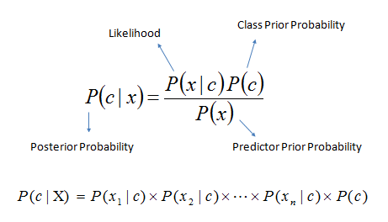
Multinomial Naive Bayes
It is a classification technique based on Bayes’ theorem with an assumption of independence between predictors. In simple terms, a Naive Bayes classifier assumes that the presence of a particular feature in a class is unrelated to the presence of any other feature. For example, a fruit may be considered to be an apple if it is red, round, and about 3 inches in diameter. Even if these features depend on each other or upon the existence of the other features, a naive Bayes classifier would consider all of these properties to independently contribute to the probability that this fruit is an apple.
Naive Bayesian model is easy to build and particularly useful for very large data sets. Along with simplicity, Naive Bayes is known to outperform even highly sophisticated classification methods.
Bayes theorem provides a way of calculating posterior probability P(c|x) from P(c), P(x) and P(x|c). Look at the equation below:
Bayes_rule'
Here,
P(c|x) is the posterior probability of class (target) given predictor (attribute).
P(c) is the prior probability of class.
P(x|c) is the likelihood which is the probability of predictor given class.
P(x) is the prior probability of predictor.

Slide 12
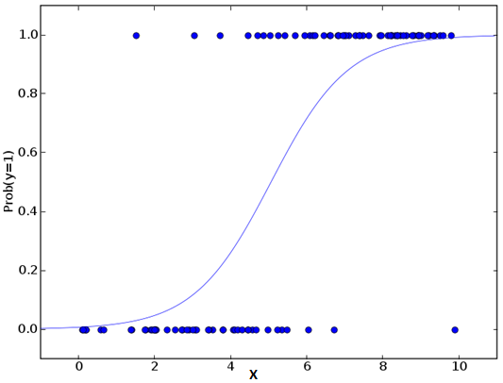
Logistic Regression
It is used to estimate discrete values ( Binary values like 0/1, yes/no, true/false ) based on given set of independent variable(s). In simple words, it predicts the probability of occurrence of an event by fitting data to a logit function. Hence, it is also known as logit regression. Since, it predicts the probability, its output values lies between 0 and 1 (as expected).
Coming to the math, the log odds of the outcome is modeled as a linear combination of the predictor variables.
odds= p/ (1-p) = probability of event occurrence / probability of not event occurrence
ln(odds) = ln(p/(1-p))
logit(p) = ln(p/(1-p)) = b0+b1X1+b2X2+b3X3....+bkXk
Above, p is the probability of presence of the characteristic of interest. It chooses parameters that maximize the likelihood of observing the sample values rather than that minimize the sum of squared errors (like in ordinary regression).

Slide 13
Random Forest
Random Forest is a trademark term for an ensemble of decision trees. In Random Forest, we’ve collection of decision trees (so known as “Forest”). To classify a new object based on attributes, each tree gives a classification and we say the tree “votes” for that class. The forest chooses the classification having the most votes (over all the trees in the forest).
Each tree is planted & grown as follows:
If the number of cases in the training set is N, then sample of N cases is taken at random but with replacement. This sample will be the training set for growing the tree.
If there are M input variables, a number m<<M is specified such that at each node, m variables are selected at random out of the M and the best split on these m is used to split the node. The value of m is held constant during the forest growing.
Each tree is grown to the largest extent possible. There is no pruning.

Slide 14
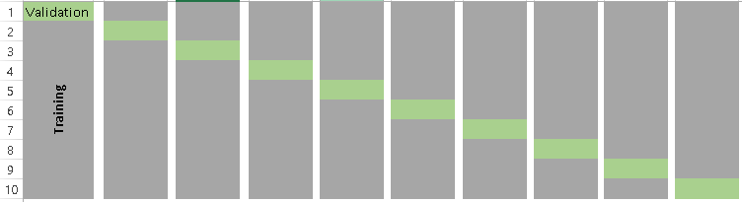
K-fold cross validation
“k- fold cross validation” is easy to follow and implement. Here are the quick steps:
Randomly split your entire dataset into k”folds”.
For each k folds in your dataset, build your model on k – 1 folds of the data set. Then, test the model to check the effectiveness for kth fold.
Record the error you see on each of the predictions.
Repeat this until each of the k folds has served as the test set.
The average of your k recorded errors is called the cross-validation error and will serve as your performance metric for the model.
“How to choose right value of k?”
Always remember, lower value of K is more biased and hence undesirable. On the other hand, higher value of K is less biased, but can suffer from large variability. It is good to know that, smaller value of k always takes us towards validation set approach, where as higher value of k leads to LOOCV approach. Hence, it is often suggested to use k=10.
visualization of how does a k-fold validation work for k=10

Slide 15
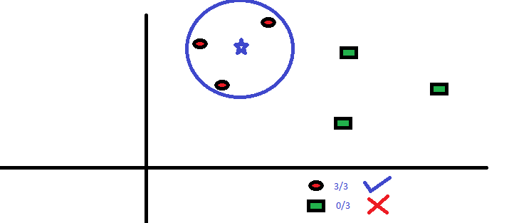
K-Nearest Neighbours (KNN)
It can be used for both classification and regression problems. However, it is more widely used in classification problems in the industry. K nearest neighbors is a simple algorithm that stores all available cases and classifies new cases by a majority vote of its k neighbors. The case being assigned to the class is most common amongst its K nearest neighbors measured by a distance function.
These distance functions can be Euclidean, Manhattan, Minkowski and Hamming distance. First three functions are used for continuous function and fourth one (Hamming) for categorical variables. If K = 1, then the case is simply assigned to the class of its nearest neighbor. At times, choosing K turns out to be a challenge while performing KNN modeling.
KNN can easily be mapped to our real lives. If you want to learn about a person, of whom you have no information, you might like to find out about his close friends and the circles he moves in and gain access to his/her information!
Things to consider before selecting KNN:
KNN is computationally expensive
Variables should be normalized else higher range variables can bias it
Works on pre-processing stage more before going for KNN like outlier, noise removal

Slide 16
Results
When applied Random Forest Classifier, accuracy came out to be 0.509328358209
When applied K-Nearest Neighbours classifier, accuracy were nearby 0.40
When tested with K-fold cross validation ,accuracies came out to be 0.56011574074074078 for cuisines and 0.032086419753086418 for recipes
using .issubset method, we found out the no. of recipes and which recipes we can make given a set of supplies in the pantry
we used word count and tfidf model to predict similar dishes. for pizza, the highest tf-idf value came out to be of style', 9.06693178868
on applying knn model, closest dish to pizza came out to be Grilled Buffalo Chicken Pizza.
then we plotted the relationship graphs.

Slide 17
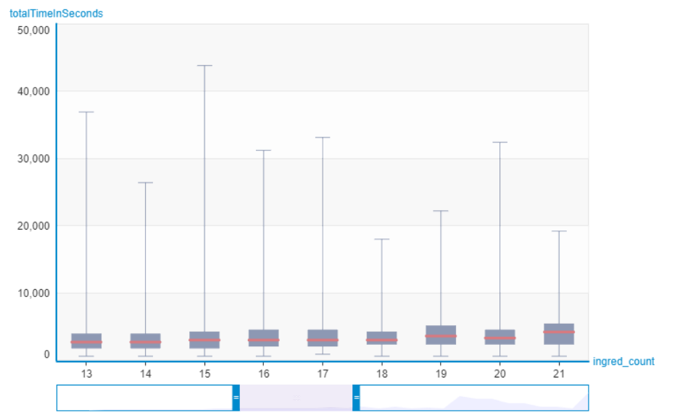
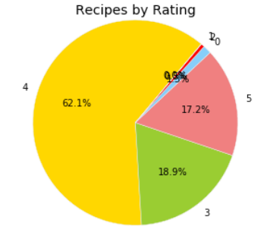
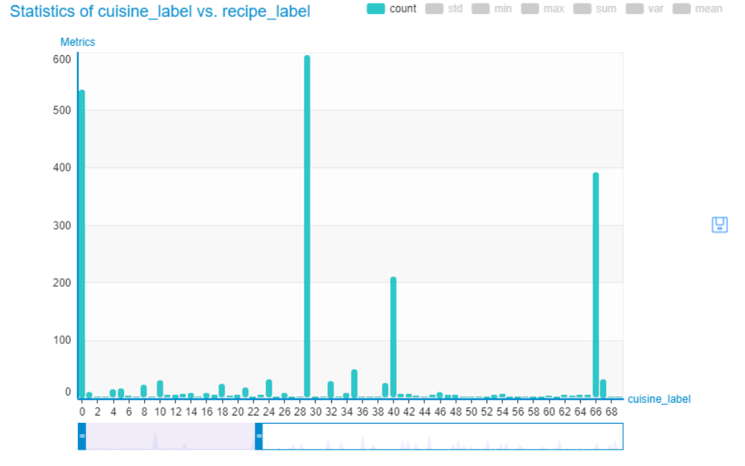

Slide 18
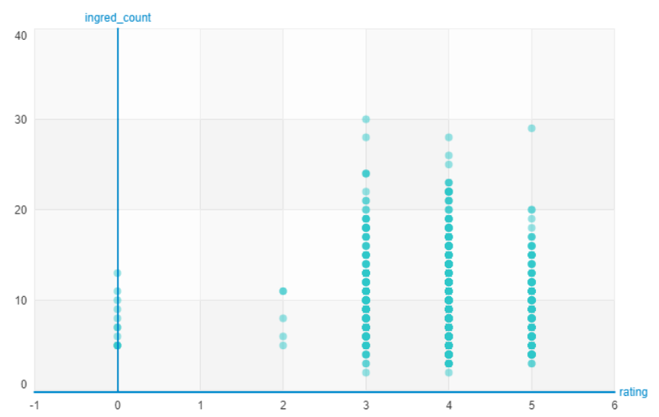
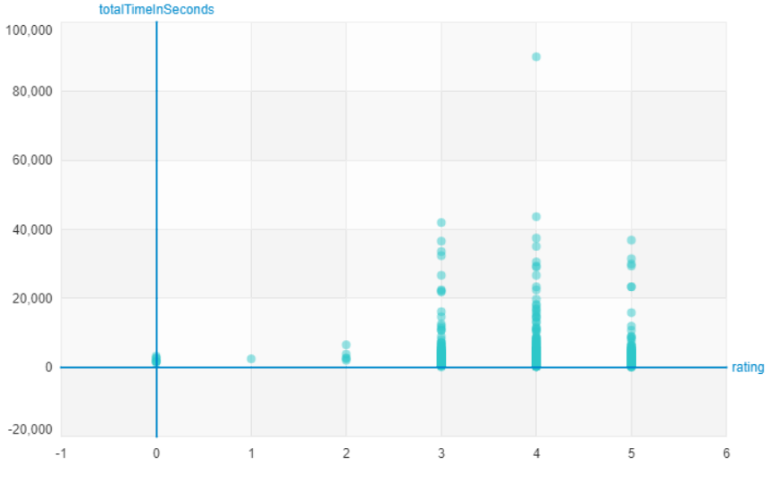

Slide 19
Advancements
Propose a recipe given set of ingredients
KNN classifier using word count and tf-idf to recommend similar recipes.
improve accuracy of regression and naive bayes using alternative classifiers such as random forest, k-fold cross validation, kNN, perceptron, linear SVC, passive aggressive, etc.
to find relationship between popularity(rating) vs no. of ingredients.
to find relationship between cooking time vs cuisine(people of which country(eg. thai) tend to spend more time in cooking)
to predict the histograms for relationship between precision, recall and f1 vs different classifiers we tried out
to predict the histograms for relationship between accuracy vs different classfiers we tried out
to depict the confusion matrix plot of different classifiers.
code reimplementation on graphlab
using recipe instructions as parameter in order to compare cooking techniques and methods
unsupervised NLP approach to select dish types from recipe names would be challenging as many recipe names are confounded by adjectives and descriptors or do not use standard english terms (eg. “Garllic Aoilli-Dipped-Salmon ceviche”- Is this salmon recipe or ceviche recipe? . we would be working on solving this ambiguity.

Slide 20
deciding on how to use the two scoring algorithms- either take the mean of both or find the ones that achieve high score on one but not the other and classify them separately
to infer the cuisine based on generalized characteristics. This will be little tricky as its very easy to find recipes with exact/similar ingredient matches.
fitting multidimensional regression curve to the scatter plot between ingredients and cooking times.
The bag of models is inelegent.There should exist a method to use the ingredients as tokens for a model rather than deconnect back to a bag of words (Ingredient tokenization).
Anything that can be done to improve the situation of multi-cuisine designations to improve the accuracy. (Multiple Cuisine designation). This advancement together with the one above it, can improve accuracy by 15% for cusine and 10% for dish.
Clustering analysis- k-means, tfidf, etc
Pricing analysis if we can find an API that accepts ingredients and returns price per serving
Publishing interesting results or infographic online using static images or Bokeh/D3
Is there a relationship b/w recipe rating and recipe costs?
What other relationships exists in the data?- plotting graphs, histograms, etc.
Which recipes can I make with a few more ingredients?
Given a set of ingredients, which cuisine/recipe is it most like?
To prepare confusion matrices of naive bayes, logistic regression and random forest.

Slide 21
References
coursera (https://www.coursera.org/)
Yummly Dataset (https://www.yummly.com/)
Boqi Li, Mingyu Wang, “Cuisine Classification from Ingredients”, revised 2005
R.M. Rahul Venkatesh Kumar, M. Anand Kumar, K.P. Soman, “Cuisine Prediction based on Ingredients using Tree Boosting Algorithms”, Indian Journal of Science and Technology, Vol 9(45), revised 2016
Juhi Naik, Vinaya Polamreddi, “Cuisine Classification and Recipe Generation”, np. 2015
Rishikesh Ghewari, Sunil Raiyani, “Predicting Cuisine from Ingredients”, n.p. 2014
Sridhar Srinivasasubramanian, Brajesh Kushwaha, Vishal Parekh, “Identifying Cuisines From Ingredients”, n.p. 2013
Rishabh Singh Verma, Himanshu Arora, “Cuisine Prediction/Classification based on Ingredients”, n.p. 2016

