Slide 1
This is What I DID
Mobile App Validation
Version 2.0

Slide 2
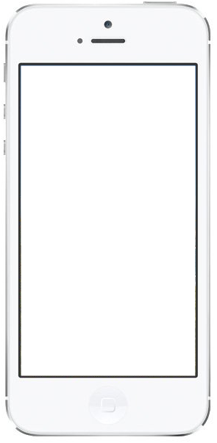

Username
Password
Login

Slide 3




Week 33
Mon | 8h
Tue | 6h
Wed | 7.5h
Thu | 8h
Fri | 8h
-
+

Slide 4
Week 33
Mon | 8h
Tue | 6h
Wed | 7.5h
Thu | 8h
Fri | 8h
-
+
This is What I DID

Slide 5

August, Friday 14
Mobile Hackathon
Assist Scrum

Slide 6
August, Friday 14
Mobile Hackathon
Assist Scrum

Slide 7



Mobile Hackathon
Start |  | 7:30 AM
End |  | 5:30 PM
Duration |  | 8hrs
Customer
Project
99X Technology
Internal

Slide 8
Assist Scrum
Start |  | 2:30 PM
End |  | 2:45 PM
Duration |  | 15 minutes
Customer
Project
Puzzlepart
Assist 365

Slide 9
August Friday 14
Mobile Hackathon
Assist Scrum

Slide 10

Week 33
Your timesheet is confirmed.
Go and have a brew.
Done

Slide 11
Week 33
Mon | 8h
Tue | 6h
Wed | 7.5h
Thu | 8h
Fri | 8h
-
+
Confirmed

Slide 12



Settings
Logout

