Slide 1

CS5260 Project Part 2
Ishan Kaul

Slide 2
Part 1 Architecture

Slide 3
State Driver – Top level function
Inputs: initial state, resources and values, transforms, optimizing country, max depth, # of output schedules, max frontier size, gamma, k, c
Uses resources & values to compute all possible trades & their lowest factor ratios
Initializes optimizer, runs and then outputs schedules to a file

Slide 4
State Optimizer
Runs the actual state space search algorithm
Part 1 implementation:
Frontier and output list – both double ended priority queues ordered on the expected utility of the last state
Search starts with initial state node, then runs a loop:
Pop frontier
Generate all possible states from frontier
Only add new states to frontier and best state list if better than the it's current worst utility
Repeat
State generation skipped if current state has depth = to max depth; loop ends when we try to pop an empty frontier

Slide 5
Generate Successors function
Input: current state
Applies all available transfers and transforms (in addition to scaling) to it, and produces new nodes
Scaling: given a ratio (eg – {input: {water: 4}, {output: food: 3}), continuously generates new 'actions' that are a multiple of all the resources and an increasing integer. Stops when any country involved has no more input resources available
Increases branching factor, but significantly reduces depth required to reach desired states when we need to do actions on a large amount of each resource

Slide 6
Part 2 Improvements

Slide 7
Partial Random Walk
Frontier split into 2 parts - 'randomized' and 'best states' frontiers
Best state frontier – depq with same functionality as the frontier in part 1
¼ size of max frontier
Randomized frontier
Simple list implementation – ¾ size of max frontier
Holds set of non-best states, and is added to 'randomly'
Implementation of 'random'
If state not good enough for best frontier, don't delete it. With probability (1/size of frontier), add it to the randomized frontier
Choose an existing index of randomized frontier to replace this node with according to a uniform distribution

Slide 8
Improved Experimental Infrastructure
Used programmatic Bash Scripts, which were able to run my optimizer with a variety of different input configurations. Allowed me to grab far more data points for analysis of Part 2

Slide 9
Experiments

Slide 10
Frontier Size
Sizes 5, 15, 30, 50, 100
States 4 and 5
Depth=3, Outputs=15, Gamma=.99, k=0.3, C=-1

Slide 11
Depth
Depths 1-8
States 4 and 5
Frontier size = 15, Outputs=15, Gamma=.99, k=0.3, C=-1

Slide 12
K
0.01, 0.1, 0.3, 0.5
States 4 and 5
Frontier size = 50, Outputs=15, Gamma=.99, C=-1

Slide 13
Gamma
0.75, 0.9, 0.99
States 4 and 5
Frontier size = 50, Outputs=15, k=1 C=-1

Slide 14
Results & Analysis

Slide 15
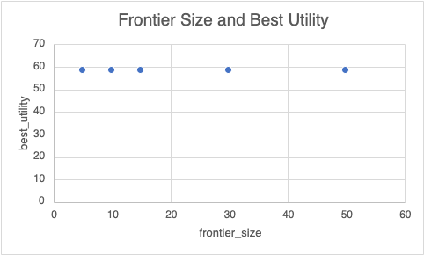
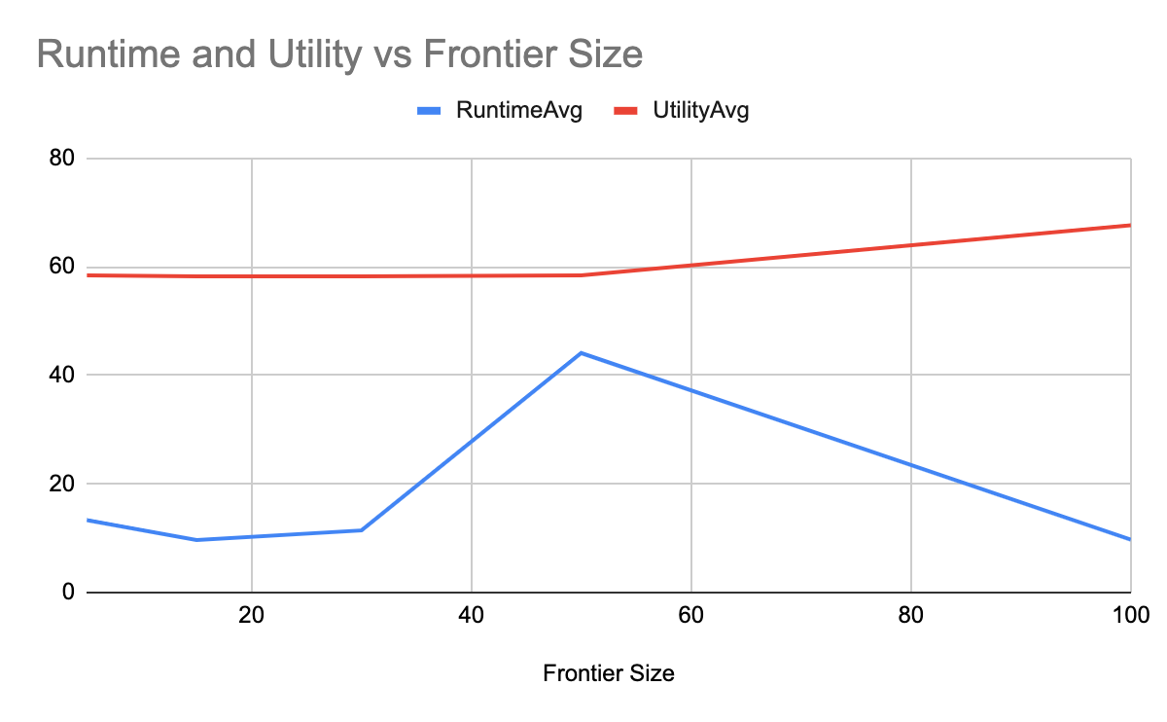
Frontier Size
Part 1
Part 2

Slide 16
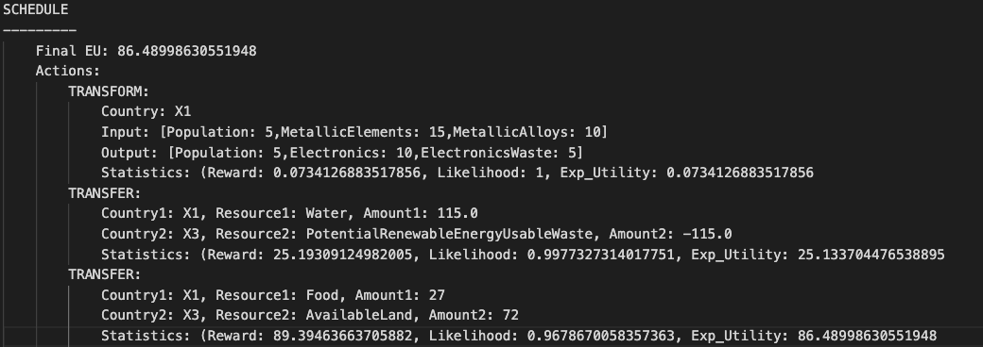
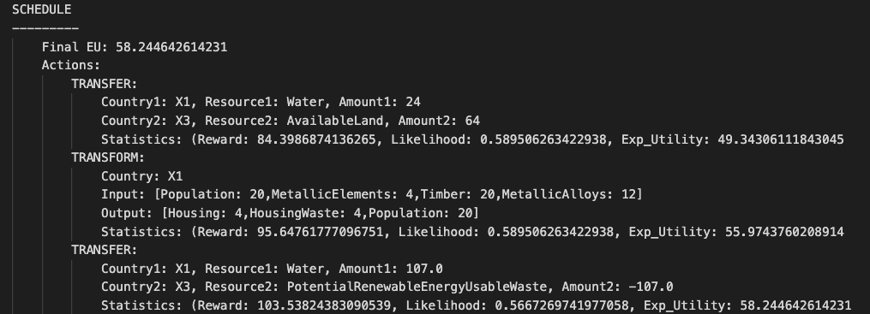
Schedule Comparison

Slide 17
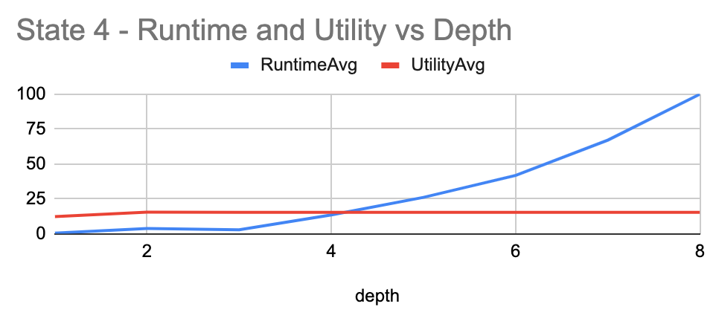
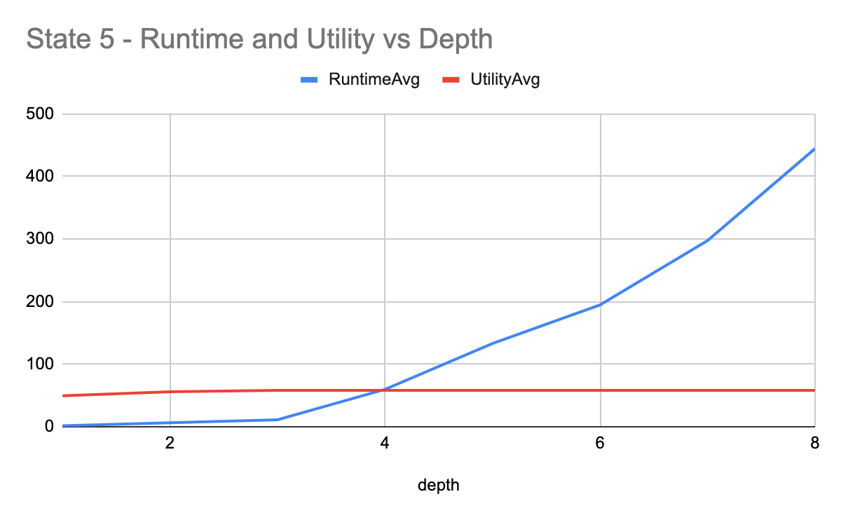
Depth

Slide 18
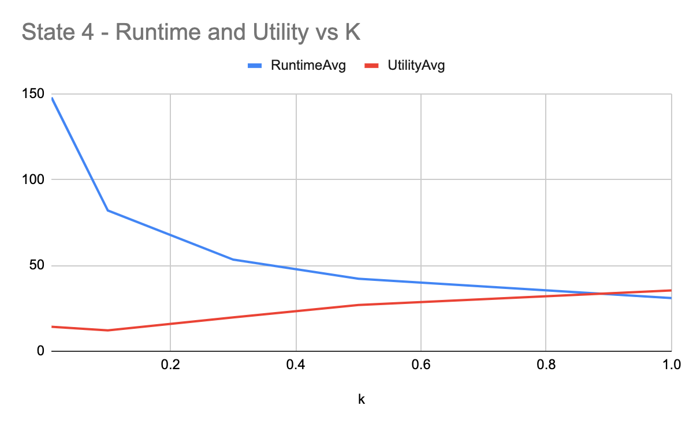
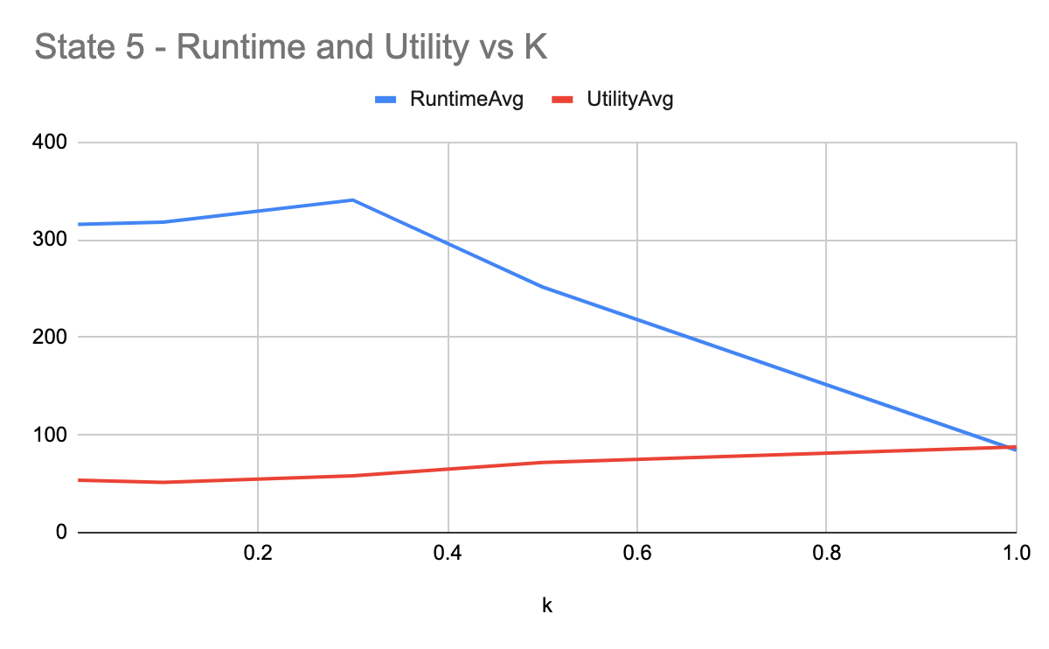
K

Slide 19
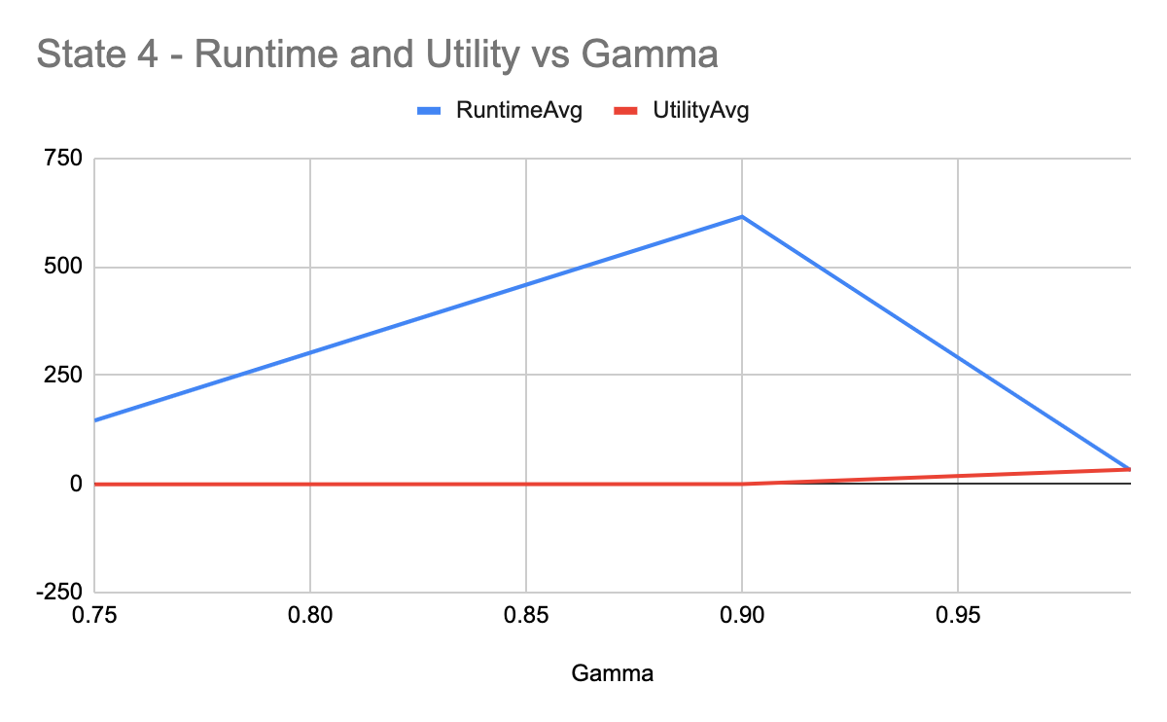
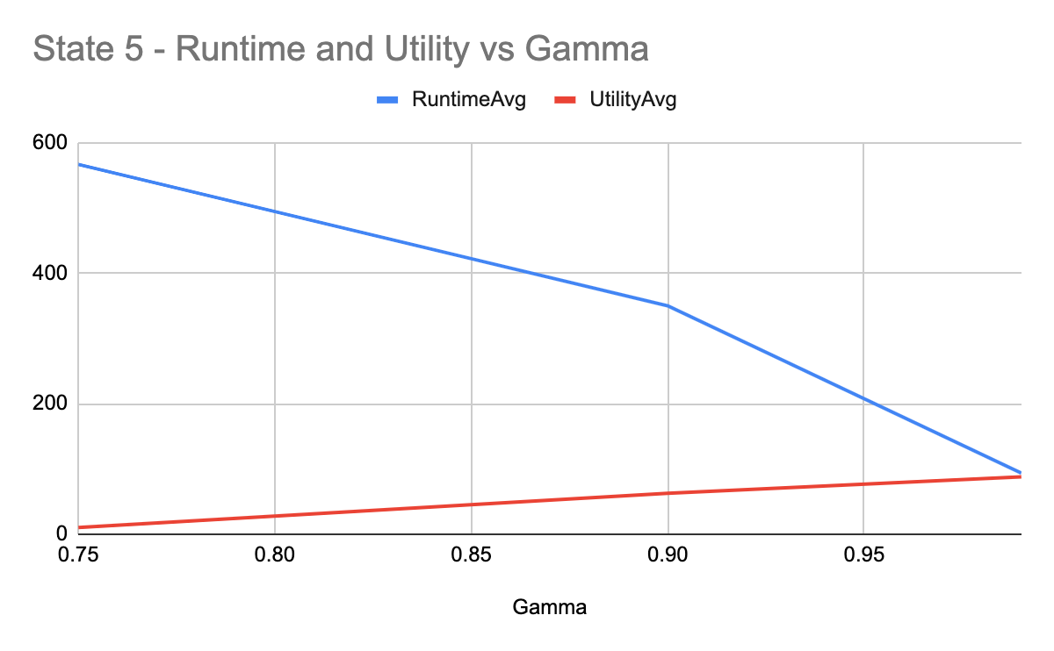
Gamma

Slide 20
Ideas for Further Improvements
Policy Filtering – resource factors
Optimization of random walk hyperparameters

