Slide 1

Final Project Medical Diagnostics Diabetic Retinopathy
Thangaraj, SSiva
CSCI E-89 Deep Learning, Spring 2020
Harvard University Extension School
Prof. Zoran B. Djordjević

Slide 2
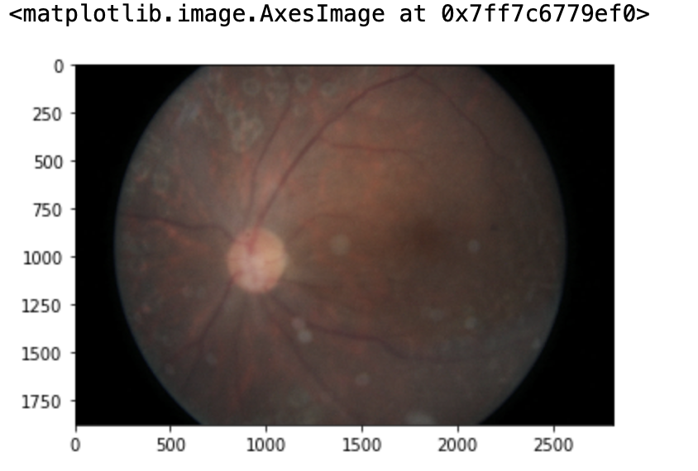
Introduction
Project scope is to analyze Diabetic Retinopathy, disease which causes blindness for Diabetes patients.
CNN
TensorFlow. KEras

Slide 3
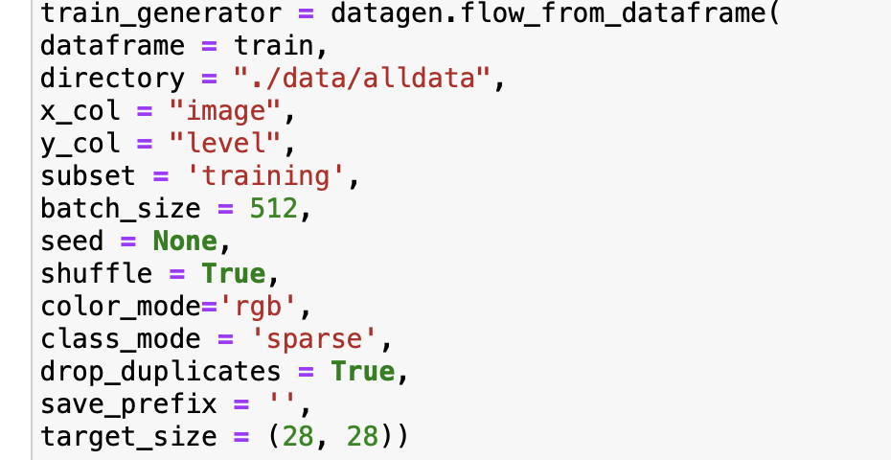
Steps
Starts Loading with input images to CNN Network
Applied filters to create a feature map.
Applied PReLU function to increase non-linearity and balance
Applied pooling layer to each feature map.
Finally, flattened the pooled images into one long vector.
Inputs the vector into a fully CNN to predict

Slide 4
YouTube URLs, Last Page
Two minute (short): https://youtu.be/ObIUpZ5_kmQ
15 minutes (long):

