Slide 1
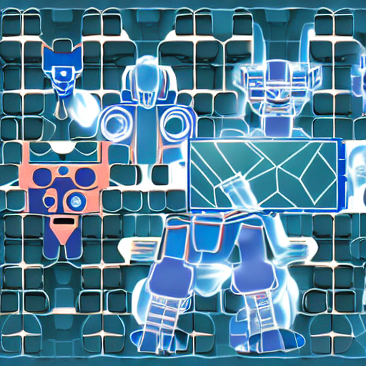
Transformers can be thought of as a new op which replaces recurrence andconvolution with attention mechanisms. A scaled dot-product attention unit,Extended via multi-head attention captures diverse relationships in parallel.

Slide 2
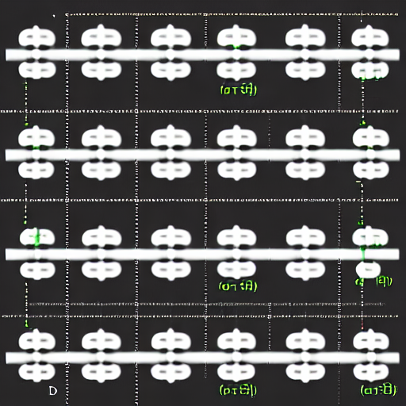
Positional EncodingTransformers apply self-attention in parallel across tokens. Without encoding any position information, the sequence a,b,c,d would produce identical attentionpatterns. Positional encodings remedy this by giving each token a unique position signal.

Slide 3
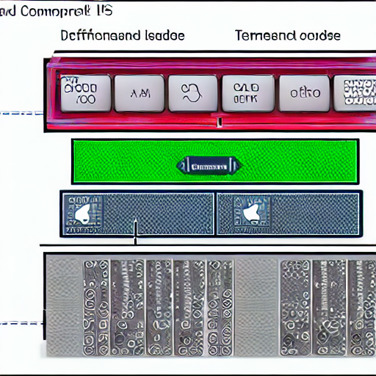
The Illustrated TransformerTransformers comprise of stacked encoder and decoder blocks. Queries, keys, and values all come from the same sequence. During decoding, an additional encoder–decoderattention layer lets the model align output tokens to encoded inputs.

Slide 4
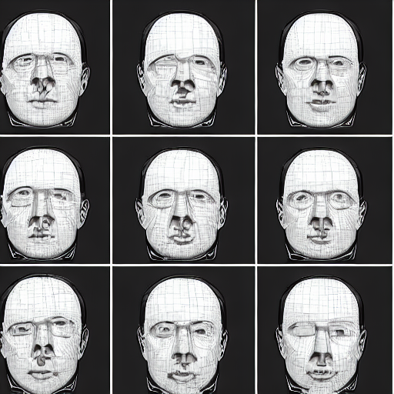
H parallel heads learn distinct projections. These are concatenated and linearly projected back to dimension dmodel. This enables the model to capture multiple types of relationships (e.g. syntactic vs. semantic) in parallel.

Slide 5
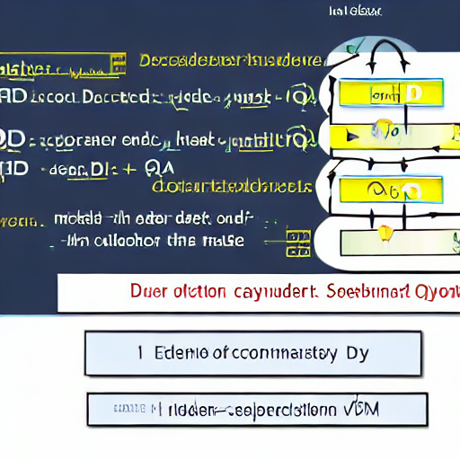
In each decoder layer, after masked self-attention, a second attention sublayer lets decoder queries attend to encoder outputs. Formally, if Qd comes from the decoder and Ke, Ve come from the encoder, then Attention(Qd, Ke,

