Slide 1

Assignment 2 – Do Bats Perceive Rats as Predators?
HIT140 Foundations of Data Science
Ishan Panta, Kritik Dahal, Deepjan Thapaliya, Manjil Sahani Chettri

Slide 2
Assignment & Dataset Description
1
2
3
Assignment Focus
Dataset 1: Bat Landings
Dataset 2: Rat Presence
Investigation A: Explore if bats perceive rats as predators by analyzing vigilance, risk-taking, and foraging success.
907 records: individual bat landings (latency, risk, reward, timing, habit).
2123 half-hour periods: rat presence, bat landings, food availability.

Slide 3
Data Cleaning Pipeline
Dataset 1: Bat Landings
Dataset 2: Rat Presence
Parsed Timestamps
Parsed Time to Datetime
Extracted `start_time`, `rat_period_start`, etc., into usable formats.
Converted all time-related entries to a consistent datetime object format.
Converted Numerics
Converted Numeric Fields
Transformed `latency` and `seconds_after_rat_arrival` to numerical types.
Ensured `rat_minutes`, `bat_landing_number`, and similar fields were numerical.
Recoded Binary Variables
Aggregated Duplicates
Standardized binary `risk` and `reward` indicators.
Consolidated any duplicate entries for half-hour periods to prevent redundancy.
Outlier Handling
Outlier Handling
Addressed and managed outliers in `bat_landing_to_food` to ensure data integrity.
Addressed and managed outliers in `rat_minutes` to ensure data integrity.
Generated Period Key
Generated Period Key
Created a unique 30-minute `period_time` key for alignment.
Created a unique 30-minute `period_time` key, matching Dataset 1.
Dataset Merging
Both datasets were successfully aligned and combined using the common period_time key, creating a unified dataset for further analysis.

Slide 4
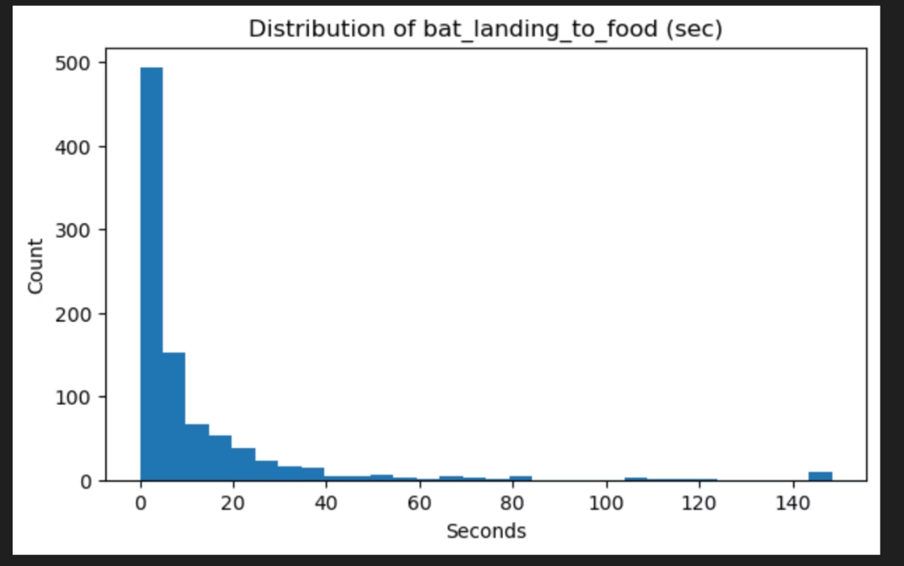
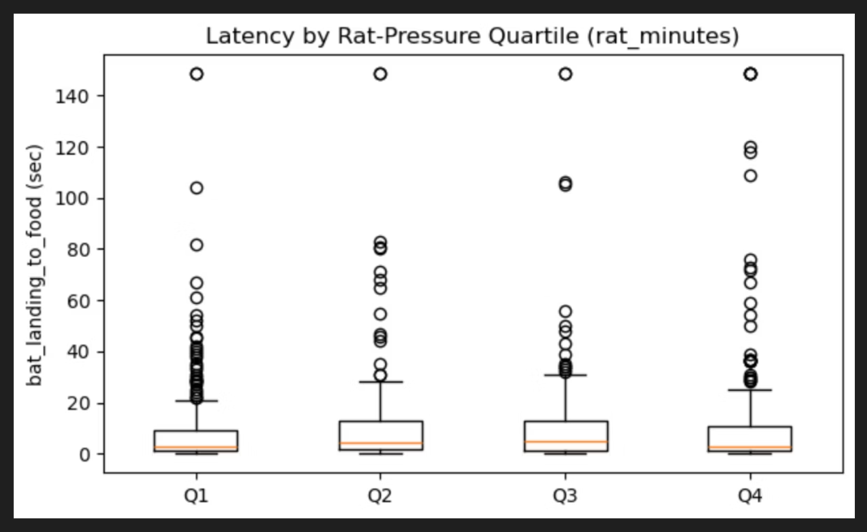
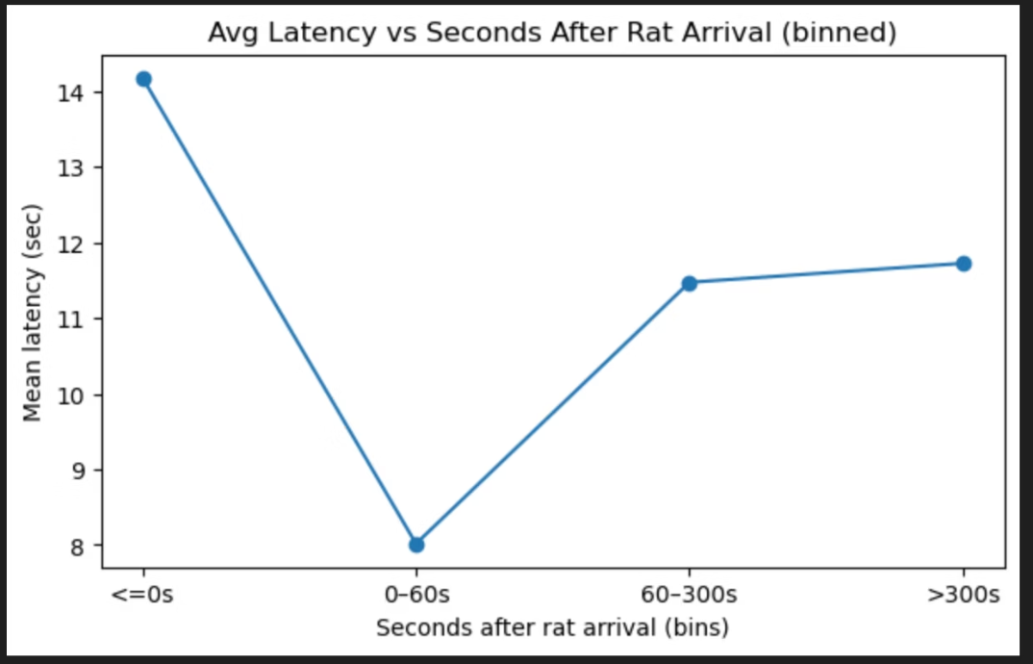
Hypothesis 1: Vigilance (Latency)
H1: Bats will hesitate longer (higher latency) with stronger rat presence.
Overall Latency Distribution (Histogram)
Latency by Rat-Pressure Quartiles (Boxplot)
Latency vs Rat Arrival Timing (Binned Line Plot)
Most bats land quickly, but a subset exhibits prolonged hesitation.
Latency medians remain stable, but data spread indicates greater variability under higher rat pressure.
Longest hesitation periods occur precisely when bats land simultaneously with rat arrivals.
Takeaway: Some evidence of increased vigilance in specific contexts.

Slide 5
Inferential Results: Hypothesis 1
Kruskal–Wallis Test
Mann–Whitney Test
Generalized Linear Model (GLM)
p = 0.27 (no significant difference across rat presence quartiles).
Q1 vs Q4: p = 0.81 (no significant effect between extreme rat presence conditions).
Rat pressure was not a significant predictor of bat latency.
Conclusion: Statistical tests reveal no reliable effect of rat presence on bat hesitation times.
Despite descriptive patterns suggesting variability, inferential analysis confirms that rat presence does not significantly alter vigilance as measured by latency.

Slide 6
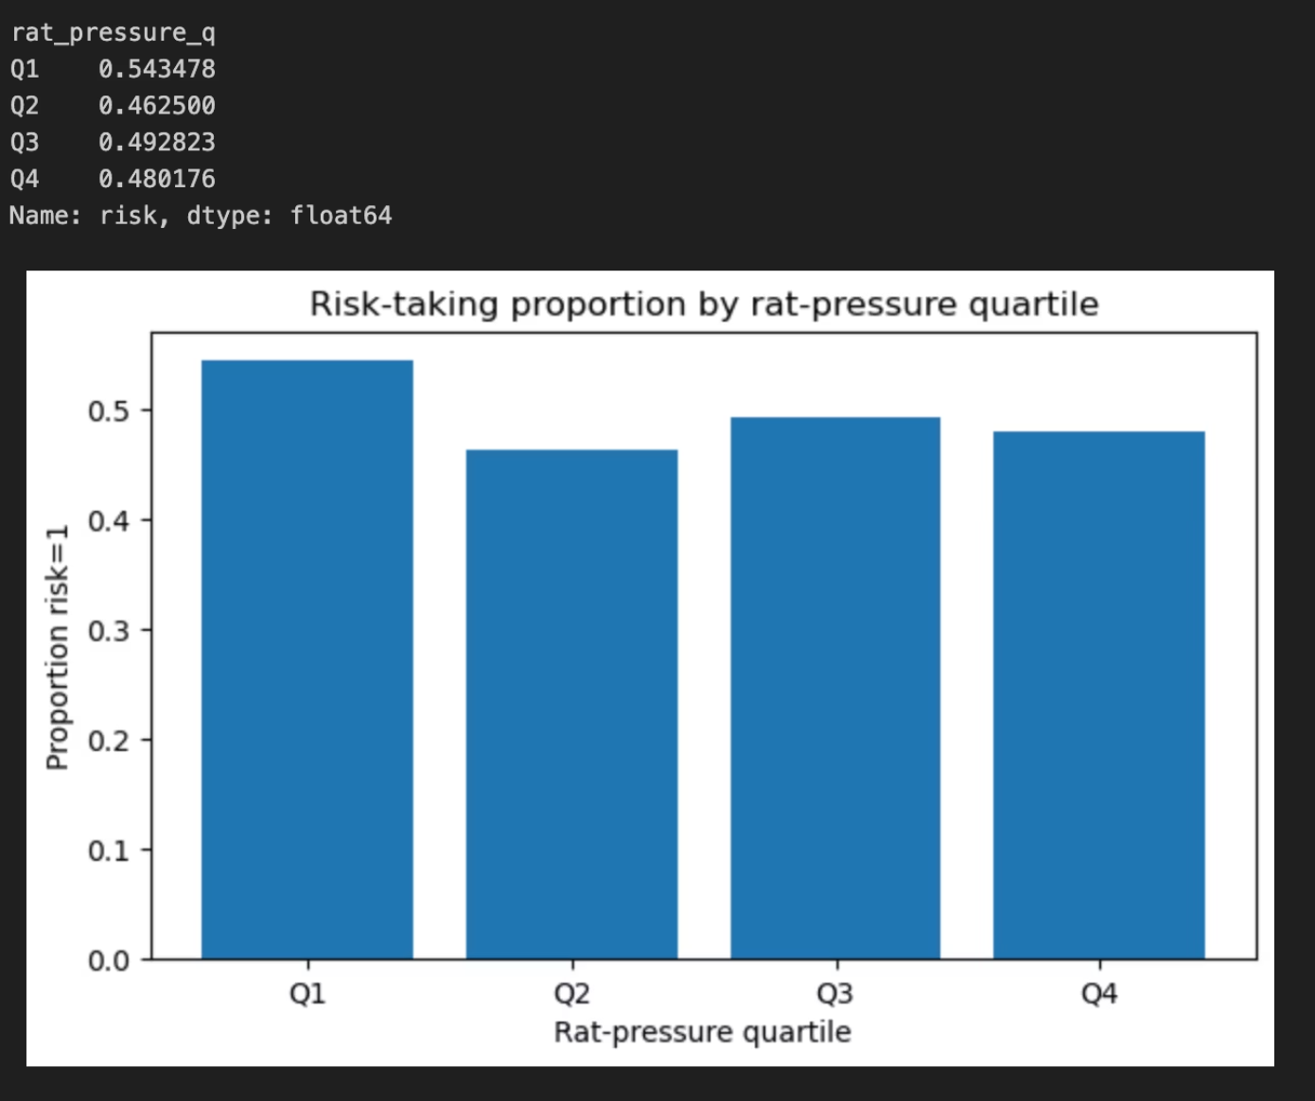

Hypothesis 2: Risk-taking
H2: Bats will take fewer risks under stronger rat presence.
Risk-Taking Proportions by Rat-Pressure Quartiles (Bar Chart)
Takeaway: A weak downward trend in risk-taking is observed with higher rat presence.
Risk-taking was defined by specific behavioral metrics captured during bat landings, such as foraging in more exposed areas or closer to potential threats.
The proportion of risk-taking behavior shows a slight decrease (from 54% to approximately 46–49%) as rat pressure increases from low to high levels.

Slide 7
Inferential Results: Hypothesis 2
Chi-squared Test
Logistic Regression
p = 0.34 (no significant difference in risk-taking across rat presence quartiles).
Rat pressure was not a significant predictor of bat risk-taking behavior.
Conclusion: No statistical relationship found between rat pressure and risk-taking.
Despite a modest descriptive decline in risk-taking under increased rat presence, the inferential analyses do not support a statistically significant link.

Slide 8
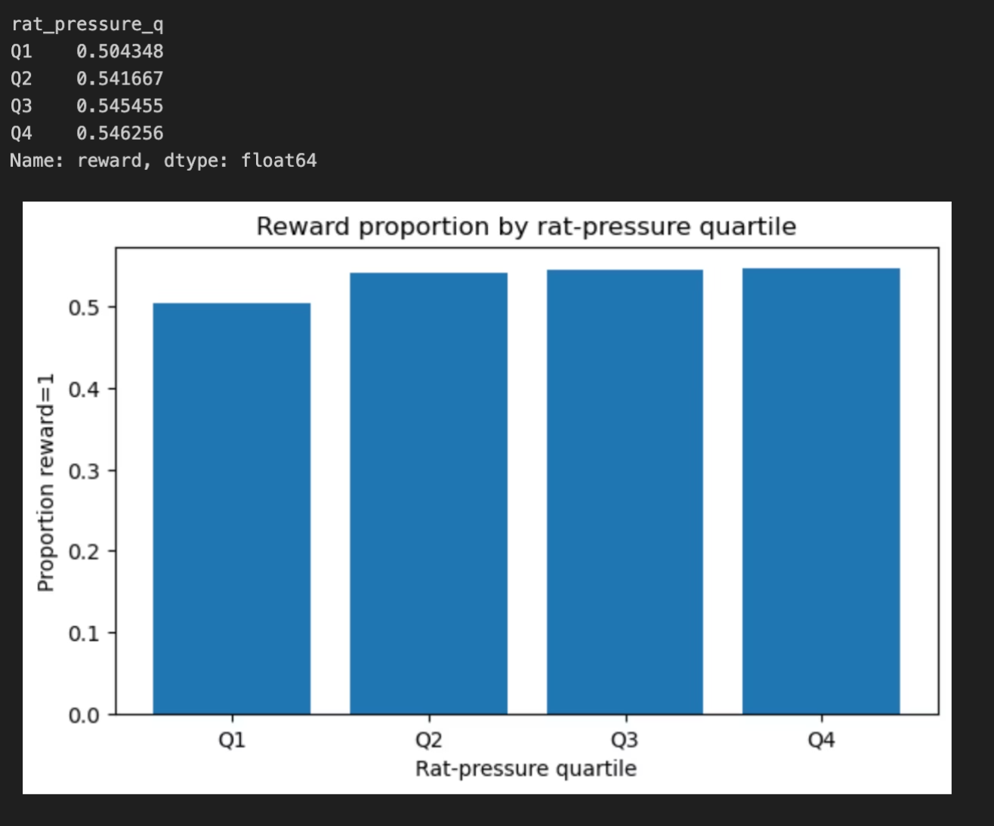
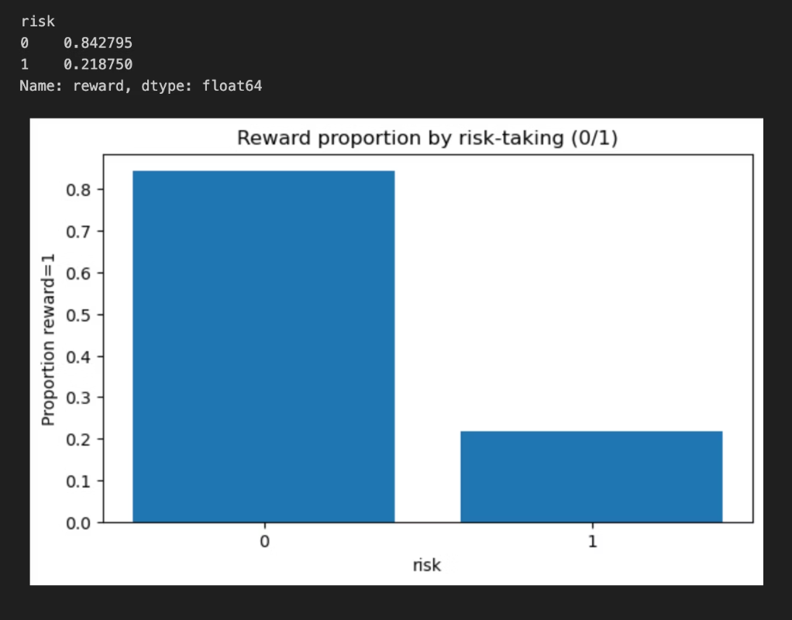
Hypothesis 3: Reward (Foraging Success)
H3: Reward rates decrease under stronger rat presence.
Reward Proportions by Rat-Pressure Quartiles (Bar Chart)
Reward Proportions by Risk Behaviour (Bar Chart)
Bats that employed risk-avoidance strategies achieved significantly higher foraging success (~84%) compared to risk-takers (~22%).
Reward rates remained stable at approximately 50–55% across all quartiles of rat pressure, indicating no observable effect of rats on overall foraging success.
Takeaway: Foraging success primarily depends on the bat's individual risk-taking behavior, not the presence of rats.

Slide 9
Inferential Results: Hypothesis 3
Chi-squared (Reward × Quartiles)
Chi-squared (Reward × Risk Behavior)
p = 0.77 (no significant effect of rat presence on reward rates).
p < 0.001 (very strong statistical effect of risk behavior on reward).
Conclusion: Foraging success is driven by bat behavior (risk vs. avoidance), not rat presence.
Statistical tests unequivocally demonstrate that a bat's approach to risk is the primary determinant of its foraging success, independent of rat activity.

Slide 10
Overall Conclusion
Descriptive vs. Inferential
Key Determinant of Outcome
Descriptive analysis hinted at weak patterns across all three hypotheses, but rigorous inferential testing found no statistical evidence that rat presence significantly alters bat vigilance, risk-taking, or foraging success.
Instead of external rat presence, the most influential factor predicting a bat’s outcome is its own behavior, particularly its propensity for risk-taking.
Final Answer: In this dataset, rats appear to act more as competitors for resources than as perceived predators for bats.

Slide 11

Thank You!!!

