Slide 1
Website Design for CODE4KIDS project
This is a raw design i.e. the design implementation of the first idea that struck into my mind after reading the write up and specification sheet.
This is the website design and not the app design.
Most of the elements are created according to material design and compatibility with mobile devices has been preserved.

Slide 2
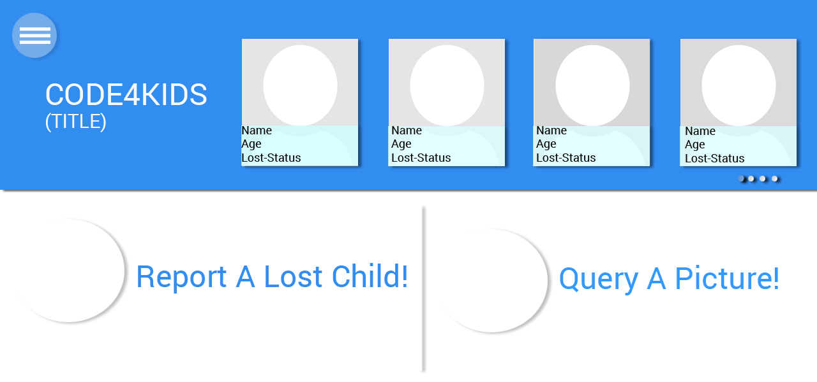
//Images of Lost Children Reported in horizontal scrolling fashion.
//Section contains the two basic components i.e Reporting and querying a picture

Slide 3
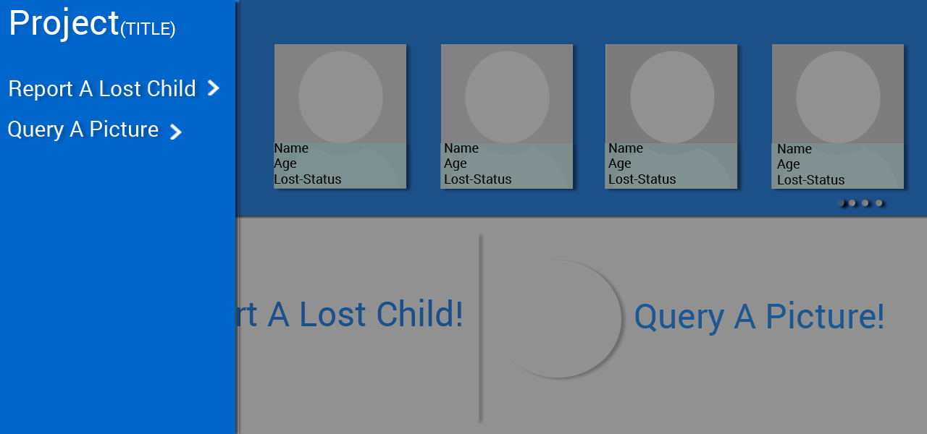
//next page
//Other Direct Links

Slide 4
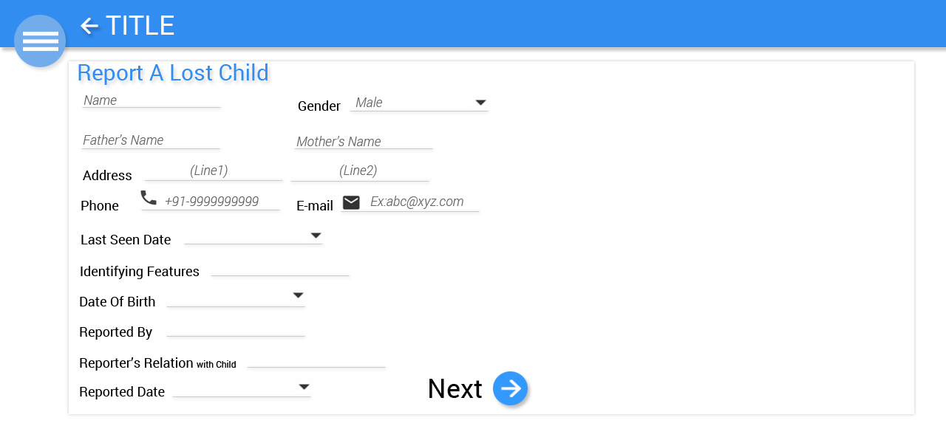

Slide 5
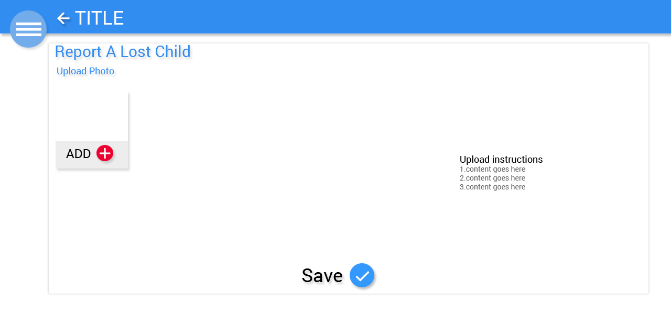

Slide 6
