Slide 1

TELECOM ANALYTICS · 2026
Predictive Customer
Attrition Engine
Strategic Risk Segmentation & Proactive Retention Workflows
via Cost-Sensitive Machine Learning

Slide 2


PROBLEM STATEMENT & PROJECT ABSTRACT
The Business
Challenge
The Technical
Scope
The Imbalance
Problem
Customer acquisition costs in telecom are 5× higher than retention values. Waiting for historical churn data leaves zero room for proactive defense.
End-to-end data pipeline parsing 7,043 historical IBM subscriber portfolios across 20 distinct account features.
Standard ML models optimize for raw accuracy, ignoring minority churners. We implemented Balanced Subsampling Constraints for high churn sensitivity.

Slide 3
END-TO-END PIPELINE METHODOLOGY
01
02
03
Data Cleaning
Vectorization
Stratification
Isolated and resolved empty text strings within TotalCharges continuous billing logs using target feature median imputation.
Transformed categorical string variables into structured binary indicators using one-hot encoding schemas.
Implemented a stratified 80/20 validation train-test split to strictly preserve churn event distributions across evaluation metrics.

Slide 4
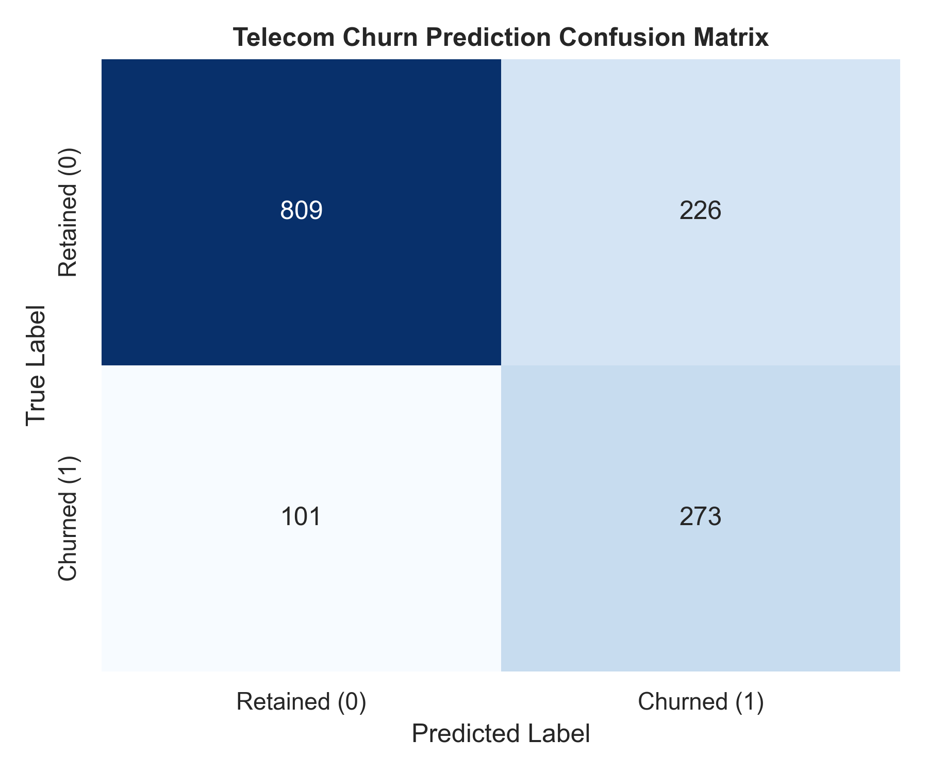

PREDICTIVE MODEL DIAGNOSTICS
Confusion Matrix
76.79%
Overall Accuracy
73.00%
Churn Recall Rate (Class 1)
274
True Departures Identified
73% of flight risks caught before cancellation — preserving core enterprise revenue.

Slide 5
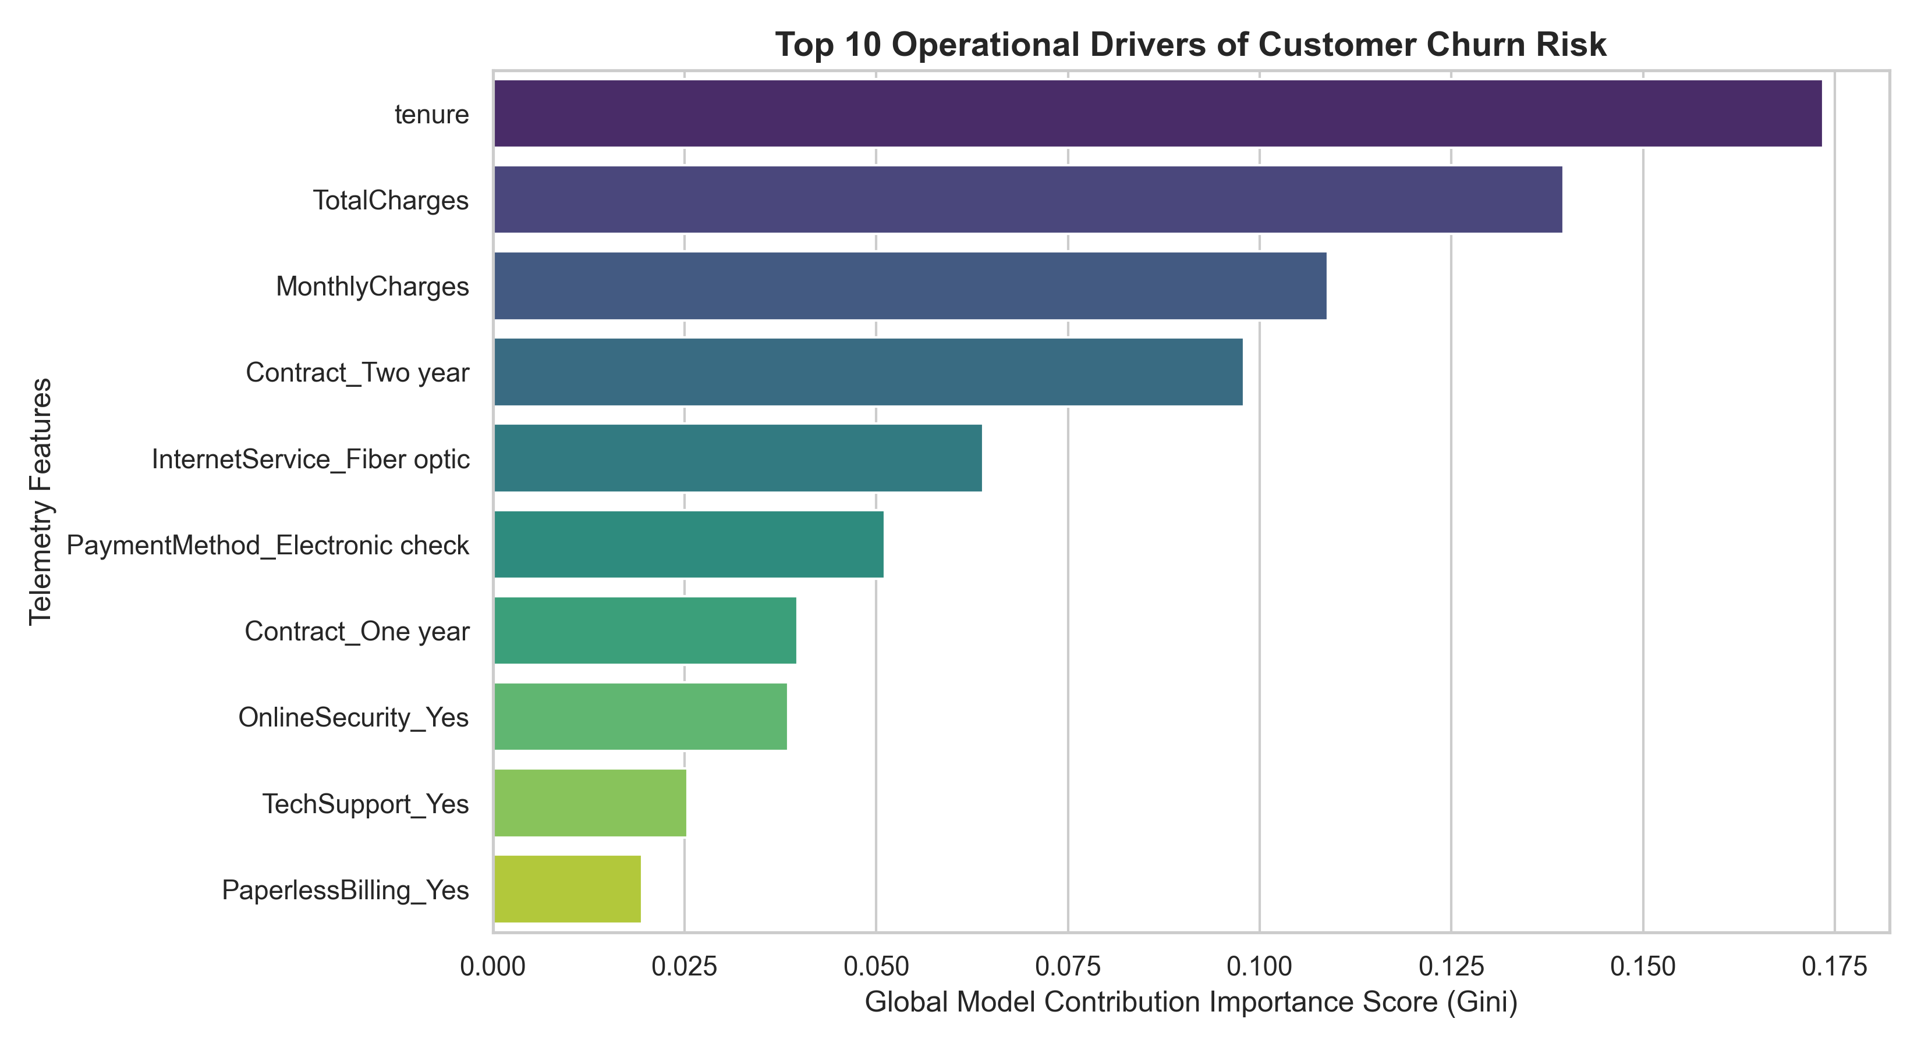
EXPLAINABLE AI — TOP CHURN DRIVERS
Month-to-Month Contracts
Absolute highest Gini importance. Removes exit friction, accelerating subscriber volatility.
Missing Digital Add-ons
No Online Security or Tech Support strongly correlates with elevated churn probability.
Price Shock
High MonthlyCharges act as the primary financial attrition trigger in early-tenure accounts.

Slide 6


ACTIONABLE CUSTOMER SEGMENTATION MAPPINGS
Our probability routing engine parsed the active testing ledger into concrete operational portfolios:
Loyal
549 accounts
High tenure, low-probability secure customer assets.
At-Risk ⚠
387 accounts
Churn probability ≥60%. High-priority targets for marketing interventions.
Standard
377 accounts
Stable customers running within typical lifecycle cycles.
Dormant
96 accounts
Low active usage with early life-cycle tenure states.

Slide 7



FINAL STRATEGIC RECOMMENDATIONS
Contract Optimization
Launch an automated campaign offering a 5% bill credit to the 387 At-Risk month-to-month accounts who transition to a secure 1-year agreement.
Friction Reduction
Bundle complimentary digital safety add-ons (Online Security / Tech Support trials) into high-tier billing brackets to build long-term account value.
Proactive CRM Alerts
Plug the generated customer_segments_manifest.csv into your CRM to trigger loyalty interventions the moment an account's probability score crosses the 60% threshold.
Ready to Deploy · Model Accuracy: 76.79% · Churn Recall: 73.00%

