Slide 1

MediManage with Medical Assistance
Ishan Rane: 23107116
Rushikesh Naik:23107084
Manish Khadtar:23107117
Sneha Raut:23107138
Project Guide
Ms. Aishwarya Londhe

Slide 2
Contents
Introduction
Objectives
Scope
Features / Functionality
Project Outcomes
Technology Stack
Block Diagram

Slide 3
1. Introduction
This project aims to develop a Medical Assistance and Health Management System that simplifies access to medical services by integrating features like doctor booking, e-pharmacy, emergency assistance, and medical records into a unified platform.
Problem Identified :
Patients often face difficulties in finding reliable doctors, accessing emergency care, managing prescriptions, and storing medical records. Fragmented services lead to confusion, delays, and potential health risks.
Solution Proposed :
A centralized digital platform will offer streamlined healthcare services, enabling users to book consultations, order medicines, access emergency help, and manage their health records efficiently and securely.

Slide 4
2. Objectives
To provide a centralized platform for streamlined access to medical services such as doctor bookings, pharmacy orders, and emergency assistance.
To enhance communication and transparency between patients and healthcare providers through real-time updates and notifications.
To ensure a secure and accessible system by offering a user-friendly interface with encrypted medical data handling.
To improve healthcare management efficiency by integrating digital solutions for patient history, prescription tracking, and health monitoring

Slide 5
3. Scope
Suitable for clinics, hospitals, and healthcare providers of all scales.
Can be used for doctor appointment bookings, pharmacy orders, and emergency services.
Enables real-time health updates and notifications for patients and staff.
Provides a digital platform for efficient healthcare service delivery and patient interaction.
Enhances patient-caregiver communication and promotes transparency in medical management

Slide 6
4. Feature / Functionality
Role-Based Access System Separate dashboards and permissions for Admin, Doctor, Pharmacist, and Patient, ensuring smooth workflow and data privacy.
Appointment Booking & Management Patients can schedule appointments with doctors, while doctors can view, approve, or reject them based on availability.
Integrated Online Pharmacy Patients can upload prescriptions and order medicines online, with pharmacists managing order fulfillment.
Emergency Assistance Module A quick-access SOS feature alerts nearby hospitals or emergency contacts in critical situations.

Slide 7
5. Outcome of Project
Users can seamlessly access real-time medical updates, appointments, and pharmacy services.
Patients can easily book appointments and raise health concerns, while doctors and pharmacists respond efficiently.
Ensures secure and verified user management through role-based access and authentication.
Enhances transparency and accountability by logging all actions including bookings, prescriptions, and emergency requests.

Slide 8
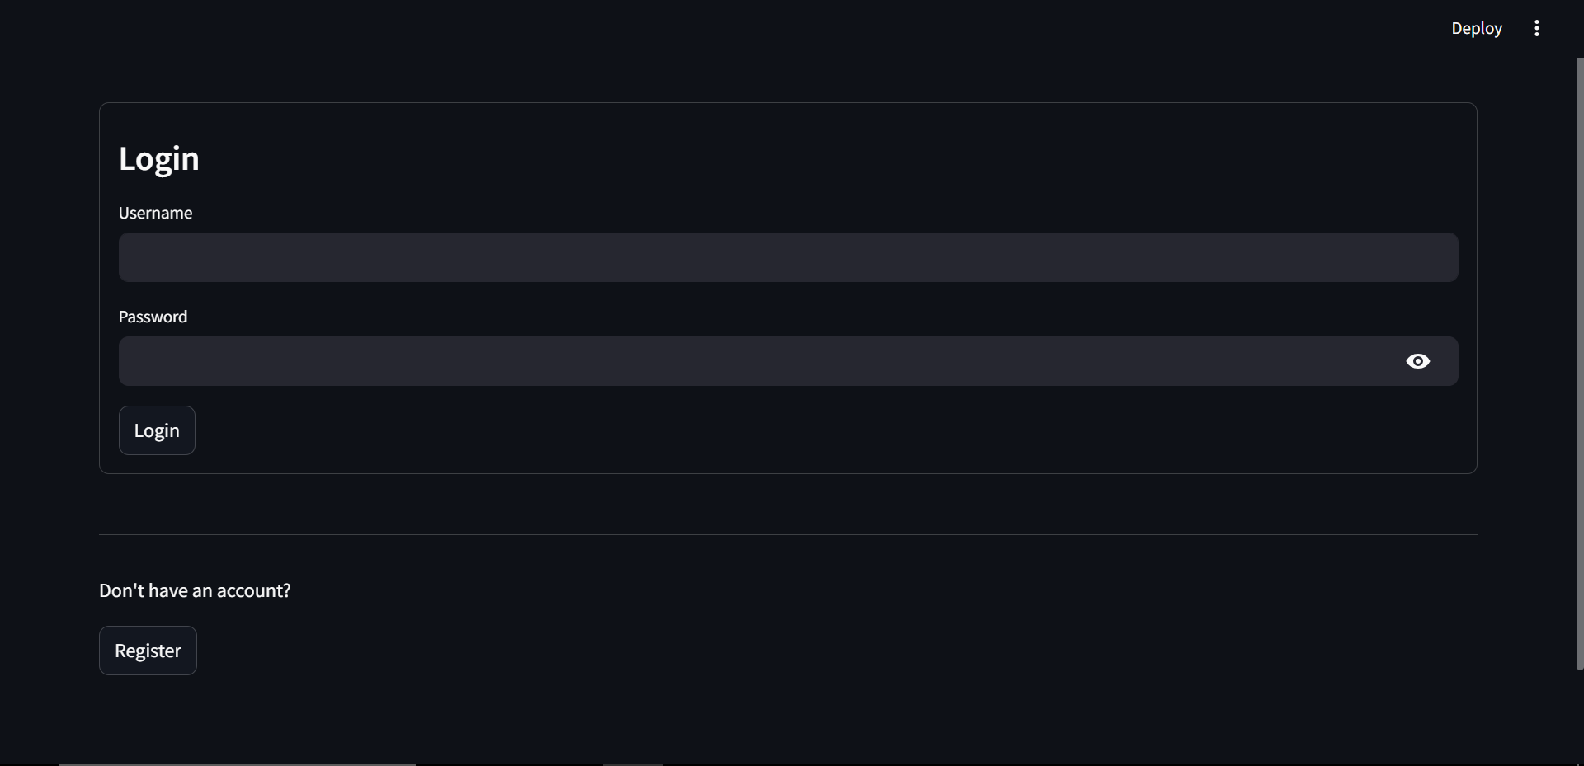
- Login page

Slide 9
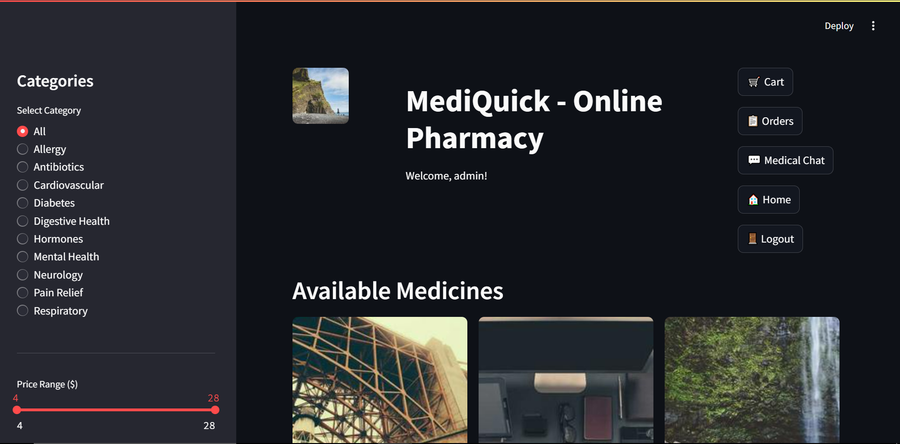
- Base page

Slide 10
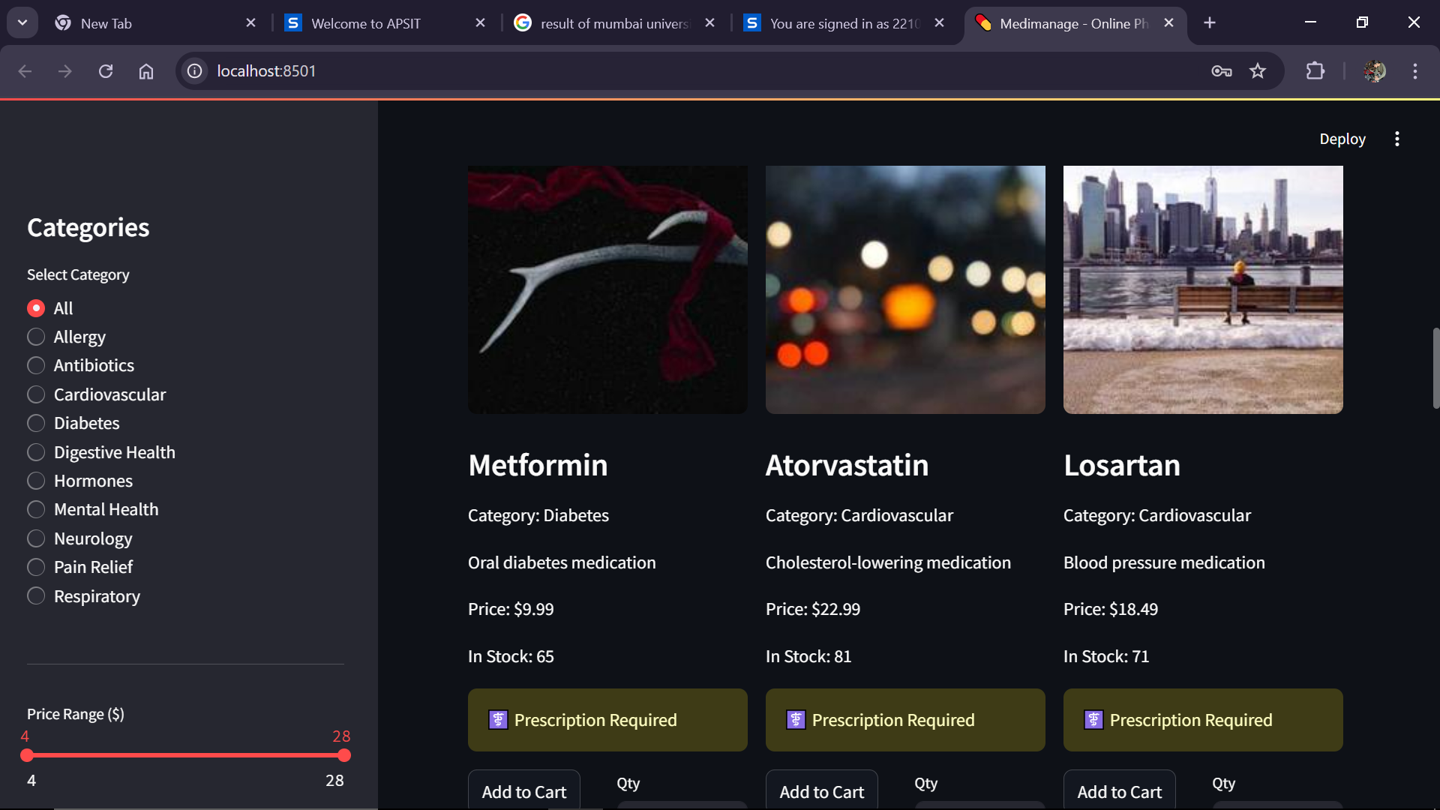
-User ineterface

Slide 11
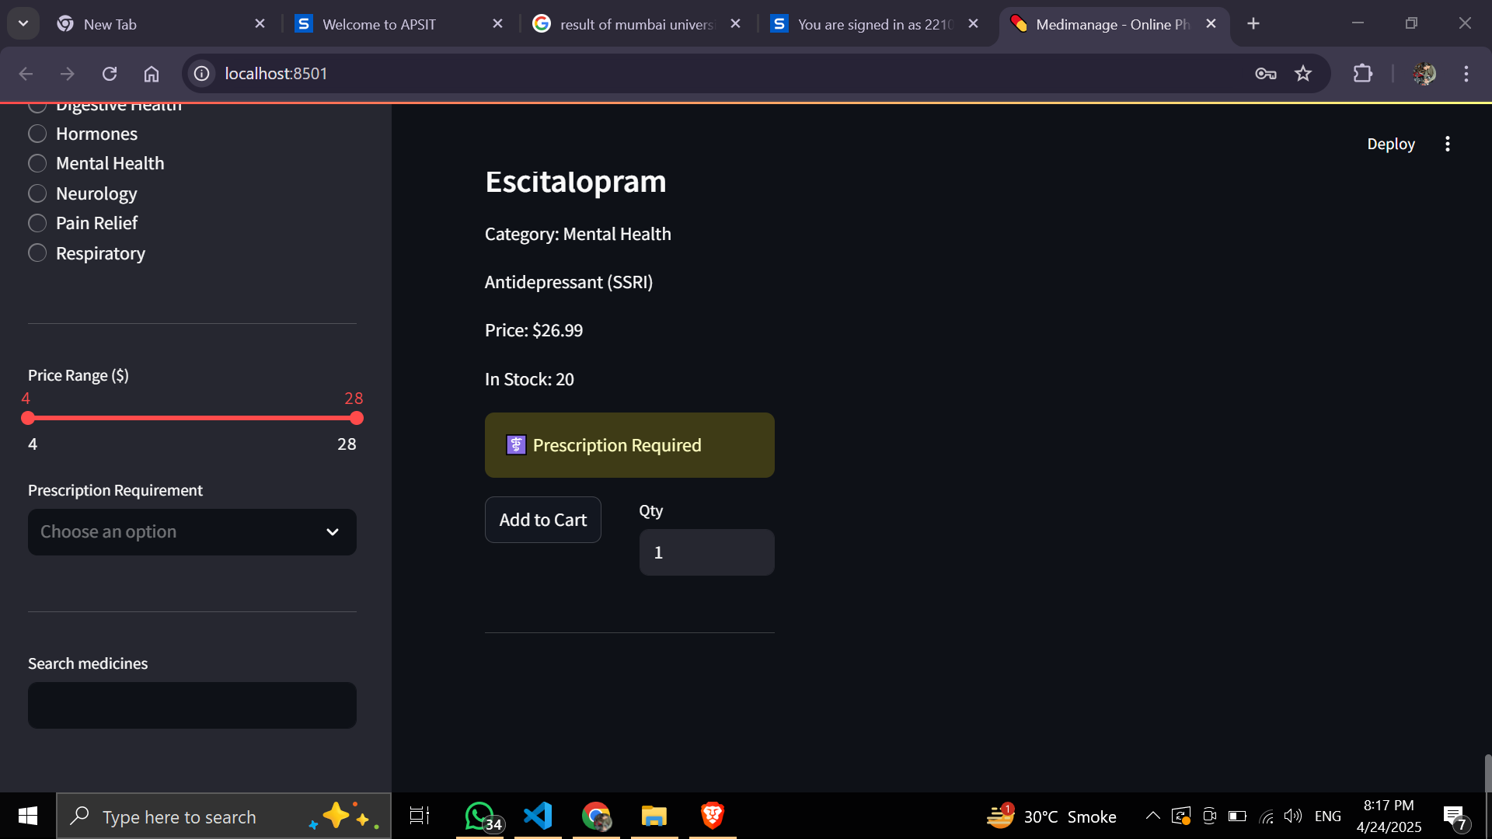
- Prescription

Slide 12
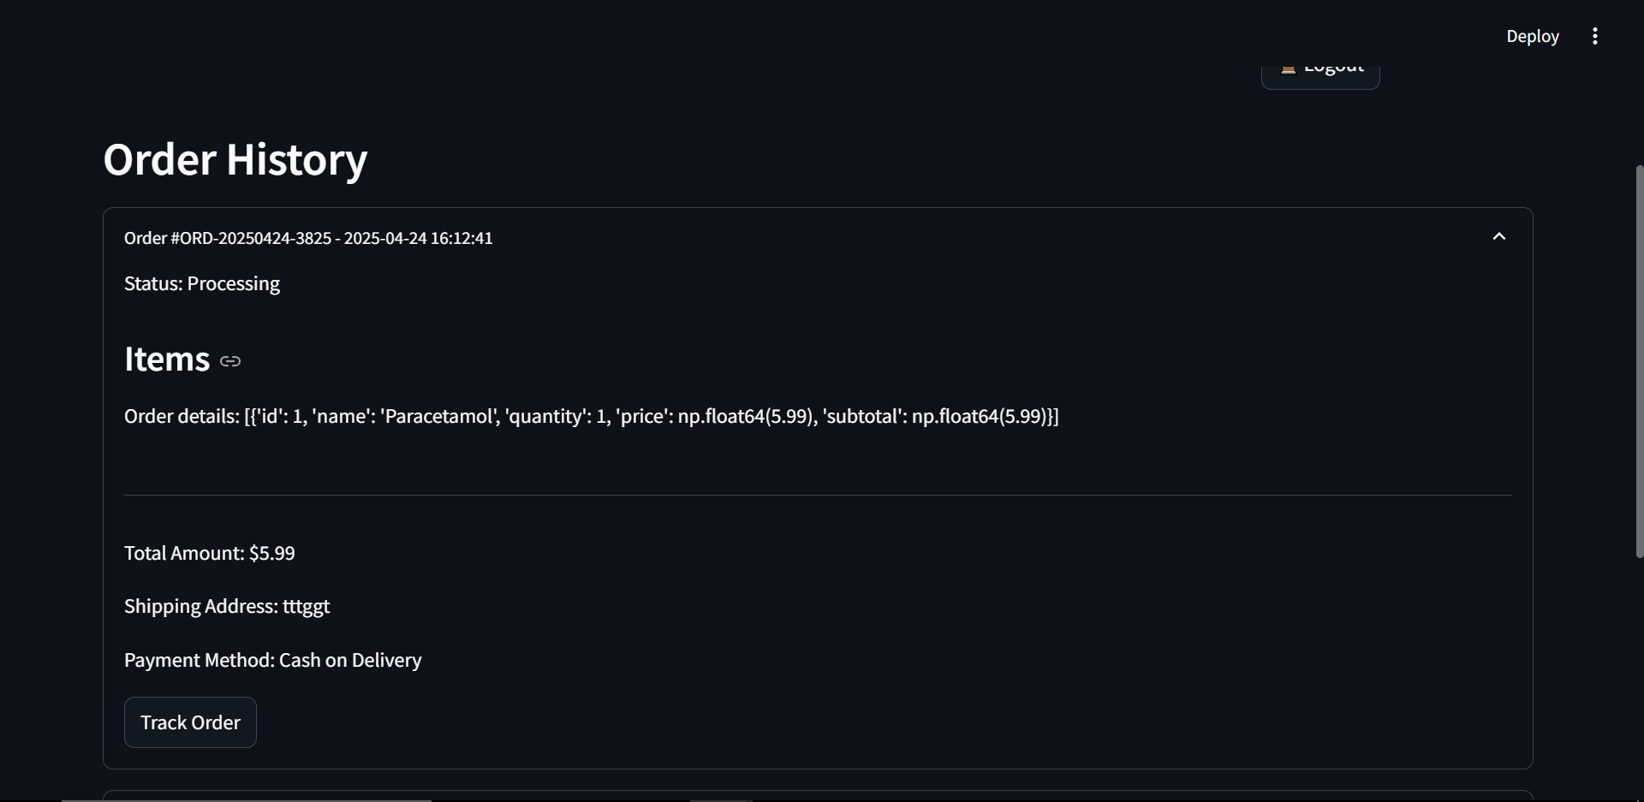
-Order history

Slide 13
6. Technology Stack
Frontend (UI): : Streamlit, Gemeni Flash 1.55 & Python
Database (Data Storage): Excel .

Slide 14
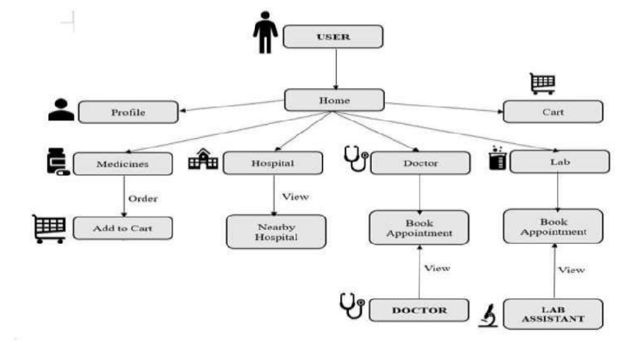
7. Block Diagram

Slide 15
References
1 Evaluation of Patient and Doctor Perception Towards the Use of Telemedicine in Apollo Tele
Health Service, Journal of Telemedicine and Telecare, 22(8), 498–504, 2016, by Rajesh V.
2 Safety Concerns with a Consumer: A Scoping Review, Journal of Medical Internet Research, 21(10), e13634, 2019, by Coiera E.
3 Pharmacy Management Software, International Journal of Computer Applications, 181(40), 27–31, 2021, by Mali M., Alibade S., Parbhane R., Awade A., and Yadav A.

Slide 16
Thank You...!!

