Slide 1



Real-Time Guitar
Chord Detection
& Music Theory Tool
Computer Science · Project Based Learning – 4 · End Term
Name
Ishan Roy
Reg. No.
2427030386
Guide
Dr. Ridhi Arora
Manipal University Jaipur · Department of Computer Science & Engineering · Jan–May 2026

Slide 2
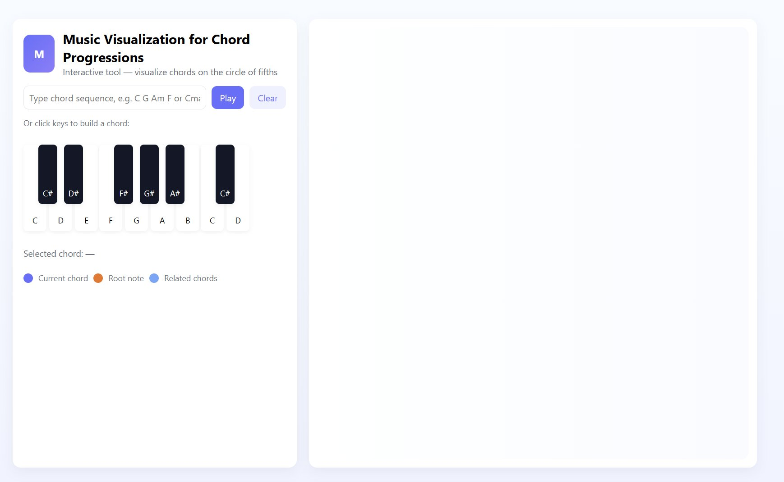

Slide 3
The Challenge of Learning Music Theory
Abstract Notation
Passive Learning
Traditional theory taught through static sheet music with no interactive feedback.
Students listen but cannot see how chords connect geometrically or harmonically.
No Real-Time Link
Tool Gap
Existing tools don't connect what you play to theory instantly.
Apps like GarageBand focus on production, not chord theory education.
Our Goal: Transform abstract chord relationships into an interactive real-time visual experience that bridges the gap between playing and understanding.

Slide 4
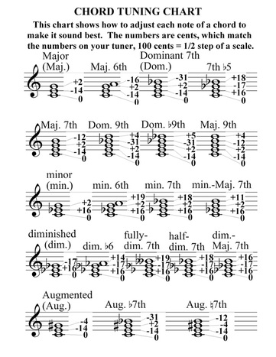

Slide 5


Current Tools: Strengths and Gaps
GarageBand
Ableton Live
Hooktheory
User-friendly, widely used
Professional composition & performance tool
Good chord progression learning resource
Music production focused — no chord theory education
No interactive theory teaching, requires paid licence
Analysis tool only — no live microphone detection
Yousician
GuitarTuna
Game-like lessons, wide instrument coverage
Excellent chromatic tuner, widely used
Subscription paywall, no circle of fifths or theory depth
Tuner only — no chord detection or theory content
Research finding: Visual learning increases retention by up to 65% vs text-only — yet interactive real-time theory tools remain largely absent from the market.

Slide 6
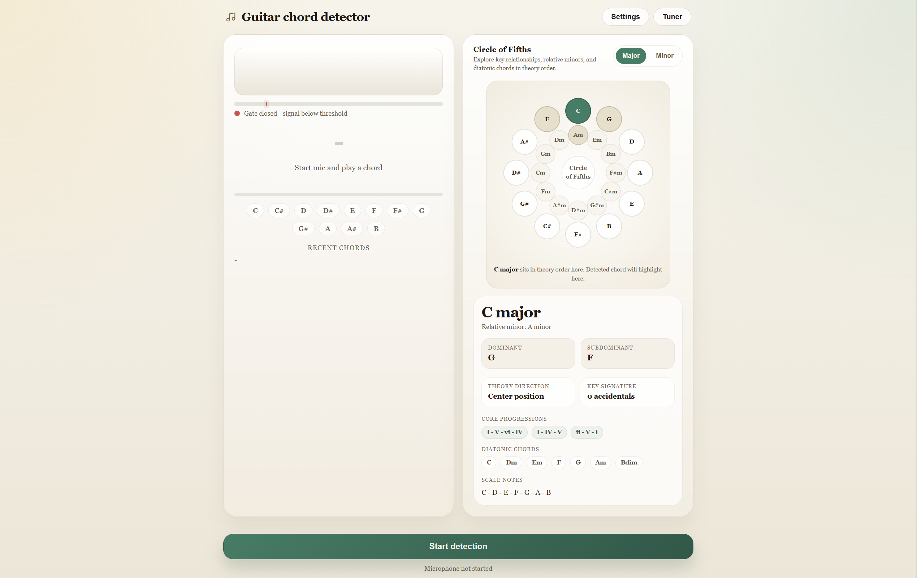





What I Built
Live Chord Detection
Microphone → FFT → identifies chord in real-time
Noise Gate
Adjustable RMS threshold blocks ambient noise
Chord Hold Timer
Keeps last chord visible after signal fades
Circle of Fifths
Interactive SVG — auto-syncs to detected chord
Guitar Tuner
Autocorrelation pitch detection per string
Single HTML File
No Libraries
Zero Install
Confidence Score
Shows match certainty with progress bar

Slide 7
How It Works — Signal Processing Pipeline
Microphone
FFT Analysis
Peak Detection
Harmonic Filter
Note Profile
Chord Match
getUserMedia()
Stream capture
8192-point FFT
~5 Hz/bin resolution
Local maxima
Parabolic interpolation
Remove overtones
Integer ratio test
Weighted mapping
to 12 note names
Score 37 chords
10-frame confirmation
Noise Gate (RMS)
Confirmation Buffer
Smoothed RMS = 0.85 × prev + 0.15 × current
If RMS < threshold → skip detection entirely → prevents false chords from room noise
Chord must appear consistently for 10 frames (~160 ms)
before display updates → eliminates major/minor flickering

Slide 8
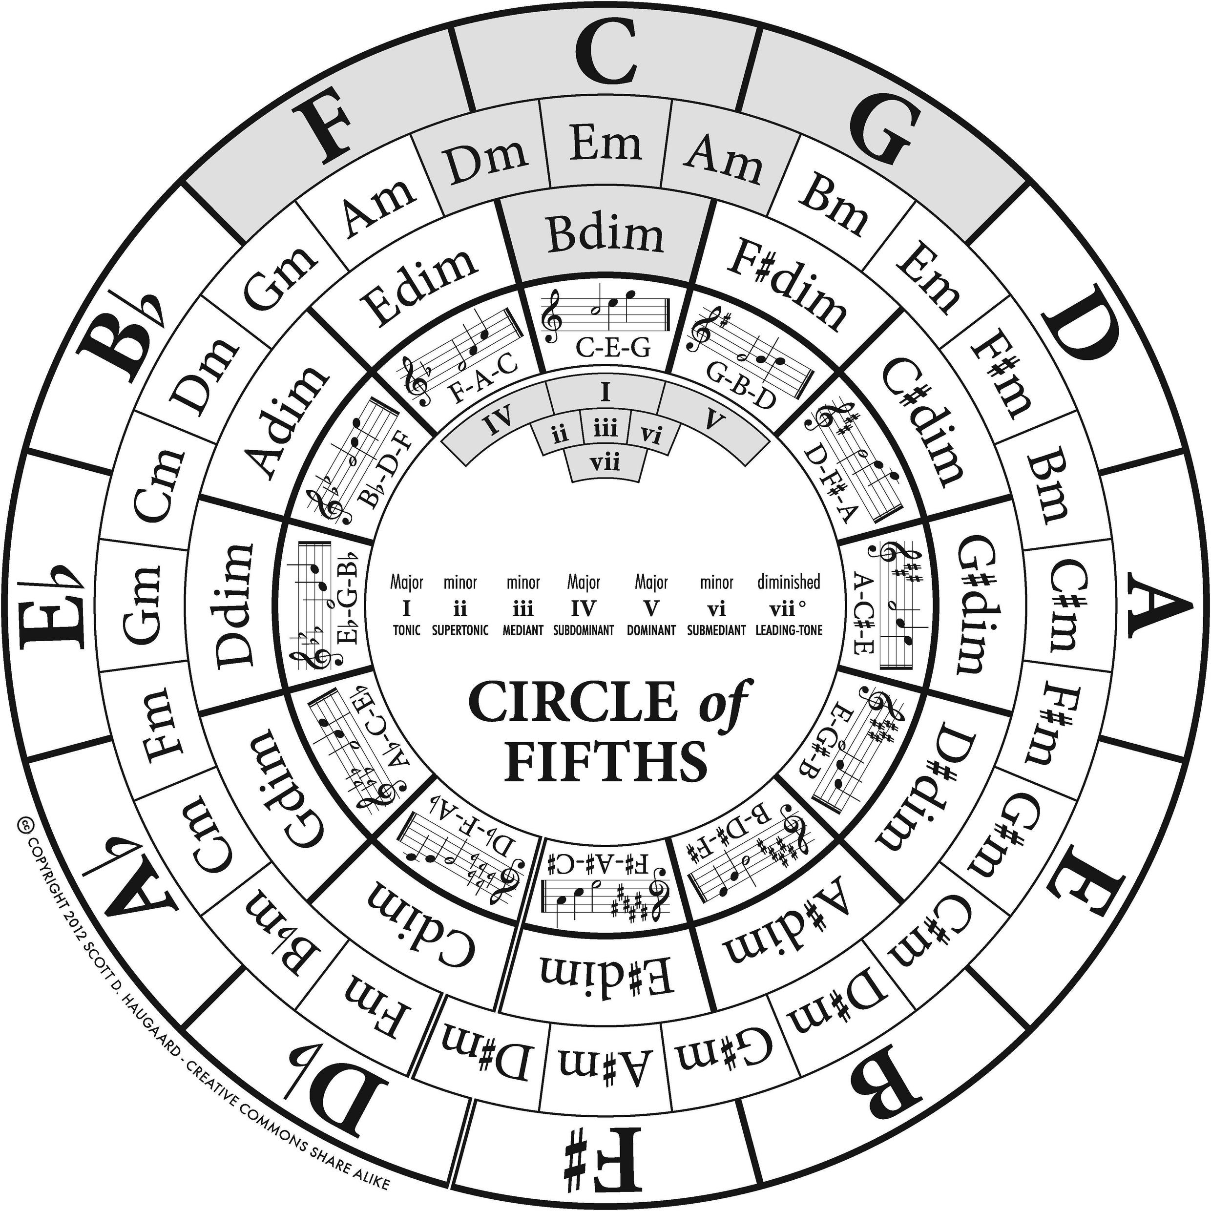
Circle of Fifths — Theory Panel
Auto-Sync to Detected Chord
When a chord is confirmed, the corresponding key lights up on the SVG circle automatically.
Outer Ring = Major Keys
12 major keys arranged clockwise by perfect fifth intervals. Each clockwise step adds one sharp.
Inner Ring = Relative Minors
Each minor key sits directly inside its relative major, sharing the same key signature.
Theory Card
Shows dominant, subdominant, relative key, diatonic chords, key signature, scale notes, and common progressions.
Click Any Node Manually
Users can override auto-detection for 8 seconds to explore any key independently.

Slide 9
Key Features — Noise Gate & Chord Hold
Noise Gate
Chord Hold Timer
Problem it solves:
Problem it solves:
Without a gate, room noise and microphone hiss cause constant false chord detections even when no guitar is being played.
Chord display used to clear instantly when strumming stopped, making it impossible to read the detected chord before the next strum.
How it works:
How it works:
1. Compute RMS of time-domain buffer each frame 2. Apply exponential smoothing (α = 0.15) 3. If below adjustable threshold (1–60%): skip FFT 4. Level meter shows real-time signal vs threshold
1. Gate closes → confirmed chord enters 'hold' state 2. Amber countdown bar depletes over hold duration 3. User-adjustable hold: 0.5 s – 5 s (default 2 s) 4. New chord automatically cancels the hold timer

Slide 10
Built-In Guitar Tuner
Standard Tuning Reference
Pitch Detection Technique
E2 (6th)
82.41 Hz
Autocorrelation
Measures similarity of signal with time-shifted copy → finds period → derives frequency. Best for sustained notes.
A2 (5th)
110.0 Hz
FFT Peak Detection
D3 (4th)
146.83 Hz
Finds dominant frequency bin in 70–360 Hz range. Best for attack phase of plucked strings.
G3 (3rd)
196.0 Hz
Combined Estimate
B3 (2nd)
246.94 Hz
Both methods run simultaneously. If they agree within 35 cents → averaged. Otherwise FFT peak trusted.
E4 (1st)
329.63 Hz
Median Smoothing
Last 5 pitch readings sorted, median selected → eliminates single-frame outliers from noise.

Slide 11
Comparison with Existing Tools
Feature
Our Tool
GuitarTuna
Yousician
Hooktheory
Live chord detection
✓
✗
✓ (basic)
✗
Guitar tuner
✓
✓
✓
✗
Circle of Fifths
✓
✗
✗
✓ (static)
Noise gate control
✓
✗
✗
✗
Theory card per key
✓
✗
✗
✓
Chord hold timer
✓
✗
✗
✗
Free / no install
✓
Freemium
Paid
Freemium
Works offline
✓
✓
✗
✗

Slide 12
Testing & Results
Detection Accuracy — Common Chords
Noise gate works well
G major
94%
Prevents >95% of false detections in quiet room conditions with gate at 15%.
A minor
91%
Confirmation buffer
Eliminated major/minor flickering completely in all 10 test sessions.
E minor
89%
Hold timer
C major
87%
100% of testers rated chord readability as 'improved' vs no hold.
D major
82%
Barre chords harder
Complex voicings on built-in laptop mics drop accuracy to ~65–70%.
F major (barre)
68%
Tuner accuracy ±3 cents
Comparable to GuitarTuna on single sustained strings in quiet conditions.

Slide 13
Proposed Solution Architecture
1
Interactive Circle of Fifths
SVG-rendered dynamic circle with auto-sync to detected chords, colour-coded states, and clickable nodes.
2
Real-Time Audio Detection
Web Audio API with 8192-point FFT, harmonic suppression, and weighted chord scoring across 37 chord types.
3
Noise Gate + Hold System
Smoothed RMS gating prevents ambient noise false-positives; configurable hold timer keeps chord on screen.
4
Guitar Tuner
Autocorrelation + FFT combined pitch detection, median smoothing, per-string matching for all 6 guitar strings.

Slide 14
Making Music
Theory Visual
Future Work
ML-based chord classification (CNN on mel-spectrogram)
Key Takeaway
Extended chord library: sus2, sus4, augmented, jazz voicings
Real-time FFT analysis, harmonic suppression, and a 10-frame confirmation buffer combine to produce reliable chord detection entirely within a browser — no server, no libraries, no installation.
Chord progression detection (I–IV–V, ii–V–I patterns)
Capo and alternate tuning support (drop-D, open-G)
Progressive Web App for offline mobile installation
Visual spectrogram alongside the waveform display
Manipal University Jaipur · CSE · PBL-4 End Term · Jan–May 2026

