Slide 1
Designing HPC job schedulers using Reinforcement Learning
Ishan Sharma (18CS30020)
Supervised by: Professor Soumyajit Dey
Mentored by: Mr. Anirban Ghose

Slide 2
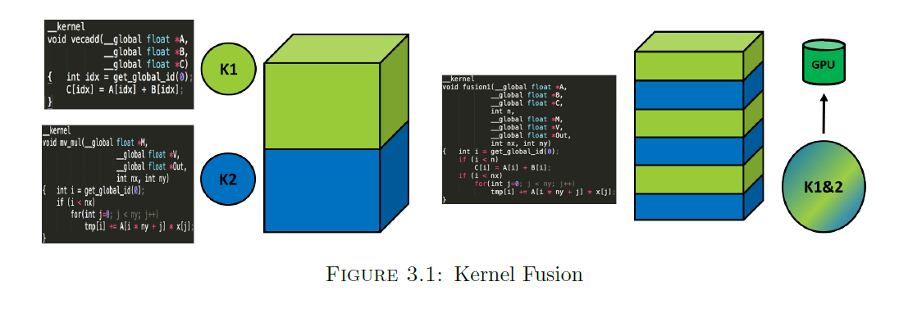
Introduction
The project aims to develop intelligent schedulers for Embedded systems in automobiles.
We consider an ADAS platform comprising both CPU and GPU cores.
There must exist a real time guarantee for execution of object detection pipelines.
Source: BTP Thesis - Arijit Kar

Slide 3
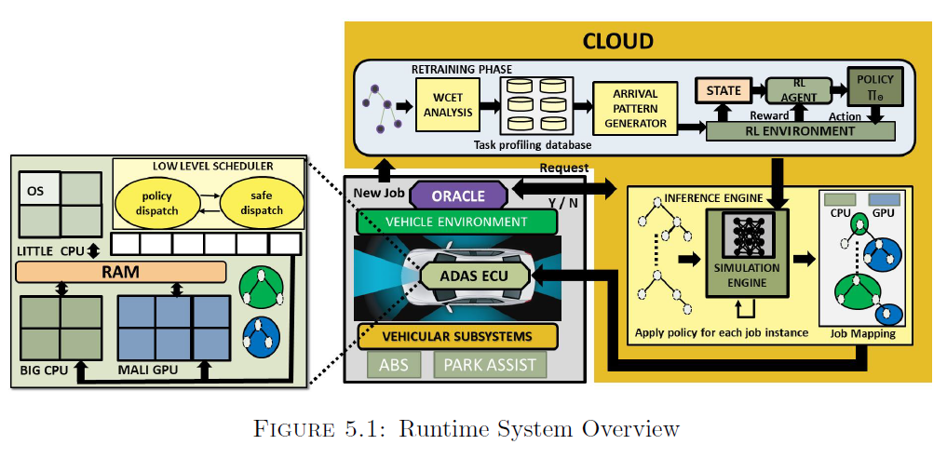
Previous accomplishments
Development of a Discrete Event Driven Simulation Engine.
Design of the architecture of the system.
Deep Q Learning was used to train the RL agent.
Source: BTP Thesis - Arijit Kar

Slide 4
What did I learn this semester?
Got acquainted with the existing framework. Made a part of a module generic, which allowed me to get hands-on with code.
Learned Reinforcement learning in general, dived deeper into Deep Q learning. Also learned modifications to architecture such as Duelling and Prioritised Experience replay.
Looked into the theory of distributed RL and devised problems to be solved.

Slide 5
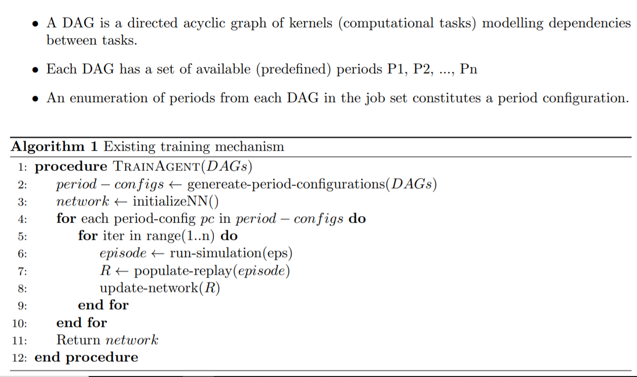
Current training procedure

Slide 6
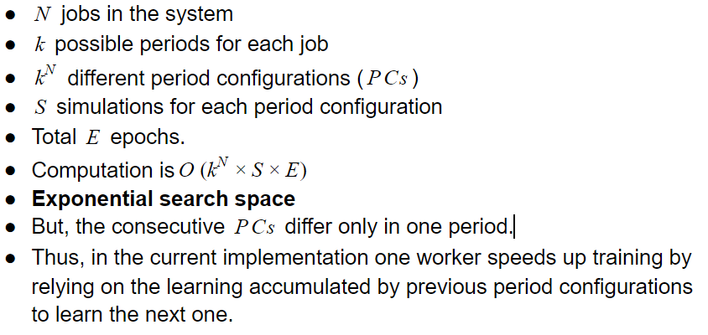
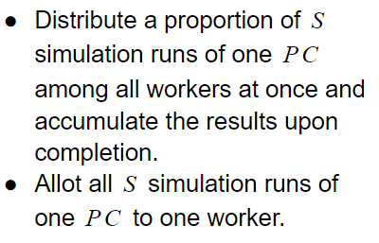
The Primary Problem
Distributed Training

Slide 7
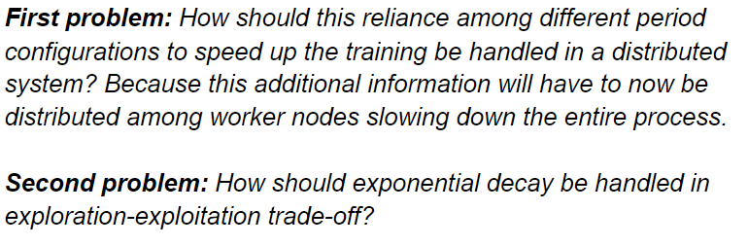
Additional Problems to be solved

Slide 8
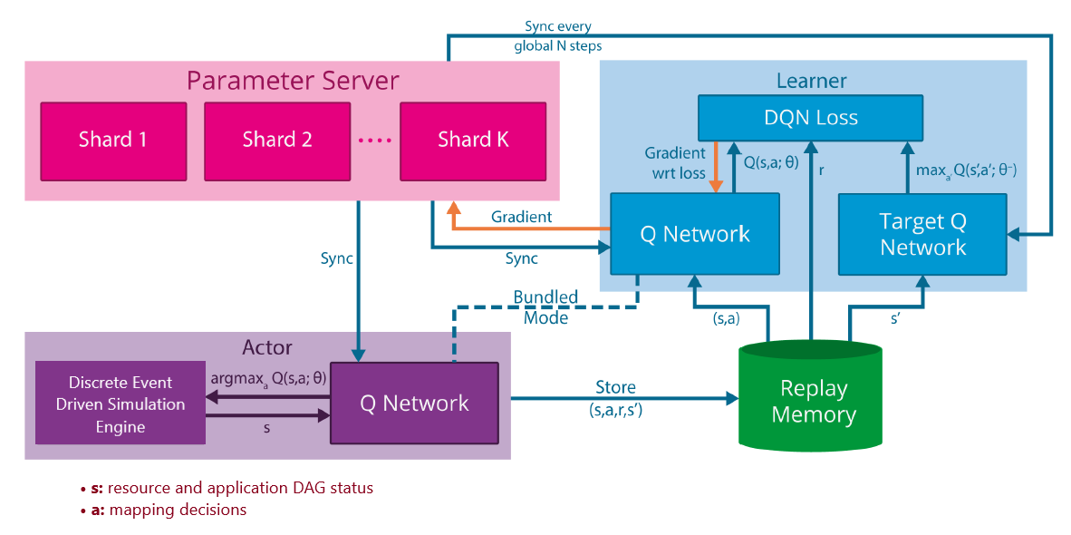
Proposed architecture

Slide 9
Thank You

