Slide 1


Smart Billing and Customer Services At Store
Prepared By :
Name: SHAH ISHAN RAJUBHAI
Enr No: 23002171310152
Batch: D2
Roll No: 67
Notes:
2

Slide 2
INTRODUCTION TO THE PROJECT
The primary focus of this project is on customer-centric features, ensuring a seamless, efficient, and a
smart shopping experience at Store.
1
Project Overview
A Smart billing system that enhances customer experience while streamlining store operations for Store Manager side.
2
Features
Real-time billing, smart coins, discounts, and personalized shopping experience for Customers, and Store Manager Functionalities.
3
Key Objectives
• For Customers: A hassle-free shopping experience with smart discounts, real-time bill generation, spending analytics, and many more ...
• For Store Managers: Efficient store management with sales reports, inventory tracking, promotional campaigns, and customer insights.
Notes:
2

Slide 3
Project Workflow
https://whimsical.com/smart-billing-and-customer-services-GuFWmM5skyAapzvNQc8vMH
Notes:
3

Slide 4
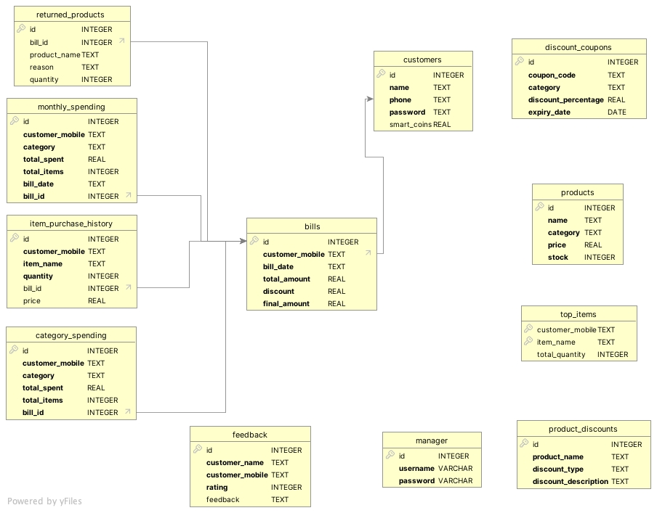
Database ER Diagram

Slide 5









CUSTOMER SIDE FEATURES
Seamless User Journey
Real-time Billing System
Spending Insights
Register, Login, and Manage Profile
Auto-apply discounts, calculate taxes, redeem coupons & smart coins Bills can be saved as a file or printed for future reference.
Monthly & category-wise spending trends, top 5 purchased items
View Offers & Coupons
Refund & Replacement Process
Smart Shopping Assistant
Exclusive store discount Coupons and Buy X Get X Free deals.
Hassle-free 30 days returns and exchanges
Personalized suggestions based on recipes, travel essentials, and home needs
Loyalty & Reward System
Past Bills Record
View Available Products
Smart Coins redemption and Generation basis on 2% of Bill Amount
Customers can access their previous Bills, including itemized details, discounts applied, and Total Bill Amount.
Customers can browse through all available items in the store.
Customized Search based on Categories, Product name with Available Stock
Notes:
4

Slide 6
STORE MANAGER SIDE FEATURES
Inventory Management
Sales Analytics
Promotional Campaigns
Product Returns Tracking
Real-time tracking of stock levels and Products at Sore.
Daily Sales
Send personalized Discount & Offers Text Messages to Customer's Mobile Number From Customer Data
Manage product returns efficiently
Monthly Sales
Yearly Sales
Discount Management
Customer Feedback Analysis
Define and manage storewide discount coupons and Offers
Understand customer concerns for service improvements
View Customers Data
Efficiently track and analyze customer information, helping them make data-driven business decisions.
Customer Profiles – View registered customers’ details, including name, contact number, and purchase history.
Business Impact:
• Helps in personalized marketing by targeting specific customers with discounts and offers.
Notes:
5

Slide 7
TECHNOLOGIES USED
Programming Language: Python
Database Management: SQLite
Data Structure & Algorithms: Trie : For efficient searching and storing of strings
Libraries Used: Matplotlib, Twilio (for messages), tabulate, termcolor.
Notes:
6

Slide 8






FUTURE ENHANCEMENTS AND SCALABILITY
Cloud Integration
AI Integration
Self-Checkout & QR Code Billing
Shift to cloud databases for real-time multi-store access
Personalized product recommendations based on past purchases
Customers can scan products and generate their bills independently, reducing checkout time.
Voice & Chatbot Assistance
Automated Coupon Suggestions
Product Unavailability :
Implementing voice commands and chatbot support
The system will automatically suggest applicable discount coupons during checkout.
Customers can enter unavailable product they want to database which can be later accessed by Store Manager.
Notes:
7

Slide 9
THANK YOU
Thank you for your time and consideration. We are confident that our Smart Billing and Customer Service system can bring real value to your organization.
Notes:
8

