Slide 1
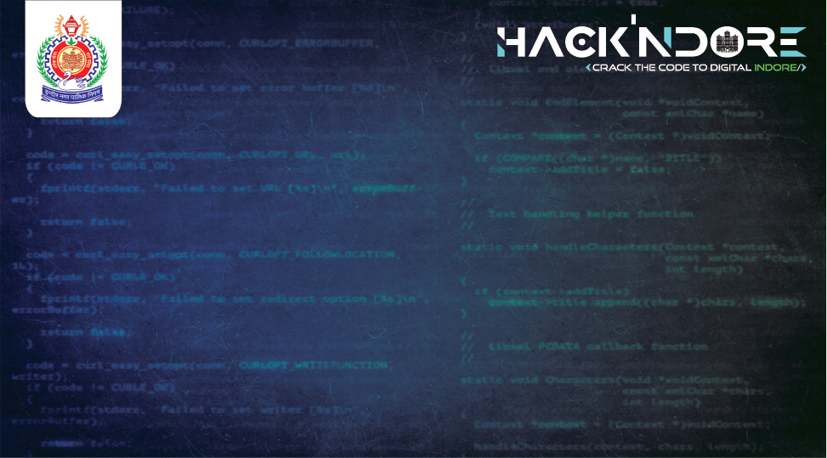
EOFFICE – DIGI DAFTAR
NOTBOTS
Shiya Mer
Ishan Sharma
Kanav Chauhan

Slide 2
Objectives of Digi Daftar
Create a centralized document management system that allows easy storage, retrieval, and sharing of documents such as NoCs, birth certificate, death certificate etc.
Develop workflow automation to streamline approval processes of tenders/tasks (initiation to completion), task assignments, and send notifications at each stage.
Design collaboration tools to facilitate communication and teamwork among municipal employees.
Integrate public service modules to enhance transparency and accessibility for residents, such as online applications for permits, licenses, and services.
Integrate chatbot for the complaint registration and provide the reference number as per pre-defined FAQs.
Ensure the system is secure, with role-based access controls and data encryption.

Slide 3
Solution Pipeline
1. User Interface
  Web Pages
    Interactive Design: Our website uses modern tools to create a user-friendly and interactive interface with inspiration from the current IMC page.
2. Backend Processes
  Server
    Handling Requests: The server processes user requests and communicates between the website and the database.
    Task and User Management: Manages tasks and user accounts, including assigning roles and permissions.

Slide 4
Solution Pipeline
3. Database
  Data Storage
    Efficient Data Handling: Stores all data, such as user information and tasks, in a structured and organized way.
    Scalable Solution: Easily handles large amounts of data.
4. Chatbot Integration
  Interactive Chatbot
    User Interaction: The chatbot provides a simple interface for users to interact with.
    Advanced Understanding: Uses advanced technology to understand user queries and provide accurate responses.
    Contextual Responses: Offers relevant answers based on the context of the questions asked.

Slide 5
Solution Pipeline
5. Document Management
  Centralized Retrieval
    Seamless Access: Users can easily retrieve official documents through a centralized system.
    Convenience: Makes it easier for users to manage their documents without hassle.
6. Security
  Secure Access
    Login: Ensures that only authorized users can access the system.
    Role-Based Permissions: Provides different access levels depending on the user's role.

Slide 6
Solution Pipeline
7. User Functions
  Task Interaction
    Update Status: Users can change the status of their tasks (e.g., in progress, completed).
    Communication: Allows users to add comments or chat related to tasks.
8. Admin Functions
  Management Controls
    Admin Roles: Admins can create and manage user accounts and tasks.
    Task Assignment: Admins can assign tasks to team members and update task details.

Slide 7
Solution Pipeline
9. Profile and Password Management
  User Profiles
    Update Information: Users can update their personal information on their profiles.
  Password Security
    Change Passwords: Users can securely change their passwords to maintain account security.
10. Dashboard
  Activity Summary
    Overview: Provides a summary of user activities and task statuses (to do, in progress, completed).
    Filtering: Allows users to filter tasks based on their current status.

Slide 8


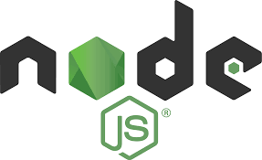
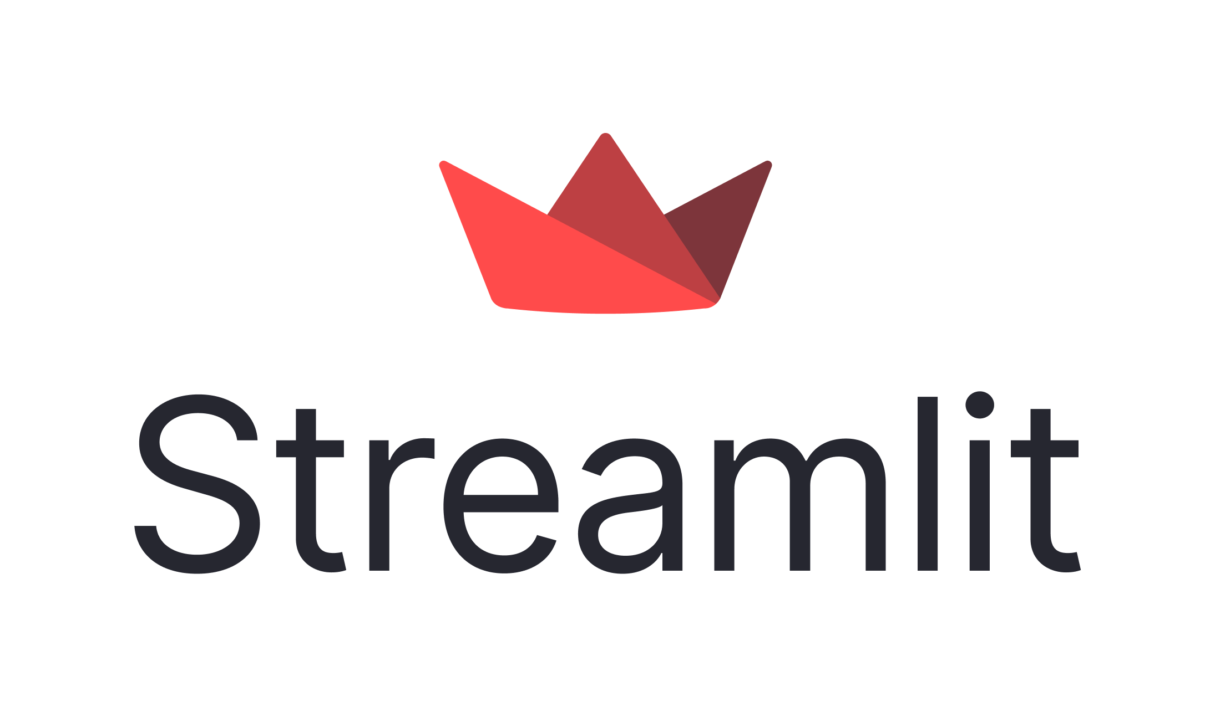
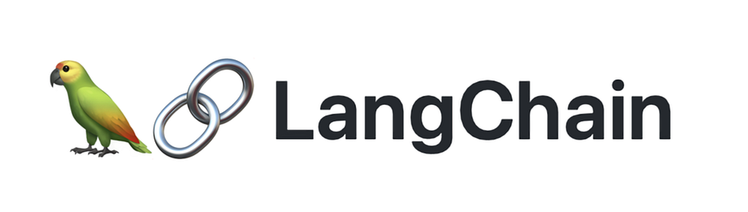
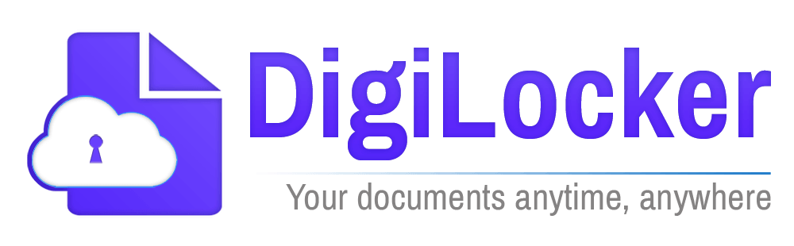
Proposed Tech Stack
MongoDB: Chosen for its scalable, document-oriented NoSQL database capabilities, in our case our employee database.
ExpressJS: Utilized for its minimal and flexible Node.js web application framework, providing robust features for web applications.
ReactJS: Employed for creating a dynamic and responsive user interface with efficient state management.
Node.js: Selected for its non-blocking, event-driven architecture, facilitating high-performance and scalable server-side applications.
Streamlit and LangChain: Integrated for building an interactive and user-friendly chatbot interface with advanced language processing capabilities.
DigiLocker API: Implemented for seamless and secure centralized document retrieval, enhancing user convenience and data integrity.

Slide 9
Uniqueness
ChatBot – Current implementation using GrokAI API calls and LangChain but proposed using OpenAI’s GPT-4 model and Pinecone for vector store so that we can upload custom data and query the data. For query retrieval we can RAGs for faster access.
  Why GPT-4? GPT-4 embeddings are utilized for their advanced contextual understanding and semantic representation capabilities which would be required for intricate and complex municipality documents.
DigiLocker Integration – This is to access the centralized database already setup removing the need for other complex infrastructure.

Slide 10
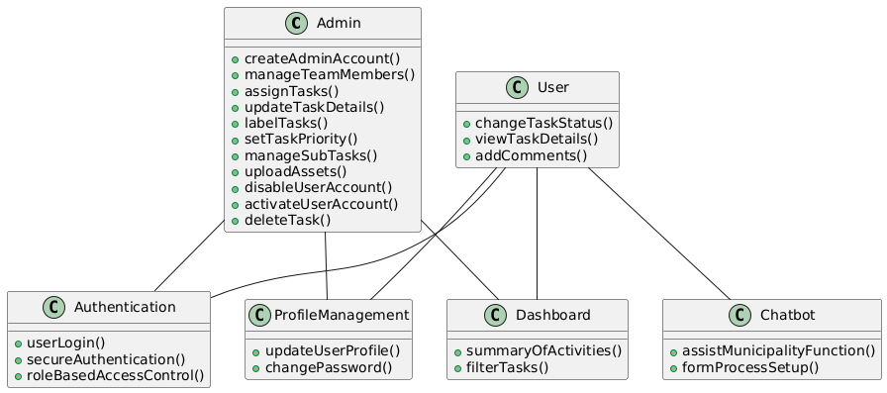
Use Case Diagram

Slide 11
Outcome
Faster Service: Automating workflows and approvals means tasks get done quicker, so people receive services faster.
Greater Transparency: Making documents and services accessible online allows residents to easily see and track their applications, making the process more open.
Better Teamwork: Tools for communication and collaboration help municipal employees work together more effectively, ensuring things run smoothly.
Improved Security: Using role-based access and encryption keeps sensitive information safe and secure, protecting both municipal records and citizen data.

Slide 12
