Slide 1
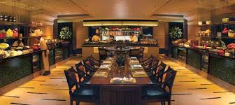
New Restaurant in Hyderabad
Coursera Capstone Final project
Author: Ishan Srivastava

Slide 2
Intro
In India, going out to restaurants to eat with friends, family, or even for business reasons, is a very common activity, especially in Hyderabad. The restaurants serve a variety of different foods, mainly Indian, and other types such as Chinese or Mexican. The amount of restaurants in Hyderabad depend on the population of the neighborhood. The more the amount of restaurants in a specific location, the more competition and trouble the restaurant will face. Currently, the restaurants in Hyderabad are facing serious competition and are close to running out of business. A businessman is trying to open a new restaurant and wishes to avoid facing this problem; where should they open it?
By opening a new restaurant in a less populated area with few to no restaurants, more customers will be satisfied and the less the restaurant will face competition due to the lack of restaurants in the neighborhood. By analyzing the neighborhoods of Hyderabad, a conclusion can be made determining where exactly a new restaurant(s) needs to be opened to meet business and customer needs.

Slide 3
Intro (continued)
So what is the main problem?
The major problem for this project is to search, analyze, and determine the best areas in Hyderabad, India, to open a restaurant which can succeed in satisfying the customers and its business needs. In Hyderabad, India, if one wishes to open their own restaurant, where should they open it?

Slide 4
Data
To solve the problem, I need:
A list of neighborhoods in Hyderabad, India
Data involving the location and amount of restaurants in each neighborhood
The geographical coordinates for each neighborhood to create the map and collect individual data

Slide 5
Data (continued)
And to find the data, I will use Wikipedia, primarily the article on the suburbs of Hyderabad, India: https://commons.wikimedia.org/wiki/Category:Suburbs_of_Hyderabad,_India, which contains 50 neighborhoods.
I will then scrap the Wikipedia page, use the geocoder package to collect the geographical coordinates, and use the Foursquare API to collect data for the restaurants in Hyderabad, India, allowing me to determine where the new restaurant needs to be opened. This will all be done in a Jupityer notebook to be published on Github.

Slide 6
Methodology
I will first obtain the number on neighborhoods in Hyderabad, India using Wikipedia. The url, https://commons.wikimedia.org/wiki/Category:Suburbs_of_Hyderabad,_India will take me to the page where I can view the neighborhood names. There are 50 neighborhoods total. I will use web scraping using Python requests and beautifulsoup packages to find the data for each neighborhood. The Foursquare API and Geocoder package will be used to collect the geographical coordinates for the neighborhoods.
After reviewing the coordinates, I will make a map using the coordinates I obtained previously, where I visualize the clusters in blue. I will use Foursquare API to analyze each neighborhood, its coordinates, and venue data. I will isolate each neighborhood and compare them using the number of restaurants and find the average frequency.
I will then cluster the data using k-means frequency into 3 individual clusters based off their frequency of occurrences based off the number of restaurants. This will allow me to understand the density and location of both neighborhoods and restaurants within each cluster to determine which cluster could use a new restaurant and why, allowing me to reach my conclusion as to where a new restaurant should be opened. I aim to look for a location that has little to no restaurants around the vicinity and will take population into account.

Slide 7
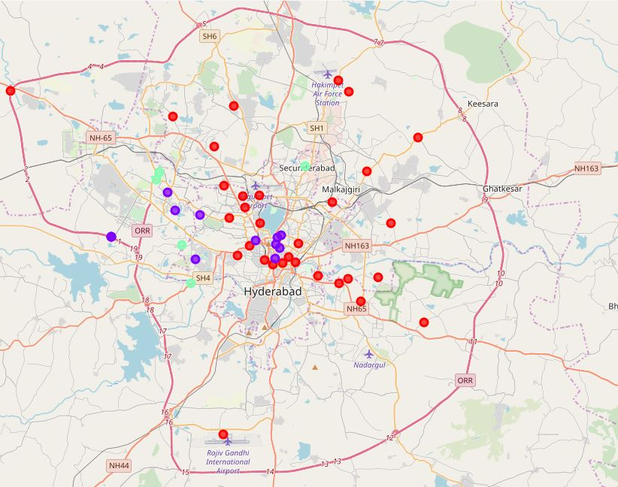
Results
I was able to successfully analyze the data using k-means clustering where I broke the data into 3 clusters
Red represents cluster 0, purple represents cluster 1, and green represents cluster 2
Cluster 0: Neighborhoods with low concentration of restaurants
Cluster 1: Neighborhoods with moderate concentration of restaurants
Cluster 2: Neighborhoods with high concentration of restaurants

Slide 8
Discussion
Based off the map, cluster 0 has the most amount of neighborhoods but ironically has the least amount of restaurants. Cluster 2 has only 5 neighborhoods with a high concentration of restaurants, while cluster 1 serves as the median, with a moderate amount of neighborhoods and restaurants. This represents a great opportunity to set up a new restaurant in cluster 0, as it has the most amount of neighborhoods and the least amount of restaurants, giving more customers and less competition, allowing for the restaurant to thrive.
This is also towards the center of the city and helps avoid customers from driving far distances, as cluster 2, which has the most restaurants, is on the outskirts of the city, causing presumably many from cluster 0 and cluster 1to travel long distances to reach those restaurants.
By opening a restaurant in cluster 0, this all can be avoided. Cluster 1 could also use a new restaurant, being close, but not as close, to the center as cluster 0. Still, cluster 0 is the cluster in most need for a new restaurant.

Slide 9
Conclusion
After scraping the Wikipedia page, collecting data for the neighborhoods and restaurants, mapping the data, and clustering the data, the solution that was found was that the neighborhoods in cluster 0 are the most ideal places to open a new restaurant which will thrive business-wise, with lack of competition and more customers to serve.

