Slide 1
Fake News Detection Model

Slide 2
Problem Statement
In Today’s World information can easily be accessible from anywhere ,Today individual can access the happenings of various events around the world in the comfort of his/her own home. It has resulted in the inaccuracy and irrelevancy in updating information by people which is commonly known as fake news which can cause real-world impacts, within minutes, for millions of users. Since a large proportion of the population uses social media for updating themselves with news, delivering accurate and altruistic information to them is of most importance. Due to the increasing number of users in social media, news can be quickly published by anybody, and its credibility stands compromised, As fake news is written to mislead readers, it makes it a difficult task to detect based on the content of the news only. The news content is diverse in terms of styles, the subject in which it is written, it becomes essential to bring an efficient system for its detection. Fake news detection has recently garnered much attention from researchers and developers . This work proposes to detect fake news using various methods using NLP and machine learning.

Slide 3
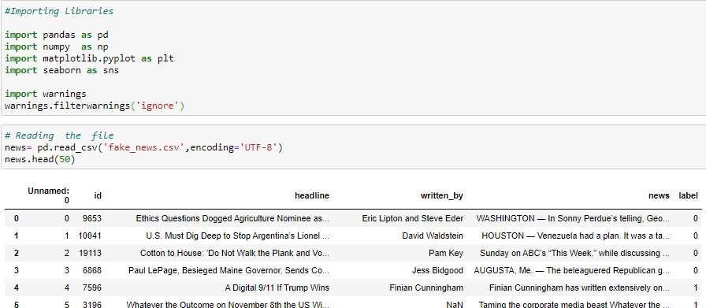
Loading Necessary Database and loading libraries

Slide 4
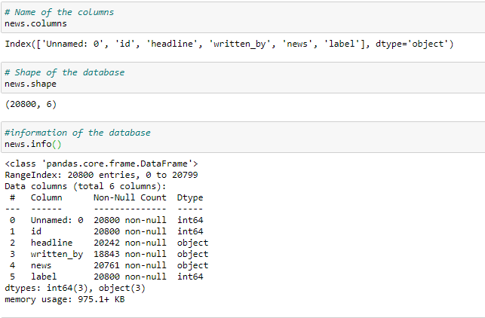
Now will check the name of the columns , shape of the database and information about the database.

Slide 5
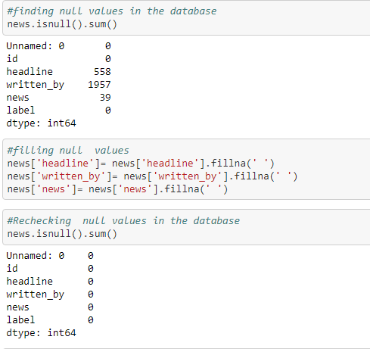
Data Pre-processing
Now will check how many null value are their in the database and we will fill these null values.

Slide 6
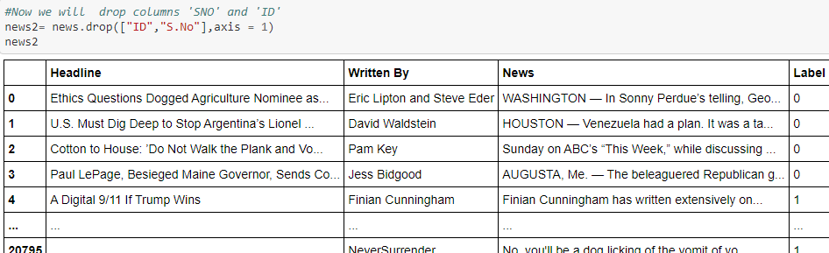
Now we will rename and drop some of the columns

Slide 7
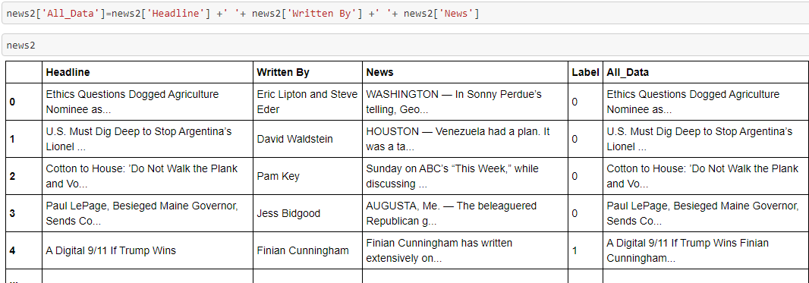
Now we will make a new column name ‘All_Data’ which will contain all data of columns ‘Headline’ , ‘Written By’, ‘Label’ .

Slide 8
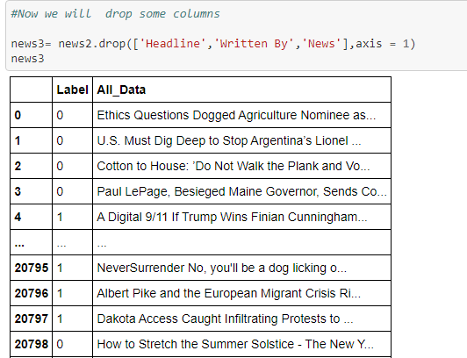
Now will drop some of the columns which are not required later on.

Slide 9
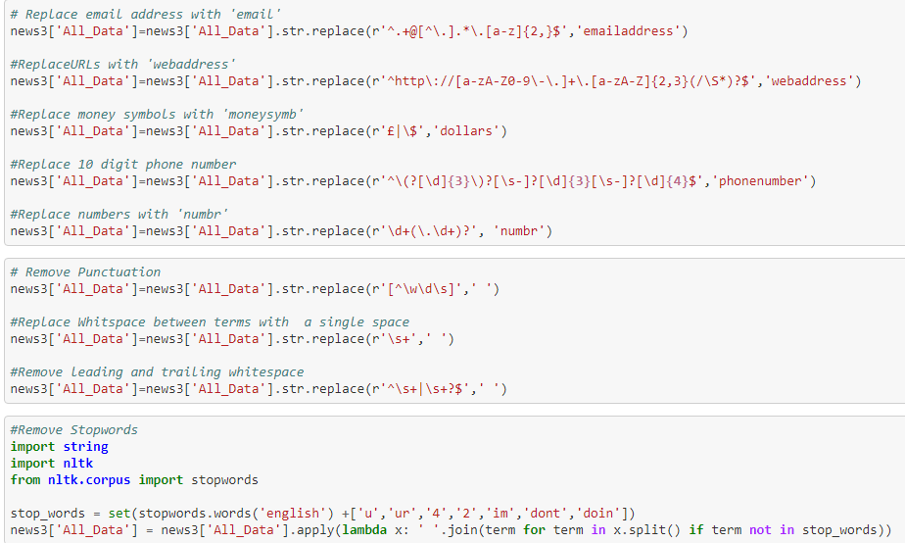
Now will replace some of the words in database with some other words and we will remove stopwords and make database much more smaller and this reduce time required for processing

Slide 10
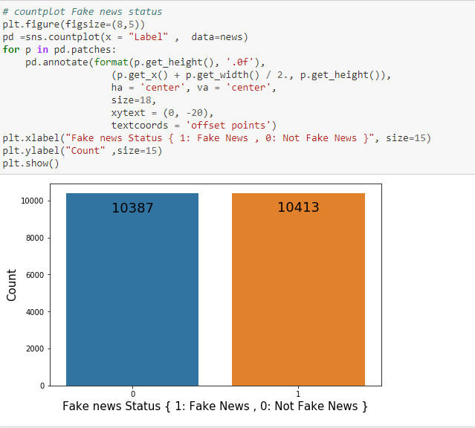
Now we will make countplot of fake and Not fake news and will see their count.

Slide 11
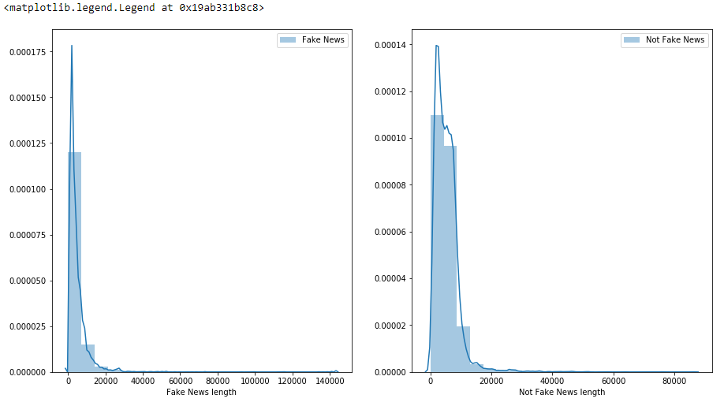
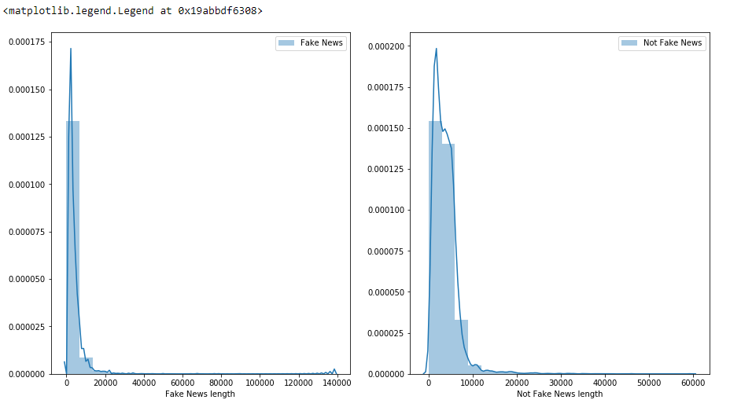
Now we will see distribution of the data before and after cleaning

Slide 12
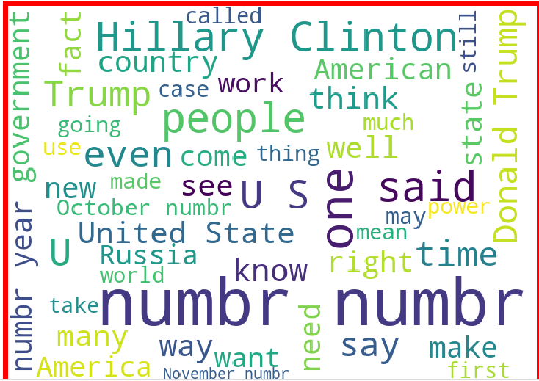
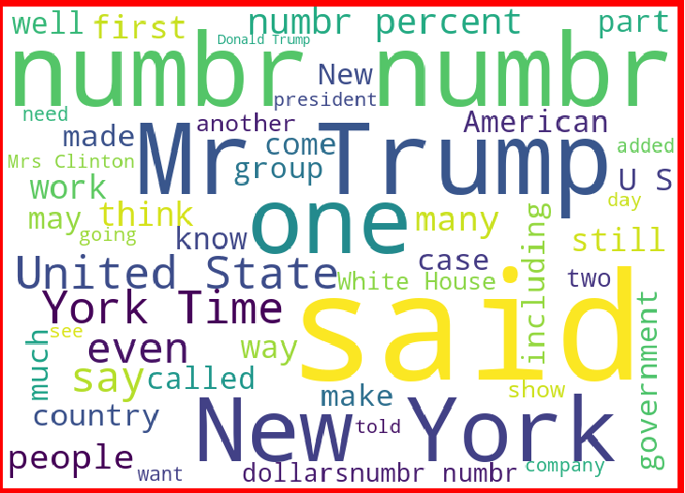
loud words in fake news
loud words in Not fake news

Slide 13
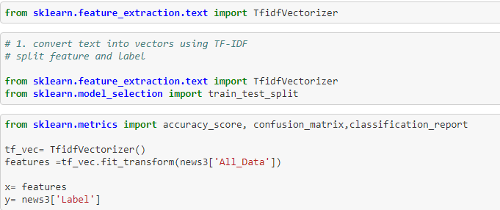
Data Inputs- Logic- Output Relationships
Now will divide the data into input and output , input will be ‘All_Data’ column and output data will be ‘Label’ column and we will also import TfidfVectorizer to convert alphabets into vectors which will be required to build the model.

Slide 14
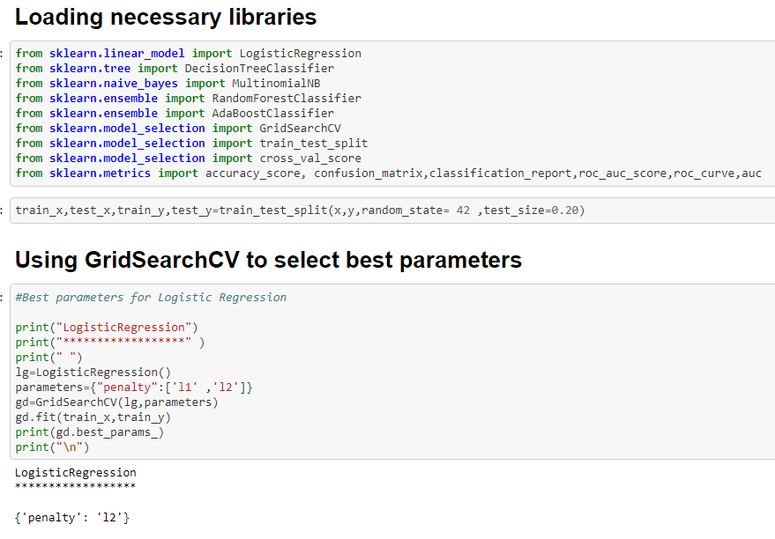
Now we will run different algorithm and check which algorithim is performing best

Slide 15
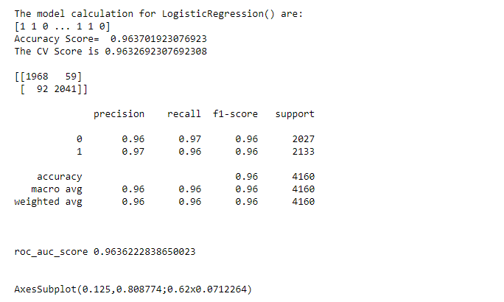
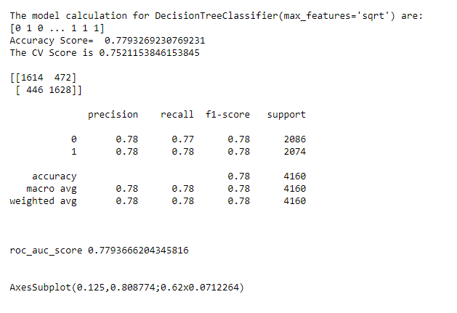

Slide 16
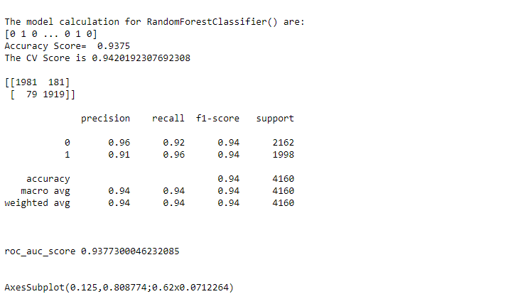
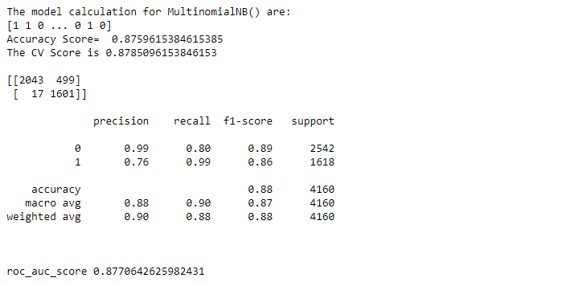

Slide 17
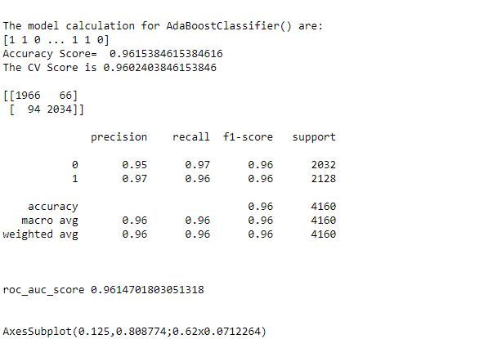
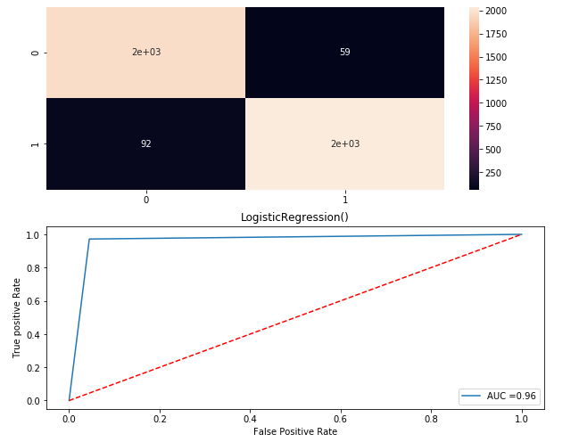

Slide 18
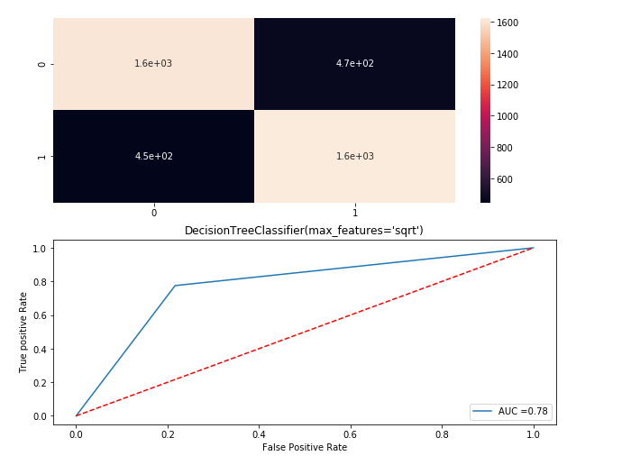
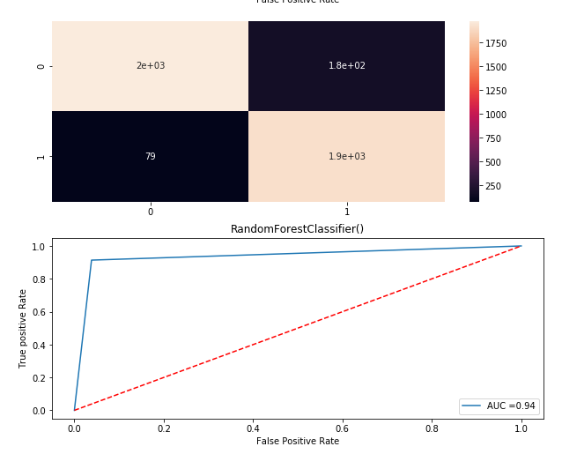

Slide 19
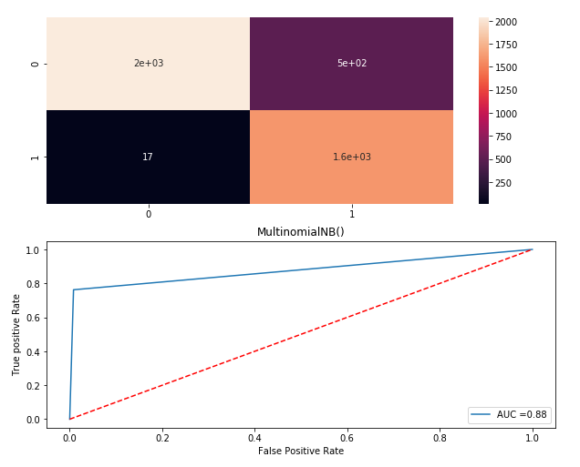
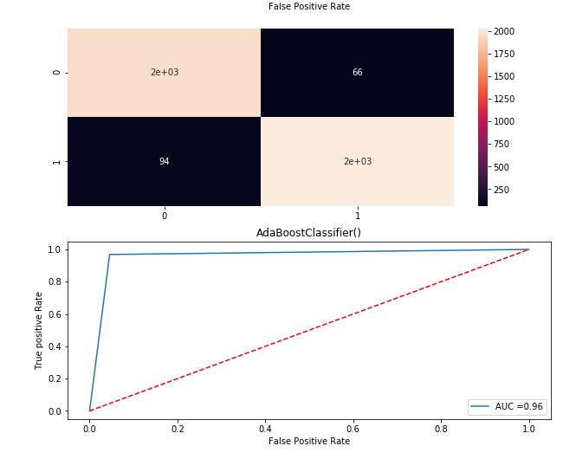

Slide 20
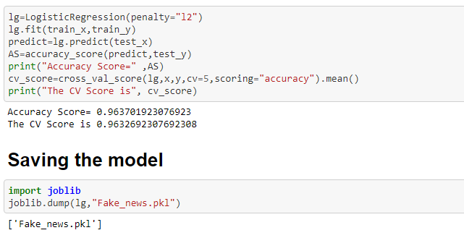
Since logistic Regression is giving better result so we choose it as final model

Slide 21
Conclusion
From the whole evaluation we can see that the maximum number of words are related to Trump and clinton and we can interpret that it was due to election campaign which was held during US presidential election and these fake news adversely effect the opinion of the voters . Most of these fake news related to trump were cleared by trump campaign but their was hardly any clarity or real news from the side of clinton and due to which it impacted the election result . Thus we can get idea how serious is Fake news Problem .

