Slide 1

HOSPITAL WEBSITE
PRESENTED BY:
DEEPAK
ISHANT SHUKLA
KARANVIR SINGH
GUNN SONI

Slide 2
INTRODUCTION
HOW IDEA CAME?
There are patients who are handicapped or are people nowadays with busy schedule cannot afford to stand in line for appointment or pay bills.The website would help to make it easier for handicapped as well as save time.
WHAT’S NEW?
It basically consists of appointment system and online payment option.As soon as an appointment or payment is made,we get a popup and the details of the user gets stored in backend that is handled by an administrator.
WHY THIS SITE?
This site is responsive and provides the information about the Hospital.User can know about the facilities,reviews of person,can book appointment online and can make payment online.hospital website can replace the existing manual ,paper based system.The time and resources can be reduced.
ABOUT SITE?
This site provides user friendly environment to the patient.Hospital website is poweful flexible and easy to use and is designed and developed to deliver real conceivable benefits to hospitals

Slide 3
Overview
The booking of appointment offline, it always create a variety of problems, both for our patients and staff.
Offline appointment booking have reduced the ability for patients to choose their suitable timming. At the same time, it is hard to see the details on the performance of the appointment booking and bill payment . The online portal of the Hospital is a set of operations for booking appintment and paying bills online, which will offer all of the benefits of the company's internal control bus schedules, and other business-related functions in connection with the sale of the tickets. It also provides its patients with the ability to make decisions about how to book appointment on the account of when the slot is available . This is a very reliable online booking system and pay bills online
not only reduce the mass in hospital , but also the content on the site provides all the relevant information of the hospital.

Slide 4
Software Used:
OPERATING SYSTEM : Windows 10
FRONT END : Html,css,java script.
SERVER SIDE SCRIPT : Php
DATABASE : Mysql

Slide 5
Methodology:
WORKING:
Hospital website is quite responsive. The front end consists of home page, about,facilities,review,posts,footer part.It consists of media queries as well that makes the website suitable for mobile screens as well.As soon as the navigation bar any part (facilities,about,review,posts) is clicked, the responsive website take the patient to the corresponding page.
1)HTML 2)CSS 3)JAVACRIPT
The backend consists of appointment and online payment option.As the details of patient gets entered in appointment and billing parts.The information of the patient get stored that is handled by an administrator or the hospital staff.
4)PHP

Slide 6
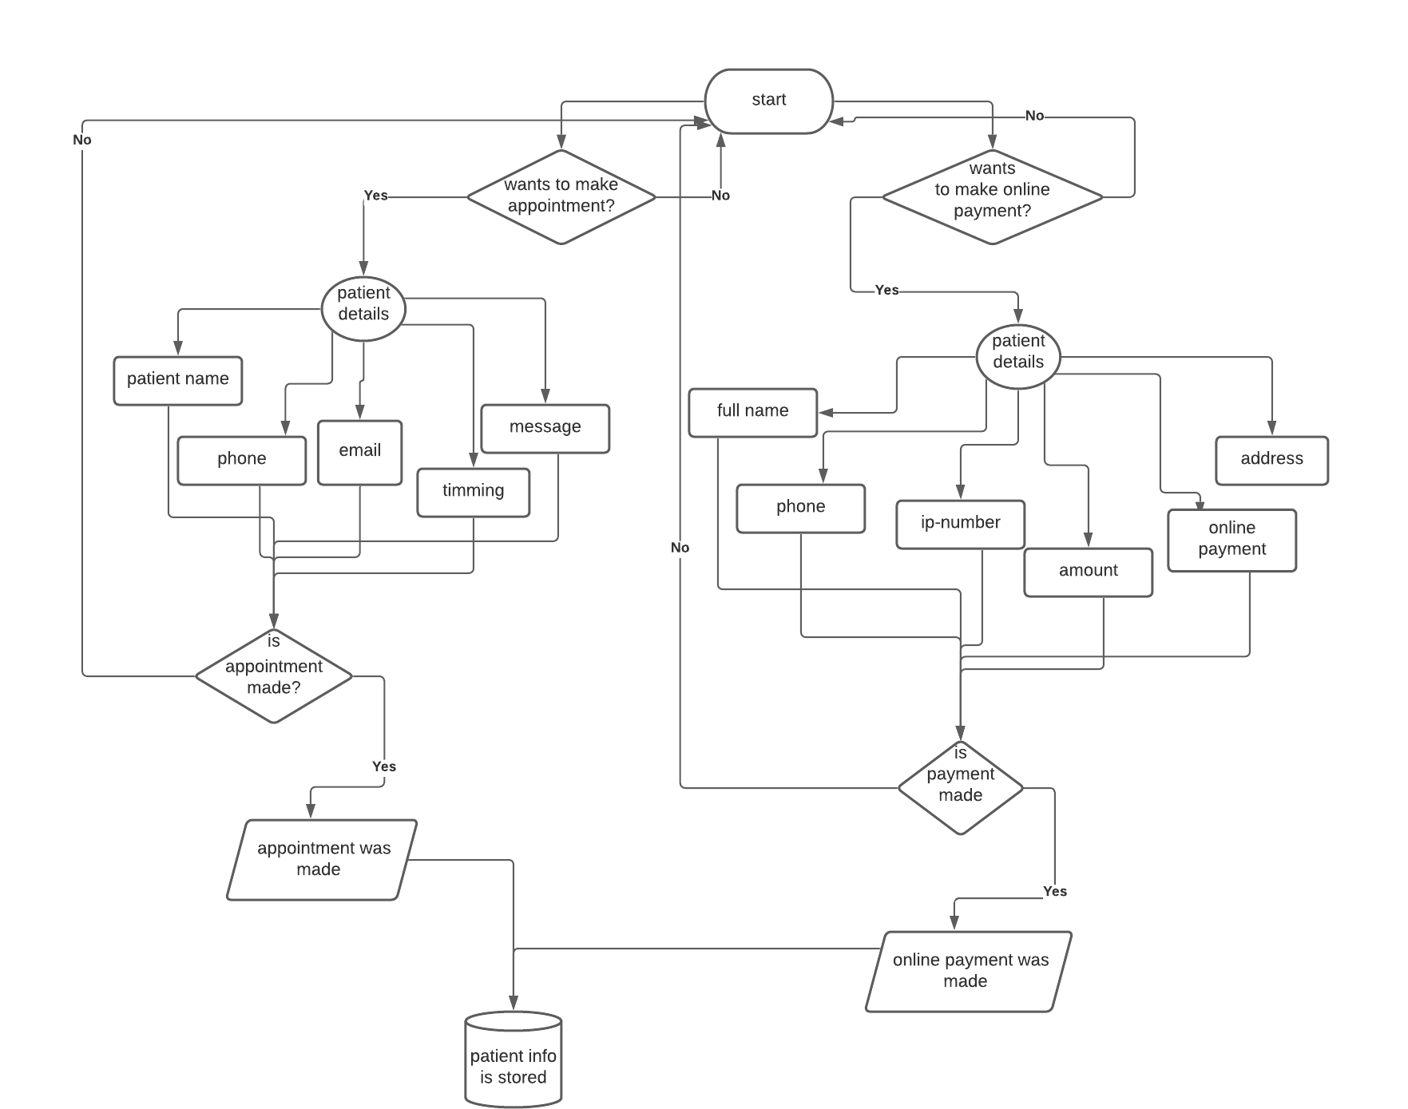
Flowchart

Slide 7
Elements
Home- .it is the start page of the website.It consists of logo of the website and also has naviagtion bar which helps us to navigate to different pages in a website.The name of hospital is also displayed in Home page of website.It also consists of fas-fa bars that are needed in small screens like that of mobile phones
About- The about part of website consists of fas fa-ambulance,fas fa procedures,fas fa-stethescope that are done with the help of bootstrap.The fas fa stethescope tells about free checkups, fas fa ambulance tells about ambulance services provided by the hospital,fas fa procedures tell us about availability of emergency rooms.
Facility: The facility part consists of various images that indicates the availability of expert doctors,enough rooms,lab of hospital,emergency rooms,team of doctors.
Review: this part tells us about the reviews about the hospital given by various patients or people.

Slide 8
Contact:It is basically back end part,that includes online payment and online appointment booking option.The details entered,get stored at the administartor side.
Posts: It consists of various posts posted by people or staff of the hospital at social networking sites.
Footer:I t provides the address of the hospital and link of hospital's page at facebook,instagram,github

Slide 9
Implementation
UI DESIGN
DATABASE CREATION
DATABASE CONNECTIO-N USING PHP
RESPONSIVE DESIGN

Slide 10
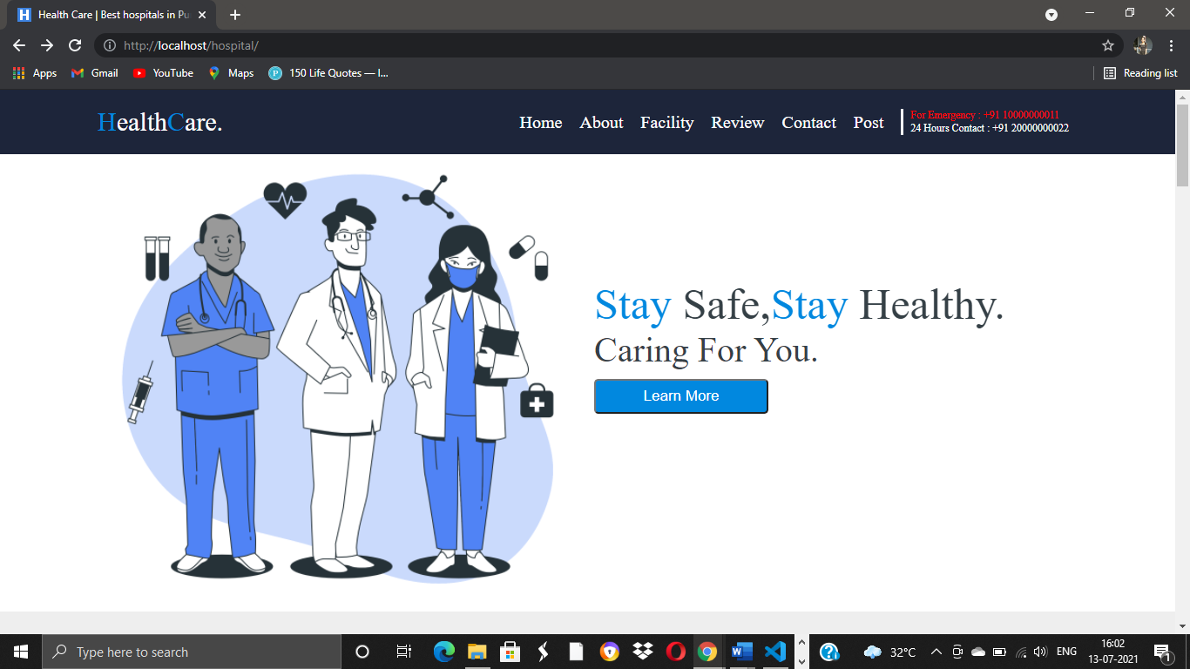
Results:

Slide 11
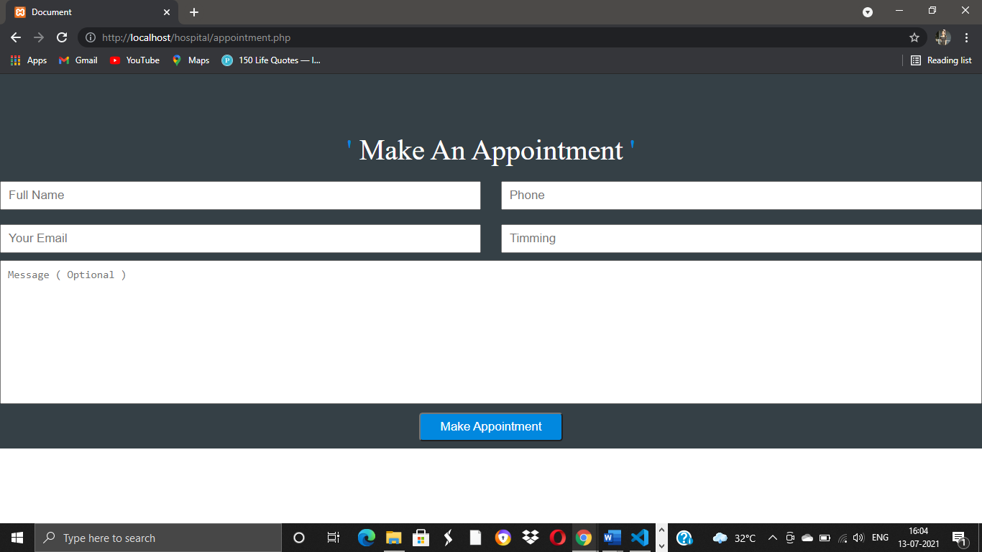
Results:

Slide 12
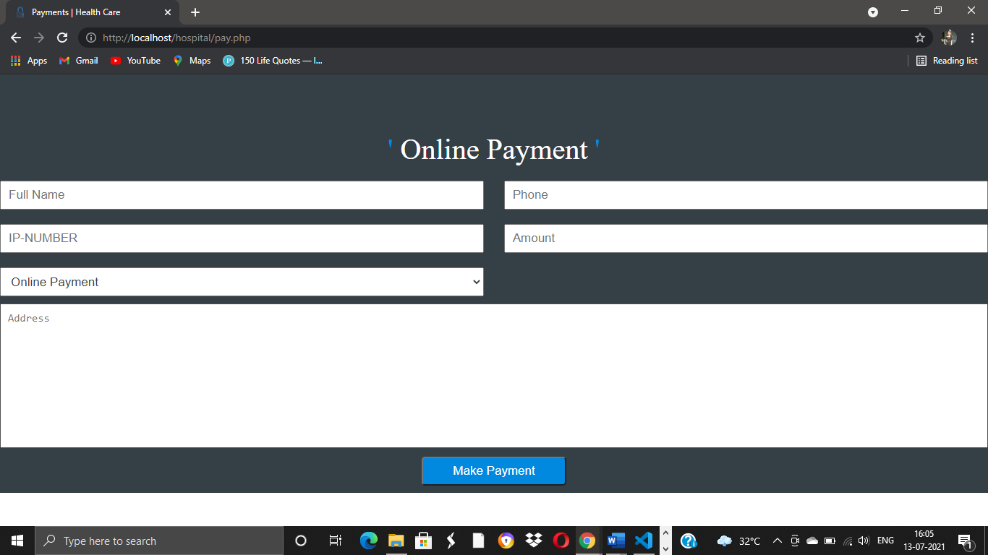
Results:

Slide 13
Conclusion:
Taking into account all the mentioned details, we can make the conclusion that the hospital Website is the inevitable part of the lifecycle of the modern medical institution. It automates numerous daily operations and enables smooth interactions of the users. Developing the hospital system software is a great opportunity to create the distinct, efficient and fast delivering healthcare model. Implementation of hospital website project helps to store all the kinds of records, provide coordination and user communication, implement policies, improve day-to-day operations, arrange the supply chain, manage financial and human resources, and market hospital services. This beneficial decision covers the needs of the patients, staff and hospital authorities and simplifies their interactions. It has become the usual approach to manage the hospital. Many clinics have already experienced its advantages and continue developing new hospital website project modules

Slide 14
FUTURE SCOPE:
Hospital website is a computer system that helps manage the information related to health care and aids in the job completion of health care providers effectively. They manage the data related to all departments of healthcare such as, Clinical. Financial.

Slide 15
FUTURE ENHANCEMENTS:
The proposed system is hopital website. We enhanced this system by including more facilities like making a practical online payement option.And including a chat option for in the website for patients to get information about any query.We can also include the appointment schedule of a particular doctor so that patient could easily get to know the appointment timing of a specific doctor.

Slide 16
THANK YOU!!

