Slide 1
Campus Shuttle Routing and Capacity Scheduling System
Route optimisation and capacity scheduling for Woxsen University using DAA algorithms
Presented by
Ishanth M
Roll no. 25WU0102101 | B.Tech CSE-AIML, Rhinos
Design and Analysis of Algorithms (25TU03MJM1)
Faculty: Dr. Monday Justin Abdullahi
Notes:
Good morning. This is my Design and Analysis of Algorithms project: a shuttle routing and capacity scheduling system for the Woxsen campus. I built a working web application that uses six algorithms from the syllabus on one shared campus graph.

Slide 2



The problem on campus
Long waits at busy stops
MAIN OBJECTIVE
Demand peaks at the Towers, Library and Admin Block, but routes and timings are decided by hand.
Cut passenger waiting time by finding shorter routes, allocating seats well and choosing trips that do not collide.
Full shuttles and empty seats
Passenger demand and shuttle capacity are checked separately, so seats are used unevenly.
Overlapping trips
Without a check, two planned trips can need the same shuttle at the same time.
Notes:
Campus shuttles look simple, but route length, passenger demand, vehicle capacity and trip timing all interact. Doing this by hand leads to long waits, uneven seat use and overlapping trips. The objective is to reduce waiting through shorter routes, better seat allocation and conflict-free trips.

Slide 3
Modelling the campus as a graph
Stops
MG
Main Gate
are vertices: 12 Woxsen locations
3
Architecture
AR
Roads
AI
4
AI Research
are edges, weighted by minutes
2
2
Law School
Admin Block
AB
LW
3
Demand and capacity
5
Tower 3
3
Blue Ember
2
T3
BE
4
stops hold waiting passengers, shuttles hold 40 seats
LB
Tower 5
2
T5
3
5
2
5
Library
Trips
6
4
3
4
T2
have fixed start and end times
SP
OV
5
Tower 2
Sports Complex
The Oval
Notes:
I model the campus as a weighted undirected graph. Each stop is a vertex and each road is an edge weighted by travel time in minutes. The map is a schematic of the real Woxsen stops from the campus map, not to scale. The highlighted path is the shortest route from Main Gate to Tower 5.

Slide 4
Six algorithms, six jobs
Algorithm | Category | Job in the project | Time
Dijkstra | Graph | Shortest route for a passenger | O(V²)
Floyd–Warshall | Dynamic programming | All-pairs travel times | O(V³)
Kruskal | Graph and greedy | Minimum connected network | O(E log E)
Activity Selection | Greedy | Most non-overlapping trips | O(n log n)
Fractional Knapsack | Greedy | Seat split with partial groups | O(n log n)
0/1 Knapsack | Dynamic programming | Whole groups within capacity | O(nW)
Each routing, scheduling or capacity question uses the one algorithm that fits it.
Notes:
Graph, greedy and dynamic programming each solve a different part of the problem. Dijkstra answers one passenger query. Floyd-Warshall prepares every pair in advance. Kruskal gives the cheapest connected road network. Activity Selection removes trip conflicts. The two knapsack variants show the difference between splitting groups and boarding them whole.

Slide 5





How the system is built
Interface layer
Algorithm layer
Sample data layer
Login, passenger and admin dashboards, map, simulation
Pure functions: Dijkstra, Floyd–Warshall, Kruskal, scheduling, knapsack
12 stops, 19 roads, demand, fleet and trip lists
Passenger
Administrator
Choose source and destination
Enter passengers and capacity
See the highlighted shortest route
Run the shuttle simulation
Monitor demand and shuttle status
Edit demand and capacity
Inspect every algorithm step
Manage the trip schedule
Notes:
The application has three layers. The algorithm layer is separate from the interface, so presentation code can never change a result. All graph algorithms read the same edge weights, which avoids showing one set of times while calculating with another. There are two roles with different dashboards. The login uses fixed demonstration credentials, not real authentication.

Slide 6
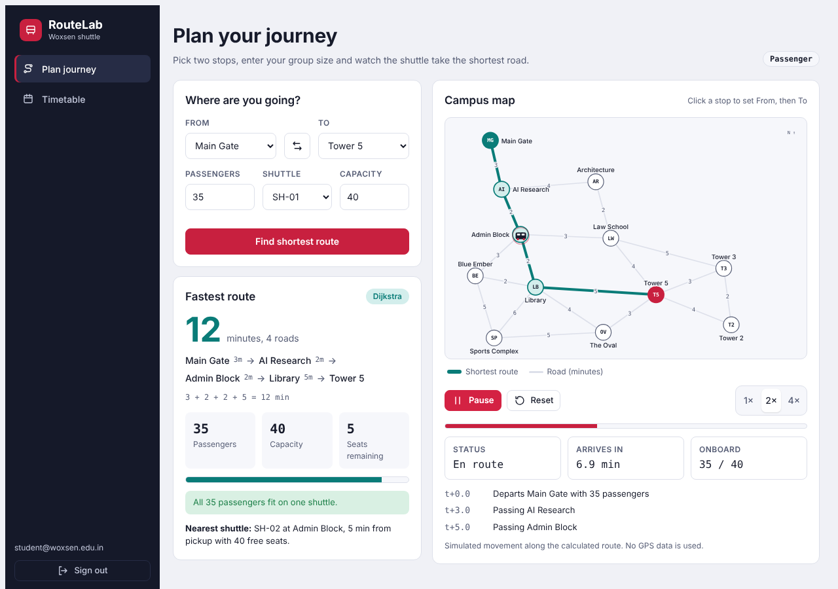
Passenger view: plan and simulate
Pick stops
Use the dropdowns or click stops on the map.
Shortest route
Dijkstra returns 12 minutes for Main Gate to Tower 5.
Seats and shuttle
Shows remaining seats and the nearest shuttle with room.
Live simulation
A shuttle moves along the route at 1x, 2x or 4x.
Notes:
Live demo here if possible. Choose Main Gate to Tower 5 with 35 passengers and 40 seats. The app reports 12 minutes along Main Gate, AI Research, Admin Block, Library and Tower 5, with 5 seats remaining. Press Start shuttle to run the simulation. The movement is simulated from the route, not real GPS.

Slide 7
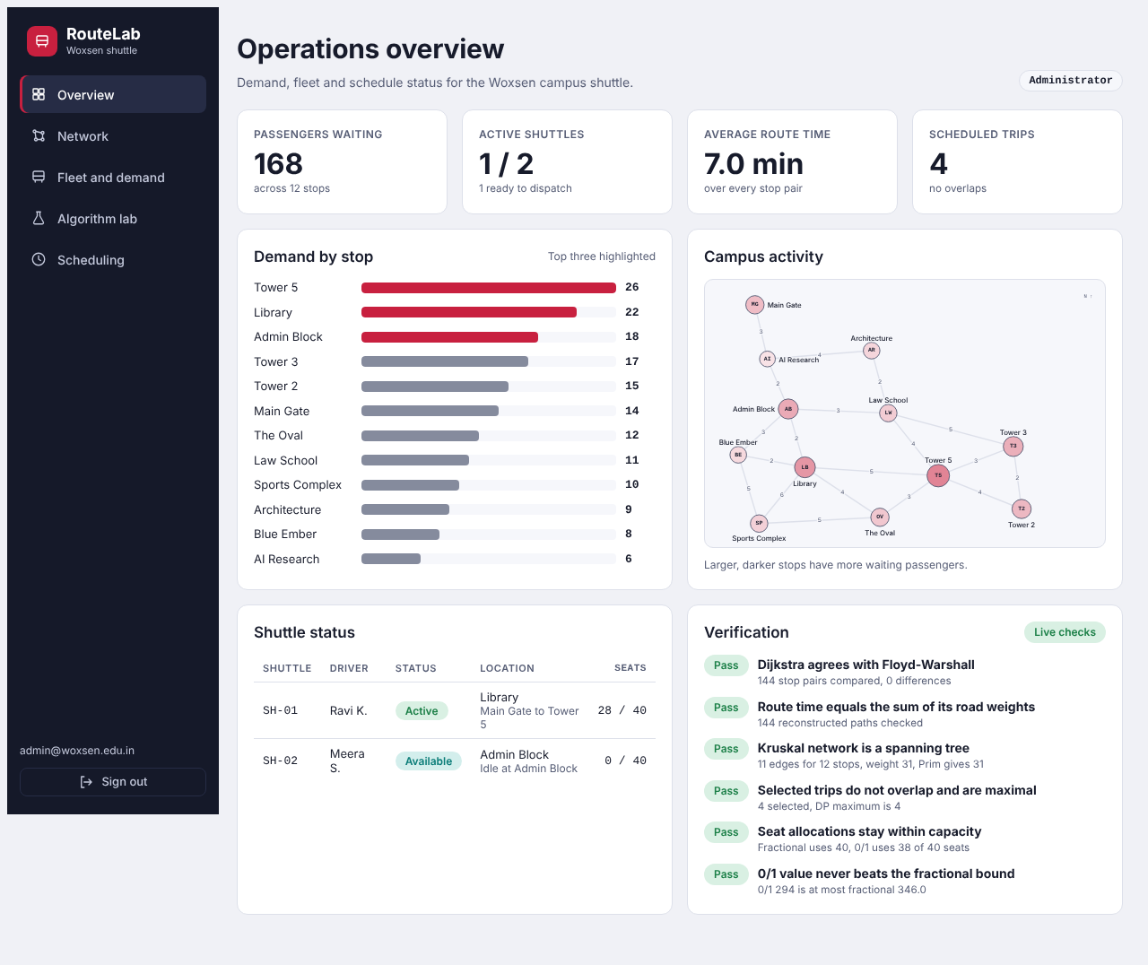
Administrator view: monitor and decide
Overview
168 passengers waiting across 12 stops, fleet status, demand bars.
Fleet and demand
Edit waiting passengers and capacity. Seat allocation updates instantly.
Algorithm lab
Step-by-step tables for all six algorithms, plus a timing comparison.
Scheduling
Add or remove trips and see which are selected.
Notes:
The administrator sees demand by stop, fleet status and a live verification panel. Changing demand or shuttle capacity on the Fleet and demand page recalculates the knapsack allocation straight away. The Algorithm lab shows each algorithm one at a time so every result can be traced.

Slide 8
Worked example: Main Gate to Tower 5
MG
3 min
AI
2 min
AB
2 min
LB
5 min
T5
Main Gate
AI Research
Admin Block
Library
Tower 5
12
Step | Stop finalised | Distance
1 | Main Gate | 0 min
2 | AI Research | 3 min
3 | Admin Block | 5 min
4 | Architecture | 7 min
5 | Library | 7 min
minutes
3 + 2 + 2 + 5 = 12. Floyd–Warshall gives the same value for this pair.
First five stops finalised by Dijkstra from Main Gate
Notes:
Dijkstra starts at Main Gate with distance 0 and keeps finalising the nearest unvisited stop. The path is rebuilt from predecessors: 3 plus 2 plus 2 plus 5 gives 12 minutes. Another path through Law School also takes 12 minutes, so this is a tie and the algorithm keeps the first one it found.

Slide 9
Results on the Woxsen dataset
12 min
31
4 of 10
38 / 40
Shortest route, Main Gate to Tower 5
Minimum network weight, 11 roads
Non-overlapping trips selected
0/1 knapsack seats used, whole groups
Splitting groups vs whole groups
Fractional: value 346, upper bound
0/1: value 294, boards Tower 5 and The Oval
Whole groups are realistic; splitting is the bound
Notes:
The 12 minute route is Dijkstra's result and the minimum network of 11 roads weighs 31. Activity Selection keeps 4 of 10 requested trips. For 40 seats, value is passengers multiplied by their average wait. The 0/1 knapsack boards Tower 5 and The Oval, using 38 seats with value 294. The fractional bound is 346, which is higher because it can split a group. These numbers come from my Woxsen sample data, so they differ from the earlier group report.

Slide 10
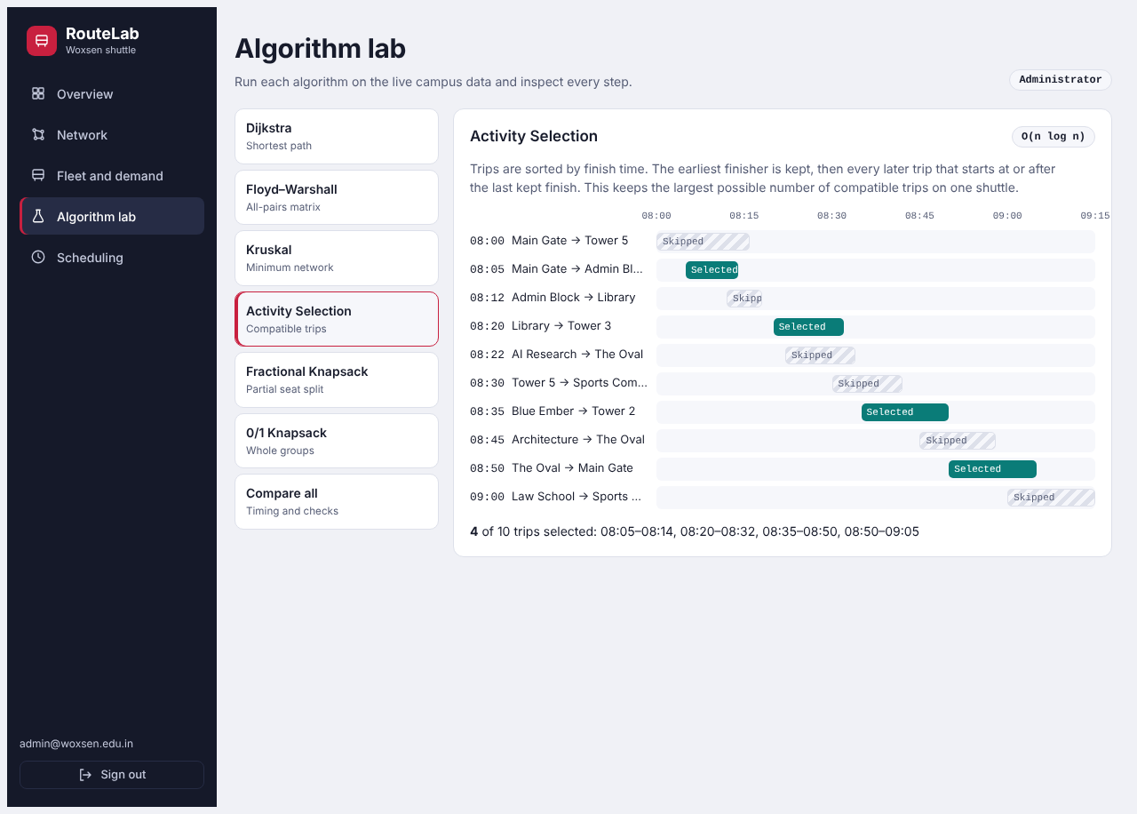

Checking results independently
Dijkstra agrees with Floyd–Warshall
144 stop pairs, 0 differences
Route time equals sum of road weights
All reconstructed paths checked
Kruskal result is a spanning tree
11 edges, weight 31, matches Prim
Trips do not overlap and are maximal
4 selected, matches a DP maximum
Seat allocations stay within capacity
Fractional and 0/1 both within 40 seats
Activity Selection in the algorithm lab
0/1 value never beats fractional bound
294 is at most 346
Notes:
I did not trust the screen output alone. Every result is checked by an independent condition: Dijkstra against Floyd-Warshall for all pairs, Kruskal against Prim, trip selection against a dynamic programming maximum, and capacity limits for both knapsack methods. These checks run live on the admin overview.

Slide 11


Limitations and future scope
Limitations
Future scope
Fixed sample data and estimated travel times
Simulated movement, no live GPS
Demo logins, not production security
One vehicle assumed in trip scheduling
Real road times and traffic-aware weights
Live shuttle location and a database
Real authenticated accounts
Multi-shuttle trip assignment
Notes:
This is an academic prototype. It uses fixed data and simulated movement. Future work could add real road times, live vehicle locations, a persistent database and multi-vehicle scheduling, while keeping routing, scheduling, allocation and presentation logic separate.

Slide 12
Thank you
Graph, greedy and dynamic programming algorithms working together on one campus problem. Questions are welcome.
Ishanth M
25WU0102101 | B.Tech CSE-AIML, Rhinos
Notes:
To summarise: each algorithm solves the sub-problem it suits, and putting them behind one working interface makes every result visible and checkable. Thank you. I am happy to take questions.

