Slide 1
Legal Case and Client Management System
Review 1 · Problem, ER design and initial schema
Project 58 · Database Management System · Ishanth M (25WU0102101)
Notes:
Review 1 (Week 7)

Slide 2
Problem and objectives
The problem
Law offices keep client, case, hearing, time, expense and billing records on paper. Deadlines are missed, billing is slow and errors go unnoticed.
1
Central database
One relational database for every case record
2
Rules in the database
Constraints and triggers protect data integrity
3
Role-based web app
Separate access for staff, lawyers and clients
4
Useful reports
Hearings, workload, billable time, dues

Slide 3
Scope and users
1
Administrator
2
Office clerk
3
Lawyer
4
Client
Manages users, reviews activity and reports
Registers clients and cases, bills and records payments
Sees own cases; logs hearings, tasks, time
Read-only view of own cases and invoices
In scope: registration, assignment, hearings, tasks, documents, time, expenses, invoices, payments, reports.
Out of scope: court e-filing, online payment gateway, document file storage.

Slide 4
Functional requirements
1
Registration
2
Assignment
3
Hearings
4
Tasks, documents
Clients and cases with unique case numbers
Assign one or more lawyers to a case
Schedule with no lawyer clashes
Track deadlines and filed papers
5
Time entry
6
Billing
7
Payments
8
Reports, search
Hours per lawyer, case and date
Invoices from time and expenses
Record part or full payments
Search and live reports

Slide 5
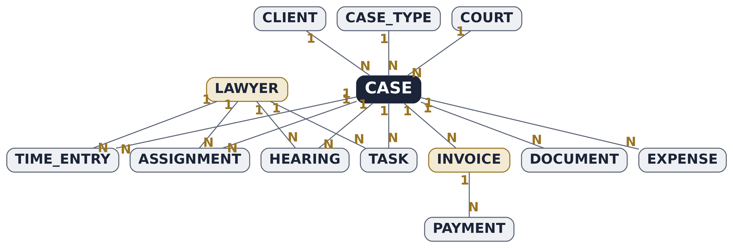
ER diagram
13 entities. Every relationship is one-to-many; case-to-lawyer many-to-many is resolved by ASSIGNMENT.

Slide 6
Key relationships
Entity A | Relationship | Entity B | Cardinality
CLIENT | files | CASE | 1 : N
CASE_TYPE / COURT | classifies / hears | CASE | 1 : N
CASE | is handled by (via ASSIGNMENT) | LAWYER | M : N
CASE | has | HEARING, TASK, DOCUMENT | 1 : N
LAWYER | attends / owns / logs | HEARING, TASK, TIME_ENTRY | 1 : N
CASE | incurs | TIME_ENTRY, EXPENSE | 1 : N
CASE | is billed by | INVOICE | 1 : N
INVOICE | is settled by | PAYMENT | 1 : N

Slide 7
Initial relational schema
Table | Primary key | Foreign keys
client, case_type, court, lawyer | own _id | none
legal_case | case_id (case_no UNIQUE) | client_id, type_id, court_id
assignment | (case_id, lawyer_id) | case_id, lawyer_id
hearing | hearing_id | case_id, lawyer_id
task | task_id | case_id, lawyer_id
document | document_id | case_id
time_entry | entry_id | case_id, lawyer_id
expense | expense_id | case_id
invoice | invoice_id | case_id
payment | payment_id | invoice_id

