Slide 1
Decentralized Communication Concepts
Messages and Streams are intercepted to enforce security policies
Runtime
Runtime
Decentralized Services
H
H
R
Data Sync Streams between Data Objects to ensure semantic interoperability
O
Msg Node
Identity Provider
Decentralized Trust
Identity Provider
Data Synchronisation Streams
P2P Messages flow between Services
Decentralized Messaging Framework
IdP Proxy
P2P
P
P
P2P
IdP Proxy
Protocol on-the-fly
Protocol Stacks are dynamically deployed to ensure transport interoperability

Slide 2
Decentralized Communication Concepts
Runtime
Runtime
Decentralized Services
H
H
R
O
Msg Node
Identity Provider
Decentralized Trust
Identity Provider
Data Synchronisation Streams
Decentralized Messaging Framework
IdP Proxy
P2P
P
P
P2P
IdP Proxy
Protocol on-the-fly

Slide 3
Messaging Framework implementation
Subscription Manager
Domain level Message Delivery
Msg Node
Data Sync Stream between Reporter and Observer
Any Messaging Protocol (Protofly)
P
P
Runtime
Runtime
Sandbox
Sandbox
Sandbox
Sandbox
Sandbox
Sandbox
Sandbox level Message Delivery
Hr
H
Ho
H
P2P
P2P
R
O
Mini BUS
Mini BUS
Mini BUS
Mini BUS
Mini BUS
Mini BUS
Native JSON Messaging
Runtime level Message Delivery
Msg BUS
Msg BUS
Data Sync Stream between Data Objects Reporter and Observer
Sync Manager
Sync Manager
Data Sync Stream Routing Path Control

Slide 4
Messaging Framework implementation
Subscription Manager
Domain level Message Delivery
Msg Node
Any Messaging Protocol (Protofly)
P
P
Runtime
Runtime
Sandbox
Sandbox
Sandbox
Sandbox
Sandbox
Sandbox
Sandbox level Message Delivery
Hr
H
Ho
H
P2P
P2P
R
O
Mini BUS
Mini BUS
Mini BUS
Mini BUS
Mini BUS
Mini BUS
Native JSON Messaging
Runtime level Message Delivery
Msg BUS
Msg BUS
Data Sync Stream between Data Objects Reporter and Observer
Sync Manager
Sync Manager
Data Sync Stream Routing Path Control

Slide 5
Messaging Framework implementation
Any Messaging Protocol (Protofly)
Native Standard Hyperty JSON Messaging
Msg Node
Subscription Manager
Domain level Message Delivery
P
Sync Manager
Sync Manager
P
Runtime
Runtime
Runtime level Message Delivery
Msg BUS
P2P
P2P
P2P
Msg BUS
Sandbox
Sandbox
Sandbox
Sandbox
Mini BUS
Mini BUS
Mini BUS
Mini BUS
Sandbox level Message Delivery
H
H
H
H
H
H
H
H

Slide 6
Identity Module
Identity Module
Policy Engine
Policy Engine

Slide 7
IDP
2) Generate Assertion
5) Validate Assertion
IDP Proxy
IDP Proxy
Identity Module
Identity Module
Sandbox
Sandbox
Runtime
Runtime
Policy Engine
Policy Engine
1)Intercept Outgoing Message
6-Message with Assertion Validated
Decentralized Messaging Framework
3) Message with Assertion
4) Intercept Incoming Message
Sandbox
Sandbox
Sandbox
Sandbox
H
H
H
H

Slide 8
Trust Model
IDP
Identity Module
Identity Module
Runtime
Runtime
2- Generate Assertion
5- Validate Assertion
IDP Proxy
IDP Proxy
Policy Engine
IDP Proxy Sandbox
IDP Proxy Sandbox
Policy Engine
2-Generate Assertion
5-Validate Assertion
1-Intercept Outgoing Message
6-Message with Assertion Validated
4-Intercept Incoming Message
3-Msg with Assertion
Decentralized Messaging Framework
Sandbox
Sandbox
Sandbox
Sandbox
H
H
H
H

Slide 9
Syncher and Sync Manager @ Hyperty Middleware
Data Sync Routing Path Management between Msg Node and Runtimes
Hyperty Runtime
Msg Node Sync Manager
Hyperty Runtime
Msg Node
Runtime Sync Manager
Runtime Sync Manager
Add Listeners to setup Data Sync Routing Path
Msg BUS
Msg BUS
Data Synchronisation Routing Path
Sandbox
Sandbox
Sandbox
Sandbox
Mini BUS
Mini BUS
Mini BUS
Mini BUS
Hr
H
H
Ho
H
Ho
Ho
Ho

Slide 10
ReTHINK Basic Comm Setup
Catalog
Catalog
Registry
Registry
H2
P2
H1
P1
H2
H1
Bob Service Provider
Alice Service Provider
9- Discover Bob’s Hyperty Instance
8- Load P2 Protostub
5- H1 Hyperty Instance is Registered
Msg Node
4- Load Protostub
Msg Node
10- Bob’s Hyperty receives Invitation from Alice’s Hyperty
2- load Hyperty
13- Data Sync Stream is established between
Alice and Bob Hyperties
P2
P2
P1
App Service Provider
Bob Device
6- Alice’s Connection Object is Created
App
Alice Device
H2
COo
App
14- AV Streams are Established
COr
H1
1- load App
Web App Server
IdP Proxy
7- Generate Assertion
IdP Proxy
12- Certify Assertion
Catalog
3- load IdP Proxy
IdP Server
IdP Proxy
11- load IdP Proxy
Alice’s Identity Provider

Slide 11
Simpler ReTHINK Basic Comm Setup
Bob’s Communication Service Provider
Alice’s Communication Service Provider
Registry
Catalog
Catalog
Registry
H2
8- Load P2 Protostub
H1
H2
P2
H1
P1
9- Discover Bob’s Hyperty Instance
5- H1 Hyperty Instance is Registered
10- Bob’s Hyperty receives Invitation from Alice’s Hyperty
Msg Node
Msg Node
13- Data Sync Stream established between Hyperties
2- load Hyperty
P2
P2
P1
App Service Provider
Bob Device
6- Alice’s Connection Object is Created
Alice Device
App
App
H2
COo
COr
H1
Web App Server
14- AV Stream is Established
1- load App
7- Generate Assertion
12- Certify Assertion
IdP Proxy
IdP Proxy
Catalog
IdP Server
IdP Proxy
3- load IdP Proxy
11- load IdP Proxy
Alice’s Identity Provider

Slide 12
Simpler ReTHINK Basic Comm Setup
Bob’s Communication Service Provider
Alice’s Communication Service Provider
11- Bob’s Hyperty receives Invitation and Data Sync Stream is established between Connection Reporter and Connection Observer Data Objects
7- Load P2 Protostub and connect to Bob’s CSP Message Node
Registry
Catalogue
Catalogue
Registry
H2
H1
H2
P2
H1
P1
8- Discover Bob’s Hyperty Instance
4- H1 Hyperty Instance is Registered
Msg Node
Msg Node
2- load Hyperty
P2
5-Connection Reporter Object is Created
P2
P1
App Service Provider
Bob Device
Alice Device
COo
COr
App
App
H2
H1
Web App Server
12- Bob’s Hyperty Observes Connection Object changes to setup AV Stream
1- load App
10- Certify Assertion
6- Generate Assertion
IdP Proxy
IdP Proxy
Catalogue
IdP Server
IdP Proxy
3- load IdP Proxy
9- load IdP Proxy
Alice’s Identity Provider

Slide 13

Register Hyperty Instance
Registry
Service Provider
Catalog
Edge Server Runtime
H1
P1
H2
Message Node
Load Hyperty
Messaging Communication between Hyperties
P1
H1
H3
User Device Runtime
H1
Media Stream Communication between Hyperties
IDP Proxy
Validate Assertions
Identity Provider
Generate Assertions

Slide 14
Messaging Oriented Middleware
router
router
router
router
router
router
H
H
H
H
H
H
H
H
router
router
router
router
router
router
router
H
H
H
H
H
H
H
H

Slide 15
Register Hyperty Instance
Registry
Service Provider
Catalog
H1
P1
Message Node
Load Hyperty
Messaging Communication between Hyperties
P1
H1
H3
User Device Runtime
H1
Media Stream Communication between Hyperties
IDP Proxy
Validate Assertions
Identity Provider
Generate Assertions

Slide 16
Catalog
H1
P1
Protocol on-the-fly
Web Microservice representing Users in client's Devices
or in the network
Hyperty executes in Web Runtimes
P1
P1
Protocol Messages
H1
H
Hyperty is securely associated to users
Hyperty Messages
chat
chat
bla bla
bla bla
User Relationship

Slide 17
Users Data
x
Users Data

Slide 18
Users Data

Slide 19
Users Data
Users Data
Users Data

Slide 20






Network
H1
Hyperty Communication
chat
chat
bla bla
bla bla
User Communication

Slide 21
Hyperty Plane
H1
H1
Hyperty Communication
Hyperty – User Association
Hyperty – User Association
User Plane
chat
chat
bla bla
bla bla
User Communication

Slide 22
Network
H1
H
Hyperty Communication
chat
chat
bla bla
bla bla
User Relationship

Slide 23

Reporter – Observer Synch Data Communication Pattern
Hyperty Data Object
Hyperty Reporter
O
Hyperty Observer
Hr
Ho
Hyperties are very developer friendly. Communication among Hyperties are base on a new P2P Data Synchronisation Reporter –Observer pattern where basicaly Hyperties only have to write on a JSON data object everytime there is a need to communicate with other Hyperties.
Everything else, including network protocols and identity management mechanisms, are handled by Hyperty Core Runtime and the Messaging Oriented Middleware.

Slide 24
Parent – Child Data Sync
Parent Hyperty Reporter
Parent Hyperty Observer
OP
Sync Object Parent
Ho
Hr
Child Hyperty Reporter
Child Hyperty Observer
OC
OC
OC
OC
OC
OC
Children Resource
containing several Child Objects

Slide 25
Catalog
H1
P1
Protocol on-the-fly
Web Microservice representing Users in client's Devices
or in the network
Hyperty executes in Web Runtimes
P1
P1
Protocol Messages
H1
H
Hyperty is securely associated to users
Hyperty Messages
chat
chat
bla bla
bla bla
User Relationship

Slide 26
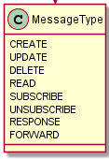
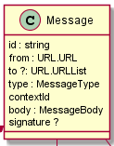
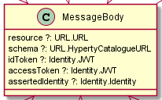
Hyperty Communication
P1
P1
Translated into Protocol Messages at User Devices
Hyperty Messages
Resource Oriented Communication based on CRUD operations
H1
H
Media/Data Streams
Stream communications are not mandatory but if required it is supported by the WebRTC standard

Slide 27
router
router
router
router
router
router
H
H
H
H
H
H
H
H
router
router
router
router
router
router
router
H
H
H
H
H
H
H
H

Slide 28
Messaging Oriented Middleware
router
router
router
router
router
router
Router Message Delivery Domain
H
H
H
H
H
H
H
H
Router Message Delivery Domain
router
router
router
router
router
router
router
H
H
H
H
H
H
H
H

Slide 29
router
router
router
router
router
router
H
H
H
H
H
H
H
H
router
router
router
router
router
router
router
H
H
H
H
H
H
H
H

Slide 30
Messaging Oriented Middleware
router
router
Routing Management
Routing Management
router
router
Routing Management
router
router
H
H
Routing Management
H
H
H
H
H
H
Routing Management
router
router
router
router
router
router
router
H
H
H
H
H
H
H
H

Slide 31
Messaging Oriented Middleware
router
router
Routing Management
Routing Management
router
router
Routing Management
router
router
H
H
Routing Management
H
H
H
H
H
H
Routing Management
router
router
router
router
router
router
router
H
H
H
H
H
H
H
H

Slide 32
Syncher – Sync Manager Networking
Msg Node Sync Manager
Runtime Sync Manager
Runtime Sync Manager

Slide 33
Syncher – Sync Manager Networking
router
router
router
router
router
router
router
H
H
H
H
H
H
H
H

Slide 34
Messaging Oriented Middleware
router
router
router
router
router
router
H
H
H
H
H
H
H
H
router
router
router
router
router
router
router
H
H
H
H
H
H
H
H

Slide 35
Syncher and Sync Manager @ Hyperty Middleware
Data Sync Routing Path Management between Msg Node and Runtimes
Hyperty Runtime
Msg Node Sync Manager
Hyperty Runtime
Msg Node
Runtime Sync Manager
Runtime Sync Manager
Add Listeners to setup Data Sync Routing Path
Msg BUS
Msg BUS
Data Synchronisation Routing Path
Sandbox
Sandbox
Sandbox
Sandbox
Mini BUS
Mini BUS
Mini BUS
Mini BUS
Hr
H
H
Ho
H
Ho
Ho
Ho

Slide 36
Hyperty Trust Model
Trust Layer
IdPy
Identity Module
Identity Module
2-Generate Assertion
5-Validate Assertion
Policy Engine
Policy Engine

Slide 37
Trust Model
Trust Layer
IDP
Hyperty Runtime
Hyperty Runtime
Identity Module
Identity Module
2-Generate Assertion
5-Validate Assertion
Policy Engine
Policy Engine
Hyperty Messaging Framework
1-Intercept Outgoing Message
3-Message with Assertion
4-Intercept Incoming Message
6-Message with Assertion Validated
H
H
H
H

Slide 38
Hyperty Trust Model
Identity Module
Identity Module
Policy Engine
Policy Engine

Slide 39
Sandbox
Sandbox
Sandbox
Sandbox

Slide 40
Trust Model
IDP
Runtime
Runtime
IDP Proxy
IDP Proxy
IDP Proxy Sandbox
IDP Proxy Sandbox
Decentralized Messaging Framework
Sandbox
Sandbox
Sandbox
Sandbox
H
H
H
H

Slide 41
Trust Model
IDP
Identity Module
Identity Module
Runtime
Runtime
2- Generate Assertion
5- Validate Assertion
IDP Proxy
IDP Proxy
Policy Engine
IDP Proxy Sandbox
IDP Proxy Sandbox
Policy Engine
2-Generate Assertion
5-Validate Assertion
1-Intercept Outgoing Message
6-Message with Assertion Validated
4-Intercept Incoming Message
3-Msg with Assertion
Decentralized Messaging Framework
Sandbox
Sandbox
Sandbox
Sandbox
H
H
H
H

Slide 42
Trust Model
IDP
Identity Module
Identity Module
Runtime
Runtime
2- Generate Assertion
5- Validate Assertion
IDP Proxy
IDP Proxy
Policy Engine
IDP Proxy Sandbox
IDP Proxy Sandbox
Policy Engine
2-Generate Assertion
5-Validate Assertion
1-Intercept Outgoing Message
6-Message with Assertion Validated
4-Intercept Incoming Message
3-Msg with Assertion
Decentralized Messaging Framework
H
H
H
H

Slide 43
Protofly
IDP
Hyperty Runtime
Hyperty Runtime
IDP Proxy
P1
Protostub Sandbox
Protostub Sandbox
Mini BUS
Mini BUS
Msg BUS
Msg BUS
Sandbox
Sandbox
Sandbox
Mini BUS
Mini BUS
Sandbox
Mini BUS
Mini BUS
Hr
H
H
Ho
H
Ho
Ho
Ho

Slide 44
Protofly
Msg Node 2
Msg Node 1
Protostub
Hyperty Runtime
Hyperty Runtime
Protostub
P2
P1
P1
Protostub Sandbox
Protostub Sandbox
Protostub Sandbox
Mini BUS
Mini BUS
Mini BUS
Msg BUS
Msg BUS
Sandbox
Sandbox
Sandbox
Mini BUS
Mini BUS
Sandbox
Mini BUS
Mini BUS
Hr
H
H
Ho
H
Ho
Ho
Ho

Slide 45
Messaging Oriented Middleware
Domain level Message Delivery
Msg Node
Any Messaging Protocol (Protofly)
P2P
Runtime
Native Standard Hyperty JSON Messaging
Runtime
Runtime level Message Delivery
Msg BUS
Msg BUS
Sandbox
Sandbox
Sandbox
Sandbox
Sandbox level Message Delivery
Mini BUS
Mini BUS
Mini BUS
Mini BUS
H
H
H
H
H
H
H
H

Slide 46
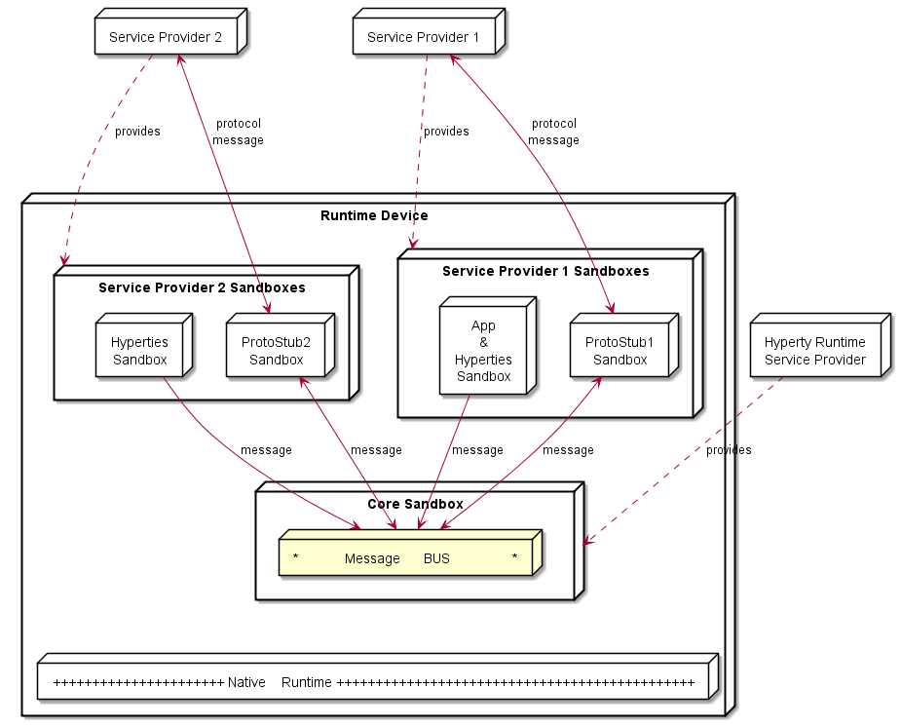
Hyperty Runtime High Level Architecture(1)

Slide 47
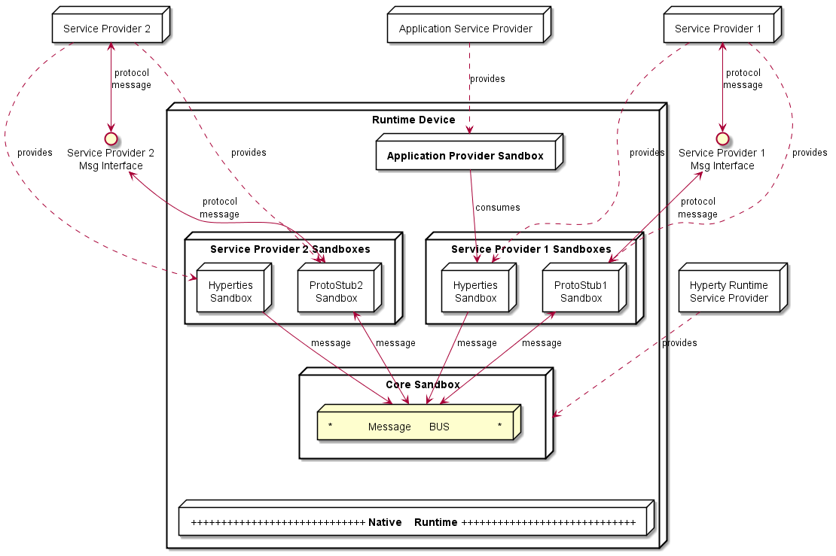
Hyperty Runtime High Level Architecture (2)

Slide 48
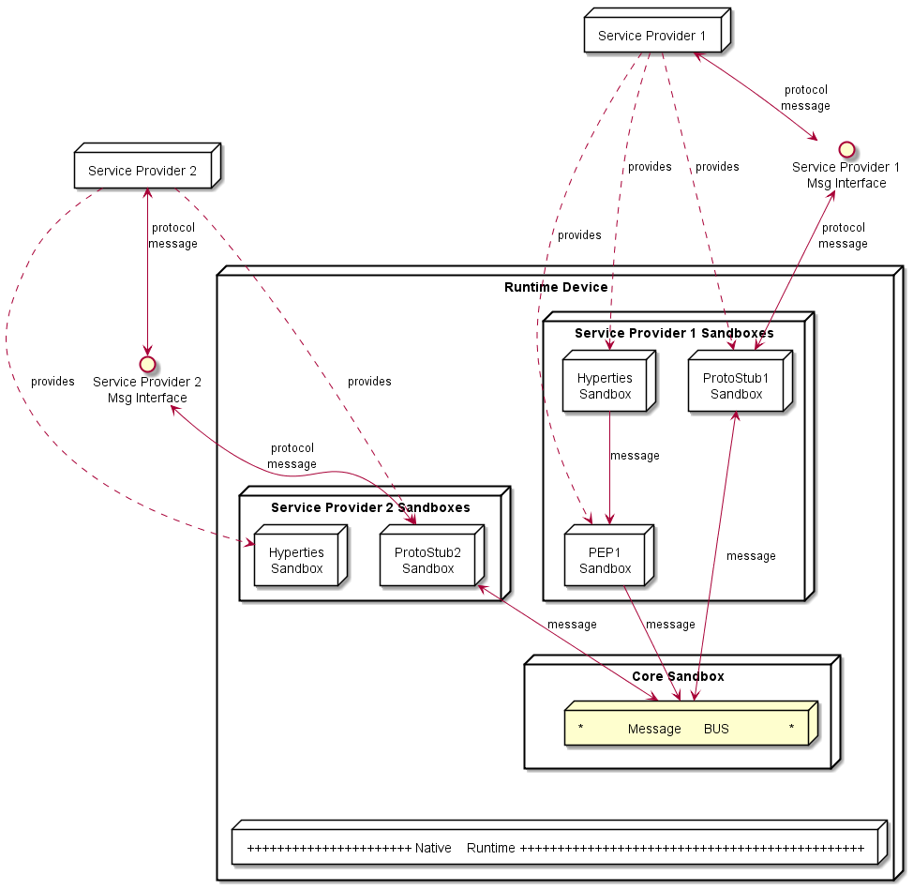
Hyperty Runtime High Level Architecturen(3)

Slide 49
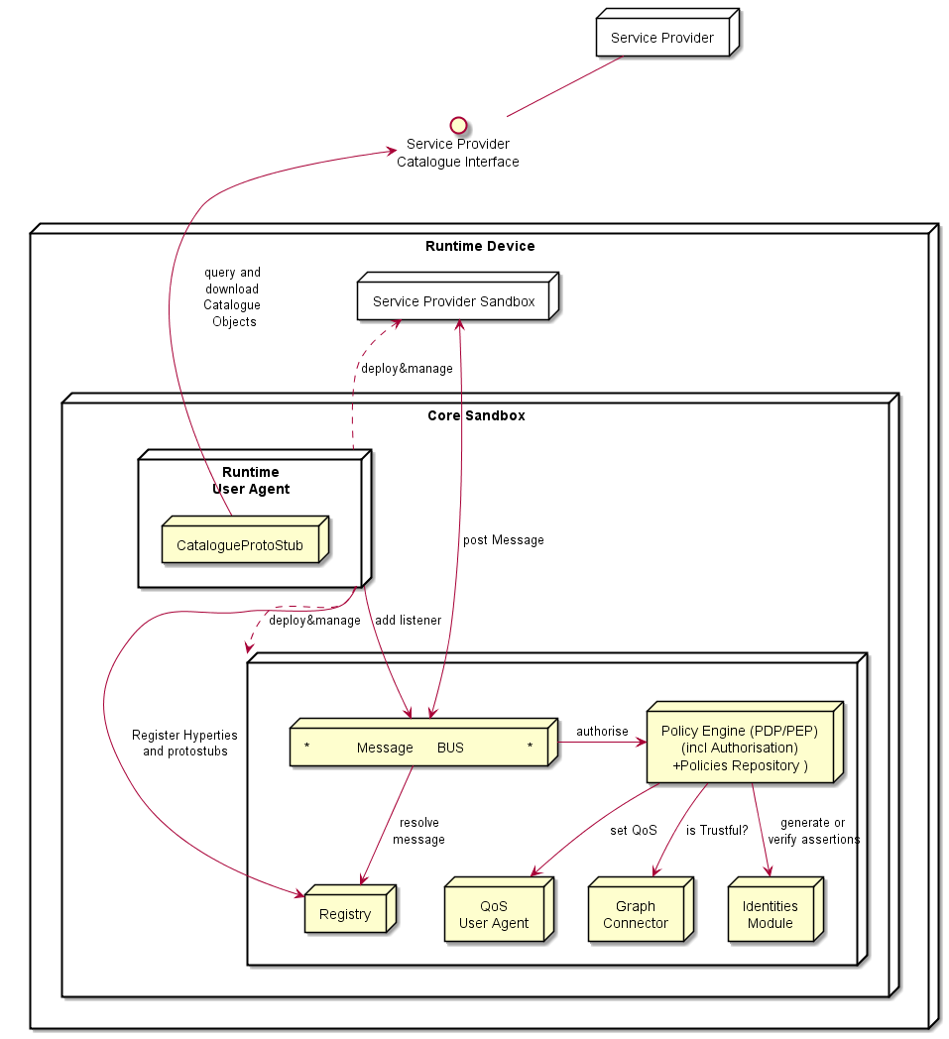
Hyperty Core Runtime Architecture

Slide 50
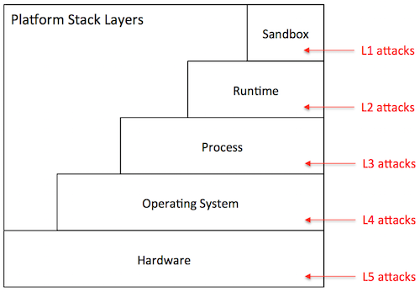

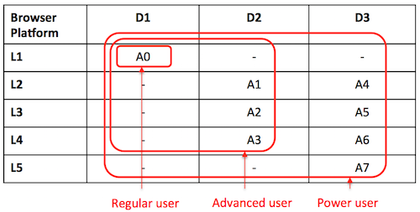
Runtime Architecture Security Analysis

Slide 51
Hyperty Runtime Basic Procedures
Hyperty Instances Registry
Alice Service Provider
Catalog
H1
P1
Msg Node
P1
Alice Device
Runtime UA
Protostub Sandbox
Msg BUS
Runtime Registry
Hyperty Sandbox
H1
WebRTC Engine

Slide 52
Hyperty Runtime Basic Procedures
Catalog
Bob Service Provider
Alice Service Provider
H2
P2
Msg Node
Msg Node
P2
P1
Protostub Sandbox
Alice Device
Runtime UA
Protostub Sandbox
Msg BUS
Hyperty Sandbox
H1
WebRTC Engine

Slide 53
Hyperty Runtime Basic Procedures
Bob Service Provider
Alice Service Provider
Msg Node
Msg Node
P2
P2
P1
Protostub Sandbox
Bob Device
Protostub Sandbox
Alice Device
Protostub Sandbox
Msg BUS
Msg BUS
Hyperty Sandbox
Hyperty Sandbox
H2
H1
WebRTC Engine
WebRTC Engine
Media Stream

Slide 54
P2P Protostub Connections
Alice Service Provider
Signalling to Setup P2P Connection uses Message Nodes and associated protostubs
Bob Service Provider
Msg Node
Msg Node
P2
P1
P2
P1
Protostub Sandbox
Protostub Sandbox
Protostub Sandbox
Alice Device (Requester)
Bob Device
Protostub Sandbox
Msg BUS
Msg BUS
WebRTC Engine
P2P Requester Stub Sandbox
WebRTC Engine
P2P Handler Stub Sandbox
P2P Req
P2P Handler
P2P Connection
P2P Connection
P2P Req
P2P Req
Carol Device (Requester)
David Device (Requester)

Slide 55
Hyperty Resource Data object
Reporter – Observer Communication Pattern

Slide 56
Reporter – Observer Synch Data Communication Pattern
Resource Synch Data JSON Object
Hyperty Observer
Ho
Hyperty Reporter
O
Hr
Ho
Hyperty Observer
Service Level Interoperability is based on standard Synch Data JSON Schema
Ho
Hyperty Observer

Slide 57
Create / Read Object
Hyperty Observer
Ho
ObjectURL
O
read
Hyperty Reporter
Hr
create
read
Ho
Hyperty Observer
authorise
Sync Manager
read
Ho
Hyperty Observer

Slide 58
Subscribe Object Changes
Hyperty Observer
Ho
ObjectURL\subscription
O
Subscribe
Hyperty Reporter
Hr
Subscribe
Ho
Hyperty Observer
Sync Manager
Subscribe
Ho
Hyperty Observer
authorise

Slide 59
Object Update
Hyperty Observer
Ho
ObjectURL\changes
update
O
Hyperty Reporter
Hr
Ho
Hyperty Observer
Ho
Hyperty Observer

Slide 60
Mobility
Hyperty Observer
Ho
update
O
Hyperty Reporter
Hr
Ho
Hyperty Observer
update
Ho
Hyperty Observer
Abstraction from Network or Hyperty Adresses Facilitates object and hyperty mobility

Slide 61
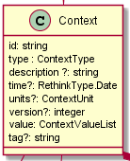
Context Hyperty
D
Context
A
B
C
Context Data Model

Slide 62
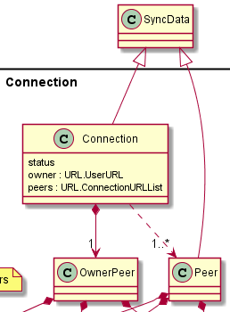
Connector Hyperty
Connection
A
B
PeerB
Connection Data Model

Slide 63
Standardised APIs and Message Model
Syncher and Message BUS APIs
Protostub API
Message Model
URL entry points

Slide 64
M2M / IoT

Slide 65
M2M: Smart Contextual Assistance
Registry
Service
Provider
Public Service Provider Managing Individual/Family domains and Backup
Catalog
H1
P1
BUS
Manage
Backup
Wearable bracelet
Paired with Smartphone
or Residential GW
Registry
Alice Residential
Gateway
Catalog
Runtime
Hyperty Sandbox
H1
H1
P1
BUS
Residential GW featuring complete reTHINK Framework to support an Individual / Family
(Alice) domain
Runtime
Hyperty Sandbox
H1
Smartphone
Featuring Hyperty Runtime

Slide 66
M2M: Smart Contextual Assistance
Registry
Service
Provider
Catalog
H1
P1
BUS
Deploy Residential GW Protostub / Health Hyperties, House Room Hypertiy
Registry
Alice Residential
Gateway
Catalog
Runtime
H1
P1
H2
BUS
Runtime
MyHealth Hyperty
P1
H1
H3
Connect to Residential GW and register Hyperties
House Room Hyperty
Bracelet Hyperty

Slide 67
M2M: Smart Contextual Assistance
Registry
Service
Provider
Catalog
H1
P1
BUS
Registry
Alice Residential
Gateway
Catalog
Runtime
H1
P1
H2
BUS
Runtime
Publish Bracelet Data
P1
H1

Slide 68
Register Hyperty Instance
Registry
Service Provider
Catalog
H1
P1
Message Node
Load Hyperty
Messaging Communication between Hyperties
P1
H1
H3
User Device Runtime
H1
Media Stream Communication between Hyperties
IDP Proxy
Validate Assertions
Identity Provider
Generate Assertions

Slide 69
Backend Support Services
Catalog
Registry
Message Node
Identity Provider

