Slide 1

Exploratory Data Analysis
on
AMEO - Aspiring Minds 2015 dataset
BY - ISHAQ MIYAWALA

Slide 2
About me
I am an aspiring Data Scientist Currently in Ultimate year of Bachelors in IT at GEC, Gandhinagar
I am currently working as Data Science Intern at Innomatics Research Labs.
Do check out my socials -> LinkedIn
Dataset Info:
The Aspiring Minds Computer Adaptive Test (AMCAT) is a challenging pre-employment assessment that helps freshers land a job.
The dataset was released by Aspiring Minds from the Aspiring Mind Employment Outcome 2015 (AMEO). The study is primarily limited only to students with engineering disciplines. The dataset contains the employment outcomes of engineering graduates as dependent variables (Salary, Job Titles, and Job Locations) along with the standardized scores from three different areas – cognitive skills, technical skills and personality skills. The dataset also contains demographic features. The dataset contains around 40 independent variables and 4000 data points. The independent variables are both continuous and categorical in nature. The dataset contains a unique identifier for each candidate. Below mentioned table contains the details for the original dataset.

Slide 3
Data Preprocessing
the amcat score data for various engineering branches contains wide amount of -1, which means that the examinee didn't gave that particular module(optional) exam in amcat, hence we can count as null value
1. we will first see the percentage of these null values
2. remove those columns with way higher # of null values (>85%)
3. Update the -1 values as Nan values in dataset
I than imputed all the null values using various technique like mean, median modes etc.
I cleaned the categorical textual columns by replacing it appropriate categories using mixed techniques of fuzzywuzzy (levenshtein distance) and keyword mapping
Deleted outliers from the columns and dropped the unnecessary columns.
Added Columns like Age, Tenure and SalaryBin for ease in EDA
Saved the updated dataframe in a csv format

Slide 4
EDA - General observations
75% of these employed people have less than 2 years of tenure in the current company
Average age of employed people is around 24 years
Average percentage for 10th and 12th are 77.9% and 74.47%
This indicates that people enrolled in amcat generally have higher academic scores
which is also proved by collegeGPA average being 71.7
Average score in each AMCAT module is in range of 500-600, where the total marks in each module is 900
Average salary is around 3,00,000 INR

Slide 5
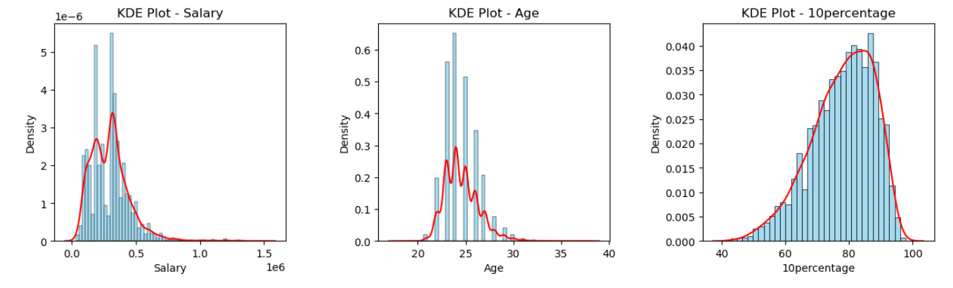
Univariate Analysis
We can see that salary is highly colluded in the middle and percentage follows a normal distribution with left skew

Slide 6
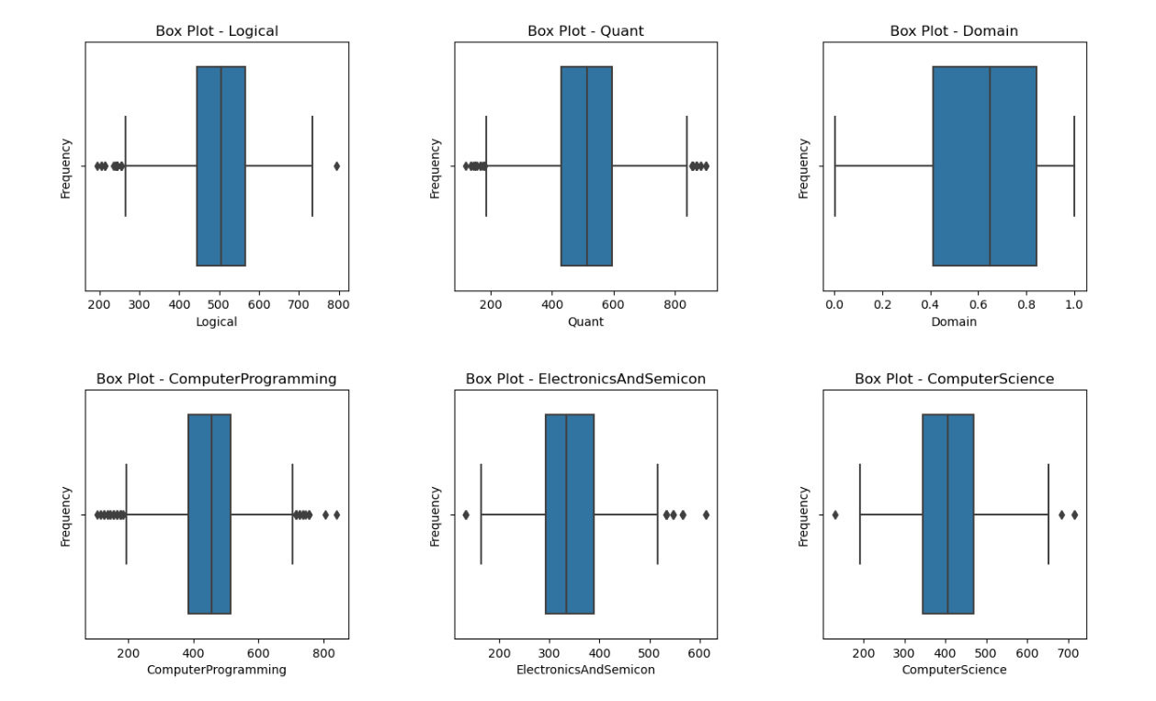
Univariate Analysis
These are the box plots for few of the features, these are box plots for marks obtained in AMCAT exams by graduates
As we can see that majority of the marks distribution is in the range of 500-600 for all the graduates which we first concluded from the general observations

Slide 7
Univariate Analysis
We can see that salary is highly colluded in the middle and percentage follows a normal distribution with left skew

Slide 8
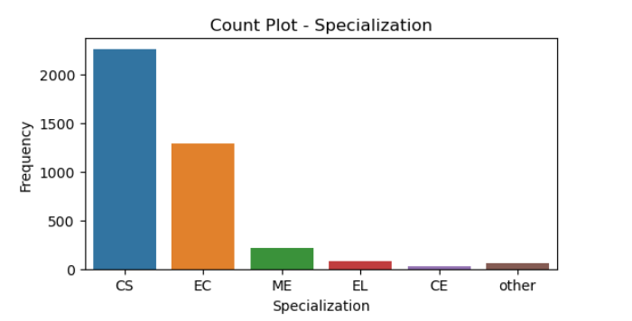
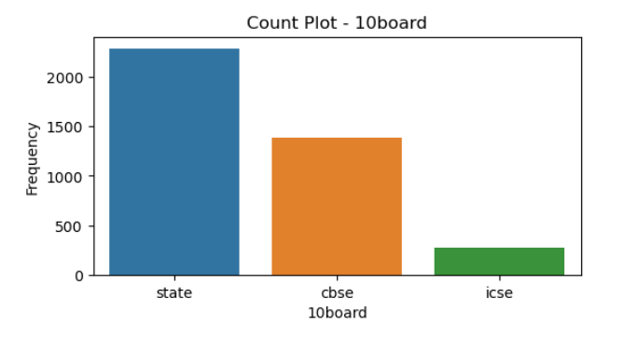
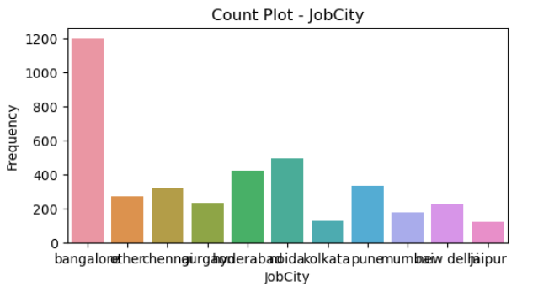
Univariate Analysis - bar plots
As we can see that graduates are mostly from CS background and have studied in state boards.
Also, Banglore is the city with the maximum amount of graduates working there by a huge margin

Slide 9
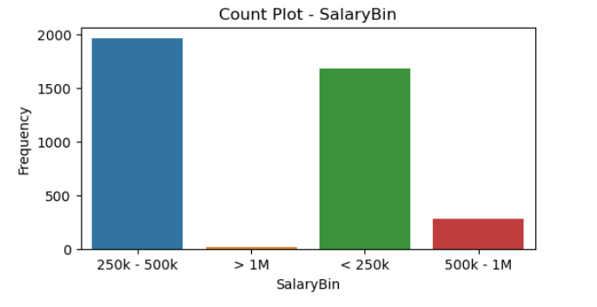
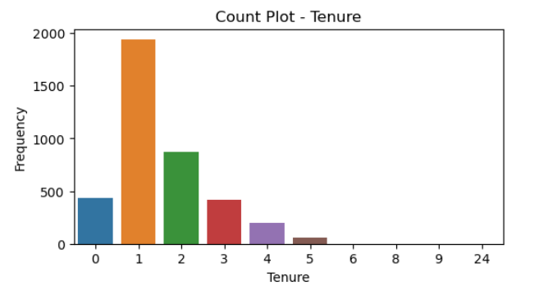
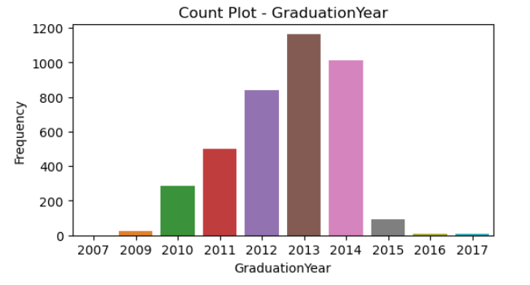
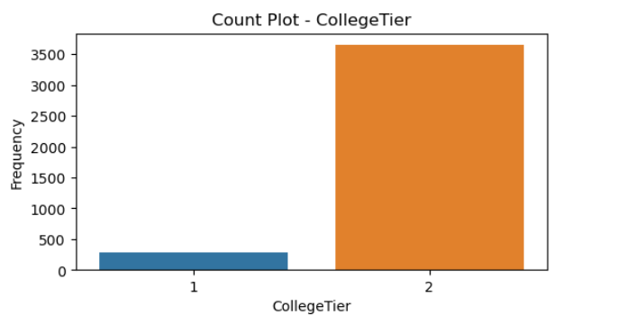
Univariate Analysis

Slide 10
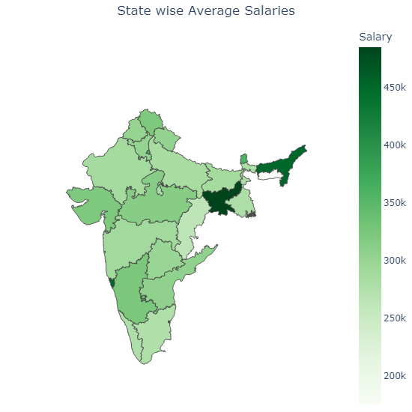
Geo Analysis
This Graph indicates the average salaries state wise in which the student has done their graduation.
Jharkhand has the highest average salary of around 4,85,000 INR, this may be correlated to great number of tier -1 colleges in the state like IIT Dhanbad, NIT jamshedpur etc
The states not represented here are the states with missing data in our dataset i.e. no student studied from those states that gave the AMCAT exams

Slide 11
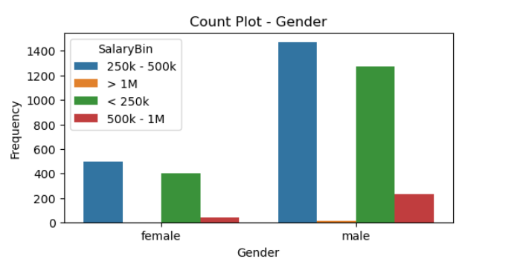
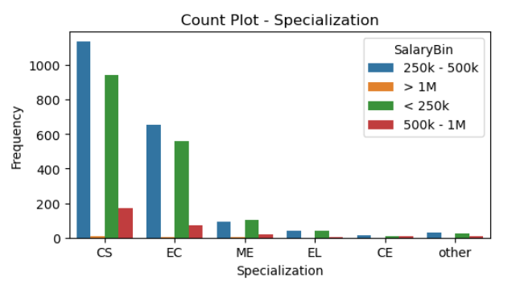
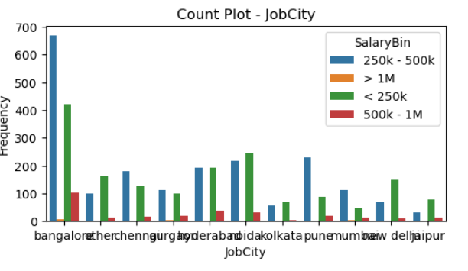
Bivariate Analysis
Males have higher ratio of earning than females between
250k - 500k to <250k
People pursuing Mechanical engineering earn around 250k
Pune has the comparatively highest percentage of graduates earning between 250k - 500k

Slide 12
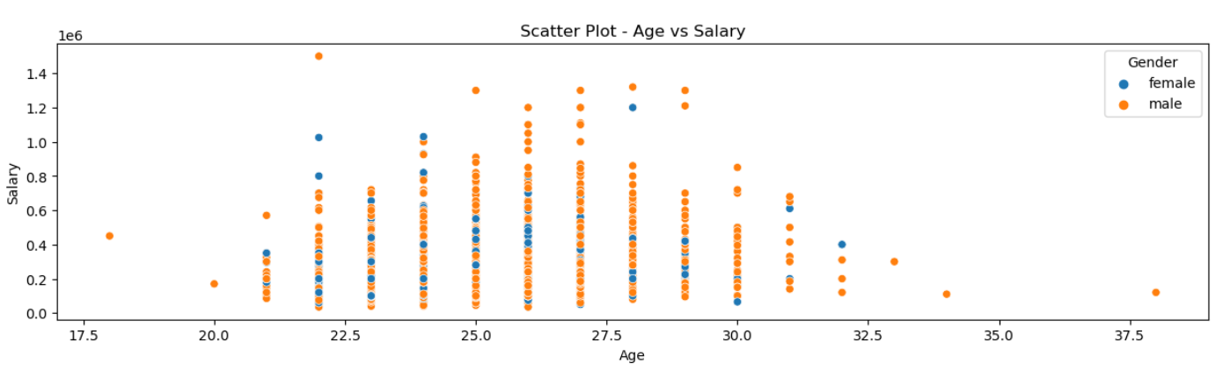
Bivariate Analysis
There’s no as such correlation between age and salary.
Males have a higher average salary than females with,
Males average salary being 3,03,017 INR and females average salary being 2,87,820 INR

Slide 13
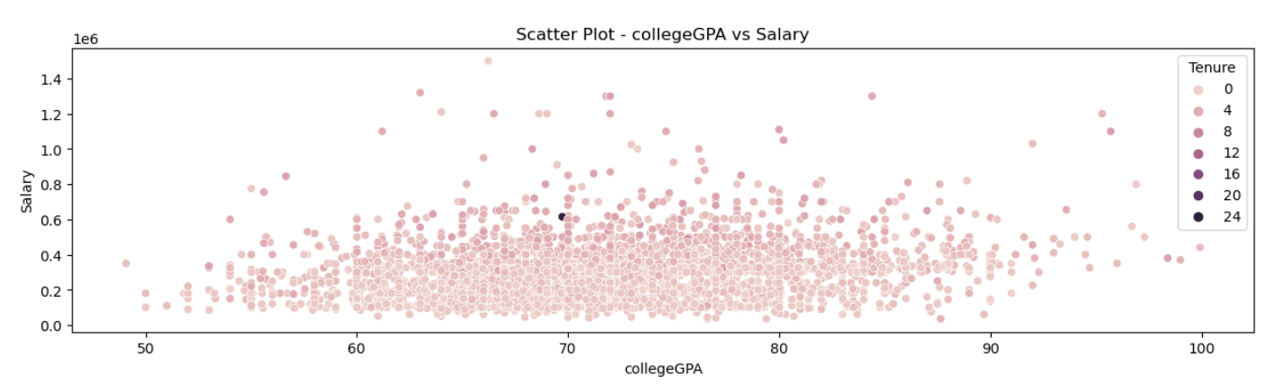
Bivariate Analysis
Higher the Tenure, higher the compensation for the Graduate, which can also be seen in all the job markets
As college GPA increases the salary also increases - positive correlation

Slide 14
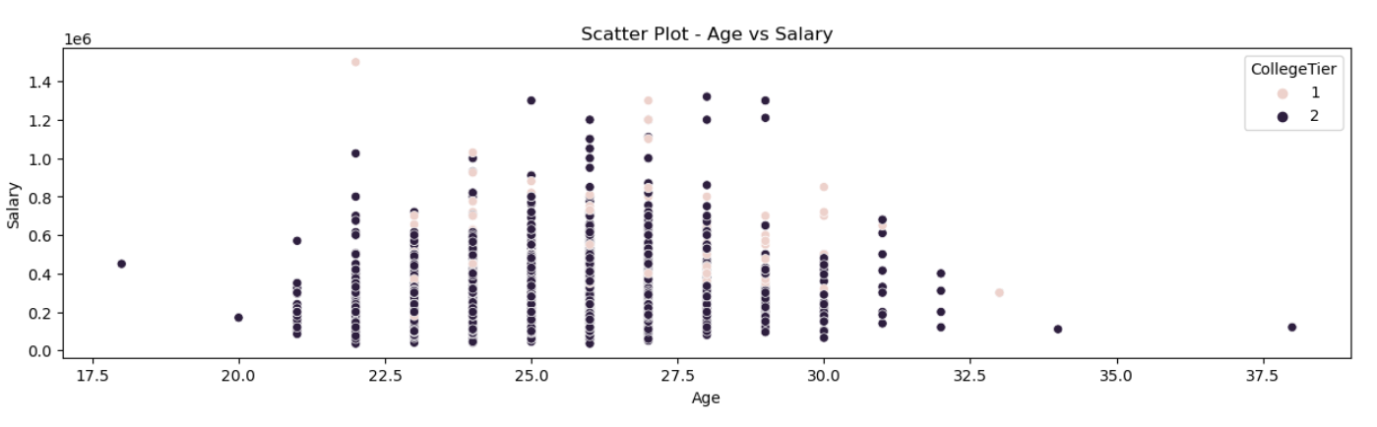
Bivariate Analysis
We can see that People graduating from the tier 1 colleges generally get higher salaries than people from other colleges

Slide 15
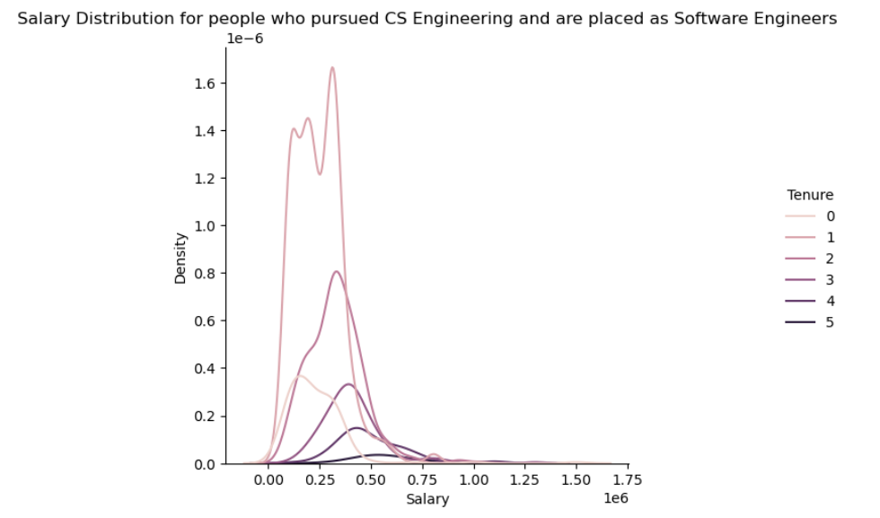
Hypothesis testing
Times of India article dated Jan 18, 2019 states that “After doing your Computer Science Engineering if you take up jobs as a Programming Analyst, Software Engineer, Hardware Engineer and Associate Engineer you can earn up to 2.5-3 lakhs as a fresh graduate.
As we can infer from the density graph that the people with 0 tenure i.e. experience of zero years(freshers) have the lightest shade which reaches the peak in the range 0.25- 3.5
Thus we can infer that students who pursued Computer science in bachelor’s are earning around 2.5-3 lakhs as freshers

Slide 16
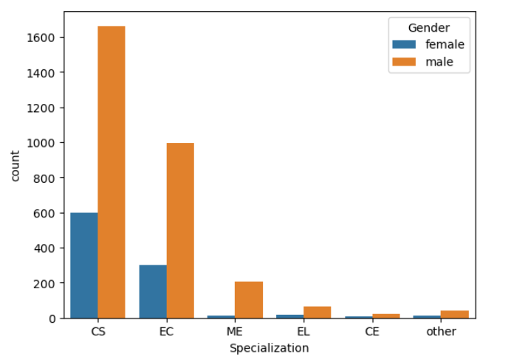
relationship between gender and specialization? (i.e. Does the preference of Specialisation depend on the Gender?)
All genders prefer to go for computer science related specializations
There are more males than females in every specialization
Females doesn’t prefer for specializations related to mechanical engineering as it has the highest ratio of male to female with 20:1 ratio
Computer Science has the least ratio of 1:3 i.e. 1 female for every 3 males

Slide 17
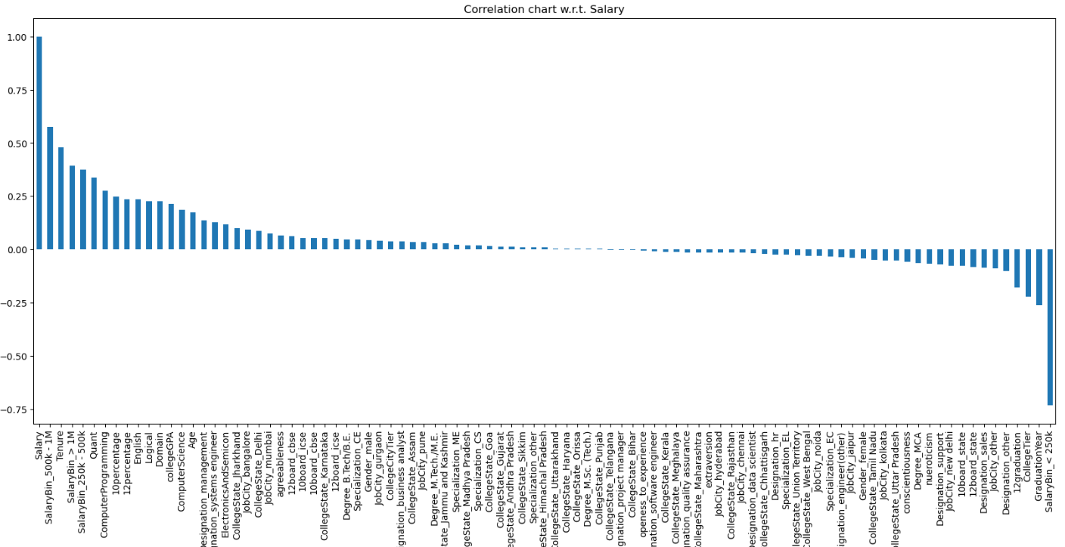
Correlation chart with target Variable i.e. Salary

Slide 18
Conclusion
This Eda was conducted mainly considering Salary as our target feature so that further processes like model building etc can be done
The features with highest positive correlation with salary are:
Tenure
Quant module
Computer Programming
10th standard percentage
12th standard percentage
The features with highest negative correlation with salary are:
Graduation Year of college
CollegeTier i.e.(tier of college)
Designation - other (Designation which is not popular or niche)
JobCity - other (cities other than the top 10 where graduates are placed)
Males generally earn higher compared to Females, this can be due to different career choices.
People going to Tier-1 colleges have a higher chance of getting high packages
People scoring good in exams like AMCAT, and GPAs from their colleges get higher salaries
Bangalore city gets the highest number of graduates which means that more companies are based in Bangalore

Slide 19
Conclusion
most people have salaries in range 200k - 400k per annum
graduates Gender ratio is 3:1 for male:female
almost 40% of the graduates work as software engineer or related fields
Graduates working in bengaluru are around 32%
Most people gave their 10th and 12th exams in state board
Almost 88% of people have completed just bachelors related engineering degree
More than 50% people did Computer Science specialization in their degree
24% People Graduated from the colleges based in Uttar Pradesh
Most people graduated in 2013
Most people have studied in tier-2 college, which is feasible as there are only limited # of tier-1 colleges in India
Most people placed via AMCAT are either freshers i.e. just joined the jobs or have 1 year experience

Slide 20

THANK YOU

