Slide 1






StudyBuddy
An iOS Study Tracker App
Built with SwiftUI & SwiftData - one app to organize, track, and improve your study habits.
IOS 17+
SWIFT 5.9
SWIFTDATA

Slide 2


The Problem Students Face
📚 Too Many Subjects
📋 Planners Get Lost
Juggling multiple courses, deadlines, and schedules with no unified system
Paper planners are unreliable - easy to misplace and hard to update
📅 Wrong Tools
Calendar apps track events, not study sessions or academic progress
StudyBuddy's solution: Schedule, tasks, Pomodoro timer, and progress tracking - all in one place.

Slide 3
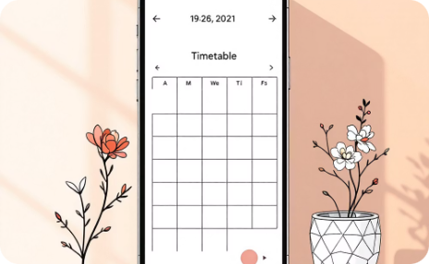
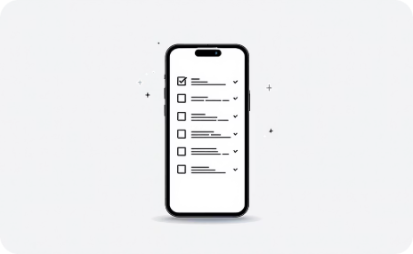
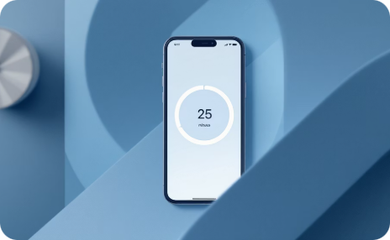
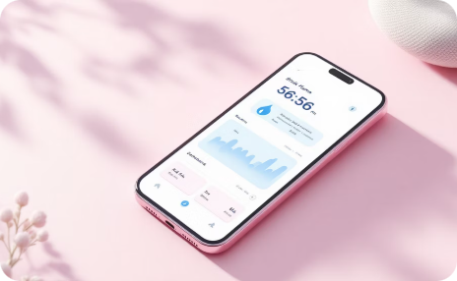
Core Features
Smart Timetable
Prioritized Tasks
Pomodoro Timer
Study Streaks
A/B week rotation keeps your class schedule accurate and always up to date
Task list with priority levels so you always know what to tackle next
25/5 focus cycles built in — stay focused, take breaks, build momentum
Track daily study sessions and maintain your streak to stay motivated

Slide 4
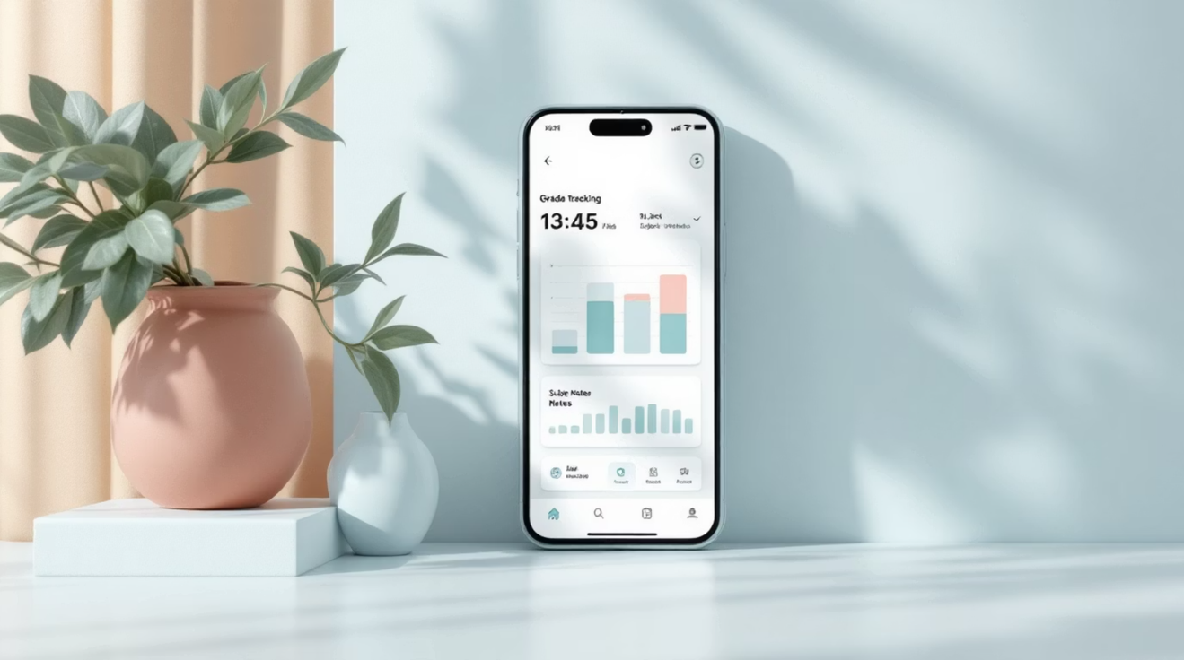
Extra Features
📊 Grade Tracking
Log grades per subject and view running averages at a glance
📝 Subject Notes
Attach quick notes directly to each subject for easy reference
🔔 Deadline Alerts
Local notifications remind you before upcoming tasks are due

Slide 5
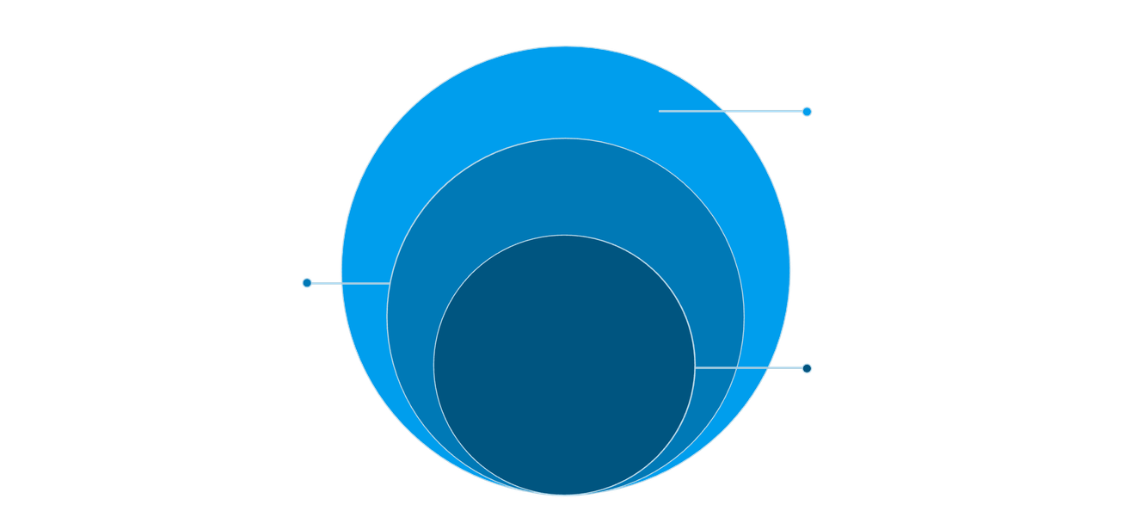
Technical Architecture
Database
SwiftData ModelContainer persists and queries data
ViewModel
Holds business logic and manages state
View
SwiftUI views render the UI and bind to state
StudyBuddy follows MVVM architecture — SwiftUI views bind to ViewModels, which manage state and interact with a SwiftData persistence layer.
Swift 5.9
SwiftUI
Latest language features
Declarative UI framework
SwiftData
iOS 17+
Native data persistence
Modern platform APIs

Slide 6

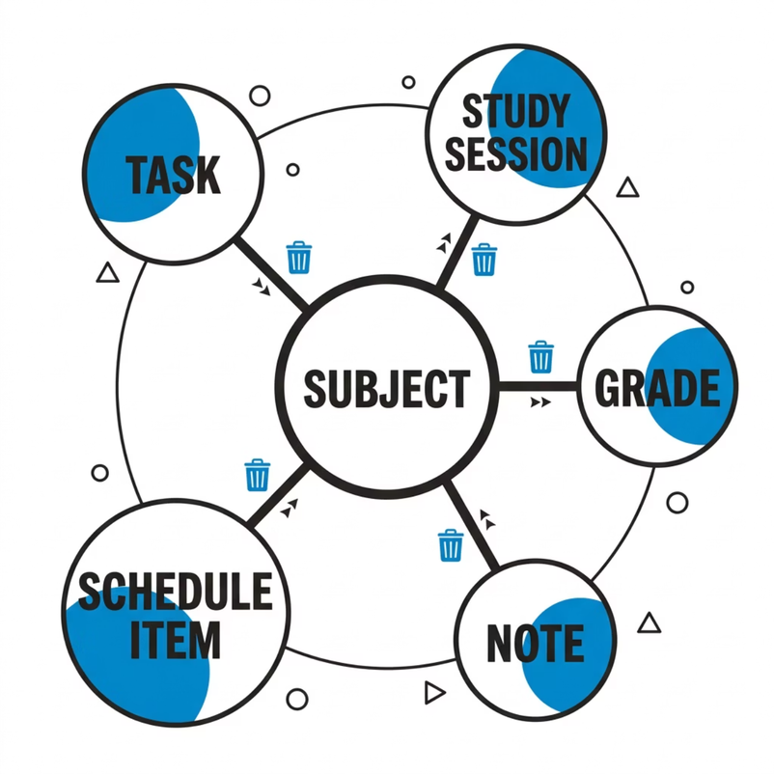
Database Design
Built entirely with SwiftData, the data layer uses six models all connected to a central Subject entity. Cascade delete ensures referential integrity when subjects are removed.
Subject
Task
StudySession
Grade
Note
ScheduleItem

Slide 7

Challenges & Solutions
1
2
SwiftData Context Issue
Timer Persistence
Problem: Multiple ModelContexts caused data inconsistency Fix: Shared ModelContainer injected via environment
Problem: Timer state lost on app suspend Fix: Persist session data every second to SwiftData
3
Segmented Control UI
Problem: Default control didn't match design Fix: Replaced with custom animated button group

Slide 8

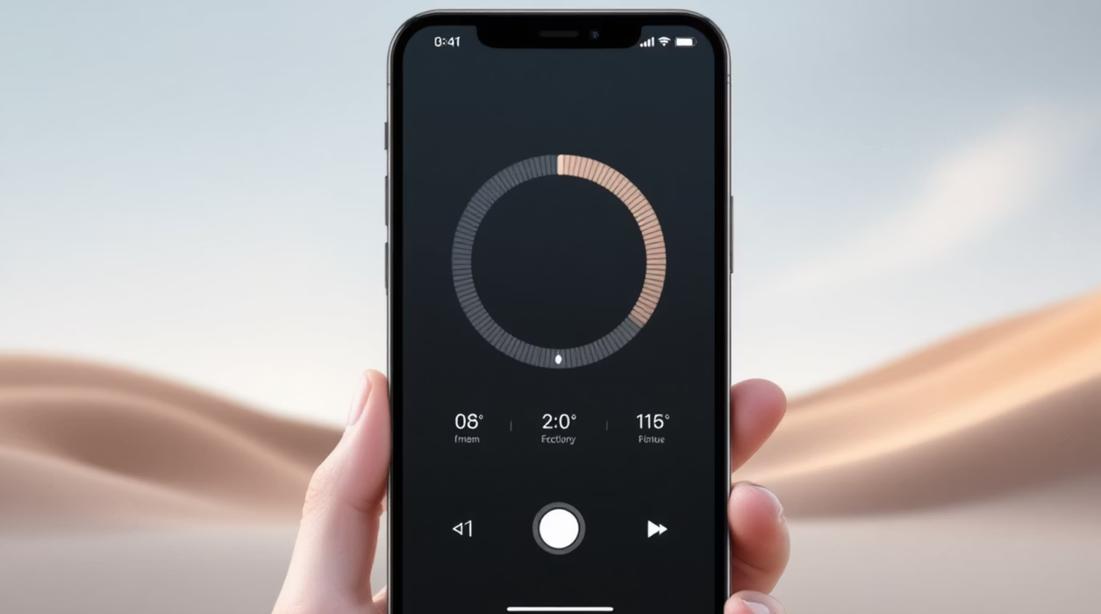


Animations & Polish
Timer Ring
Animated circular progress ring that fills during Pomodoro sessions
Task Completion
Satisfying checkmark animation when marking tasks complete
Animated Counters
Number counters animate when displaying stats and streaks

Slide 9
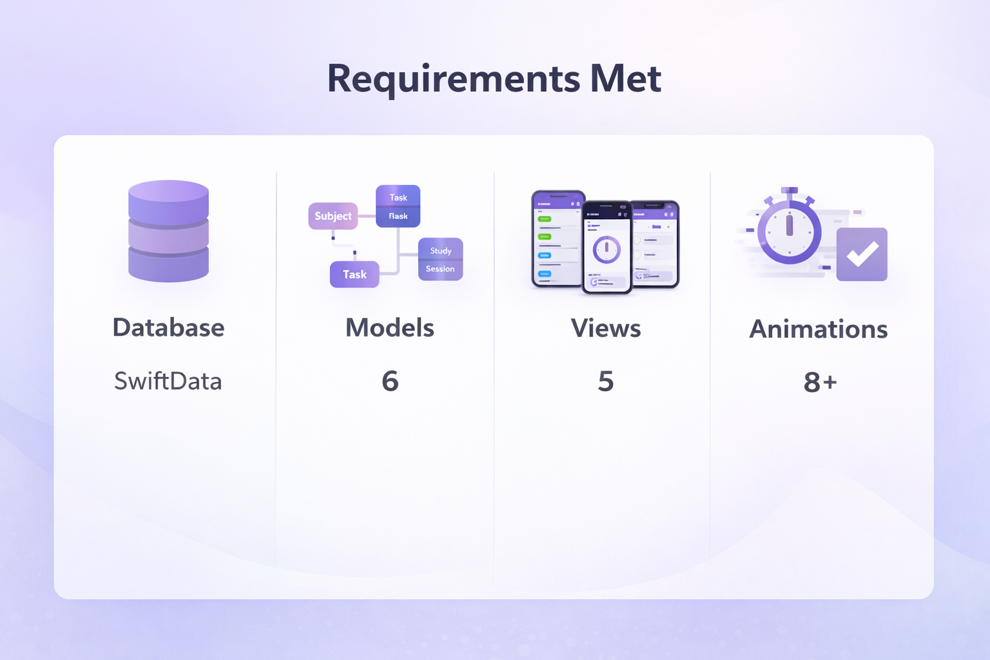
Live Demo

Slide 10
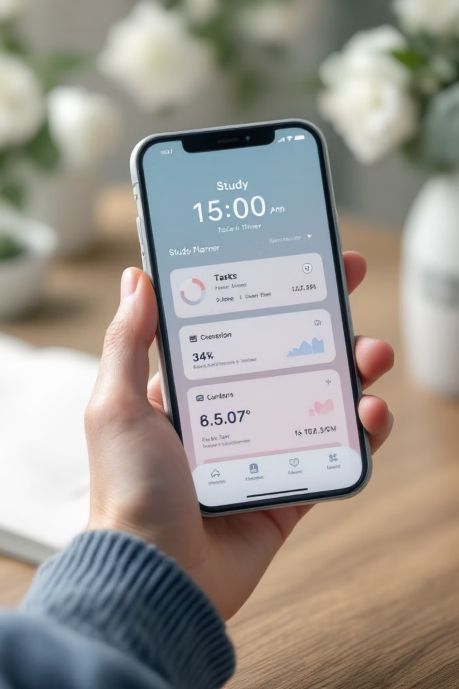

Conclusion
What Went Well
Clean, polished UI with SwiftUI
Reliable data management via SwiftData
Smooth, purposeful animations throughout
Future Improvements
iCloud sync for cross-device access
Home Screen widget for quick stats
Export study reports as PDF
Group Study
StudyBuddy demonstrates a complete iOS app - from architecture to animations - built entirely with modern Apple frameworks.

Slide 11
“Study smarter, stay consistent, and let technology work for you.”
References
• Apple Developer Documentation – SwiftUI & SwiftData
• Stack Overflow – debugging and implementation help
• AI – concept understanding and guidance
• Course materials (COSC 316 lectures and labs)
• Instructor guidance and feedback
By: Isharat Jahan
Student ID: 300372842
Course: COSC 316
Instructor: Mohammad Khajezade

