Slide 1

Soil Screening Results
Address of Resident from Site Analysis Database
Date
Dear Name of Resident,
During your site visit, the Urban Soil Co-Lab at the University at Buffalo completed a soil screening to help characterize potential lead exposure risks on your property. Please note that the Urban Soil Co-Lab screens for lead only and does not assess other soil characteristics such as nutrients, pH, or organic matter.
This packet includes:
An explanation of how the Urban Soil Co-Lab collects and analyzes samples
A summary of your results
Information from NY Soil Health on understanding your results and safety practices
Lead in soil is often associated with deteriorating lead-based paint, particularly around older homes, but can also result from past industrial activity, vehicle emissions, and legacy infrastructure. Soil lead levels can vary significantly even within small areas of a property, so these results may not fully represent conditions across your property.
While UB’s soil screening provides a helpful snapshot, it does not identify contamination sources or fully characterize a site. Field-based XRF results are less precise than laboratory analysis and are not intended for regulatory or legal use. UB is not a licensed environmental consultant or laboratory, and these results should not be used for permitting or compliance purposes. We encourage confirmatory testing through accredited laboratories or university extension services.
We encourage a proactive approach to limit and prevent exposure. There is no single “safe” level of lead in soil, and risk depends on multiple factors including concentration, soil conditions, and how the space is used.
All results are kept confidential.
Marisa Manheim, Ph.D.​
Department of Environment & Sustainability​
University at Buffalo
Lourdes Vera, Ph.D.​
Department of Environment & Sustainability​
Department of Criminology & Sociology
University at Buffalo

Slide 2
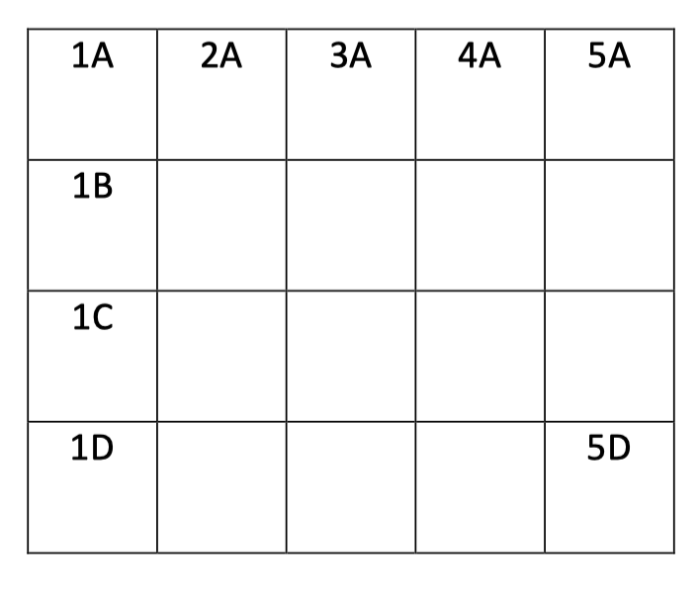
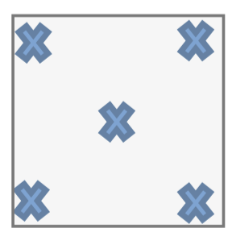
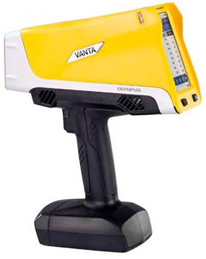
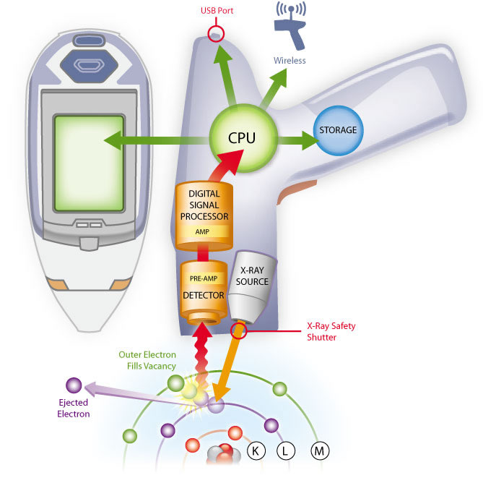
Sample Collection and Screening Method
Our study collects soil samples using the Pittsburgh Protocol. First, we determine the dimensions of the property and divide the area into approximately 10 ft by 10 ft grid squares.
Within each grid square, we collect 5 soil cores. Each core is ¾ of an inch wide and 5 inches deep. The 5 cores are then combined into a single composite sample and labeled with its grid location.
1A
Figure 1: A yard is divided into a grid. Each square is labeled with numbers and letters.
Figure 2: Five samples are taken from each grid square in a standard pattern.
We analyzed your samples using a X-ray fluorescence (XRF) device. This tool uses low-level X-rays to measure elements present in soil. We focus on lead, which is reported in parts per million (ppm). 1 ppm means one part lead for one million parts of soil. Please note that XRF is a screening tool and further testing is advised.
Figure 3: Portable X-ray fluorescence (XRF) device used for soil screening.
Figure 4: Illustration of how XRF technology detects elements in soil samples.

Slide 3

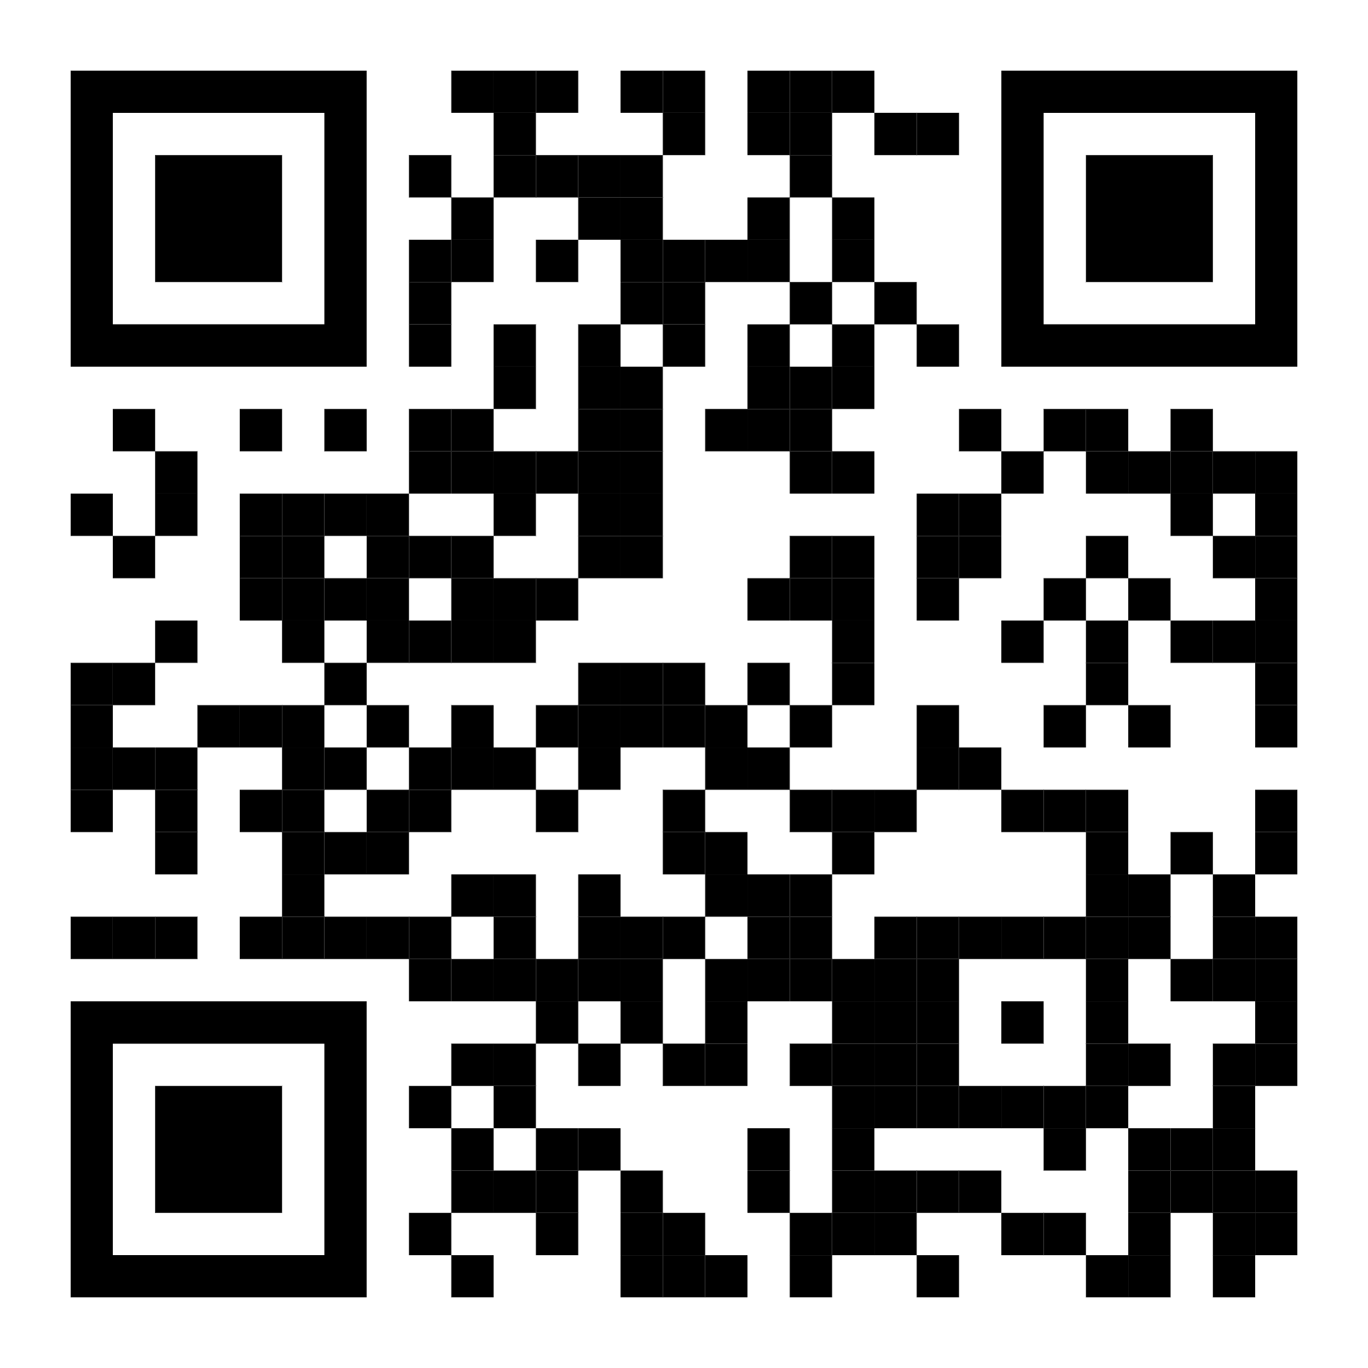
Soil Report Summary
We collect soil samples using a grid. We analyze samples using an X-ray fluorescence (XRF) device. This screening tool detects the amount of lead present in the soil.
How do we analyze soil?
What do these results mean?
Soil lead levels can vary widely, even within small areas. Elevated levels can increase exposure risk, especially for children. Knowing where lead is higher can help guide safer use of your yard, such as where to garden and where to limit direct contact.
Map of Site
Heat map of property with basemap and numbers – drag and crop image to ensure that front street, backyard, and key are all visible
Scan for resources
on reducing
exposure and
managing lead in
soil:

Slide 4
Detailed Results
Total lead concentrations in your soil
 | Highest | Lowest | Average
Backyard | ### ppm | ### ppm | ### ppm
Front yard | ### ppm | ### ppm | ### ppm
Heat map of property (no basemap) - make sure background is white

