Slide 1
Scientific Calculator in C
BY-
Isha Surve
MIS 112003142
Div 2

Slide 2
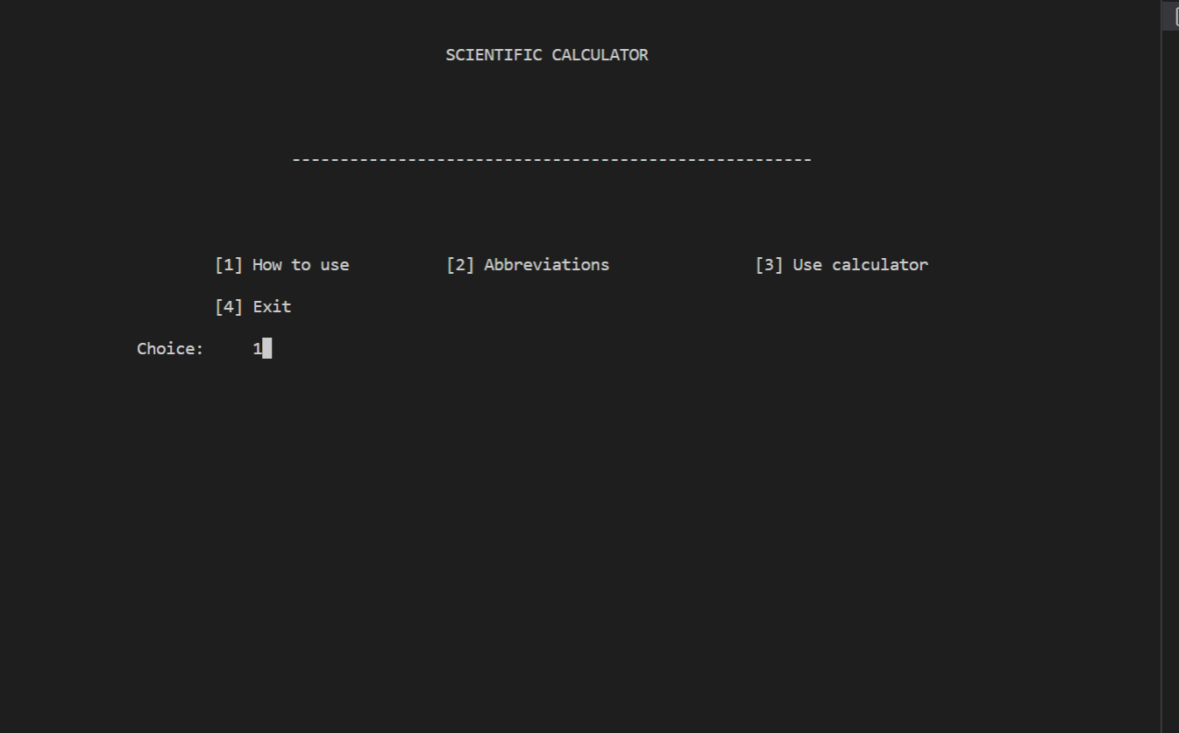

Slide 3
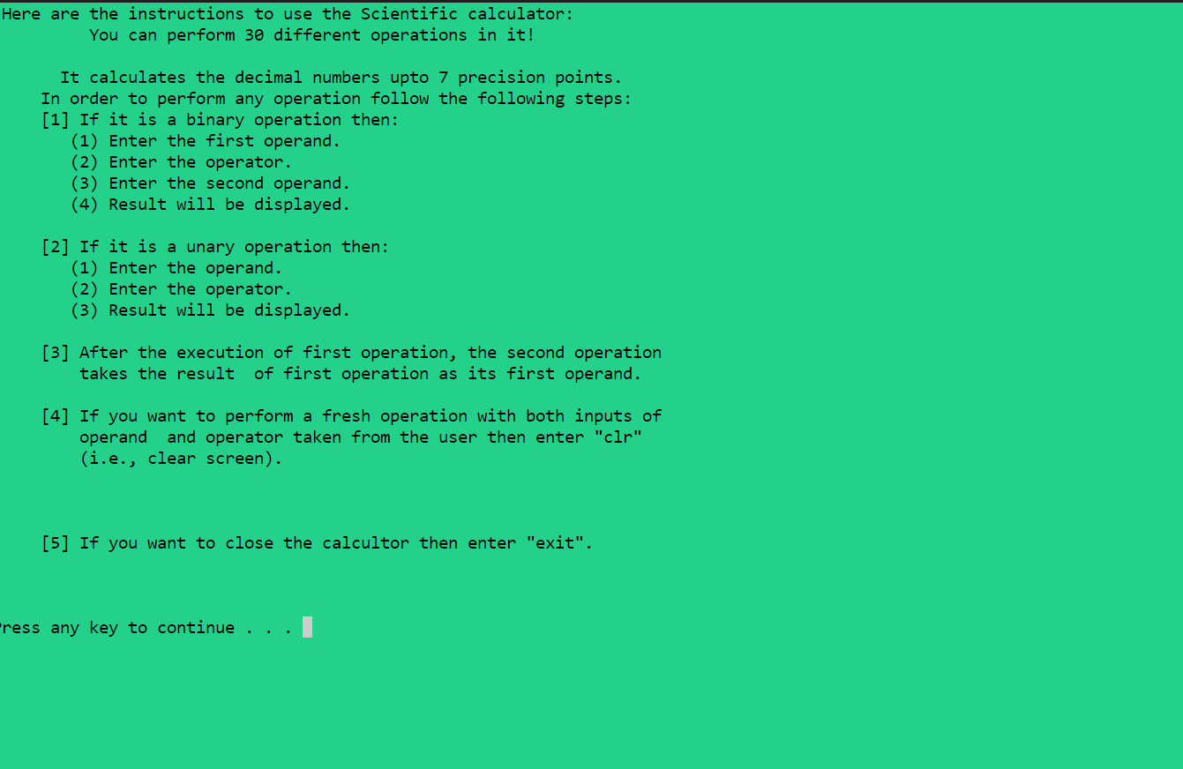

Slide 4
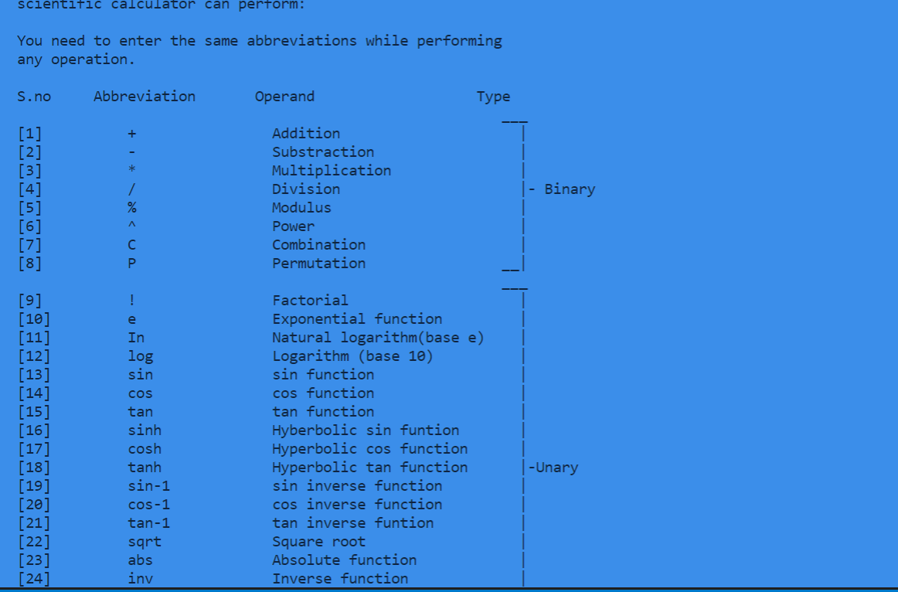

Slide 5
