Slide 1
Apple Stock Price Analysis
Using Python
Isha Tyagi
AnalystLab Africa Internship

Slide 2
Project Objective
• Analyze Apple stock prices (2020–2024)
• Understand stock trends
• Calculate returns and moving averages
• Visualize stock performance

Slide 3
Dataset
Source: Yahoo Finance (yFinance)
Ticker: AAPL
Columns: Date, Open, High, Low, Close, Volume
Period: Jan 2020 – Jan 2025

Slide 4
Exploratory Data Analysis (EDA)
• Checked dataset shape
• Checked data types
• Found missing values
• Summary statistics

Slide 5
Feature Engineering
• 7-Day Moving Average (MA7)
• 30-Day Moving Average (MA30)
• Daily Change
• Daily Return
• Monthly Average Close

Slide 6
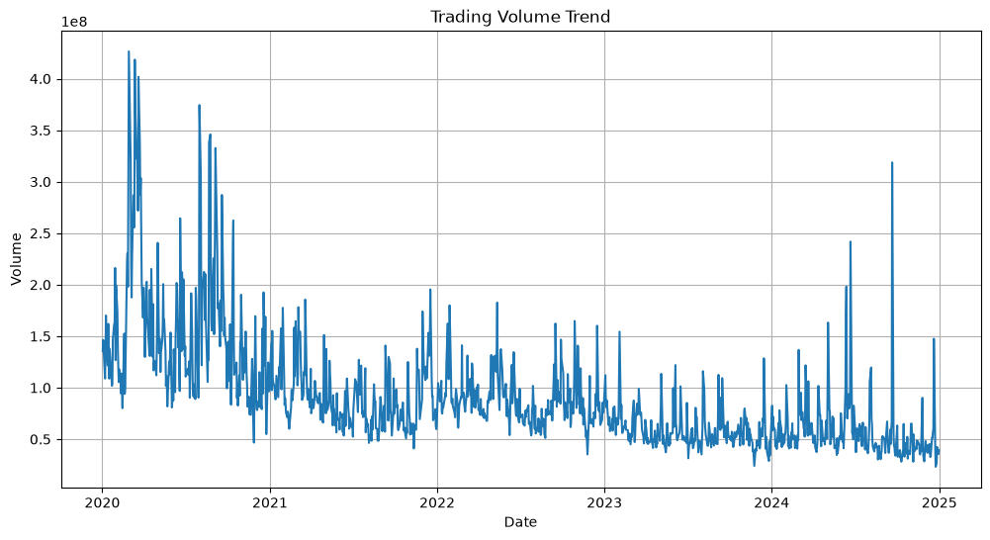
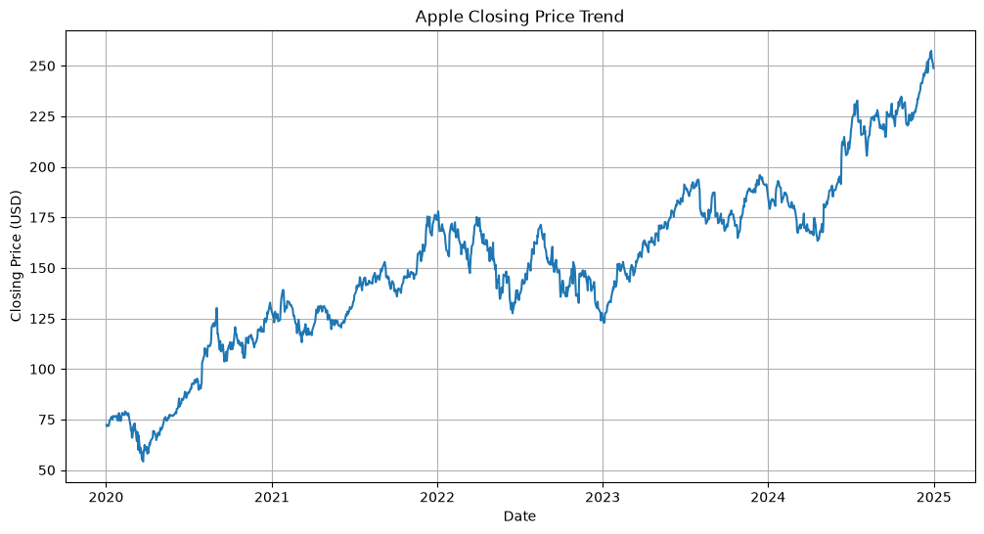
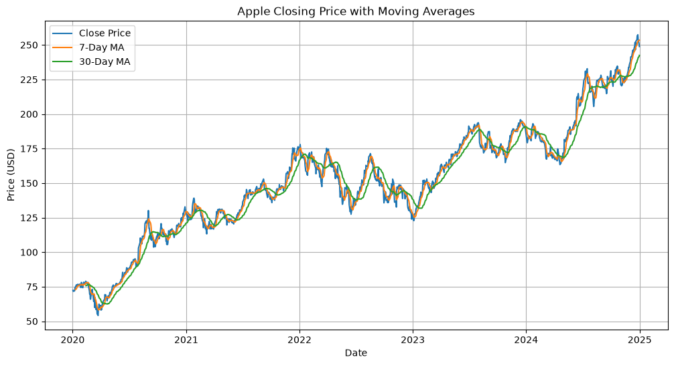
Visualizations
• Closing Price Trend
• Trading Volume
• closing price with moving Averages
• Daily Return
• Monthly Average Closing price

Slide 7
Key Insights
• Apple stock showed overall growth.
• MA7 follows short-term trend.
• MA30 shows long-term trend.
• Trading volume changed over time.

Slide 8
Tools Used
• Python
• Pandas
• NumPy
• Matplotlib
• yFinance
• Jupyter Notebook

Slide 9
Conclusion
Apple stock performed well over the long term.
Python helped analyze trends, returns, and volatility.
This project improved financial data analysis skills.

