Slide 1
Dragonblood
The CTF challange
Group 2

Slide 2
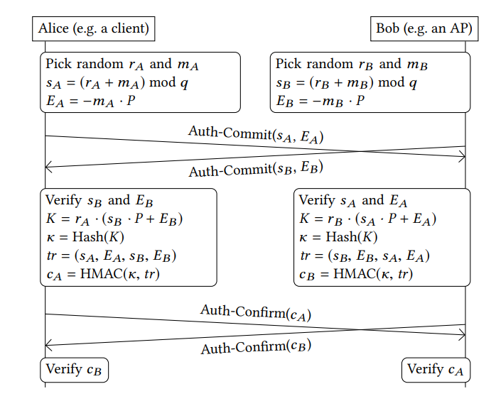
Introduction
WPA3 was announced in 2018, meant to replace the previously used WPA2.
Dragonfly – the name of the handshake used in WPA3 and EAP-pwd.
We use WPA—SAE for personal networks, and WPA3-EAP-pwd for enterprise.
Dragonfly is supposed to prevent offline dictionary attacks.
Notes:
Mention what WPA is\stands for(wi-fi protected access), protocol to authenticate users access to wi-fi networks

Slide 3
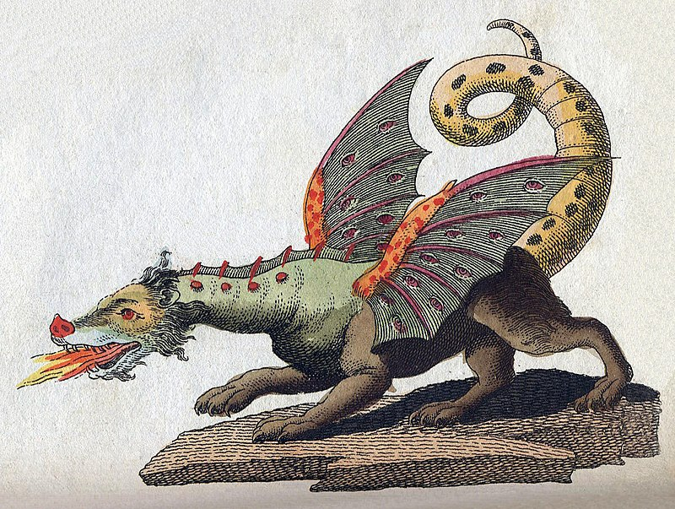
Dragonblood
Introduced in the paper: “Dragonblood: Analyzing the Dragonfly Handshake of WPA3 and EAP-pwd”, by Eyal Ronen and Mathy Vanhoef.
Side-channel attacks enable password theft via offline brute-force dictionary attacks.
It is very costly to sufficiently defend against side-channel attacks.
In the paper they managed to get a 99.5% confidence rate using only 75 * 20 = 1,500 measurements!

Slide 4
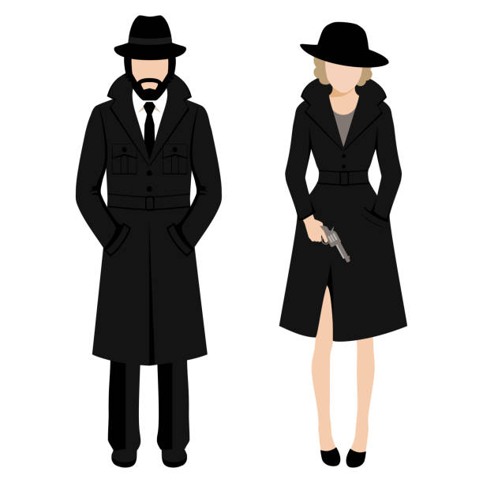
CTF Overview
You are agents sent to a foreign country to obtain access to a protected wi-fi network on a secret military base.
Your goal is to obtain the Wi-Fi password in order to infiltrate the network and listen on private communication.
You win once you found the correct password!

Slide 5
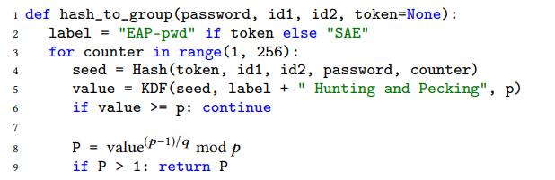
Hash-to-Group
The count of iterations performed is dependent on the password!
Using different spoofed addresses, we can get a unique fingerprint of the password…

Slide 6
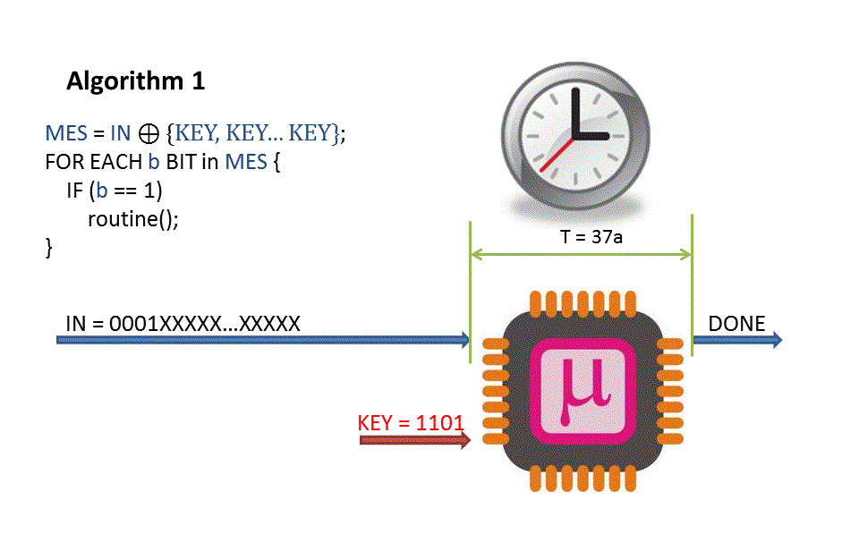
The Attack
In This CTF you will implement a timing attack:
Exploit variations in the time taken for the Dragonfly handshake operations to learn information about the password.
Target the Hash-to-Group operation in the handshake.
Implement an offline brute-force attack to acquire the passwords.
Spoof multiple MAC addresses to force multiple handshakes to measure time differences.

Slide 7
In Practice
Measure how long the server takes to respond to commit messages for each spoofed address (dragonblood)
Use that information to figure out how many iterations were performed in Hash-to-Group for each address (datareader.py)
Use Offline Brute-force to find a password with a fingerprint that matches the measurements (fingerprint and find_matches.py)

Slide 8
Files To Change
finger/fingerprint.c
finger/sae.c
attack/dragontime.c
datareader.py
find_matches.py
Don’t change any other file!

Slide 9
finger/fingerprint.c
The execution time for each address is not deterministic (due to noise and other factors) but we know it is dependent of the number of iterations performed for each address.
To get a fingerprint of the passwords, we first want to find out which addresses cause the same number of iterations, then find “groups” of addresses that share the iteration count.
Finally, we can sort these groups from shortest to longest time.
To do so, we need a way to tell if two addresses share the same iteration count.

Slide 10
finger/fingerprint.c
You will need to implement the building of the dictionary.
You need to generate a fingerprint for each password from passwords.txt.
Modify sae_derive_pwe_ffc inside finger/sae.c so it returns the number of iterations executed for the given parameters.
Use it to build a CSV table where each row corresponds to a password, and each column corresponds to a spoofed address.
Each cell should have the number of iterations for the password with the given address.
The output should look like example/example_out.csv.

Slide 11
attack/dragontime.c
Here you implement the data gathering part of the attack.
In the all-around implementation:
Open the network card, set the rate and get the MAC address.
Set the source address to be the current address.
Initialize timers for timeout and commit injection.
In authentication check:
Calculate and update the difference in time between commit.
Print into the measurements file the current time for the address.
In timeout check:
If the last commit happened before timeout, de-auth and commit it again.

Slide 12
datareader.py
Here there are functions for analyzing timing measurements.
qplot() plots the data as a quantile graph for easy visualization.
iterations() and its helper functions analyze the data to estimate the number of iterations performed on each address.
We will be using the pandas python library, so make sure you are familiar with it!
You need to implement Crosby’s Box Test in this file.

Slide 13

Crosby’s Box Test
Used to test whether two samples are from the same distribution or not, while taking advantages of quantile ranges that have less noise.
Two parameters, $0≤i<j≤1$
For each sample, define a range between the i-th and j-th quantile.
If they overlap, we will assume that they are of the same distribution.
Choosing the right $i,j$ is crucial!

Slide 14
find_matches.py
In this file, you will use the functions from datareader.py and the dictionary you created to find which password in the dictionary matches the fingerprint you calculated.
Build a k-d tree in create_tree to sort the passwords.
Find the best matches to the measurements’ fingerprint.

Slide 15
Instructions: Setup
Enter the CTF website and create an account.
Download and unzip the file from the CTF challenge.
Now you will have to fill in the missing code in the files…

Slide 16
Instructions: Execution
Open a terminal, cd to the top folder, and run: $ sh setup_user.sh $(<MAC_AP) wlan0 You can replace “wlan0” with your Wi-Fi device, find it with ip addr or ifconfig.
To start taking measurements, run: $ sudo ./dragontime -d $(<DEVICE) -a $(<MAC_AP) -o measurements.txt After getting 100 measurements, stop dragontime with CTRL + C.
To generate fingerprints for the passwords, run: $ ./fingerprints passwords.txt out.csv The fingerprints will then be saved to out.csv.
After getting the measurements and fingerprints, run: $ python find_matches.py measurements.txt out.csv

