Slide 1
COL864: Assignment 2 Presentation Field D*: An Interpolation-based Path Planner and Replanner
ISHA CHAUDHARY (2018EE30614)
ANKIT KUMAR (2017MT10727)

Slide 2
PROBLEM STATEMENT: THE TECHNICAL GAP
Classical Planning Algorithms using grid representations to find an optimal path from start state to goal state, make the agent proceed only along a discrete set of directions.
The heading angle of the agent is generally a multiple of π/4, which corresponds to the 8 conventional directions.
This often leads to unnatural, cost inefficient and difficult paths to follow for a physical agent.

Slide 3
THE SOLUTION ENVISIONED
The researchers used linear interpolation to calculate accurate path cost estimates during the planning. This approach led to lower cost paths using arbitrary heading direction at any node, to reach the goal state.
This algorithm is designed to be operable both in uniform and non-uniform cost environments.
The algorithm can be considered as an extension to the D* family of algorithms. Like D* Lite, the Field D* focusses to explore the most relevant parts of the state space both in the initial planning and replanning.

Slide 4
BASELINE: THE EVOLUTION OF SOLUTIONS
A common technique to tackle the problem is to post-process the paths obtained using any classical planning algorithm (aka smoothing). We attempt to find the farthest point, P along the solution path obtained, which can be connected by a collision-free straight line path and thus straighten the path to P in the solution path.
This approach can be shown to fail in several non-uniform cost environments.

Slide 5
BASELINE: THE EVOLUTION OF SOLUTIONS
Konolige presented an interpolated planner to interpolate the cost-to-goal value function and obtain smooth paths from start state to goal state. As the algorithm doesn’t include the smoothed path cost into the planning, the paths obtained are not as good as those with continuous cost calculations.
Philippsen approach based on Fast Marching Methods incorporates interpolation step into planning, but is not suited to navigation tasks. This is because it assumes that the transition cost from one particular grid node to each of its neighbours is constant.
Thus, linear interpolation has been a well experimented but often unsuitably applied idea for Navigation tasks.

Slide 6
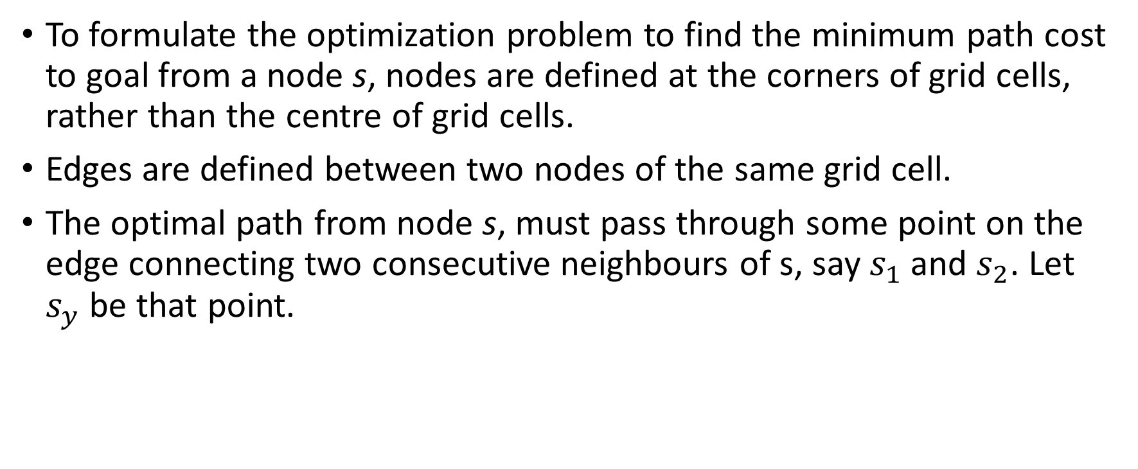
COST ESTIMATION USING LINEAR INTERPOLATION
To formulate the optimization problem to find the minimum path cost to goal from a node s, nodes are defined at the corners of grid cells, rather than the centre of grid cells.
Edges are defined between two nodes of the same grid cell.
The optimal path from node s, must pass through some point on the edge connecting two consecutive neighbours of s, say $s_{1}$and $s_{2}$. Let $s_{y}$ be that point.

Slide 7
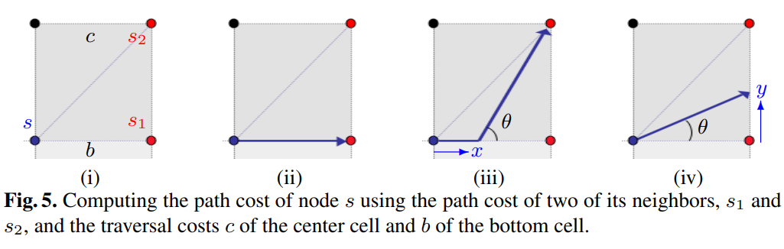

COST ESTIMATION USING LINEAR INTERPOLATION
The optimal path cost to $s_{y}$ is found using linear interpolation as:
$$g\left(s_{y}\right)=yg\left(s_{2}\right)+\left(1−y\right)g\left(s_{1}\right)$$
Here, y $∈\left[0, 1\right]$ is the vertical distance between $s_{1}$ and $s_{y}$.
Figure taken from the being paper presented

Slide 8
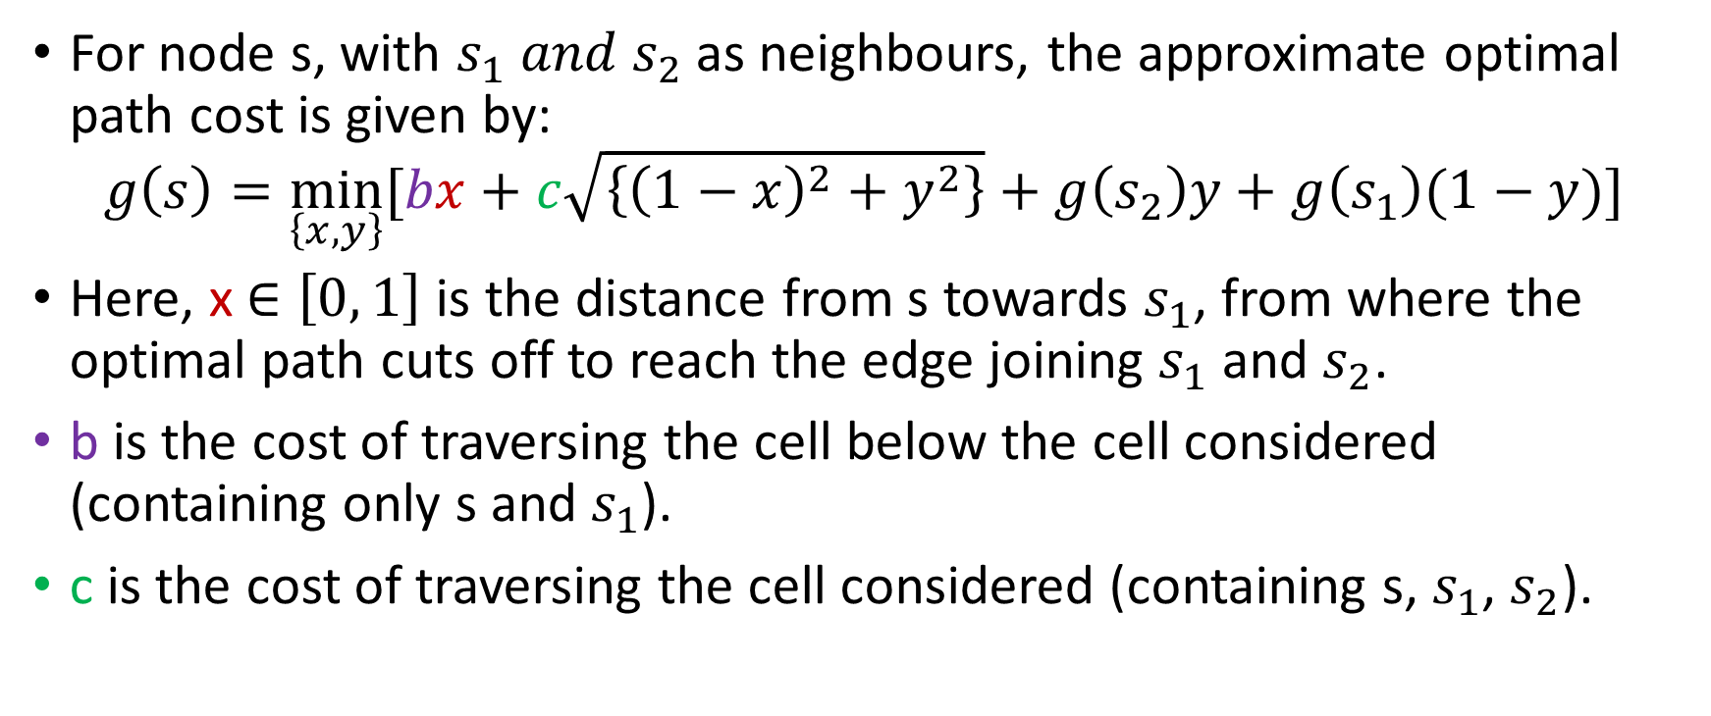
ESTIMATING PATH COST
For node s, with $s_{1} and{ s}_{2}$ as neighbours, the approximate optimal path cost is given by:
$$g\left(s\right)=\min_{\left\{x, y\right\}}{[bx+c\sqrt{\left\{{\left(1−x\right)}^{2}+y^{2}\right\}}+g\left(s_{2}\right)y+g\left(s_{1}\right)(1−y)]}$$
Here, x $∈\left[0, 1\right]$is the distance from s towards $s_{1}$, from where the optimal path cuts off to reach the edge joining $s_{1}$ and $s_{2}$.
b is the cost of traversing the cell below the cell considered (containing only s and $s_{1}$).
c is the cost of traversing the cell considered (containing s, $s_{1}$, $s_{2}$).

Slide 9
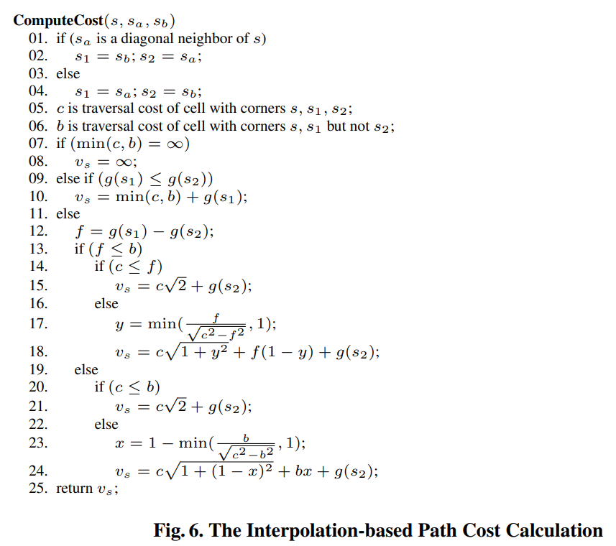
A Procedure for the Optimized Path Costs

Slide 10
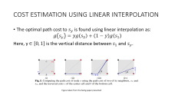
Procedure for Optimized Costs: Explained
The minimization will cause at least one of x and y to be 0.
The minimization for the different conditions mentioned above can be verified using differentiation of the expression for the minimization.
The paths which can be traversed from s can be either one among 5 ii, iii, iv.

Slide 11
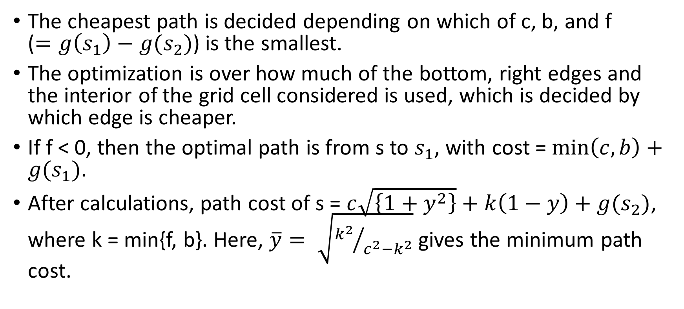
Procedure for Optimized Costs: Explained
The cheapest path is decided depending on which of c, b, and f ($=g\left(s_{1}\right)−g(s_{2})$) is the smallest.
The optimization is over how much of the bottom, right edges and the interior of the grid cell considered is used, which is decided by which edge is cheaper.
If f < 0, then the optimal path is from s to $s_{1}$, with cost = $\min\left(c, b\right)+g(s_{1})$.
After calculations, path cost of s = $c\sqrt{\left\{1+y^{2}\right\}}+k\left(1−y\right)+g(s_{2})$, where k = min{f, b}. Here, $\overline{y}= \sqrt{{k^{2}}/{c^{2}−k^{2}}}$ gives the minimum path cost.

Slide 12
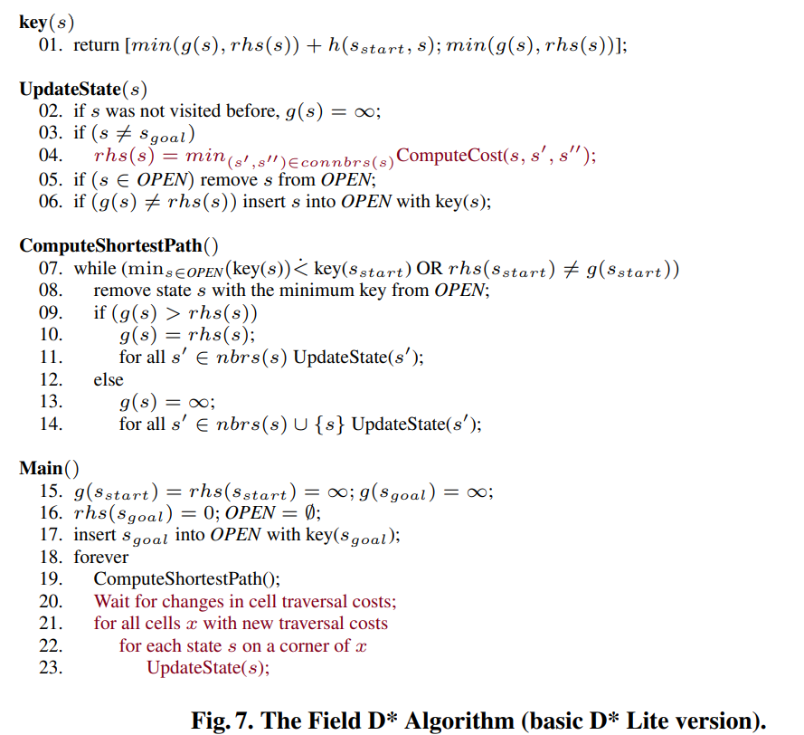
THE FIELD D* ALGORITHM PSEUDOCODE

Slide 13
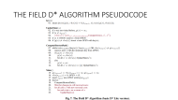
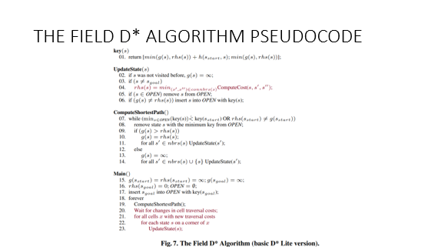
THE FIELD D* ALGORITHM
The Field D* algorithm is a version of the D* Lite Algorithm, using the interpolation based path cost calculation, done earlier.
The pseudocode is basically that of D* Lite, with the red parts specific to Field D*.
The D* Lite algorithm has been adapted to grid worlds in the pseudocode.
As is clear from the pseudocode, the algorithm starts from the goal state and tries to reach the start state.

Slide 14
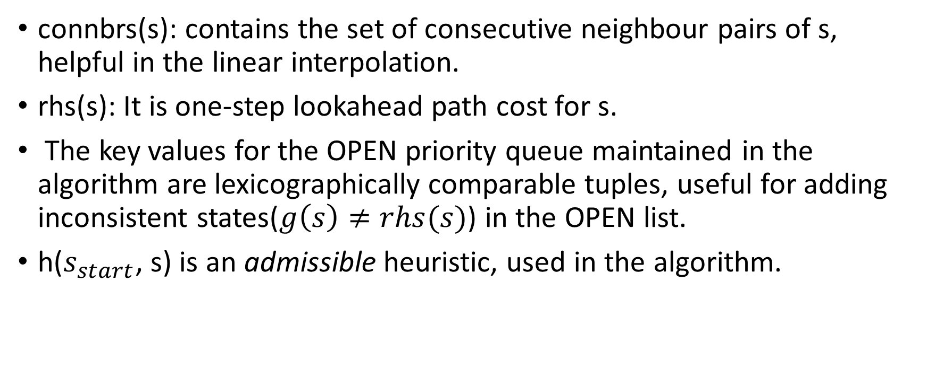
THE FIELD D* ALGORITHM
connbrs(s): contains the set of consecutive neighbour pairs of s, helpful in the linear interpolation.
rhs(s): It is one-step lookahead path cost for s.
The key values for the OPEN priority queue maintained in the algorithm are lexicographically comparable tuples, useful for adding inconsistent states($g\left(s\right)≠rhs(s)$) in the OPEN list.
h($s_{start}$, s) is an admissible heuristic, used in the algorithm.

Slide 15
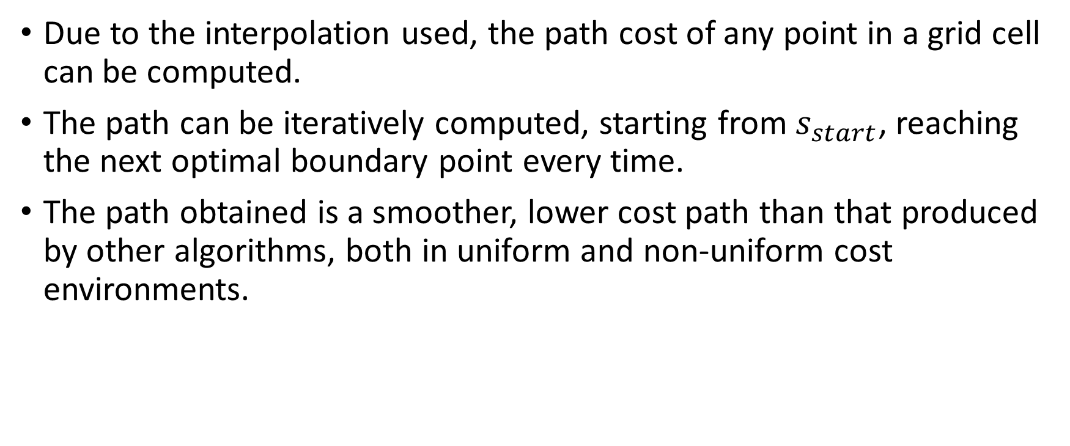
FIELD D*: EXTRACTING THE PATH
Due to the interpolation used, the path cost of any point in a grid cell can be computed.
The path can be iteratively computed, starting from $s_{start}$, reaching the next optimal boundary point every time.
The path obtained is a smoother, lower cost path than that produced by other algorithms, both in uniform and non-uniform cost environments.

Slide 16
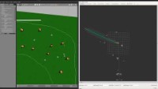
RESULTS
Field D* has been tested and applied to various practical applications.
Runtime Analysis: Field D* takes roughly 1.7 times longer to plan and replan, as compared with simple D* Lite.
Improvement in the Cost of paths produced: The paths produced were observed to be around 4% less costly than the paths from D* Lite.

Slide 17
RESULTS
The key advantage of deploying Field D* is that the agent now follows smoother paths than before. This is of practical importance, even if the cost reduction may not be very significant.
The transition function generated is continuous due to interpolation, because of which Field D* can generate low cost, smooth paths even in low resolution grids. This is useful, especially when the agent has limited memory chips on board.

Slide 18
FURTHER SCOPE
The algorithm can be extended to be able to plan over long distances (multi-resolution planning).
A challenging extension would be to enable the algorithm to plan over 3D spaces.
In order to further reduce the turnings in the path, an interpolation over the path headings could be performed, instead of cost.

Slide 19
References
Reference of the paper presented: Ferguson, Dave & Stentz, Anthony. (2005). Field D*: An Interpolation-Based Path Planner and Replanner. 28. 239-253. 10.1007/978-3-540-48113-3_22.
Technical report: D. Ferguson and A. Stentz. The Field D* Algorithm for Improved Path Planning and Replanning in Uniform and Non-Uniform Cost Environments. Technical Report CMURI-TR-05-19, Carnegie Mellon School of Computer Science, 2005
D* Lite: S. Koenig and M. Likhachev. Improved fast replanning for robot navigation in unknown terrain. In Proceedings of the IEEE International Conference on Robotics and Automation (ICRA), 2002
An implementation of Field D*: https://www.youtube.com/watch?v=51-eMWDA8mU

Slide 20
THANK YOU!
ANY QUESTIONS?

