Slide 1
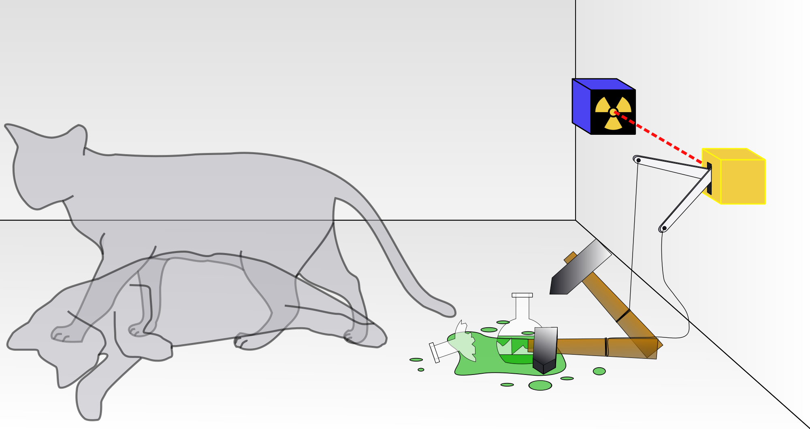
A Day of Quantum Mysteries
One Day @Ucalgary
26 September 2015
Image source: Wikimedia Commons

Slide 2
What is this about?
What is quantum mechanics?
Why is it mysterious?
How to understand quantum mysteries through simple ideas?
How is quantum mechanics useful?

Slide 3
The science of the tiny
Founded in early 20th Century by stalwarts including Bohr, Einstein, de Broglie, Schroedinger, Heisenberg, Dirac, Pauli…
Enabled technological revolution: Digital media, magnetic resonance imaging, microelectronics, nanotechnology…
Answered puzzling questions
Opened up more puzzling ones!
Highly counterintuitive and mysterious
Anybody can taste the mystery!

Slide 4
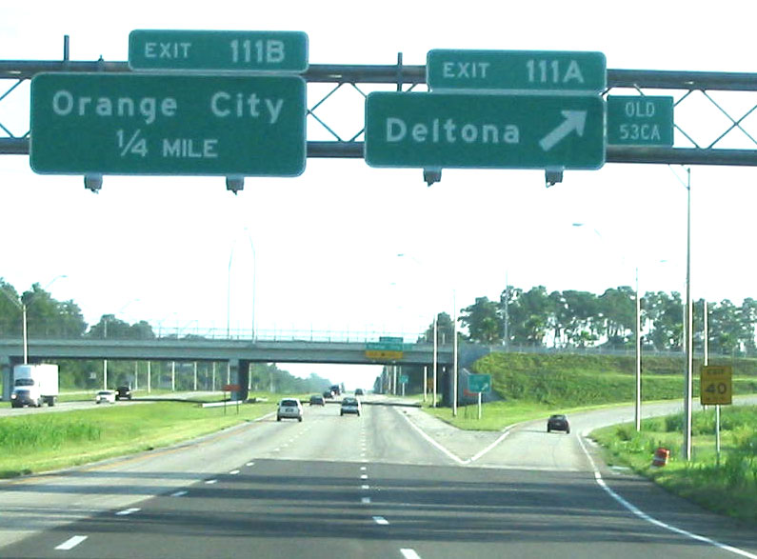
A fork in the path
Source: Wikimedia Commons

Slide 5
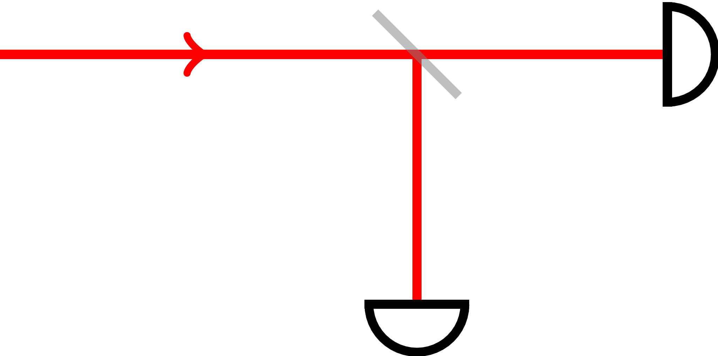
A fork in light’s path

Slide 6

A fork in the l o n e l y path
Photograph by author

Slide 7
Experiment 1: Splitting lonely light

Slide 8
Experiment 1: Splitting lonely light

Slide 9
“Photons”: Particles of light

Slide 10
Why the split?
Two plausible theories for light splitting:
Two distinct types of “hard-wired” photons:
Ones that always get transmitted;
Ones that always get reflected.
Identical photons that make random choices
T
R

Slide 11
Exp. 2: Beam-splitters in succession

Slide 12
What happens if photons are hard-wired?
R
T
T
R
R
R

Slide 13
Hard-wired photons fire only two detectors!
T
R

Slide 14
Actual outcome: All detectors fire!

Slide 15
Same outcome on further branching

Slide 16
“Random choice” theory wins!
Two plausible theories for light splitting:
Two distinct types of “hard-wired” photons:
Ones that always get transmitted;
Ones that always get reflected.
Identical photons that make random choices
T
R

Slide 17
Exp. 3: Splitting and recombining light

Slide 18
Recall Experiment 2

Slide 19
Exp. 3: What do you expect?

Slide 20
Exp. 3: The surprise outcome

Slide 21
Exp. 4: Variation on Exp. 3

Slide 22
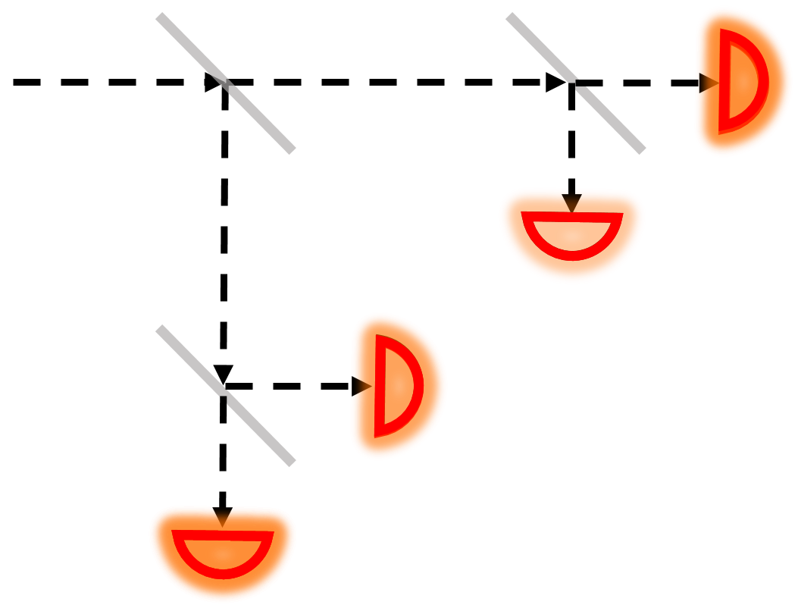
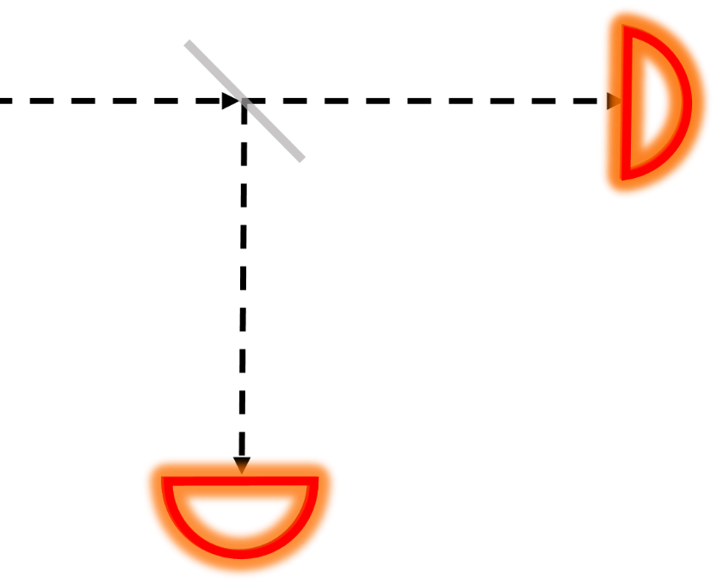
Experiments 1 and 2

Slide 23
Experiment 2: Paths

Slide 24
Experiment 2: Paths

Slide 25
Experiment 2: Paths

Slide 26
Experiment 2: Paths

Slide 27
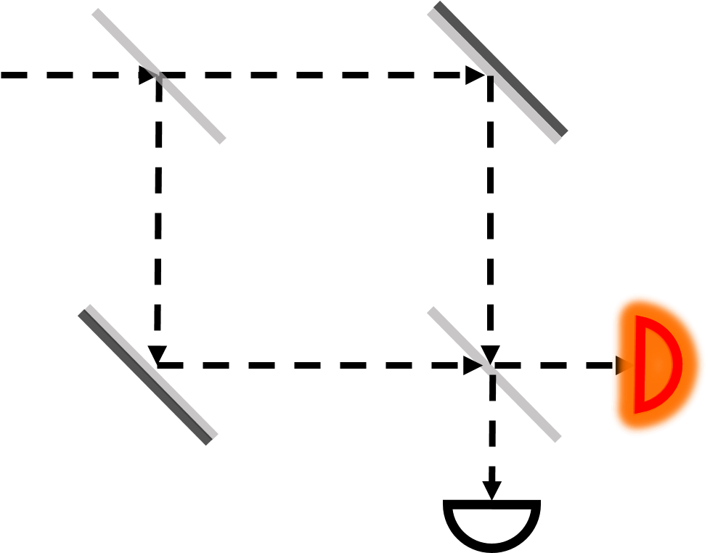
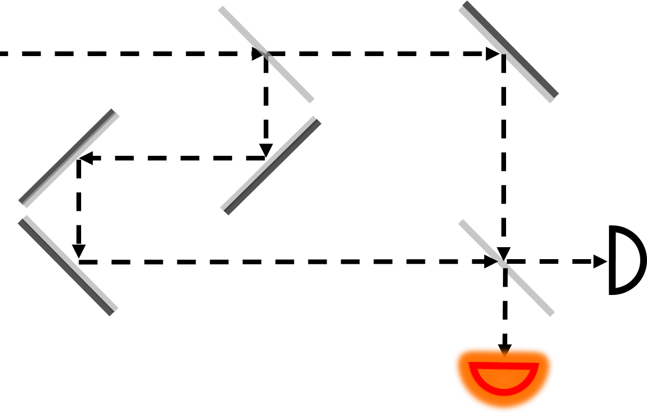
Experiments 3 and 4

Slide 28
The Indistinguishability Principle
If an outcome could have resulted from different paths, the photon “saw” all those paths simultaneously!

Slide 29
Experiments 3 and 4

Slide 30
Experiment 2: Path is obvious from detector

