Slide 1



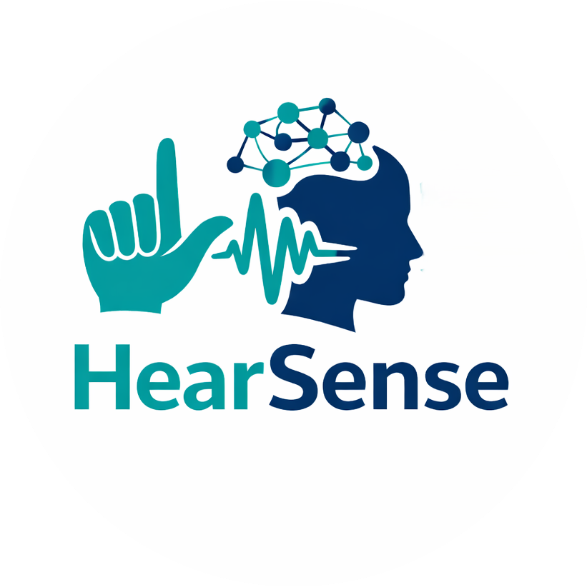


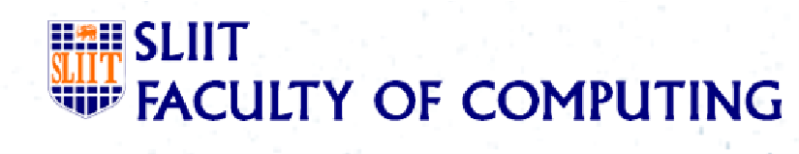
“HearSense” - Intelligent Sinhala Sign Language Communication Platform with Emotion Recognition and Environmental Awareness
PRESENTED BY : AVERY DAVIS
Group ID : 25 - 26J - 223

Slide 2
Intelligent Sinhala Sign Language Learning and Communication Platform with Emotion Recognition and Environmental Awareness
Overall Problem
People with hearing, speaking, and communication disabilities in Sri Lanka face multiple, interconnected challenges:
Learning Sinhala Sign Language (SSL) is difficult due to non-adaptive, static learning platforms
Deaf users often miss critical environmental sounds (vehicle horns, alarms), risking personal safety
Existing sign recognition systems focus only on hand gestures, ignoring facial expressions and emotions
Children with speaking disabilities struggle with daily two-way communication with family members
These problems are addressed separately in most systems, but rarely in a unified, user-centered way.

Slide 3
Intelligent Sinhala Sign Language Learning and Communication Platform with Emotion Recognition and Environmental Awareness
Impact & Gravity
Sign Learning System -Without adaptive feedback and Sinhala-specific content, learners repeatedly practice incorrect signs, resulting in slow progress, poor accuracy, and reduced confidence.
Environmental Sound Alert System -The inability to detect and understand critical environmental sounds such as horns and alarms exposes Deaf users to serious safety risks in daily and emergency situations.
Sign Recognition with Emotion System -Ignoring facial expressions and emotional cues in sign recognition leads to loss of meaning, miscommunication, and unnatural interactions between users.
Two-Way Communication System -The lack of accessible two-way communication tools limits children with speaking disabilities from expressing daily needs, causing communication barriers and emotional frustration.

Slide 4

Intelligent Sinhala Sign Language Learning and Communication Platform with Emotion Recognition and Environmental Awareness
Who Has This Problem & Who Benefits from the Solution
Deaf and Hard-of-Hearing individuals
Children with speaking disabilities
Parents and caregivers
Special education teachers and institutions
General public interacting with Deaf users
Sri Lankan society as a whole

Slide 5
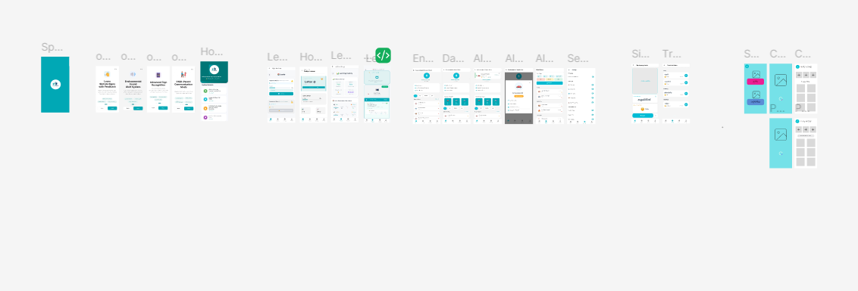
Intelligent Sinhala Sign Language Learning and Communication Platform with Emotion Recognition and Environmental Awareness
Prototype Link: https://www.figma.com/design/VEynPD8mx50Lb2EFkGbYCs/SignLanguage?node-id=0-1&p=f&t=O8OQxYwLiCwm7enK-0

Slide 6

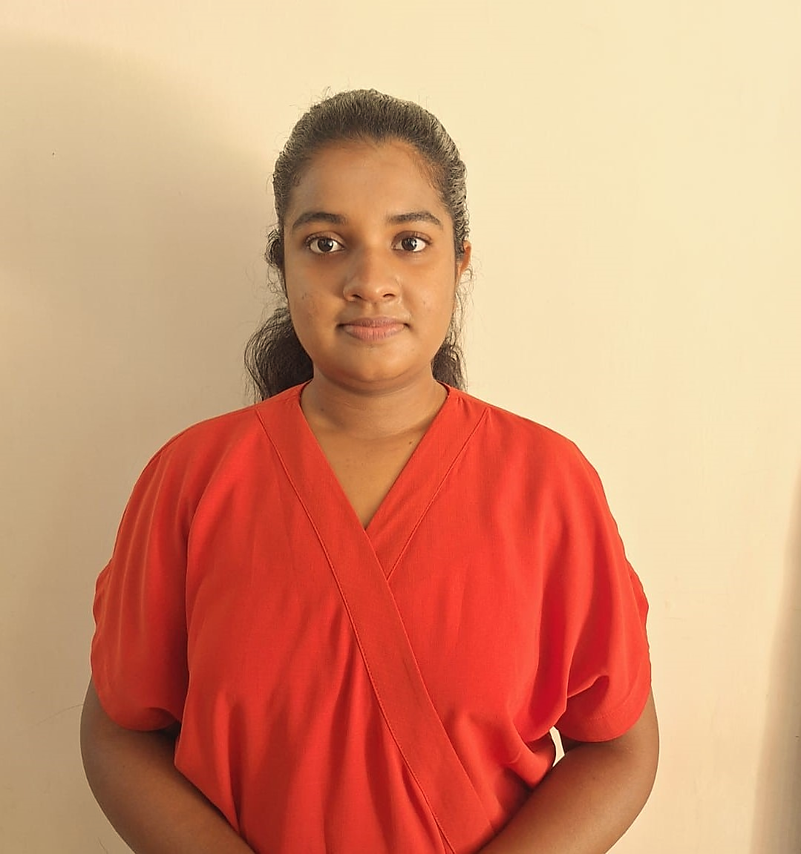
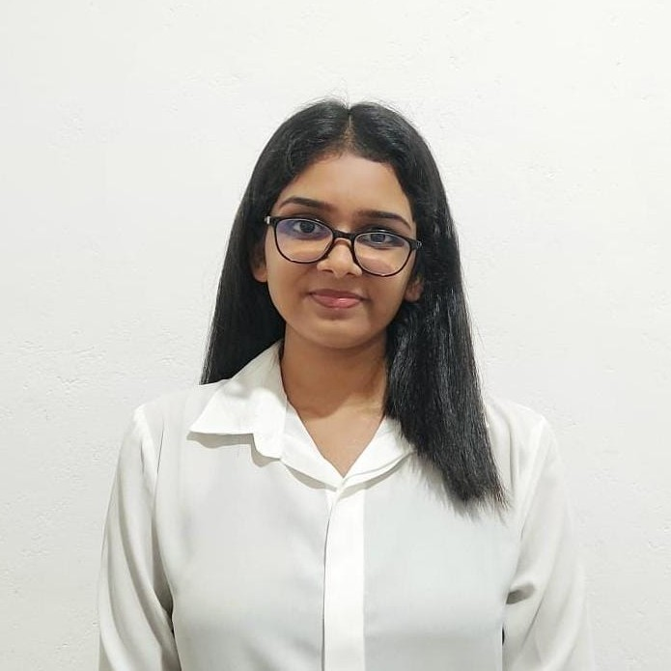
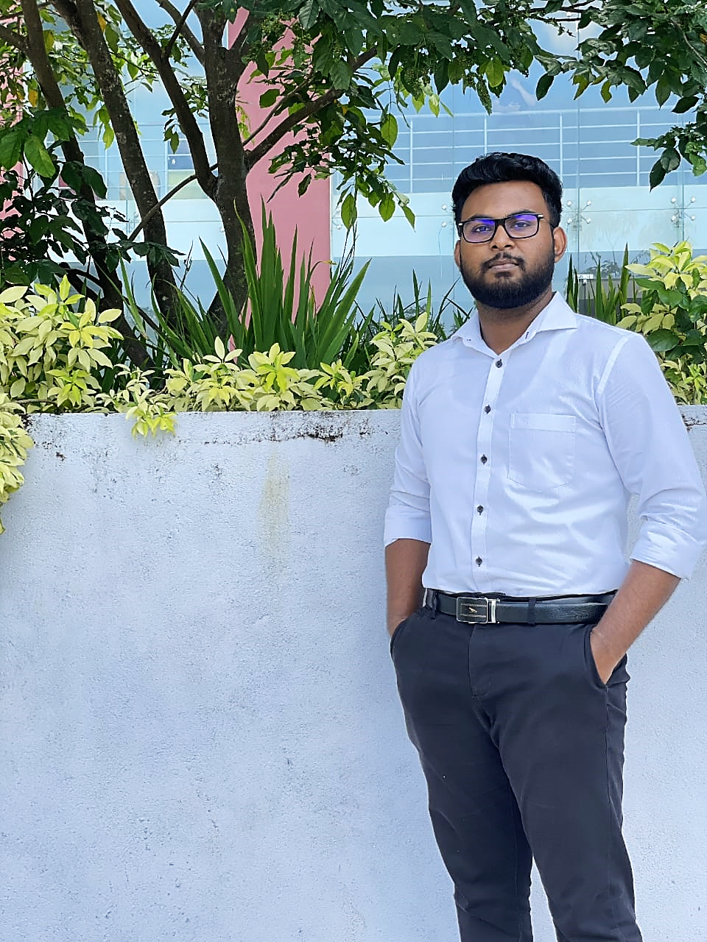



Meet Our Team Members
IT22315878
Silva H. T. P.
IT22325464
KODITHUWAKKU M. A. S. S. H.
IT22304674
LIYANAGE M. L. I. S.
IT22308870
De Silva U. P. A. N.

Slide 7


IT22315878
SILVA H. T. P.
Specialization : Information Technology
Title of the Individual Component:
Adaptive Sinhala Sign Language Learning Systems

Slide 8

Adaptive Sinhala Sign Language Learning Systems
Sub-Problem
Existing Sinhala Sign Language systems mainly focus on static alphabet signs.
Dynamic letters, dynamic forms, and number signs are not supported.
Learning paths are fixed and do not adapt to individual learners.
There is no real-time evaluation of sign accuracy.
How the Solution Addresses It
🎯 Recognizes Sinhala static letters, dynamic letters ,dynamic forms of letters and numbers from images and video.
🎯 Outputs predicted sign + confidence score for real-time feedback.
🎯 Acts as the core recognition module for adaptive and personalized learning path.

Slide 9
Adaptive Sinhala Sign Language Learning Systems
User Need
Users want an easy way to learn Sinhala Sign Language.
They need the system to adapt to their learning path.
They want the system to be simple and easy to use.
They need real-time feedback to improve.
Our Solution
Uses an RL agent to give feedback.
Creates an adaptive learning path.
Eye-catching UI with good user interaction.
Shows users’ progress over time.
Can be used on any mobile device.

Slide 10
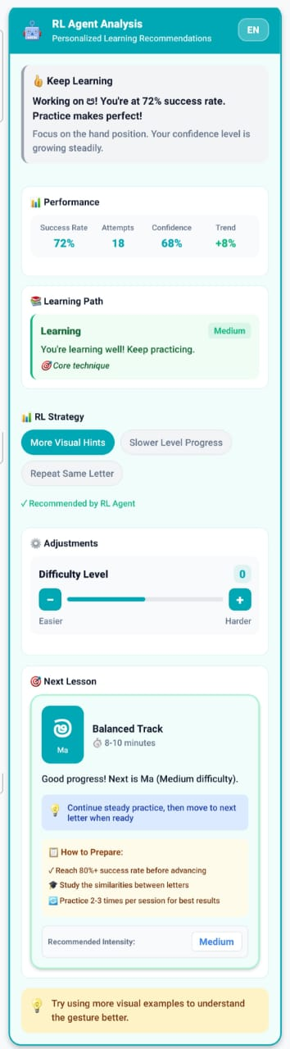
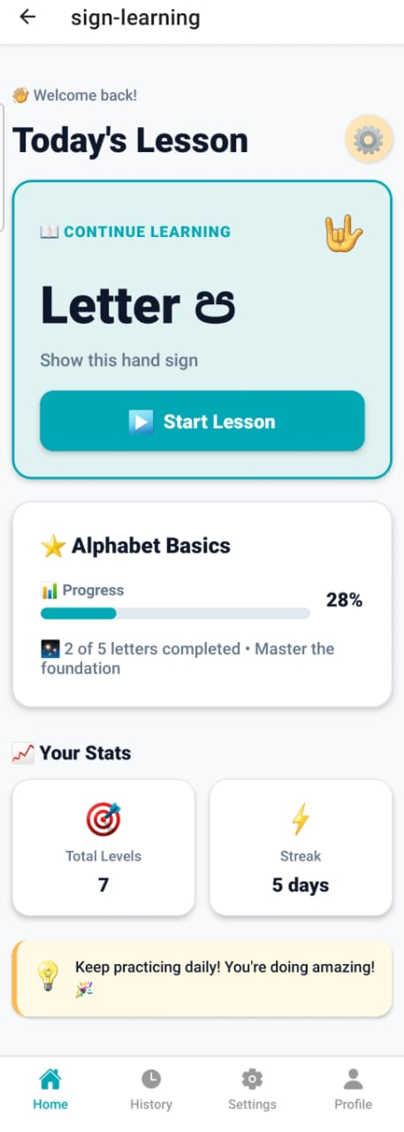
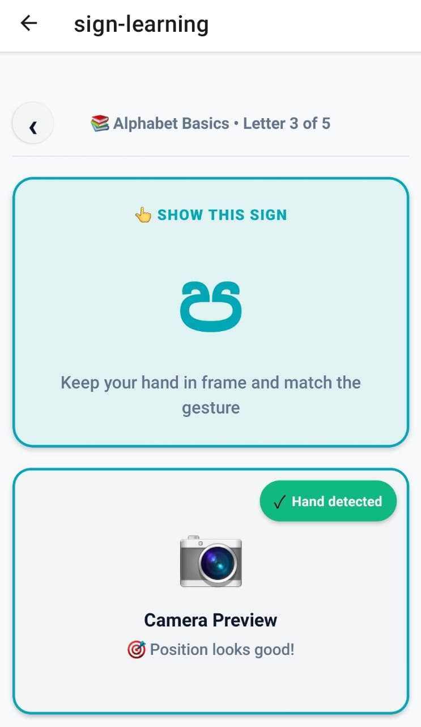
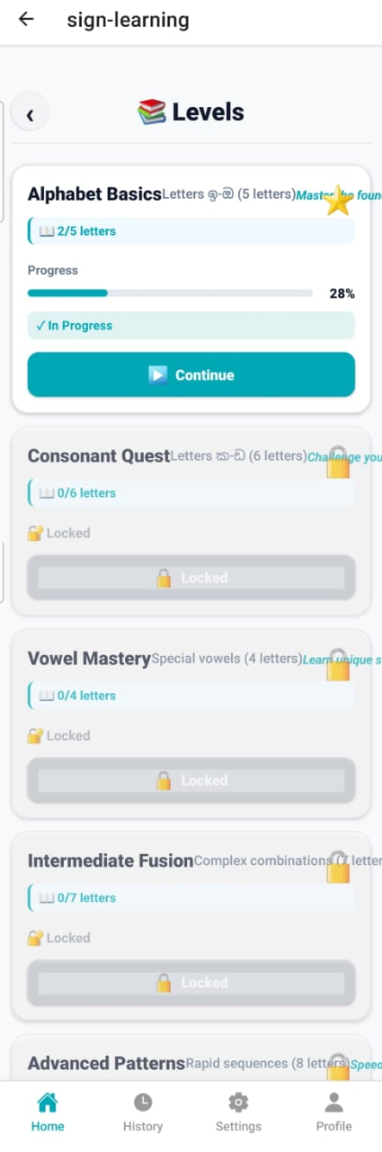
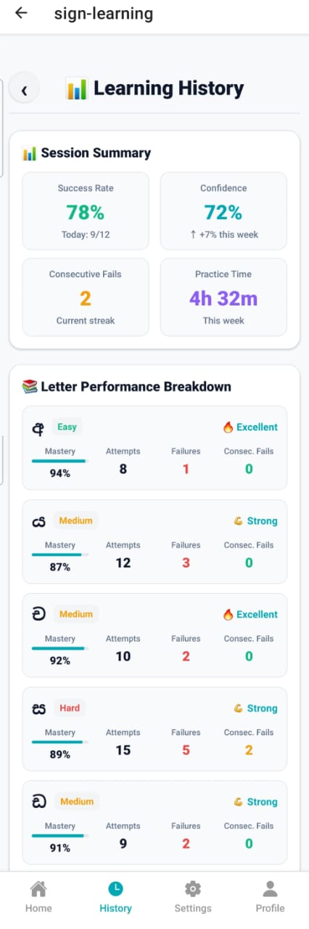
Adaptive Sinhala Sign Language Learning Systems
User-Centered Interface Intuitive, customizable, and visually clear

Slide 11

Adaptive Sinhala Sign Language Learning Systems
Unique Contribution
Combines AI (RL agent) with sign language learning.
Makes learning Sinhala Sign Language faster and more engaging.
Encourages continuous learning through feedback and progress tracking.
Key Design Strengths
Personalized learning with adaptive paths.
Real-time feedback using an RL agent.
Interactive and eye-catching UI.
Easy to use on multiple devices.
User Feedback on Prototype
Learners reported increased engagement due to adaptive lessons.
Positive feedback on AI-guided corrections improving gesture accuracy.
Users appreciated customized encouragement, making learning less intimidating.
Prototype confirmed mobile accessibility and usability, suitable for home or classroom learning.
Implementation Stages: Initially focused on static and dynamic letters; based on user feedback, vowel forms and number signs were added to enhance learning coverage.

Slide 12
IT22325464
KODITHUWAKKU M. A. S. S. H.
Specialization : Information Technology
Individual Component: Environmental Sound Alert Module
1/6/2026
IT22325464 | KODITHUWAKKU M. A. S. S. H.
12

Slide 13
Environmental Sound Alert Module
Sub-Problem
🔇 Deaf users cannot perceive critical environmental sounds like vehicle horns and emergency sirens
→ Miss critical safety warnings in everyday life
❓ Existing systems detect sounds but don't identify the source or vehicle type → Reduced situational awareness and context
⚠️ All alerts treated equally without urgency-based prioritization for safety-critical situations → Delayed reactions to high-priority threats
📱 Current solutions lack multi-modal alert feedback → Poor user experience for Deaf and hard-of-hearing community
How the Solution Addresses It
Detects and classifies environmental sounds in real-time → Provides immediate awareness of vehicle horns and sirens
Performs fine-grained vehicle horn classification → Identifies specific vehicle types for better context (Car, Bus, Train, Truck, Motor bicycle)
Assigns urgency scores to prioritize critical alerts → Ensures high-priority sounds receive immediate attention
Delivers multi-modal alerts optimized for Deaf users → Combines vibration, flash, visual banners, and emojis

Slide 14
Environmental Sound Alert Module
User Requirements Addressed by the Solution
USER NEED OUR SOLUTION
🎯Contextual Sound Awareness
🎯 Vehicle-Specific Horn Classification
🎯 Urgency-Based Alert Prioritization
🎯Accessible Multi-Modal Alerts
🎯 Continuous Environmental Monitoring
Identifies sound type and source category, not just "a sound occurred"
Distinguishes car, bus, train, truck, and motorcycle horns
Assigns High/Medium/Low priority levels to ensure critical alerts stand out
Delivers vibration patterns, screen flashes, visual banners, and emojis
Always listening and detecting critical sounds automatically

Slide 15
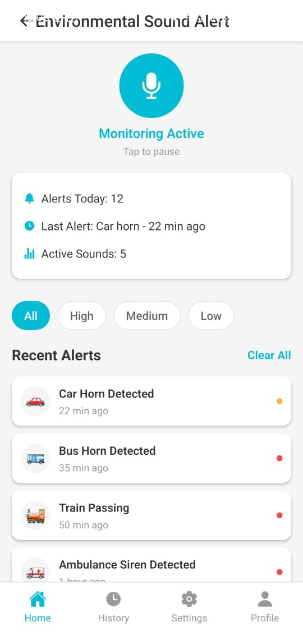
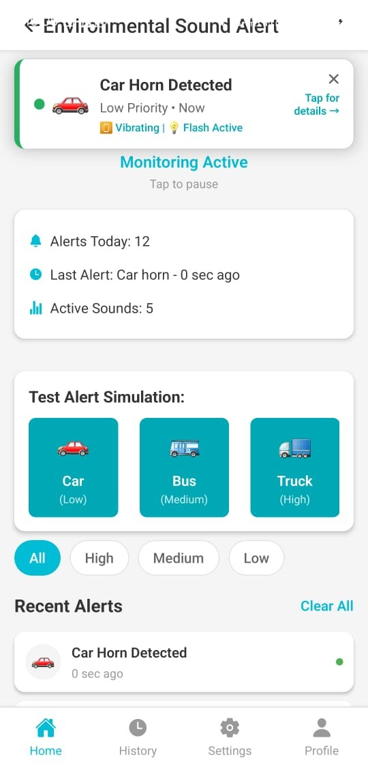
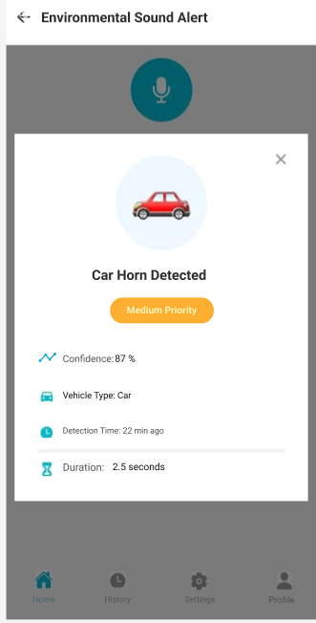
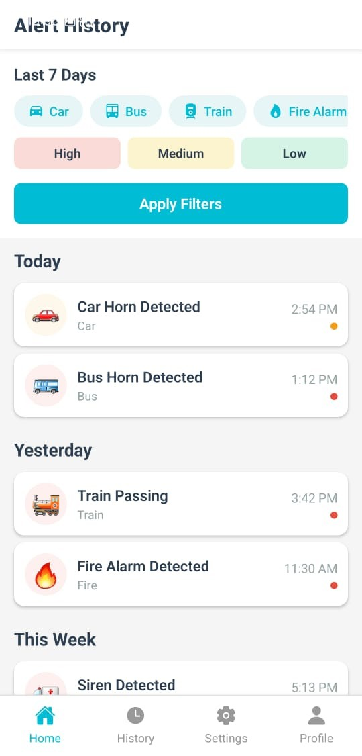
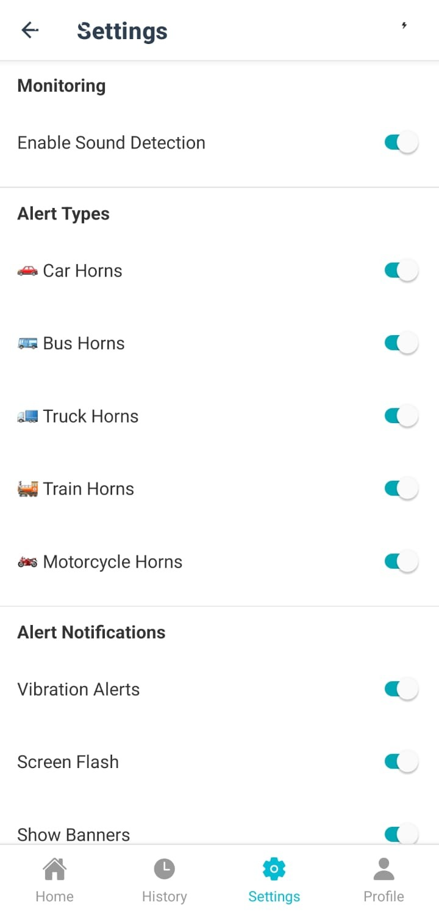
Environmental Sound Alert Module
Design Excellence/Contribution
User-Centered Interface - Intuitive, customizable, and visually clear

Slide 16

Environmental Sound Alert Module
Key Design Strengths:
Accessibility-first multi-modal alert system
Real-time intelligent classification (5 vehicle types)
User-centered, icon-based interface design
Continuous automatic environmental monitoring
Unique Contribution:
First fine-grained vehicle horn classification system
Context-aware urgency prioritization for Deaf users
Multi-modal alerts (vibration, flash, visual)
Enhances safety and independence in traffic environments
User Feedback on Prototype
Real-time alerts gave sense of safety
Visual icons immediately understandable
Multiple alert modes important
Priority color coding intuitive
Comfortable using independently
Users valued customization control
Vibration strength mattered

Slide 17
IT22304674
LIYANAGE M. L. I. S.
Specialization : Information Technology
Individual Component : Smart Sinhala Sign Language Reader

Slide 18
Smart Sinhala Sign Language Reader with Emotion Recognition
Sub-Problem
Existing SSL recognition systems focus only on hand gestures, missing critical emotional and contextual information.
Most systems ignore facial expressions and body postures that add meaning and emotional context to sign communication.
Lack of multimodal integration (hands, face, pose) reduces recognition accuracy, especially for complex signs and emotional expressions.
Cloud-based solutions compromise user privacy and require internet connectivity, limiting real-time performance and offline accessibility
How the Solution Addresses It
Integrates hand gestures (126D), facial expressions (468 landmarks), and body pose (33 points) for holistic sign recognition.
Detects emotional context (happiness, sadness, anger, surprise, fear, neutral) with intensity measurements.
Recognizes 227 Sinhala sign classes using LSTM and Hybrid CNN models with temporal sequence analysis.
Operates entirely on-device using edge AI for full privacy, offline capability, and low-latency processing.
Delivers multimodal output (text, emotion indicators) for accessibility and immediate awareness of sign meaning.

Slide 19
Smart Sinhala Sign Language Reader with Emotion Recognition
User Requirements Addressed by the Solution
Multimodal Sign Recognition: Integrates hand landmarks (126 dimensions), facial features (468 landmarks), and body pose (33 key points) for comprehensive sign interpretation.
Emotion Context Detection: Detects emotions (happiness, sadness, anger, surprise, fear, neutral) with intensity measurements for richer communication understanding.
Privacy-Preserving Real-Time Recognition: On-device processing with edge AI models ensures full privacy, offline capability, and low latency.
Comprehensive Output: Delivers sign text, emotion indicators, and confidence scores for complete communication understanding.
Extensive Sign Vocabulary: Recognizes 227 Sinhala sign classes across multiple categories using LSTM and Hybrid CNN models.

Slide 20
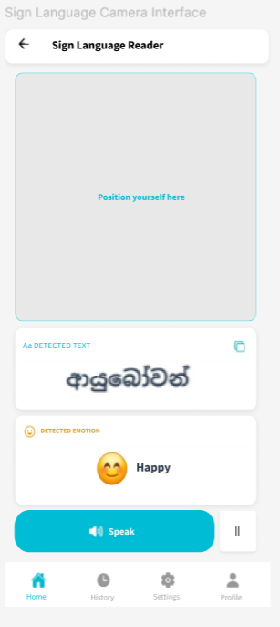
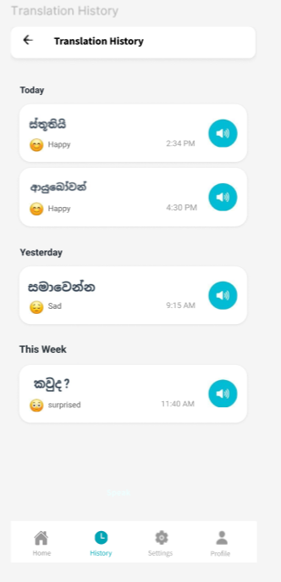
Smart Sinhala Sign Language Reader with Emotion Recognition
Design Excellence/Contribution
User-Centered Interface

Slide 21
Smart Sinhala Sign Language Reader with Emotion Recognition
Design Excellence and Contribution:
Key Design Strengths:
Multimodal recognition combining hand gestures, facial expressions, and body pose.
Real-time emotion detection with intensity measurements.
Complete on-device processing for privacy and offline capability.
Recognizes 227 Sinhala sign classes with high accuracy.
Unique Contribution:
Integrates emotion recognition with sign language for richer communication understanding.
Captures full emotional context (happiness, sadness, anger, surprise, fear, neutral) during signing.
Processes 1,582 multimodal features (126 hand + 1,456 facial) for comprehensive analysis.
Provides privacy-preserving recognition with lower latency for real-time communication.

Slide 22
Smart Sinhala Sign Language Reader with Emotion Recognition
User Feedback on Prototype
Visual displays were clear and easy to understand
UI were intuitive
Emotion indicators helped understand context better

Slide 23
IT22308870
DE SILVA U. P. A. N.
Specialization : Information Technology
Individual Component: Introducing a Sinhala Two-Way Communication System for Children with Speaking Disabilities

Slide 24
Introducing a Sinhala Two-Way Communication System for Children with Speaking Disabilities
Sub-Problem Identified:
Children struggle to express needs using speech
Parents know only limited sign language
Existing tools are not child-friendly or visual enough
How the Solution Addresses It:
Allows children to select visual signs instead of speaking
Supports up to 3-word sentence building for simple expression
Enables parents to search words and show signs
Reduces communication anxiety for shy children
User Requirements addressed:
Child Requirements:
Visual learning → ✔ Sign-based interface
Simple interaction → ✔ Large icons, minimal text
Emotional comfort → ✔ Friendly colors and layout
Parent Requirements:
Limited sign knowledge → ✔ Word-to-sign search
Easy communication → ✔ No complex navigation

Slide 25
Introducing a Sinhala Two-Way Communication System for Children with Speaking Disabilities
Design Excellence and Contribution:
Key Design Strengths:
Research-driven UI decisions
Child-centered interaction design
Accessibility-first approach (no audio dependency)
Unique Contribution:
Combines Sinhala signs + sentence building
Tailored for local Sri Lankan context
Designed specifically for young deaf learners
User Feedback on Prototype:
Child Feedback (Observed):
Preferred visual icons over text
Found sentence building engaging
Comfortable using without assistance
Parent Feedback:
Sign search feature very helpful
Interface easy to understand
Reduced communication difficulty

Slide 26
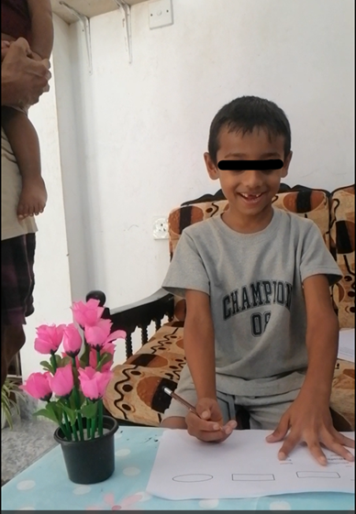
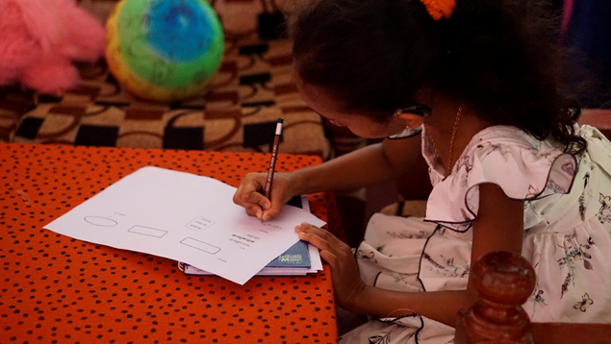
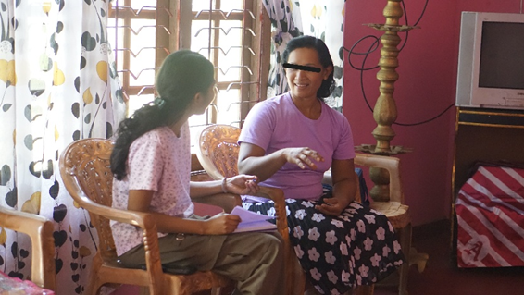
Introducing a Sinhala Two-Way Communication System for Children with Speaking Disabilities
User Research Images:
Indumini is completing my task that given to her
Me interviewing Indumini's mother
Hashila is completing my tasks with helping of his father

Slide 27
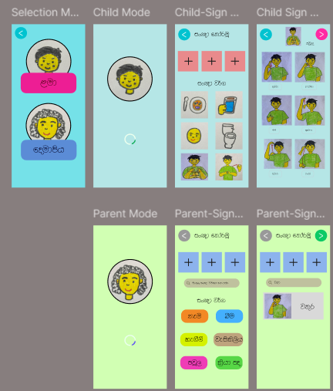
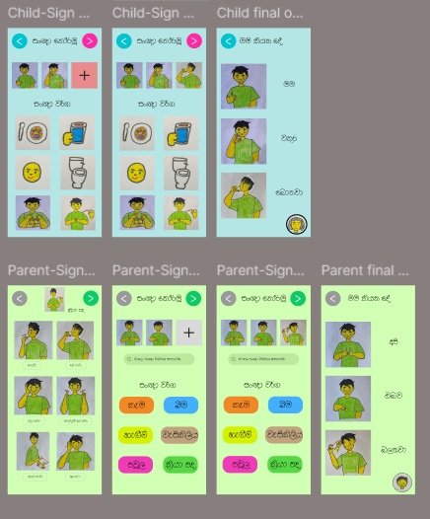
Introducing a Sinhala Two-Way Communication System for Children with Speaking Disabilities
Screenshot of Figma UIs:

Slide 28
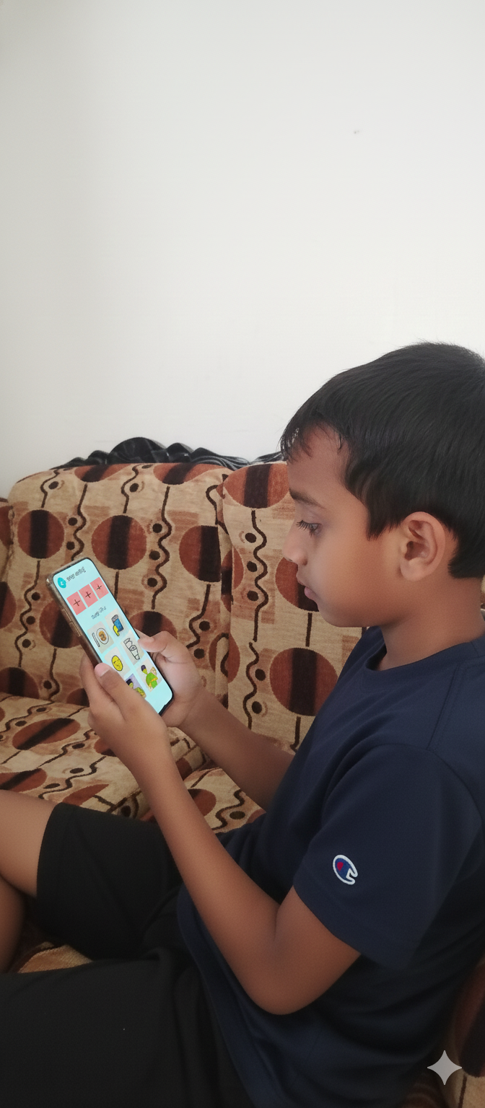
Introducing a Sinhala Two-Way Communication System for Children with Speaking Disabilities
User Feedback on Prototype:
Child Feedback (Observed):
Hashila testing my prototype

Slide 29

Intelligent Sinhala Sign Language Learning and Communication Platform with Emotion Recognition and Environmental Awareness
Commercialization/Sustainability of Solution
Customer Persona Name: Hansika Jayawardhana Role: Sign Language Interpreter Needs:
Learn Sinhala Sign Language correctly
Communicate emotions and daily needs
Stay aware of environmental sounds for safety
Use simple, visual, mobile-friendly interfaces
Components Used:
Sign Learning System (skill development)
Environmental Sound Alert System (safety)
Sign Recognition with Emotion (expressive communication)
Two-Way Communication System (daily interaction)

Slide 30
Intelligent Sinhala Sign Language Learning and Communication Platform with Emotion Recognition and Environmental Awareness
Commercialization/Sustainability of Solution
Target Market
Deaf and Hard-of-Hearing population in Sri Lanka
Children with speaking disabilities
Special education schools and institutes
NGOs and rehabilitation centers
Families and caregivers
Cost Recovery Costs are recovered through:
Subscription plans.
Licensing to schools, institutions, and caregiving centeres.
Using Optional premium features.

Slide 31

THANK YOU

