Slide 1
Prerequisites
Packages
Beautifulsoup
https://www.crummy.com/software/BeautifulSoup/bs4/doc/
Conda: conda install –c anaconda beautifulsoup4
Selenium
https://www.selenium.dev/documentation/en/
Conda: conda install –c conda-forge selenium
Navigation Page URL
Content Page URL

Slide 2
Identify the URL for forum page navigation
Truncate pre and post page number:
url1 = sustainabilitycommunity.springernature.com/channel/1385?page=
Or
url1 = https://sustainabilitycommunity.springernature.com/search?page=
url2 = &query=nature

Slide 3
def pagination():
url_list = []
for i in range(1, 6, 1):
url = "https://sustainabilitycommunity.nature.com/channels/1385?page=" + str(i) + ".html"
url_list.append(url)
return url_list

Slide 4
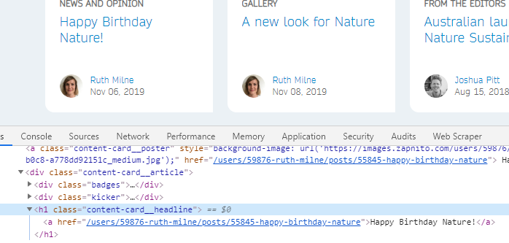
Identify the class that contains the content link
class_ = content-card__headline

Slide 5
def getLinks(pageURL):
pages = []
hdr = {'User-Agent': 'Mozilla/5.0'}
req = Request(pageURL,headers=hdr)
html = urlopen(req)
bs = BeautifulSoup(html, 'html.parser')
for link in bs.find_all('a', class_='content-card__poster', href=re.compile('1385')):
if 'href' in link.attrs:
if link.attrs['href'] not in pages:
pages.append('https://sustainabilitycommunity.nature.com' + link.attrs['href'])
return pages

Slide 6
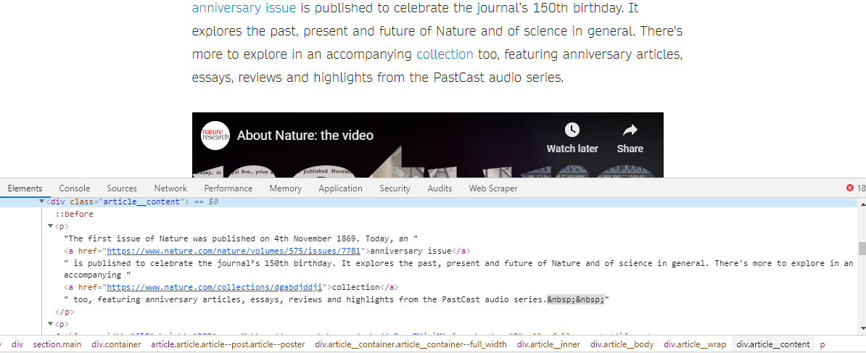
Identify the class that contains the text
div header for class_ = article__content

Slide 7
def scrape(url):
hdr = {'User-Agent': 'Mozilla/5.0'}
req = Request(url,headers=hdr)
html = urlopen(req)
bs = BeautifulSoup(html, 'html.parser')
for post in enumerate(bs.find_all('div', class_='article__content')):
item = {'post': post.text}
results.append(item)

Slide 8
Driver Code
results = []
dates = []
for url in pagination():
for page in (getLinks(url)):
print(page)
try:
scrape(page)
getDates(page)
except:
item = {'post': 'ERROR 404'}
results.append(item)
df_sustain = pd.DataFrame(results)

Slide 9
Mini project – covid-19 linguistics analysis
w/o 5/4: Data Gathering
i.e. https://www.the-hospitalist.org/hospitalist/coronavirus-updates - This blog includes more than 300 articles all published post Jan 2020
w/o 5/11: Initial Exploration
Top word count and bigram count
Top verbs and adjectives
Sentiment and subjectivity summary
w/o 5/18: Cluster Analysis
Choose a better model (LDA or LSA)
Visualize results with Cytoscape

