Slide 1
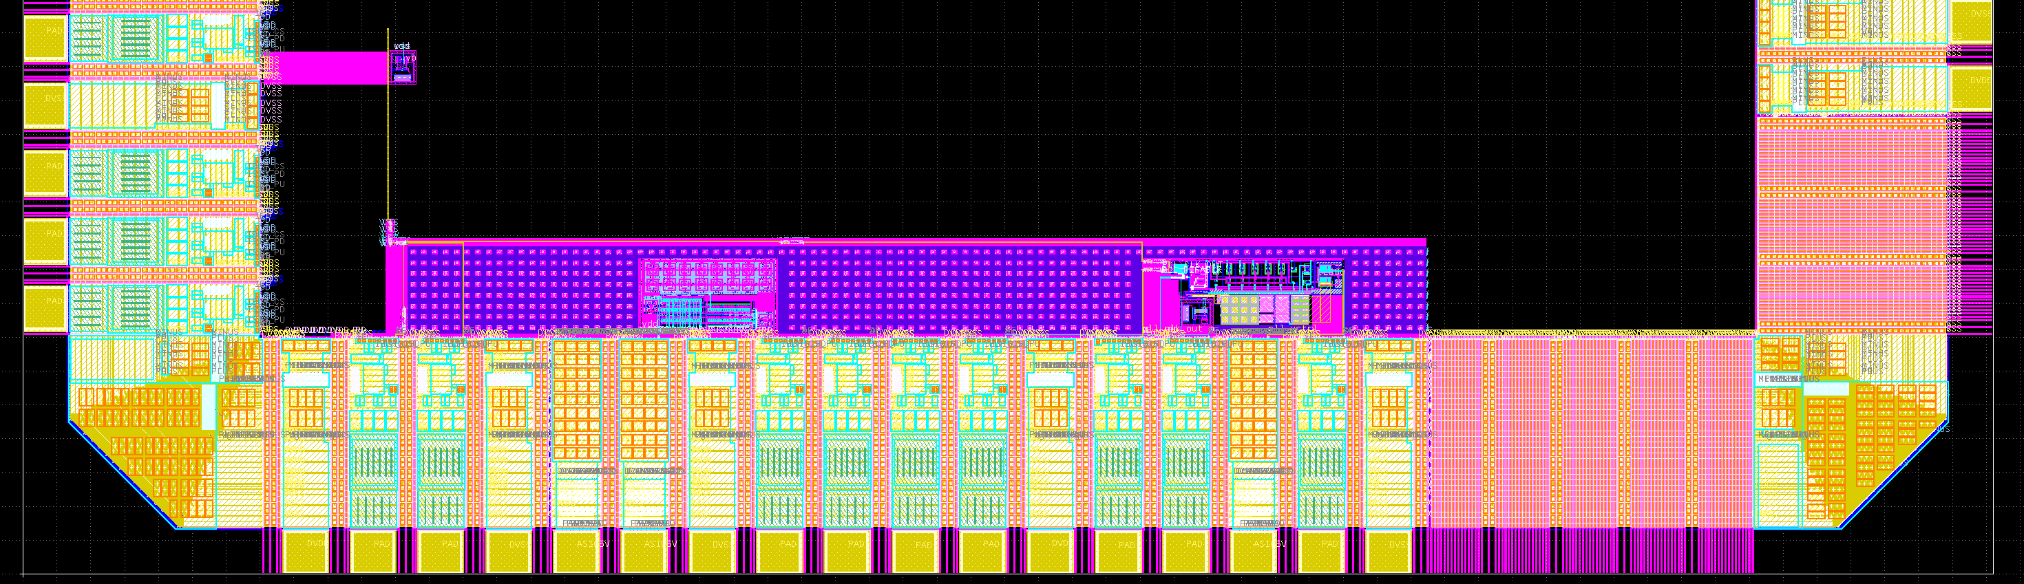
Location of block in LTC2
Reference current source for Korea DAC
(540,724)
(912, 358)
Bandgap reference
(1692, 366)
PLL
vss
vss
vdd
vss
dac_clk
mon_clk
mon_vin
mon_sel
pll_free
dac_clk_sel
mon_vout
mon_out
pll_vctrl
pll_disable
pll_clk_out
pll_ref_clk

Slide 2
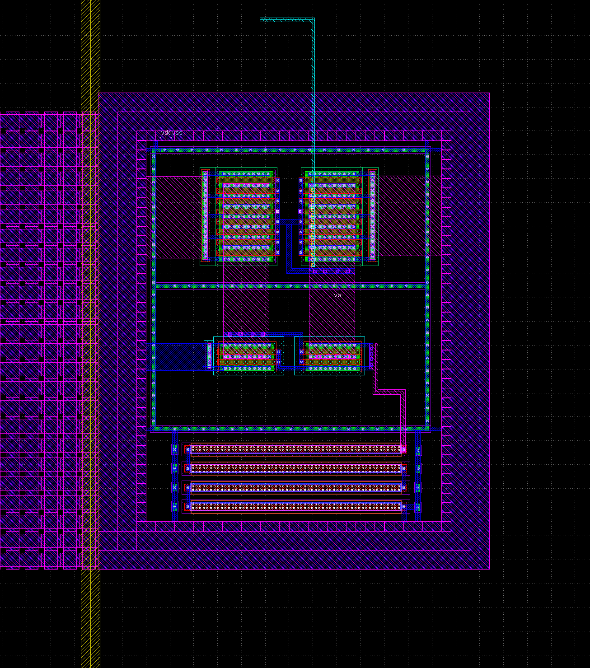
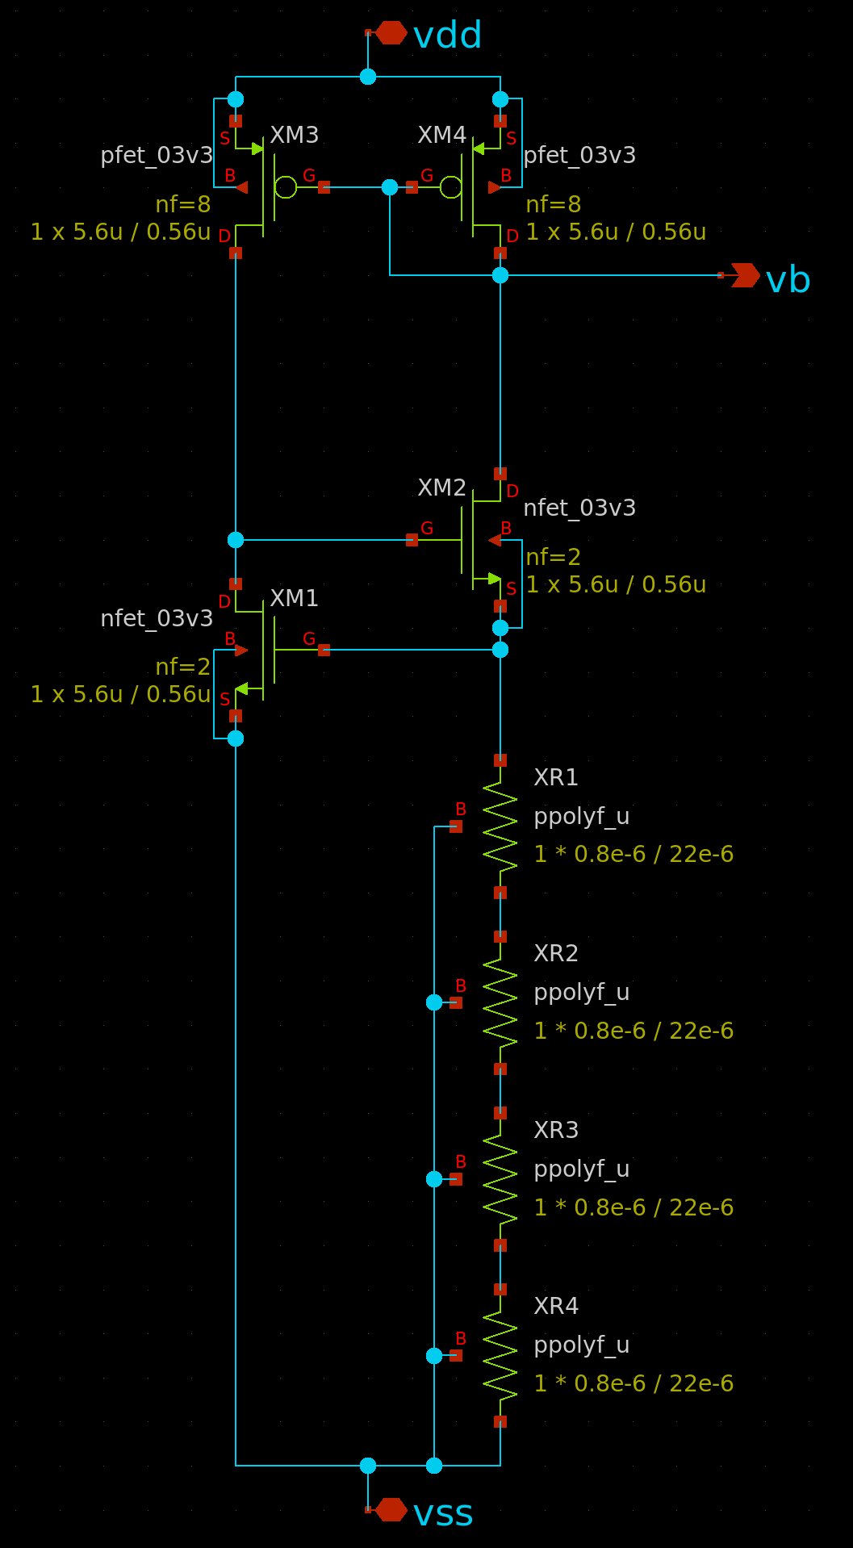
Vth-reference current source
generate 20 μA current
(output is bias voltage for current mirror)
DAC
(581, 774)
50 μm
41 μm
(540, 724)

Slide 3
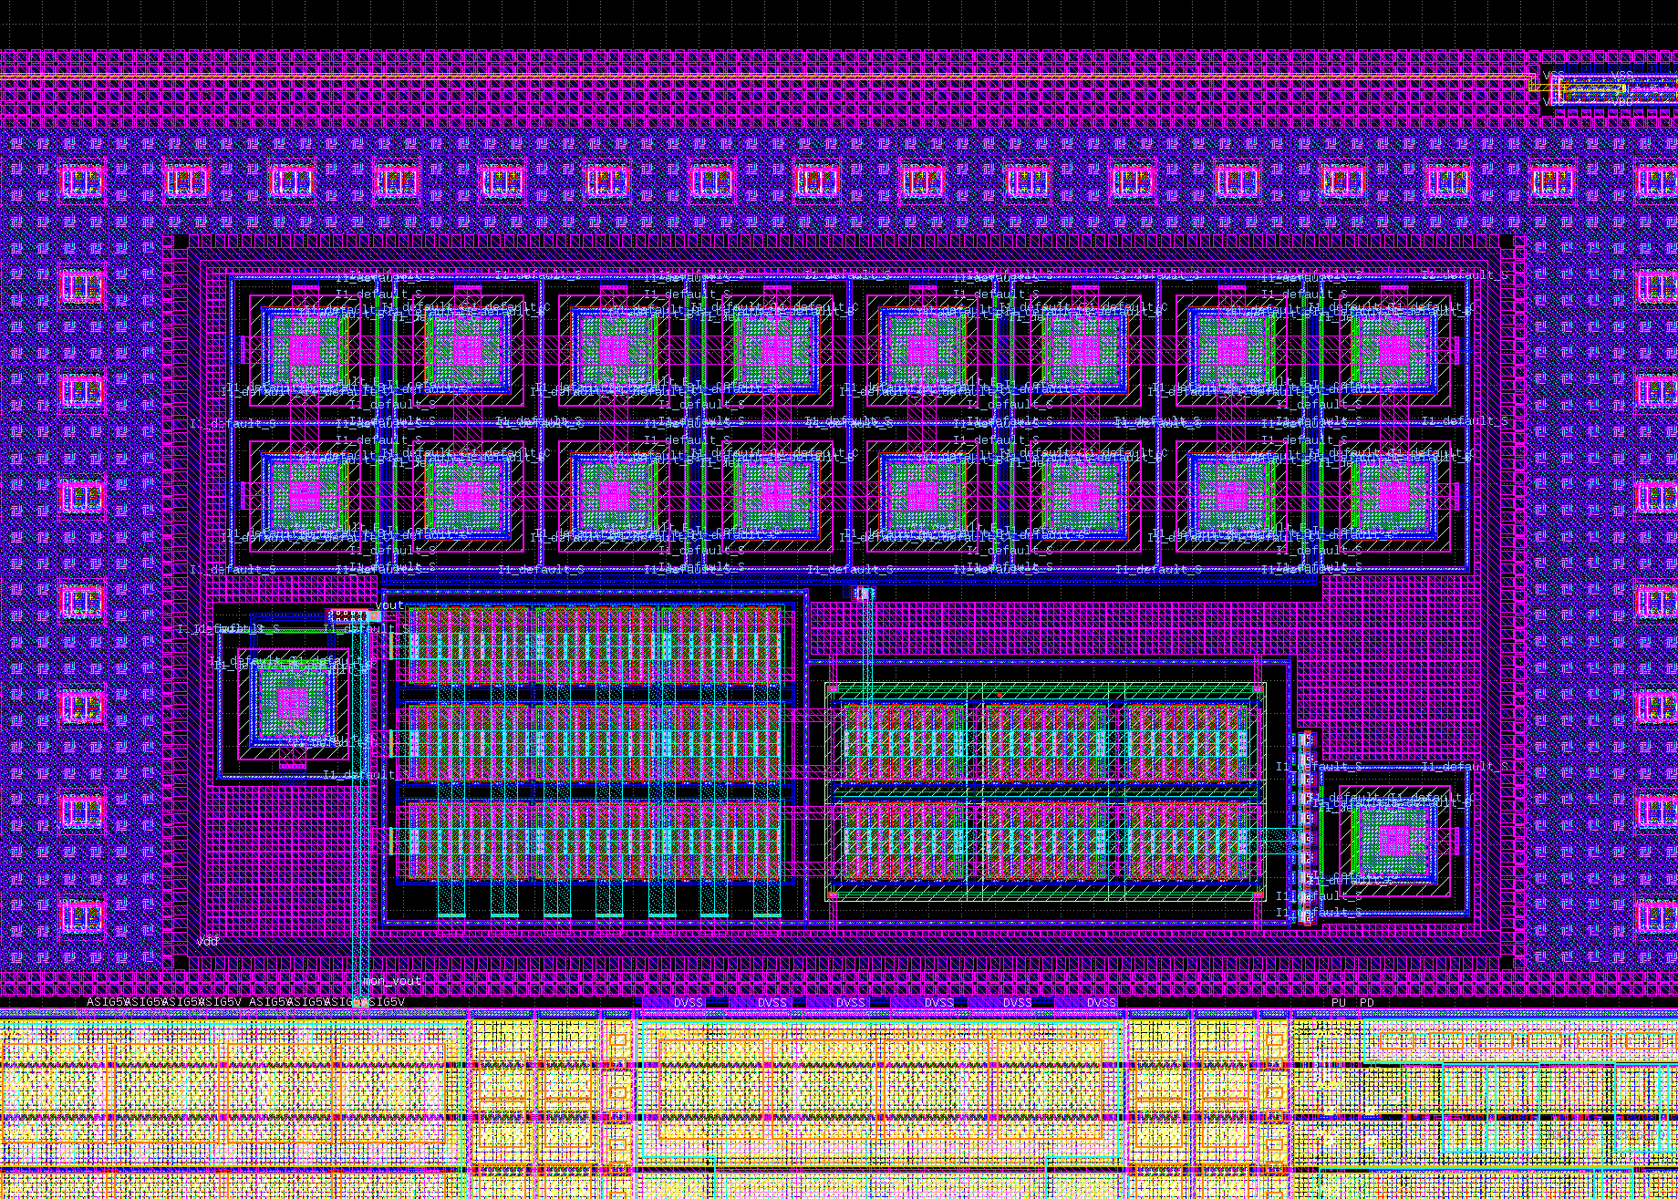
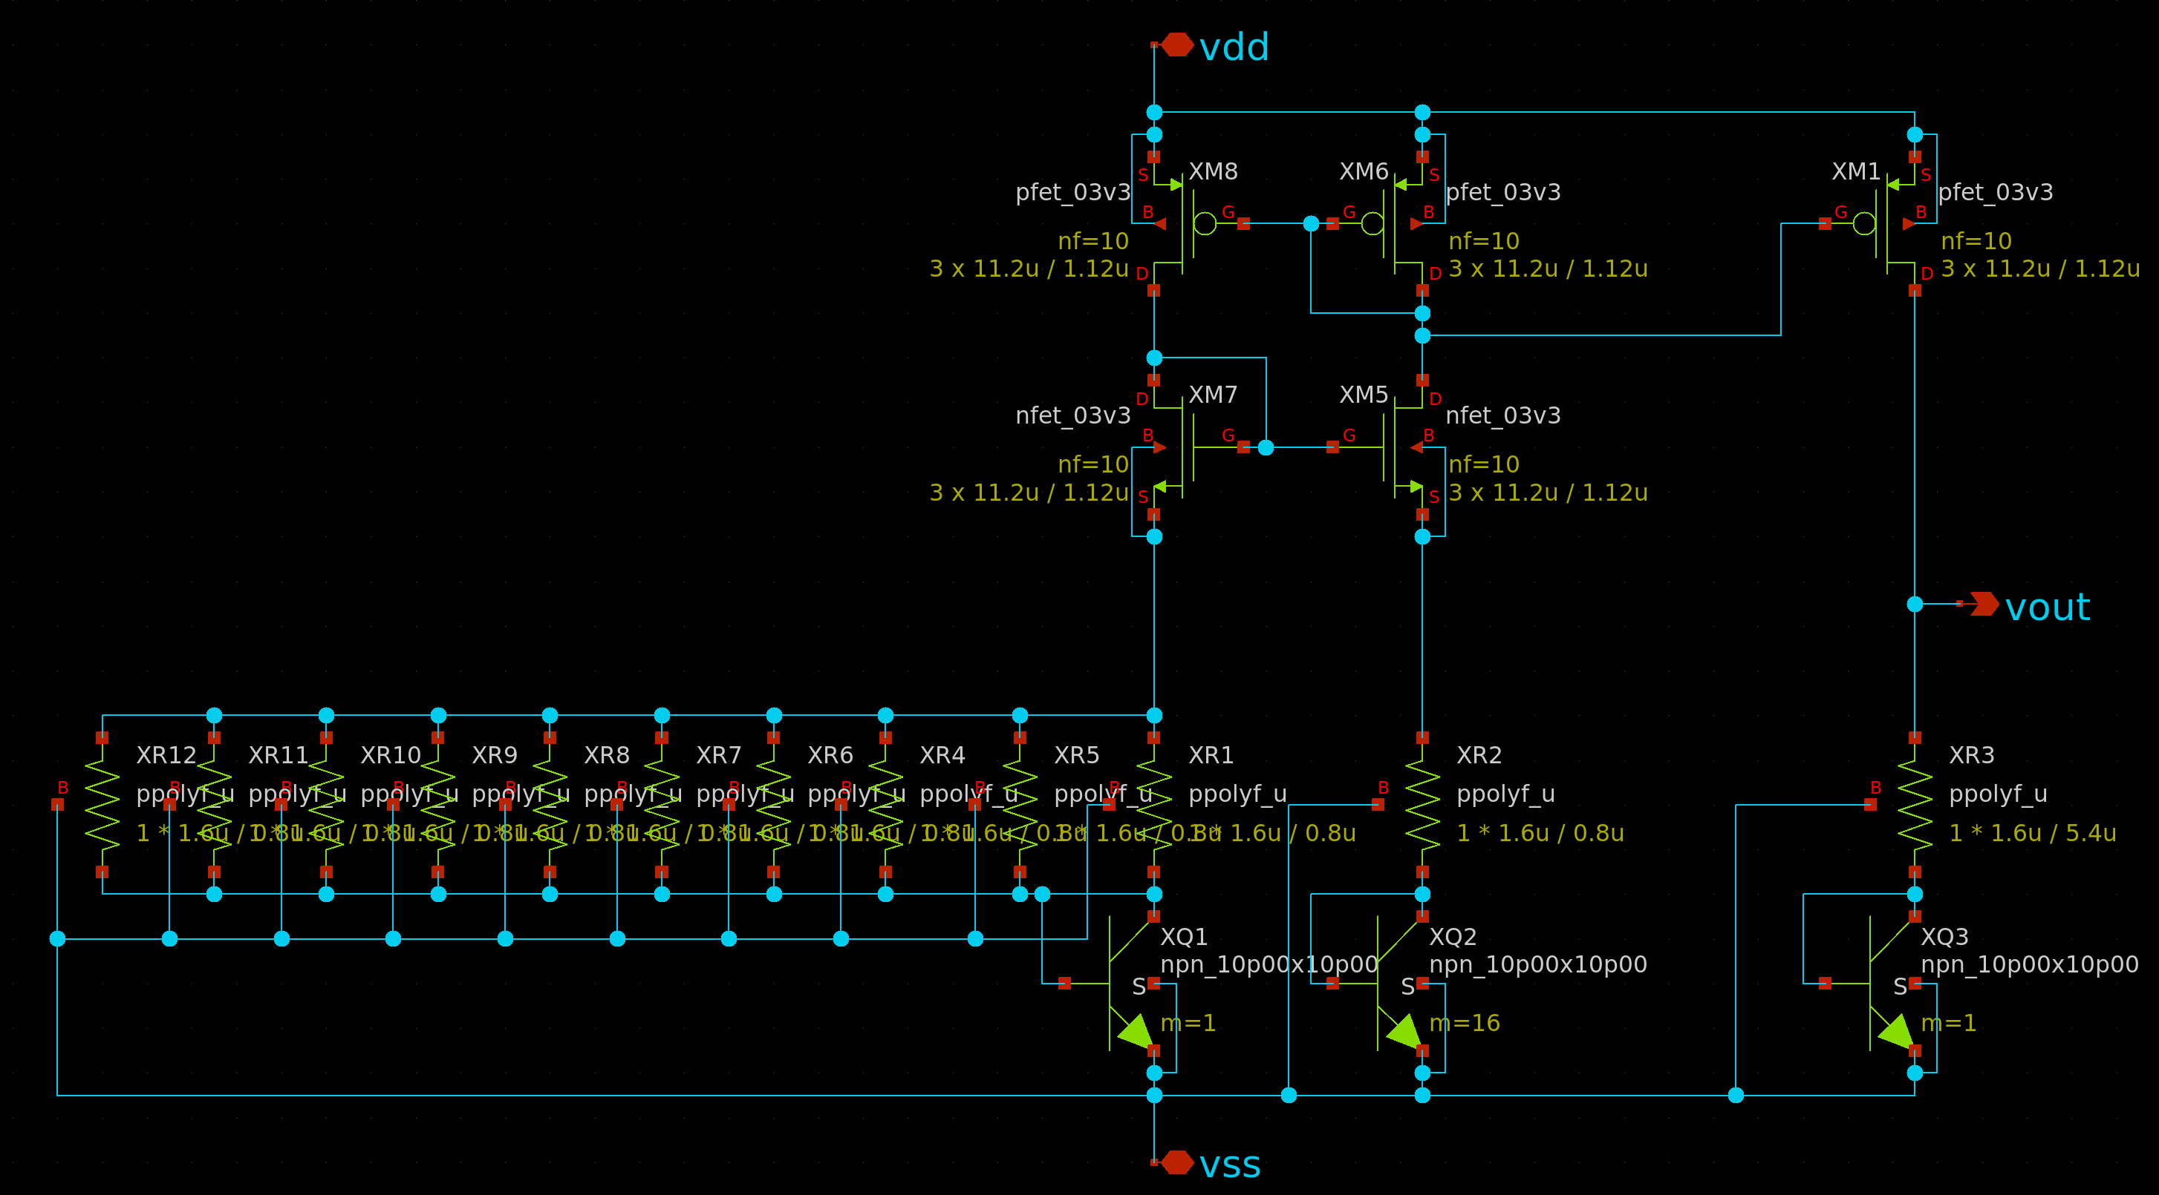
Bandgap reference
output: 1.2 V
(1112, 466)
108 μm
200 μm
(912, 358)
output to pad (mon_vout)

Slide 4
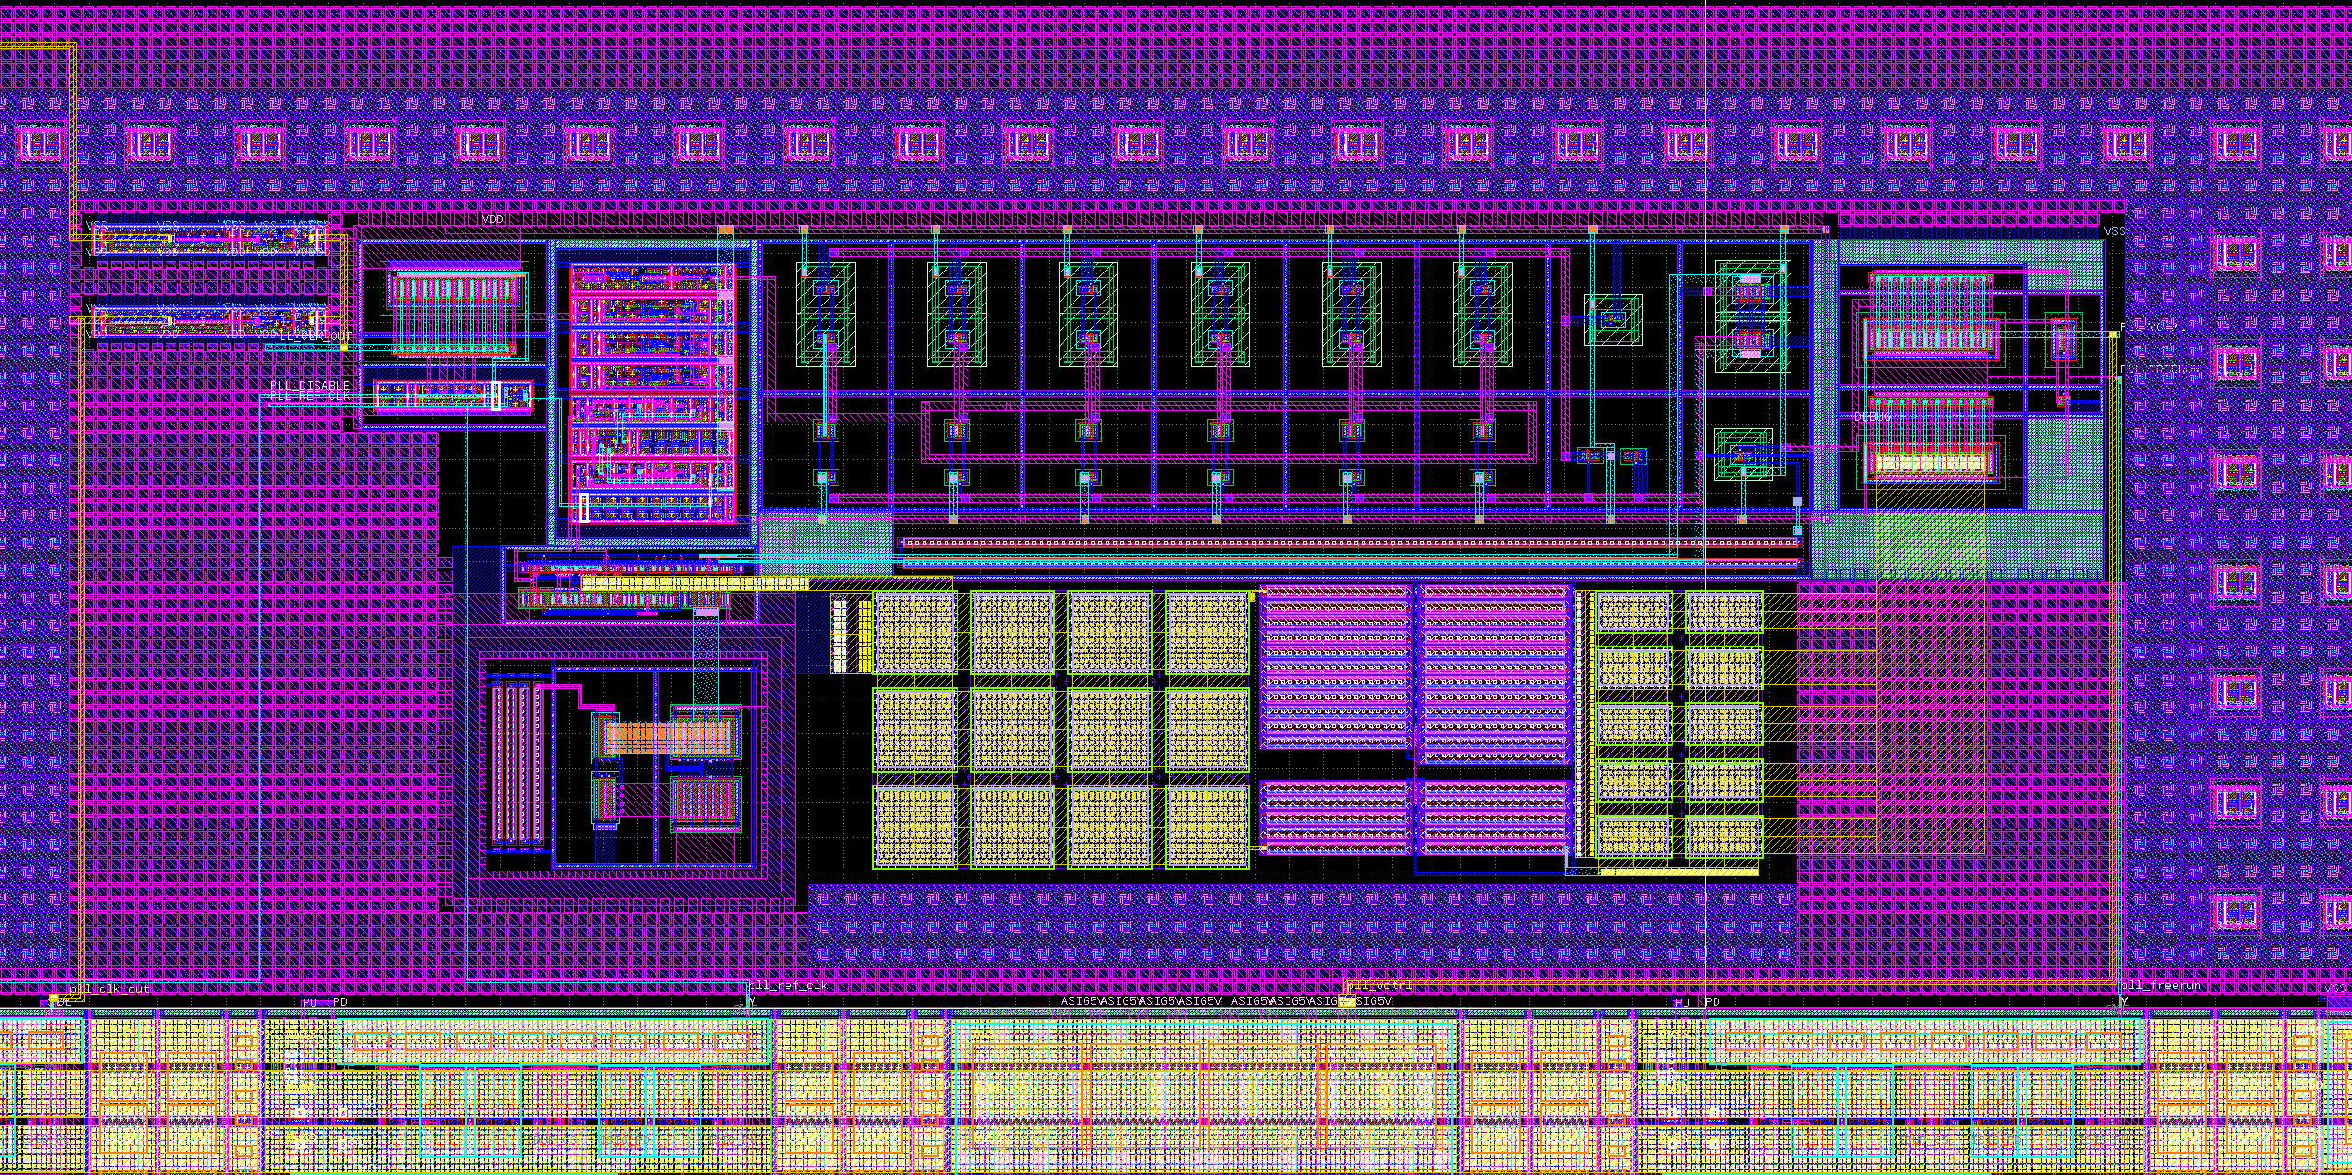
PLL
8 MHz input / 48 MHz output
clock buffer
(1952, 464)
260 μm
98 μm
(1692, 366)

Slide 5
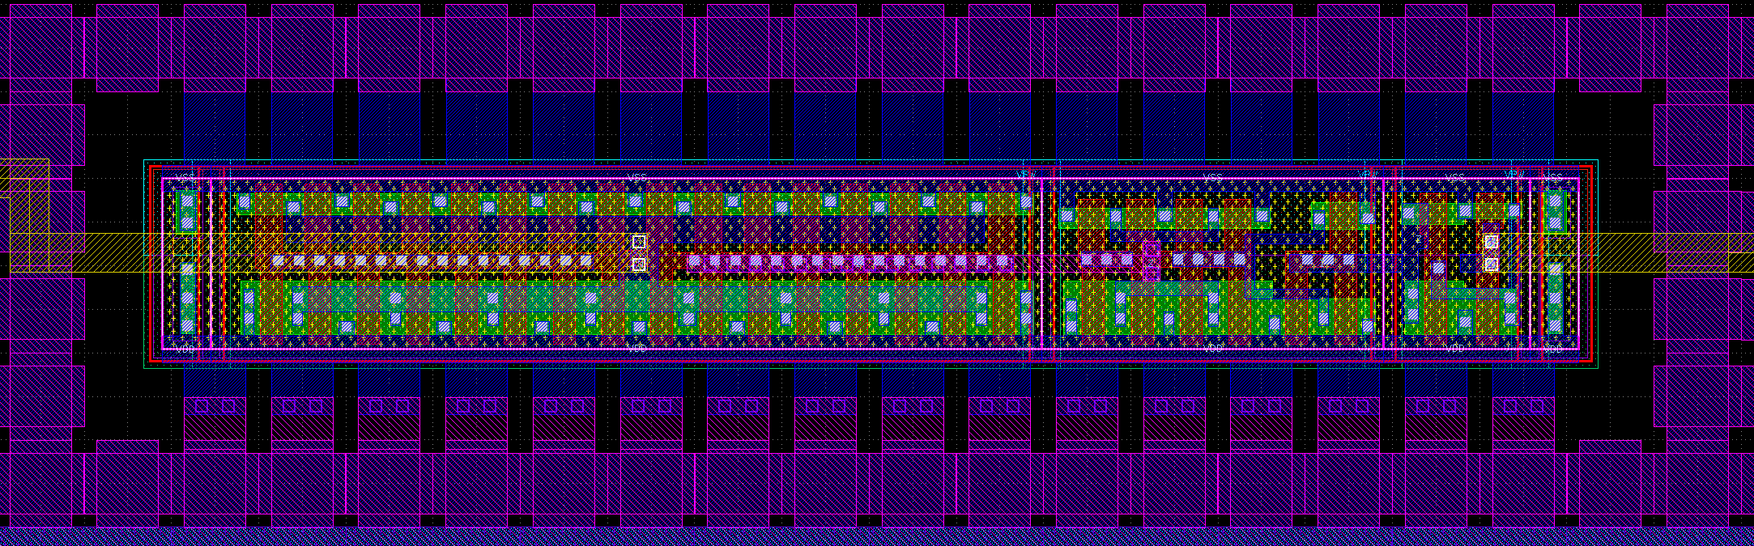
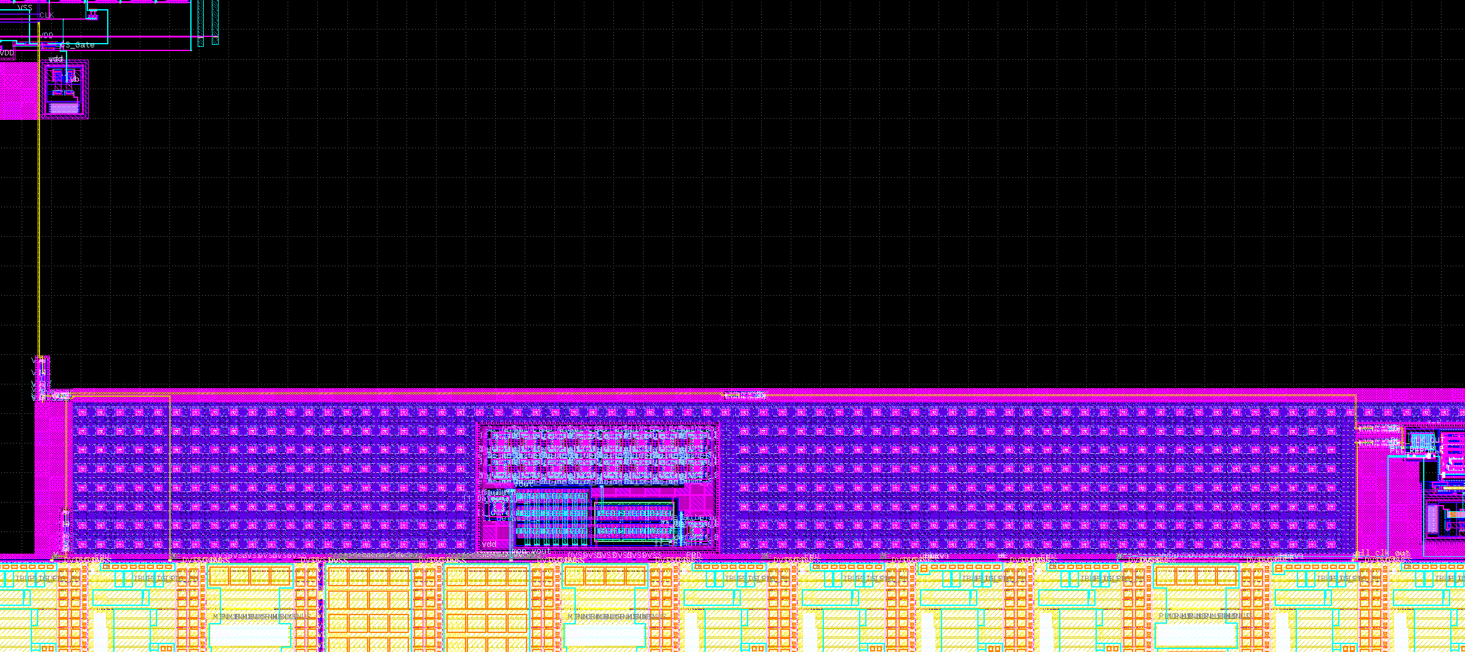
clock distribution
clock buffer
clock input of DAC
clkbuf_16
clkbuf_4
clkbuf_1
clock buffer (clkbuf_1 - clkbuf_4 - clkbuf_16)
MUX (mux2_4 standard cell)
PLL output
dac_clk
pll_clk_out
dac_clk_sel

Slide 6
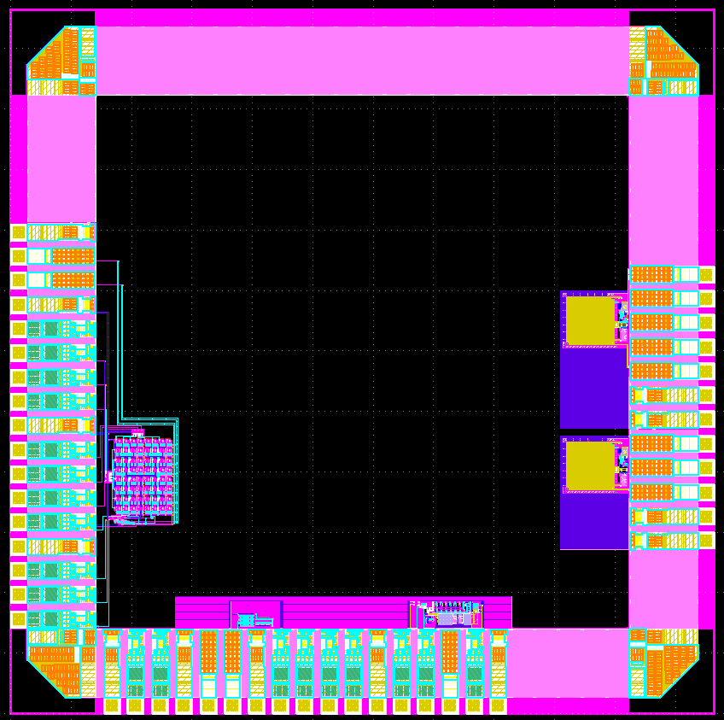
BGR&CS
By Akira Tsuchiya
&
Miho Yamada
PLL
By Mori Mizuki
&
Noritsuna Imamura

