Slide 2
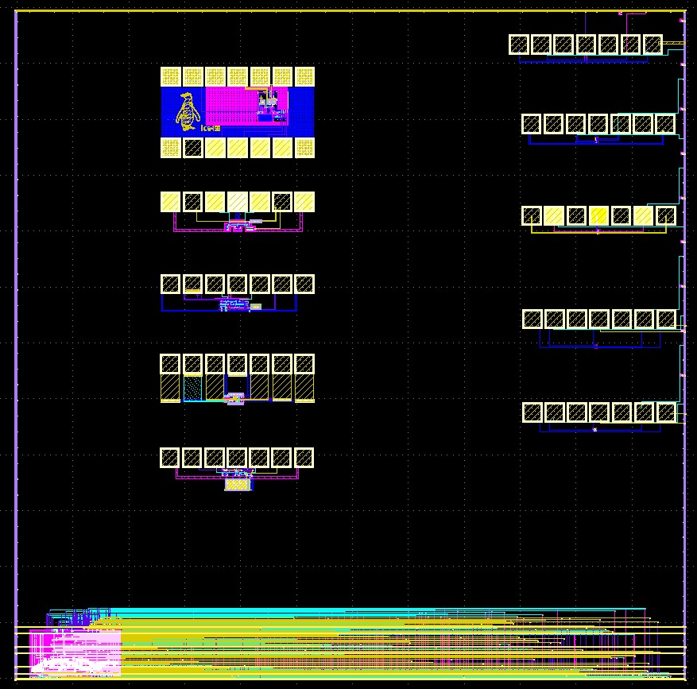
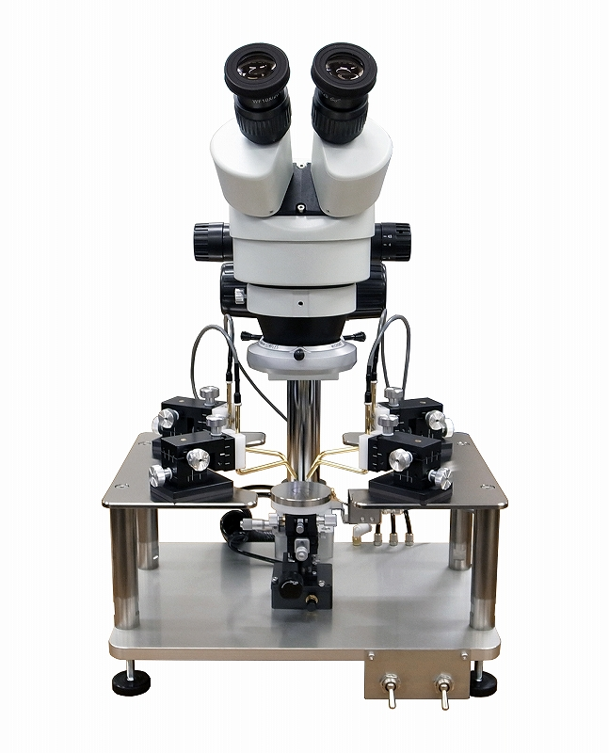
ponzu840w’s
Design
Ice458’s
Design
Bols-blue’s
Design
Noritsuna’s
Design
homelith’s
Design
gitefu’s
Design
Ajisai’s
Design
3zki’s
Design
Noritsuna’s
Design
Yamada3’s
Design
OPAMP & ADC
Inverter

