Slide 1
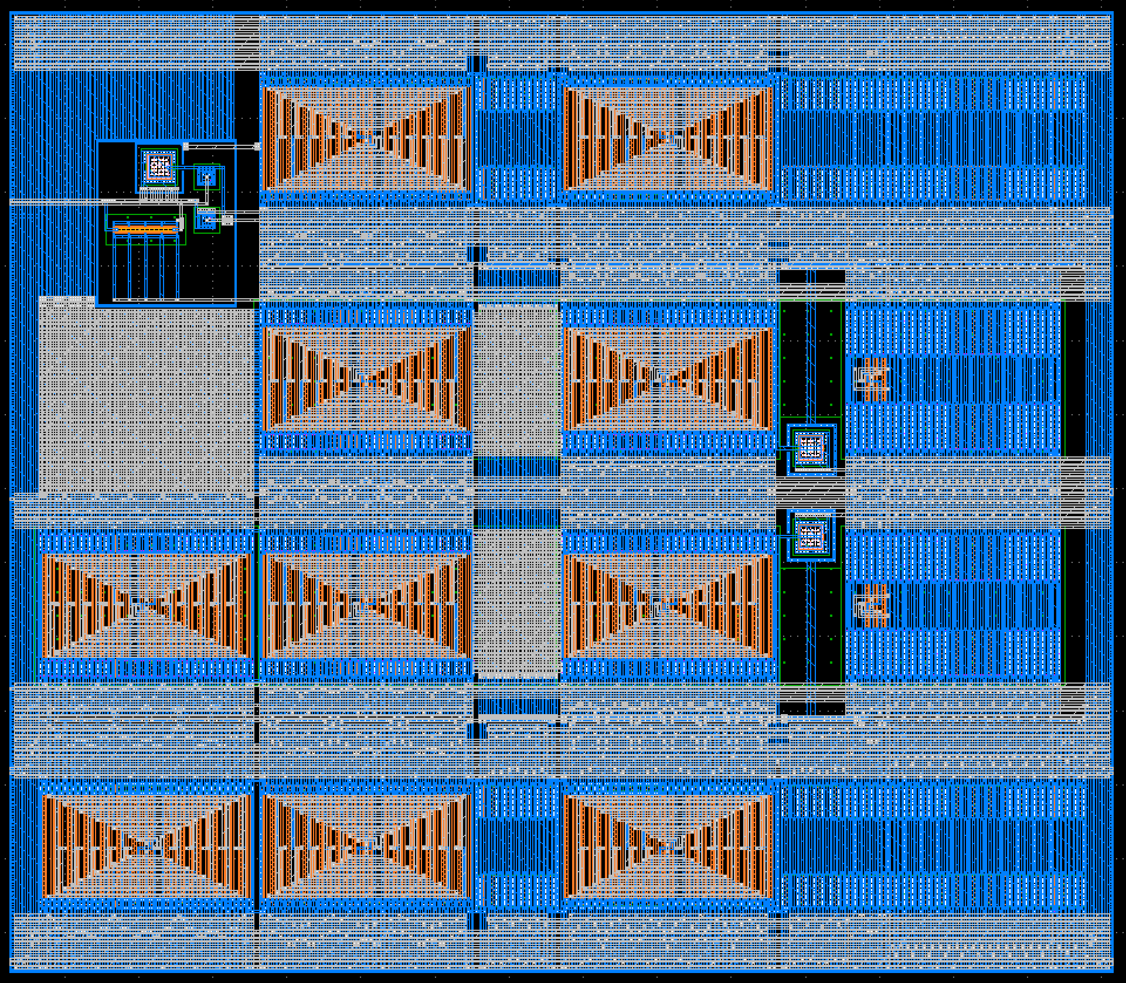
Detector
CS
RF AMP

