Slide 1
Supporting Uncertain Predicates in DBMS Using Approximate String Matching and Probabilistic Databases
By: AMOL S. JUMDE AND RAVINDRA B. KESKAR
Ia1 presentation
Ishita rai
Sy-comps, b2-1911083

Slide 2
Abstract
Current relational database systems are deterministic in nature and lack the support for approximate matching.
In this paper, the authors propose a system to support approximate matching in the DBMS field
This paper introduces a ‘≈’ (uncertain predicate operator) for approximate matching and devises a novel formula to calculate the similarity scores.
We get results ranked according to their closeness to the queried literals.
The paper includes results of operations on performed on IMDb movie database and European Football database.
Two variations of the operator, ‘≈+’ and ‘≈-’ are also discussed.

Slide 3
I. Introduction
Pattern matching in deterministic databases
Need of Uncertain matches
Example of Uncertain Predicates

Slide 4
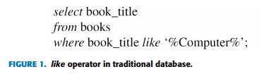
Pattern matching in deterministic databases
In traditional database, we use ‘like’ operator (equivalent to substring matching) and the pattern is described using special characters ‘%’ and ‘_’
We can use comparison operators , ≥, =, and <> as well as like operators too. Where clause is used for conditions.
Here, a comprehensive knowledge of database is required or we might get an empty result-set.

Slide 5
Need of Uncertain matches
The empty result set might also be caused due to a single misspelled word, or a typing error.
Problems may arise due to the homophonic nature of the words. For example, Cristopher or Kristopher.
Instead of returning an empty result-set, it will be better to return the result-set ranked according to the degree of similarity.
From the approximate results that the user would get, she would come to know about the actual values in the database and she may re-query with the exact keywords that she intended.

Slide 6
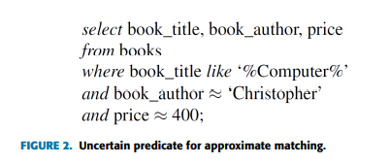
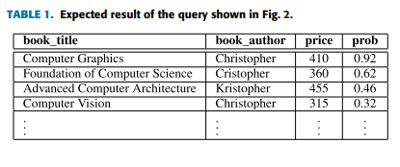
Example of Uncertain Predicates
Let’s assume there exists an uncertain predicate operator, denoted as ‘≈’, which is used for approximate matching.
The result of the given query could be a relation annotated with the percentage of matching.
These matching scores can be treated as the probability scores or the confidence scores for the respective tuples, and can be stored with the tuple.
the result-set is ranked according to its derived probability, indicating the most credible (i.e. the highest probable) answer first.

Slide 7
III. Preliminaries
Uncertainties and Probabilistic Databases
Approximate String Matching(ASM)

Slide 8
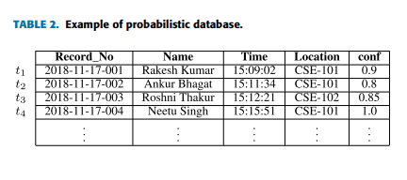
Uncertainties and Probabilistic Databases
Nowadays, many applications have to deal with uncertain data, such as object recognition, sensor networks, moving object monitoring etc.
The use of nulls is proposed to handle the uncertainty in traditional databases. This may result in a loss of information.
Probabilistic database stores uncertainty in terms of a probability for that uncertain tuple or attribute.
E.g.: Consider, an institute has installed an automated system for maintaining students’ attendance.
Possible World: A traditional relational database has only one state, containing all the present tuples. In contrast, a probabilistic database can be in one of several states. It is a set of multiple possible certain databases each of which has some chance to appear in the real world.

Slide 9
Approximate String Matching(ASM)
ASM aims to find the closest match for a query string. The uncommon part between the two strings is considered as the error between them.
the approximate string match is generally measured in terms of distance.
distance metrics are classified into three major categories, namely
  edit based
  q-grams based (or n-grams)
  and heuristic based

Slide 10

The edit based metrics are measured in terms of the number of edit operations required to make two strings equal. These edit operations include addition, deletion, and substitution of a character, or transposition of characters.
heuristic based distances don’t have a solid mathematical backbone and are mostly specifically designed for something particular. For eg: Jaro Method designed d to pair the records between the census data and the independent Post Enumeration Survey (PES) conducted by the U.S. The intuition behind the method is that the types of errors like transpositions of characters or character mismatches between close characters are more likely due to the typing errors.

Slide 11
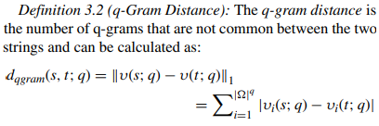
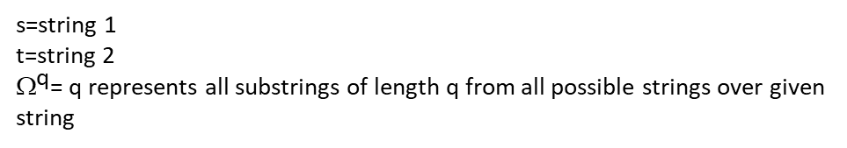
The q-gram based distances aim to find common q-grams between two matched strings. The q-grams of string s is a set of all possible q length substrings of s. The maximum number of distinct q-grams for string s is |s|−q+1. if q = 2 and s = ‘VNIT’ then the q-grams are {‘VN’, ‘NI’, ‘IT’}.
The q gram distance can vary between 0 and |s| + |t| − 2q + 2.
For example, the q-gram distance between ‘Tuesday’ and ‘Thursday’ is 7 for q = 2 as ‘Tu’, ‘ue’, ‘es’, ‘Th’, ‘hu’, ‘ur’, and ‘rs’ are the q-grams that are not common between them.
String A: {‘Tu’, ’ue’, ‘us’, ‘sd’, ‘da’, ‘ay’}
String B: {‘Th’, ’hu’, ‘ur’, ‘rs’, ‘sd’, ‘da’, ‘ay’}
s=string 1
t=string 2
${\text{}}^{\text{q}}$= q represents all substrings of length q from all possible strings over given string

Slide 12
IV. Methodology
Naïve Solution to calculate distance between 2 strings
Proposed solution to calculate distance between 2 strings

Slide 13
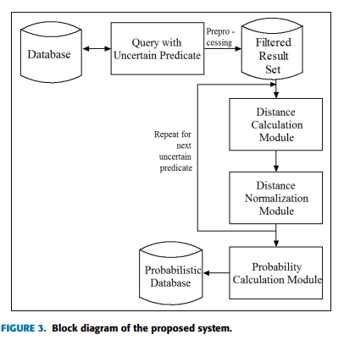
Methodology
The basic modules of the proposed system are as follows:
Pre processing: The certain predicates are applied and we obtain the filtered results.
Distance Calculation: This module calculates the distance between the queried literal and each of the field values in the corresponding column to get the distance array.
Distance Normalization: Distance array is normalized in the range [0, 1]
Probability Calculation: this module combines the probabilities obtained from the uncertain predicates to calculate the final probability of filtered tuples and finally, we get a probabilistic database as an output.

Slide 14
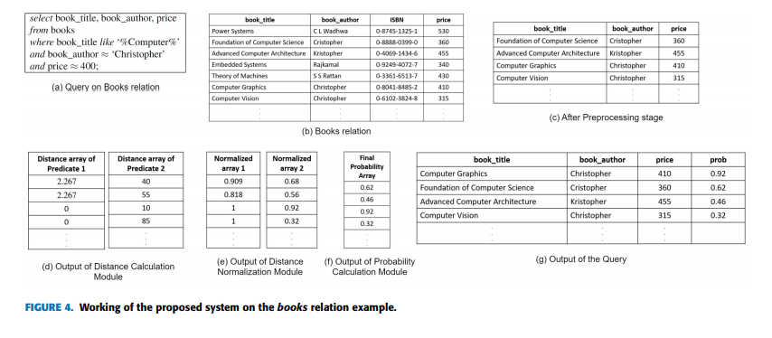

Slide 15
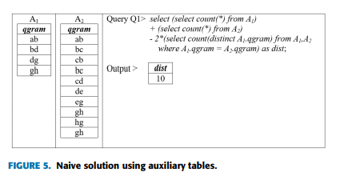
Naïve Solution to calculate distance between 2 strings
q-gram distance needs O(|Ω|^ q ) storage. To avoid such high space complexity, we use auxiliary tables to calculate the q-gram distance between the two strings (s and t) in RDBMS.
Auxiliary tables are created and deleted later.

Slide 16
Proposed solution to calculate distance between 2 strings
Why not Naïve Method?
The problem in using q-gram distance in its purest form is that the user may query a part of the original string present in the table. For example, she may query ‘Harry Potter’ instead of ‘Harry Potter and the Order of the Phoenix’.
Such extra uncommon parts of one of the strings increase the distance.
To overcome this problem, we introduce the concepts of Local q-gram distance and Global q-gram distance
LOCAL Q-GRAM:
Length of larger string y is divided into the set of substrings (yi’s) where length of each substring is equal to the length of smaller-length string (x).
lx , ly are the length of strings x and y, respectively. n = ly − lx + 1, which will be the number of possible substrings (yi’s) of length lx of a string y.

Slide 17
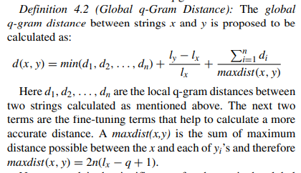
GLOBAL Q GRAM DISTANCE:
that the first string may be contained anywhere in the second string. Hence, to minimize the distance between two strings, minimum of local q-gram distances is considered (min(d1, d2,..., dn)).
But even if d(‘aaa’, ‘aaa’) is 0 and d(‘aaa’, ‘aaaaa’) is also 0 (for q = 2), still, the first string should get precedence over the second in terms of similarity. So we add a penalty of (ly−lx )/lx. Hence, higher the length differences (amongst the matched strings), higher will be the penalty
Even then, d(‘aaa’, ‘aaaaa’) = d(‘aaa’, ‘baaad’). Here we believe that ‘aaa’ is more closer to ‘aaaaa’ than ‘baaad. A ratio that measures the amount of cumulative dissimilarity between the two strings measured relatively against the maximum distance is added.
For other data types like numeric or date, a simple absolute difference of the values would be the distance between them.

Slide 18
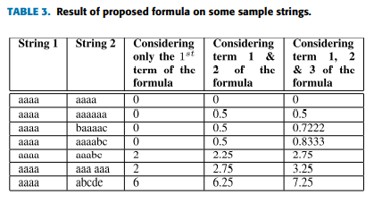
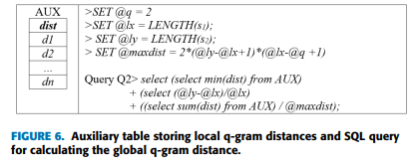

Slide 19

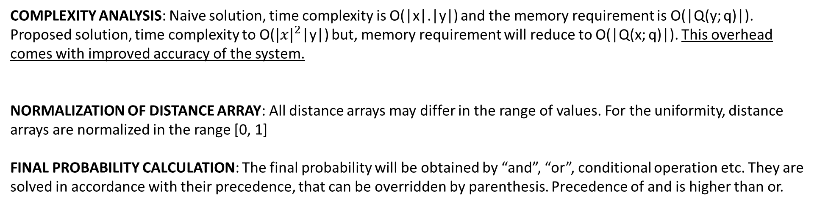
COMPLEXITY ANALYSIS: Naive solution, time complexity is O(|x|.|y|) and the memory requirement is O(|Q(y; q)|). Proposed solution, time complexity to O(${|x|}^{2}$|y|) but, memory requirement will reduce to O(|Q(x; q)|). This overhead comes with improved accuracy of the system.
NORMALIZATION OF DISTANCE ARRAY: All distance arrays may differ in the range of values. For the uniformity, distance arrays are normalized in the range [0, 1]
FINAL PROBABILITY CALCULATION: The final probability will be obtained by “and”, “or”, conditional operation etc. They are solved in accordance with their precedence, that can be overridden by parenthesis. Precedence of and is higher than or.

Slide 20
Implementation, Experimentation and Datasets
Procedure
Testing datasets
Results and Discussion

Slide 21
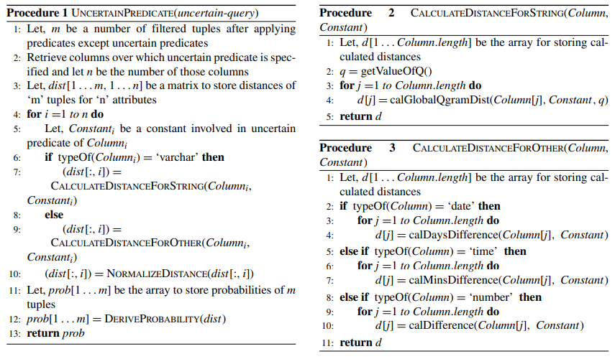
Procedure

Slide 22
Testing datasets
For experimentation, authors have used the MySQL database. MySQL C API library is used to communicate with MySQL server.
The libmysqlclient is a client version of the library that C applications use to communicate. This C API offers several data structures for database connection, for storing the result of a query, like, MYSQL, MYSQL_RES, MYSQL_ROW. It also provides various C API functions like mysql_init() for initializing MYSQL structure, mysql_real_connect().
IMDb movie and European football databases were used for testing.

Slide 23
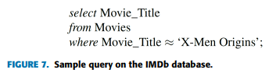
Results and Discussion
As part of the experimentation, the authors compared the performances of the naive approach with proposed solution.
They also compared the results of the proposed global q-gram distance with the classic edit based distances. We analyzed the effect of the value of q on accuracy.
They have also presented the results of additionally proposed operators (≈+ and ≈−). h the proposed solution.

Slide 24
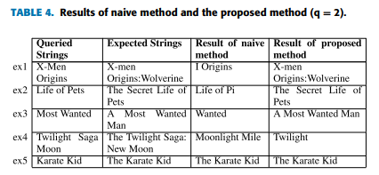
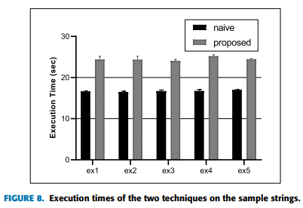
A)Naïve vs Proposed solution:
A naive method fails when there is a significant mismatch between the lengths of two strings.
In the proposed method, there is an overhead of matching individual substrings which resulted in the change of the complexity from O(|x|.|y|) to O(|x|^2.|y|).
Fig. 8 is the average of 10 experiments over 5043 tuples. An average of execution times of all the experiments (5*10 = 50 experiments) shows a 46.3% increase in the execution time.
But, this trade-off comes with improved accuracy as shown

Slide 25
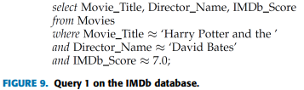
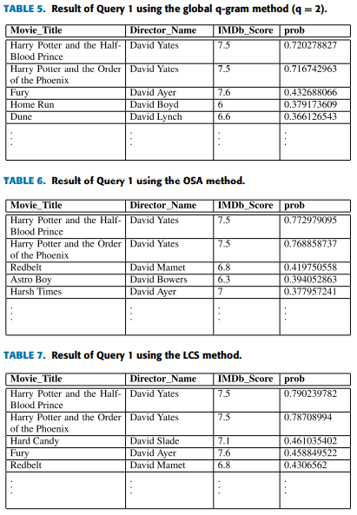
B) Edit based vs Global q-gram distance
The intend is to get a film from the Harry Potter film series, which has its IMDb score is near to 7.0 and is directed by ‘David Bates’. In reality, some parts of this film series are directed by David Yates.

Slide 26
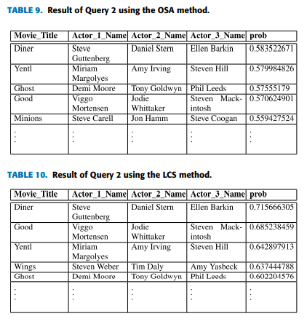
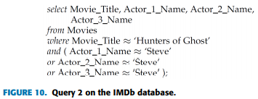
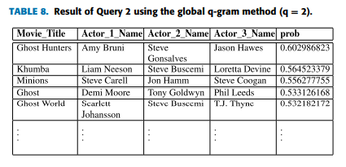
OSA and LCS methods from the edit-based category were tested.
Here we queried for titles which are similar to ‘Hunters of Ghost’ in which an actor named ‘Steve’ has acted. But the real name of the movie is ‘Ghost Hunters’ and the complete name of the actor is ‘Steve Gonsalves’. IMDb database has three columns for storing the names of three actors and we are not sure which column of actor names contains ‘Steve’.

Slide 27
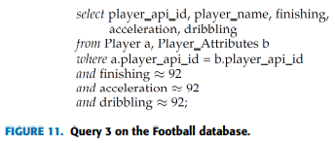
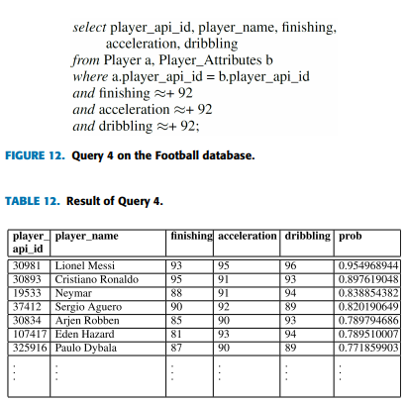
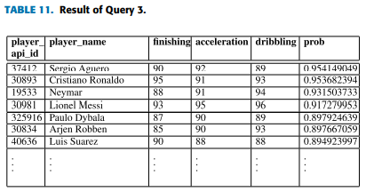
C) Additional operators

Slide 28
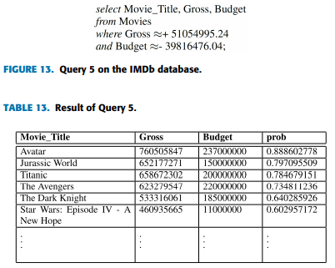

Slide 29
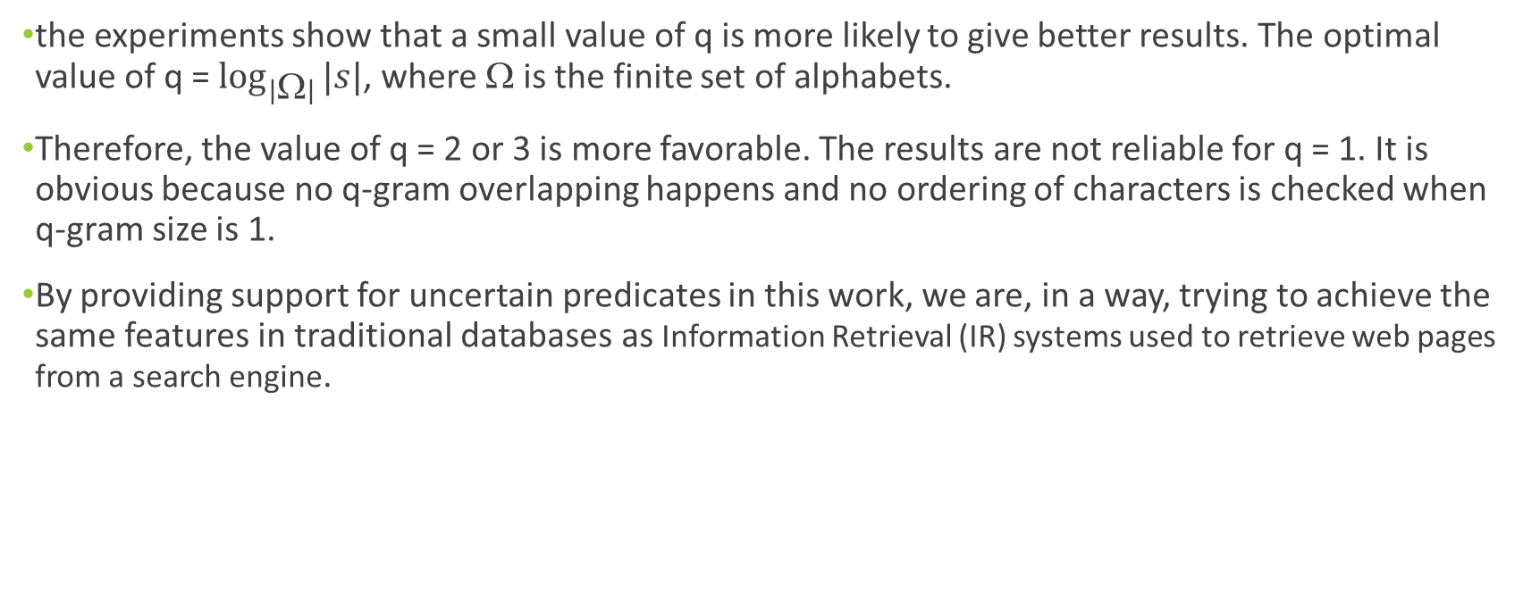
D) Effects of value of q
the experiments show that a small value of q is more likely to give better results. The optimal value of q = $\log_{|Ω|}{|s|}$, where $$ is the finite set of alphabets.
Therefore, the value of q = 2 or 3 is more favorable. The results are not reliable for q = 1. It is obvious because no q-gram overlapping happens and no ordering of characters is checked when q-gram size is 1.
By providing support for uncertain predicates in this work, we are, in a way, trying to achieve the same features in traditional databases as Information Retrieval (IR) systems used to retrieve web pages from a search engine.

Slide 30
Conclusion and Future Work:
A database management system to support the uncertain predicates is proposed through similarity between the values (of strings) is measured in terms of a modified q-gram distances, i.e. local q-gram distance and global q-gram distance.
A novel formula to calculate these distances between the strings is proposed and explained in detail.
A set of sample queries indicate how this could be beneficial.
As an extension, two additional variants of the uncertain predicate which add to the practicability of the system are introduced.
The proposed global q-gram distance may find its application in other fields like record linkage, data deduplication, DNA sequence alignment

Slide 31
Implementation Strategy
Use of MySQL
Import author’s database
Connect it to python using connector
Define a keyword instead of using proposed symbol as it is not available on keyboard
Write the functions in python, retrieve data, perform functions and add to tables
OR use procedures

Slide 32
Paper References
1] N. Dalvi and D. Suciu, ‘‘Efficient query evaluation on probabilistic databases,’’ VLDB J., vol. 16, no. 4, pp. 523–544, Aug. 2007.
[2] D. Suciu, D. Olteanu, C. Ré, and C. Koch, ‘‘Probabilistic databases,’’ Synth. Lectures Data Manage., vol. 3, no. 2, pp. 1–180, 2011
[9] G. Navarro, ‘‘A guided tour to approximate string matching,’’ ACM Comput. Surv., vol. 33, no. 1, pp. 31–88, Mar. 2001
[33] D. Amagata, Y. Sasaki, T. Hara, and S. Nishio, ‘‘Probabilistic nearest neighbor query processing on distributed uncertain data,’’ Distrib. Parallel Databases, vol. 34, no. 2, pp. 259–287, Jun. 2016.
[34] E. F. Codd, ‘‘Extending the database relational model to capture more meaning,’’ ACM Trans. Database Syst., vol. 4, no. 4, pp. 397–434, Dec. 1979.
[35] T. Imieliński and W. Lipski, ‘‘Incomplete information in relational databases,’’ J. ACM, vol. 31, no. 4, pp. 761–791, Sep. 1984.
[36] N. Dalvi, C. Ré, and D. Suciu, ‘‘Probabilistic databases: Diamonds in the dirt,’’ Commun. ACM, vol. 52, no. 7, pp. 86–94, Jul. 2009.
[37] N. Fuhr and T. Rölleke, ‘‘A probabilistic relational algebra for the integration of information retrieval and database systems,’’ ACM Trans. Inf. Syst., vol. 15, no. 1, pp. 32–66, Jan. 1997.
[38] T. J. Green and V. Tannen, ‘‘Models for incomplete and probabilistic information,’’ in Proc. Int. Conf. Extending Database Technol. Berlin, Germany: Springer, 2006, pp. 278–296.
[39] A. S. Jumde and N. S. Chaudhari, ‘‘Query processing techniques in probabilistic databases,’’ in Proc. Int. Conf. Comput., Analytics Secur. Trends (CAST), Dec. 2016, pp. 483–488.
[40] R. W. Hamming, ‘‘Error detecting and error correcting codes,’’ Bell Syst. Tech. J., vol. 29, no. 2, pp. 147–160, Apr. 1950.
[41] S. B. Needleman and C. D. Wunsch, ‘‘A general method applicable to the search for similarities in the amino acid sequence of two proteins,’’ J. Mol. Biol., vol. 48, no. 3, pp. 443–453, Mar. 1970.
[42] V. I. Levenshtein, ‘‘Binary codes capable of correcting deletions, insertions, and reversals,’’ Sov. Phys.-Dokl., vol. 10, no. 8, pp. 707–710, 1966.
[43] R. A. Wagner and R. Lowrance, ‘‘An extension of the string-to-string correction problem,’’ J. ACM, vol. 22, no. 2, pp. 177–183, Apr. 1975.
[44] E. Ukkonen, ‘‘Approximate string-matching with q-grams and maximal matches,’’ Theor. Comput. Sci., vol. 92, no. 1, pp. 191–211, Jan. 1992.
[45] M. A. Jaro, ‘‘Advances in record-linkage methodology as applied to matching the 1985 census of tampa, florida,’’ J. Amer. Stat. Assoc., vol. 84, no. 406, pp. 414–420, Jun. 1989.
[46] M. Widenius, D. Axmark, and M. AB, ‘‘Mysql 5.5 reference manual,’’ Oracle Corp., Redwood City, CA, USA, Tech. Rep. 5.5, 2014.

Slide 33
Bibliography:
https://www.youtube.com/watch?v=E_mN90TYnlg
https://en.wikipedia.org/wiki/Edit_distance
https://en.wikipedia.org/wiki/Possible_world
https://www.w3schools.com/python/python_mysql_getstarted.asp

