Slide 1
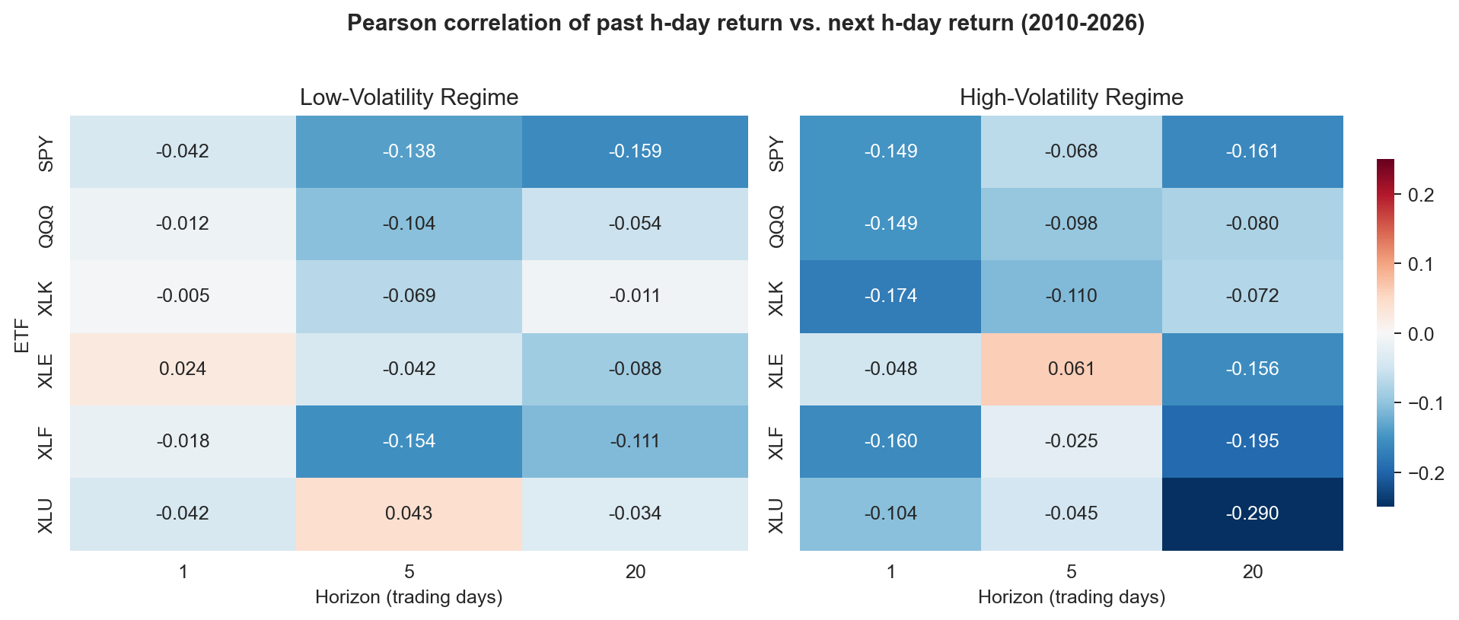
Mean Reversion in US Sector ETFs Depends on Volatility Regime
Short-horizon return reversal is mild in calm markets and ~3-4x stronger in high-volatility markets.
Pervasive 1d reversal. Every ETF shows negative lagged/forward correlation at h = 1 day.
Regime amplifies reversal. At h = 1d, Low-Vol r is near zero; High-Vol r ranges from -0.10 to -0.17.
Sector dispersion matters. XLU (utilities) has the strongest 20-day reversal (r = -0.22 full-sample, -0.29 high-vol).
One outlier. XLE (energy) is the only ETF with a positive 5-day correlation — commodity momentum, not equity reversal.
Takeaway. Return-predictability patterns in US equity ETFs are not uniform — they depend jointly on horizon, sector, and volatility regime. Conditional analysis makes a mildly-noisy full-sample average look like a cleanly-structured signal.
Data: Yahoo Finance (SPY, QQQ, XLK, XLE, XLF, XLU), 2010-01-05 to 2026-04-17, 4,248 trading days. Regime: SPY 20d realized-vol quartiles (expanding).

