Slide 1
NutriTrack Web App Using MERN Stack
A complete nutrition app

Slide 2
Team Members
Mohit Koul [2022A1R013]
Karan Sharma [2022A1R009]
Ishika Razdan [2022A1R016]

Slide 3
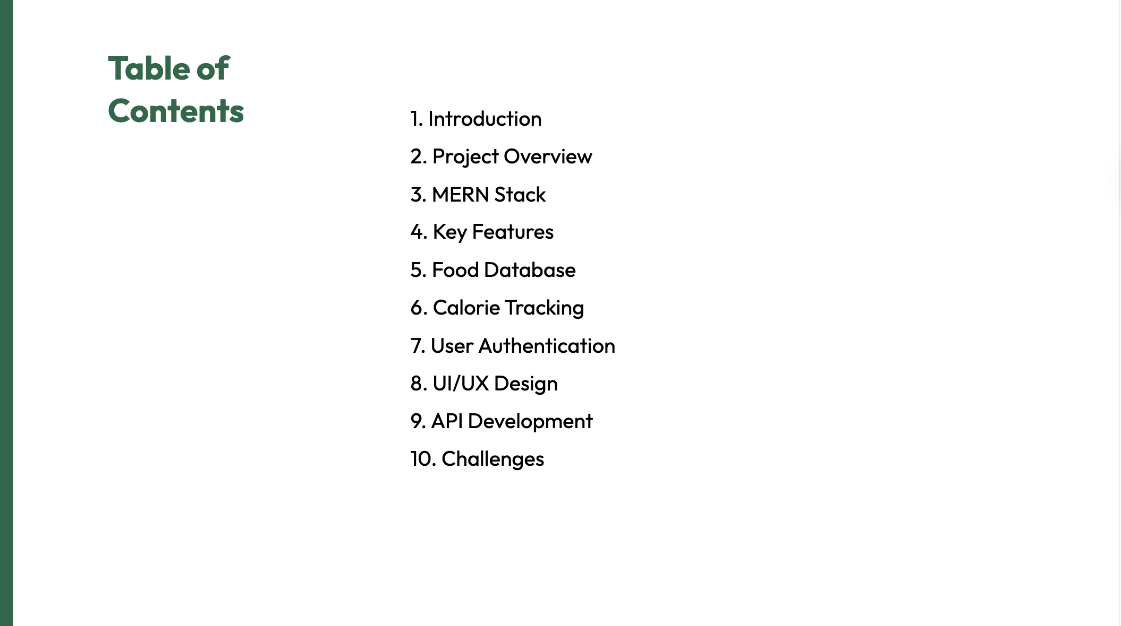
1. Introduction 2. Project Overview 3. MERN Stack 4. Key Features 5. Food Database 6. Calorie Tracking 7. User Authentication 8. UI/UX Design 9. API Development 10. Challenges

Slide 4
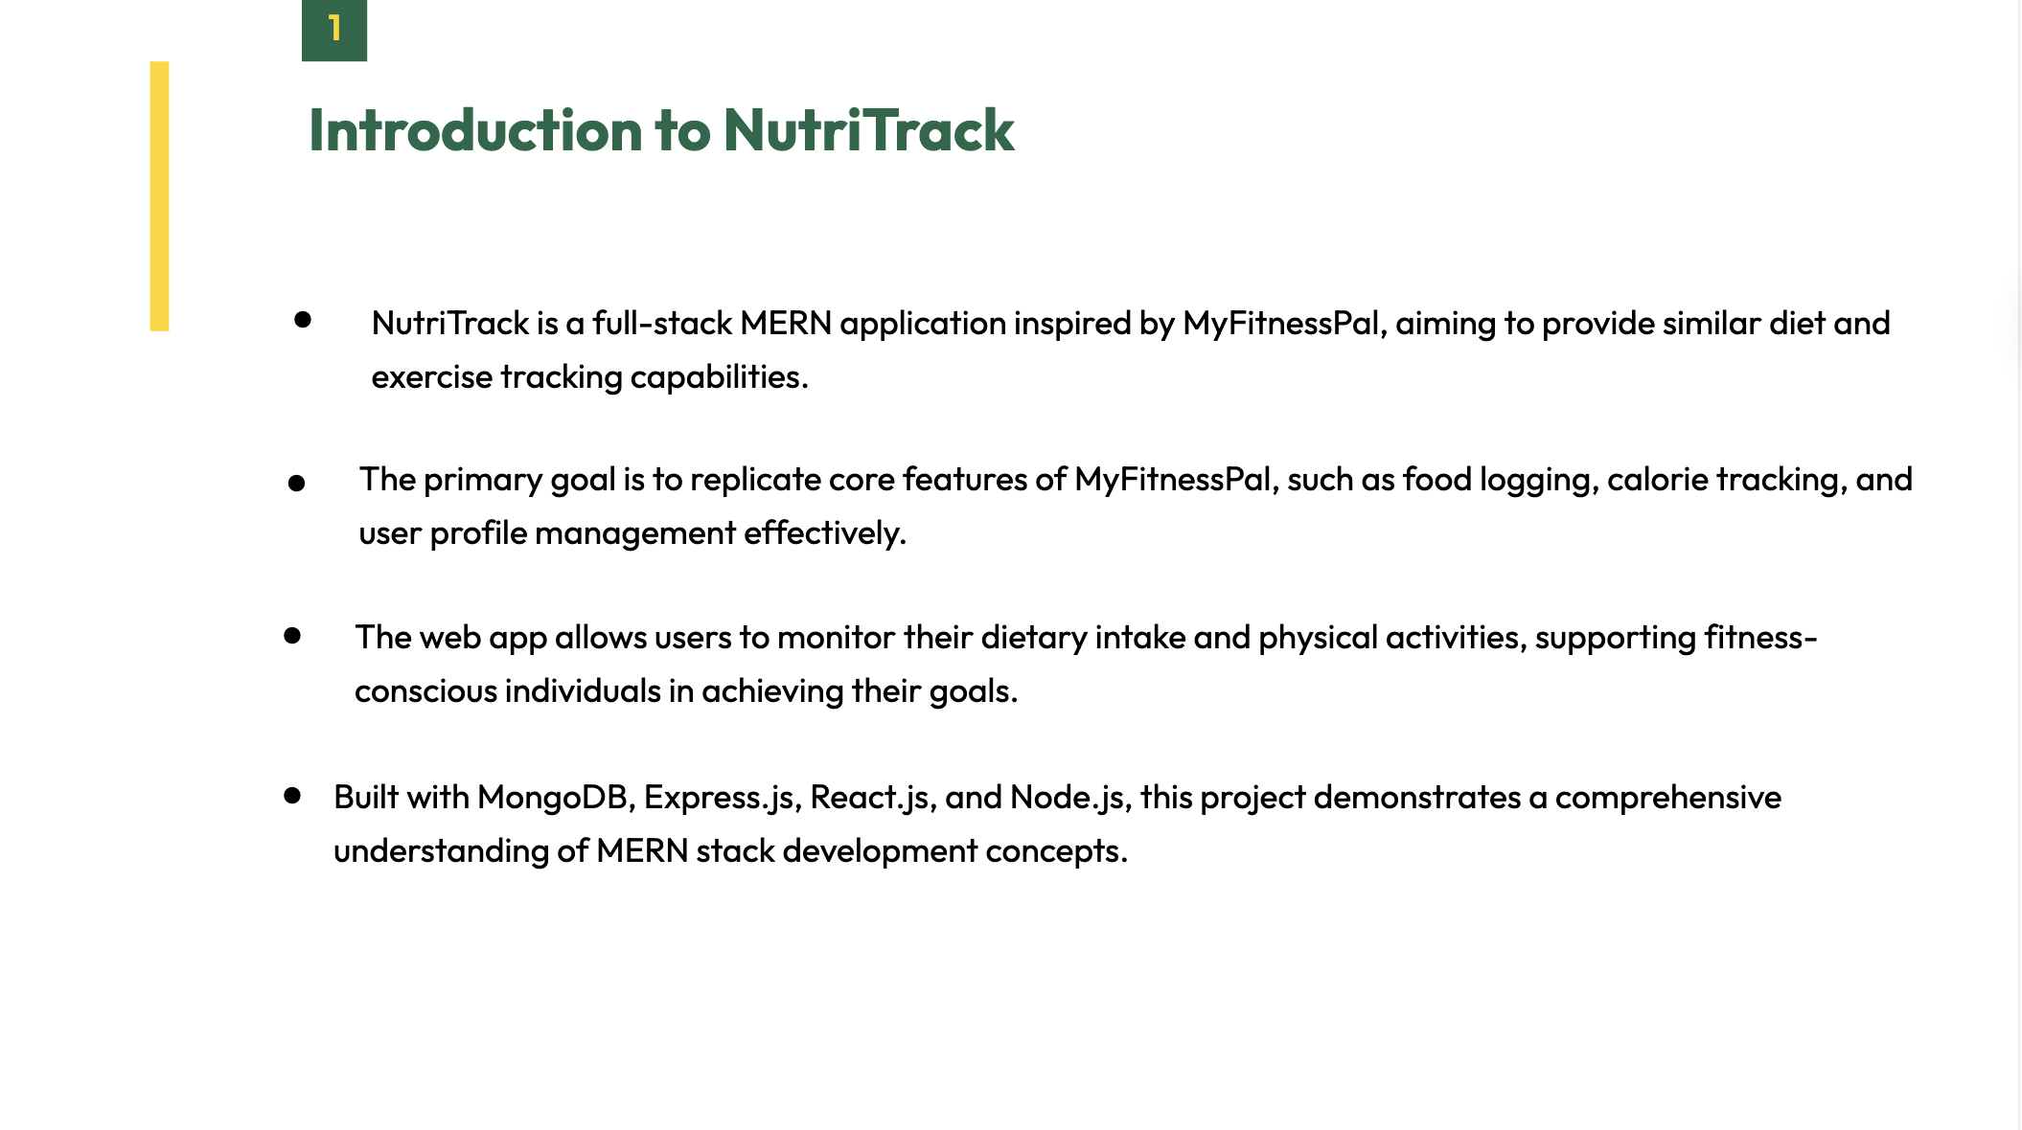

Slide 5
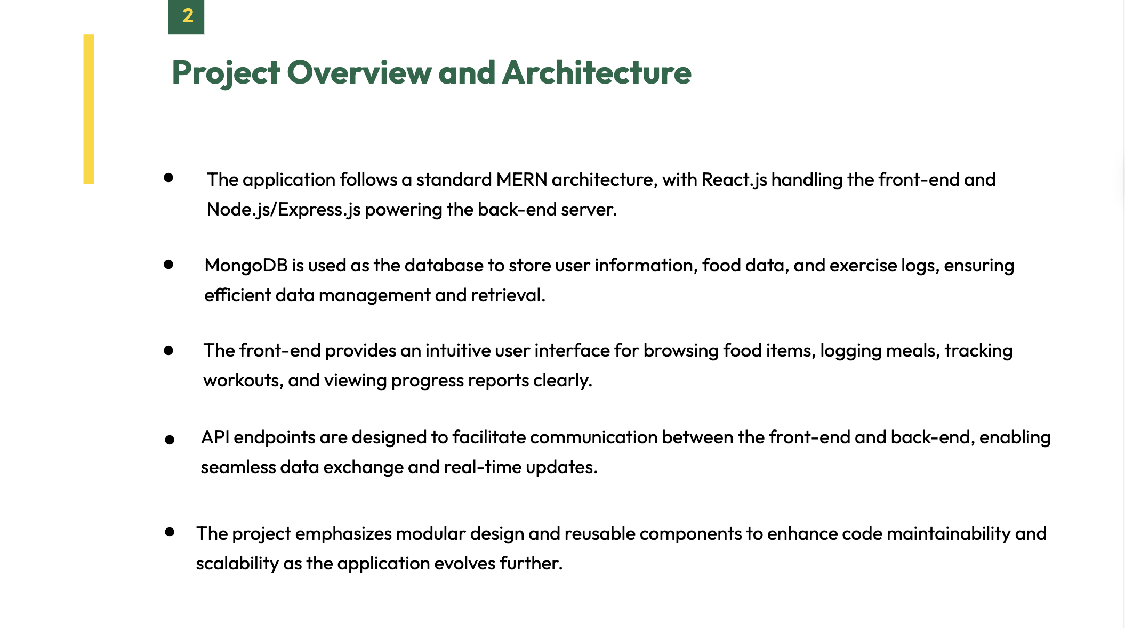

Slide 6
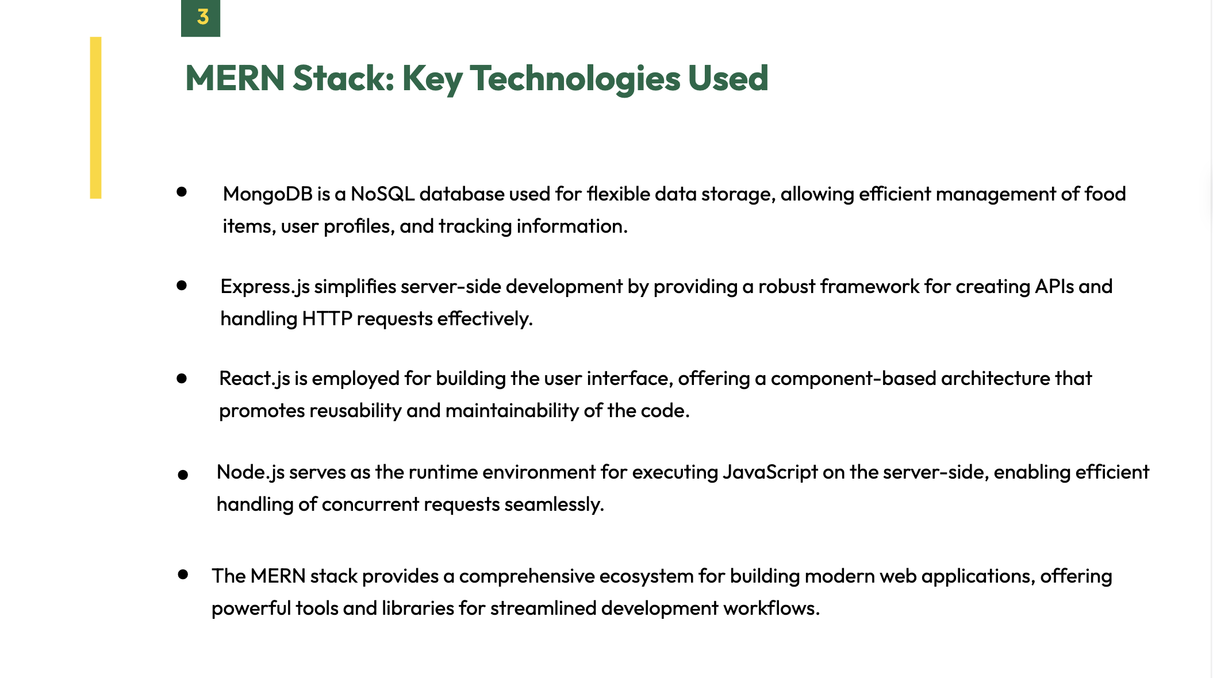

Slide 7
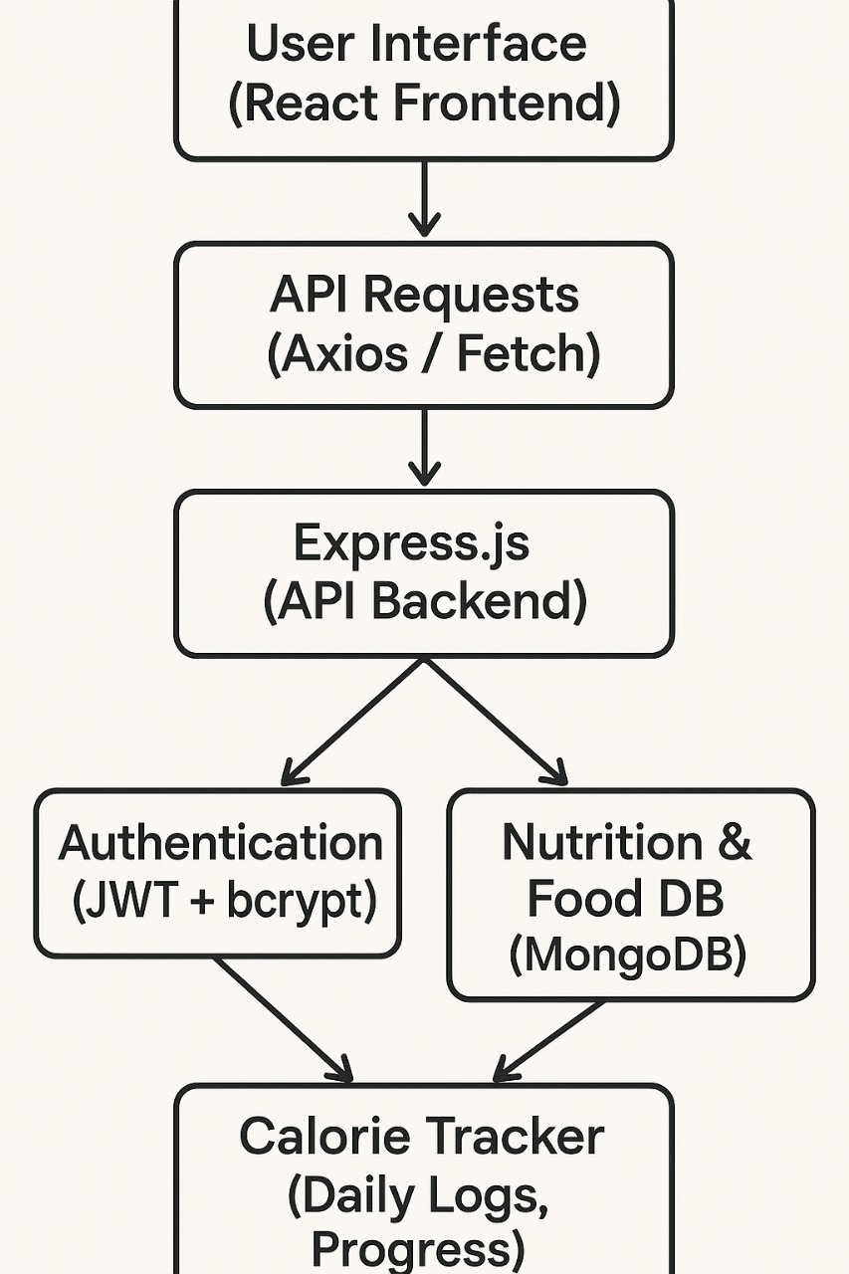
Data Flow Diagram

Slide 8
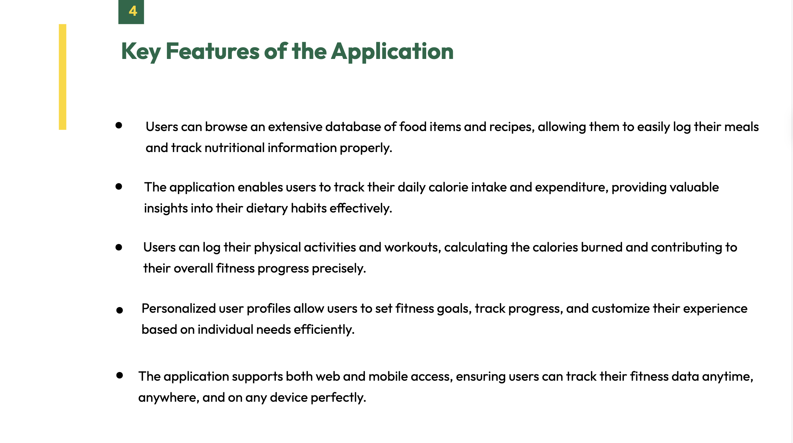

Slide 9
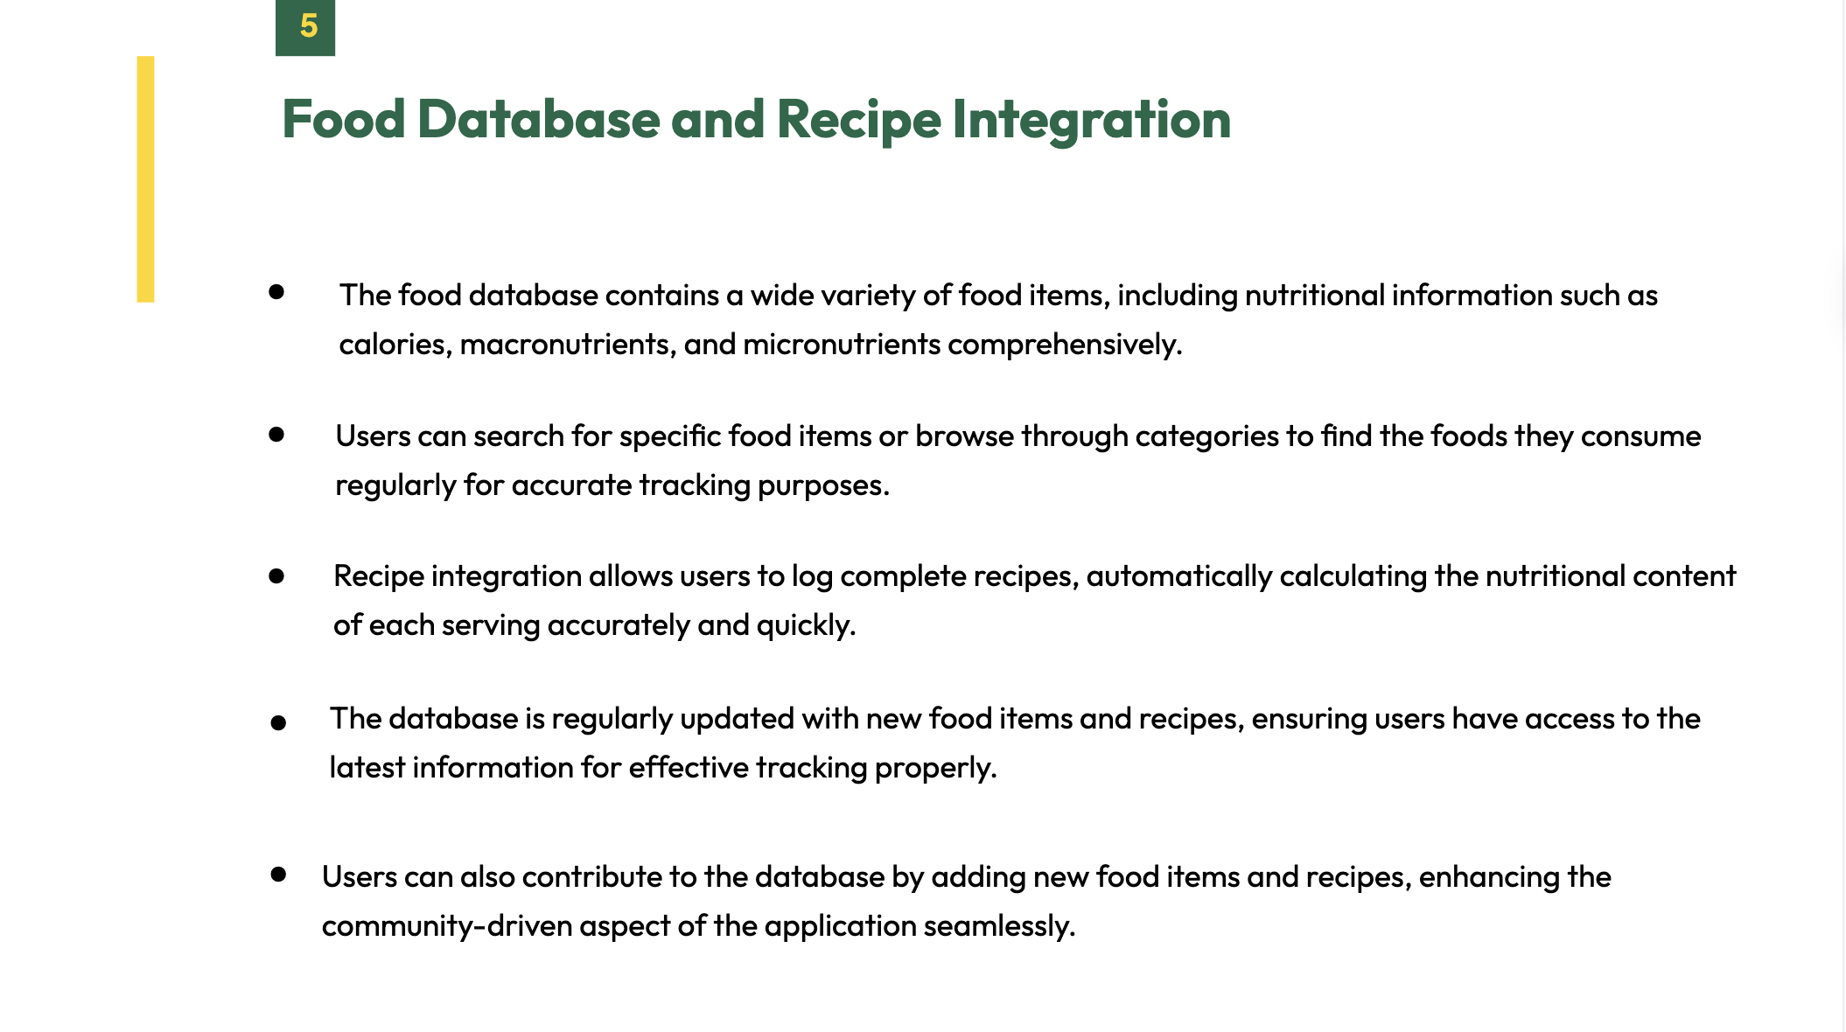

Slide 10
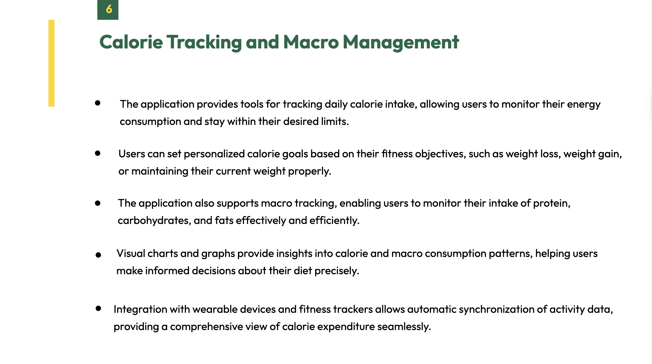

Slide 11
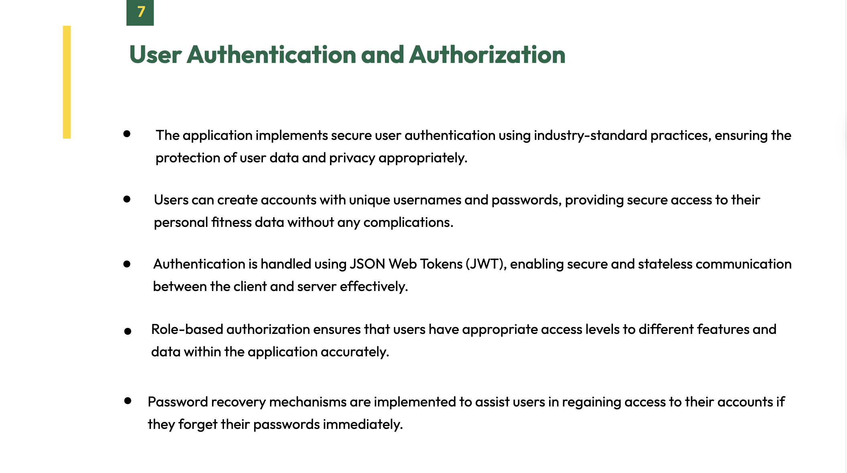

Slide 12
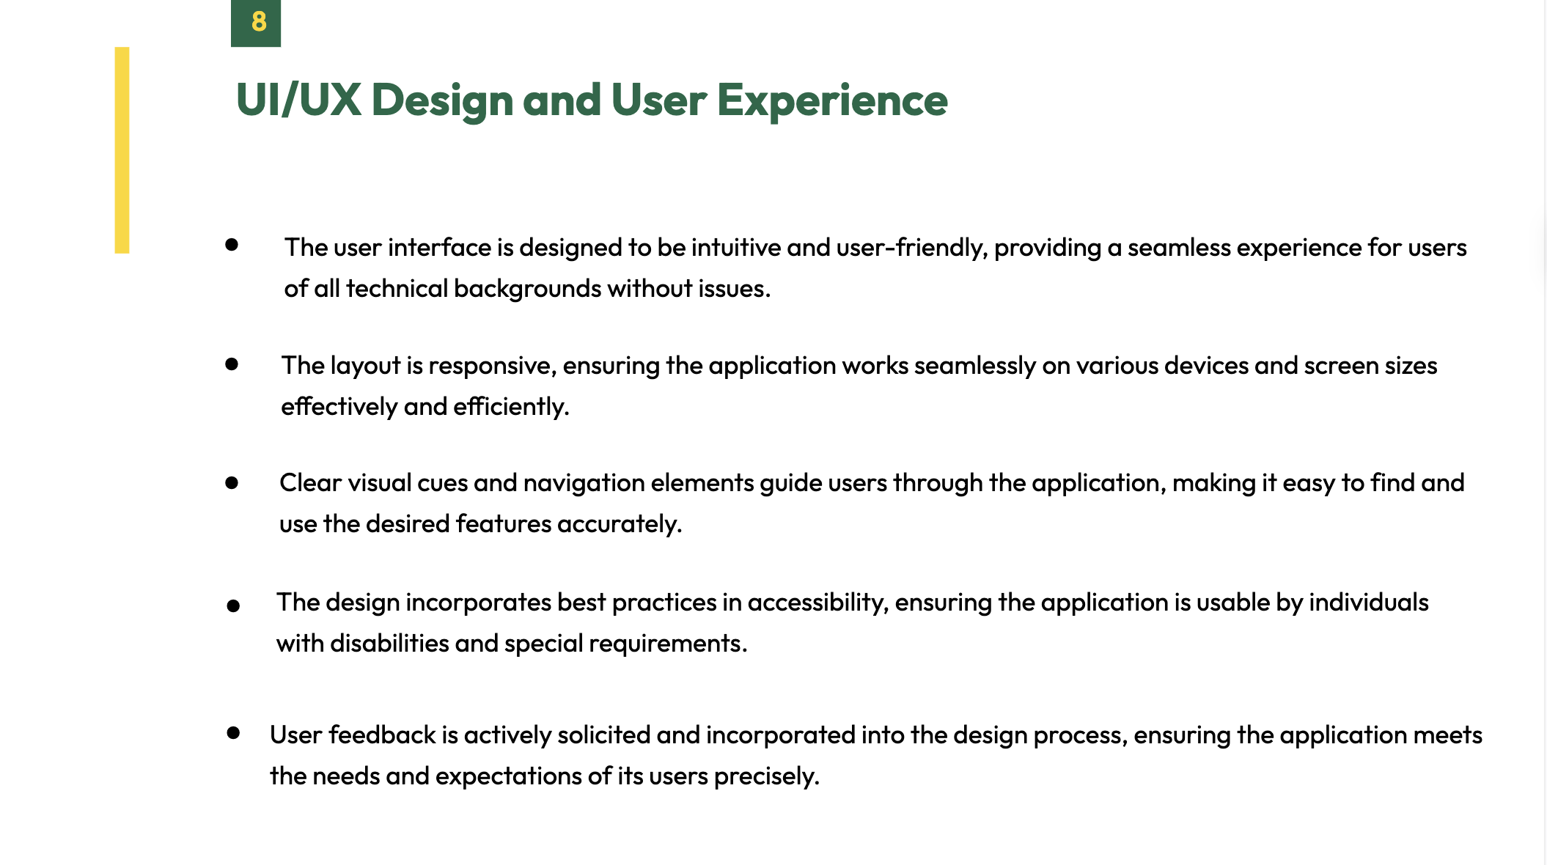

Slide 13
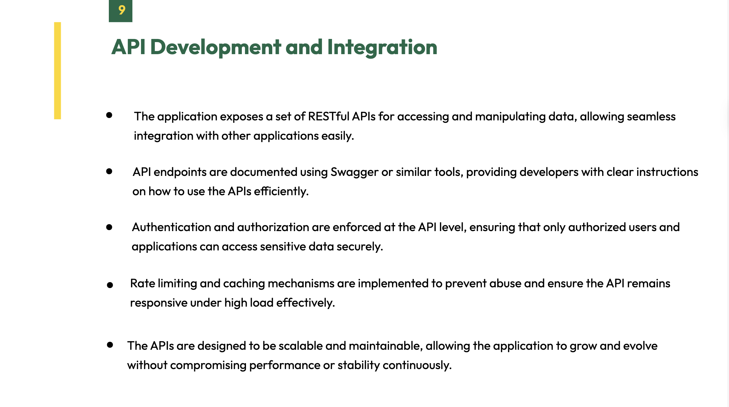

Slide 14
