Slide 1

CSCI 2400 Computer Systems Data Lab Recitation 2
August 31 2020
Taeho Kim

Slide 2
Contents
Q1: bitNor
Q2: fitsShort
Q3: thirdBits
Q4: anyEvenBit
Q5: copyLSB
Q6: implication
Q7: bitMask
Q8: ezThreeFourths
Q9: satMul3
Q10: bitParity
Q11: ilog2
Q12: trueThreeFourths

Slide 3
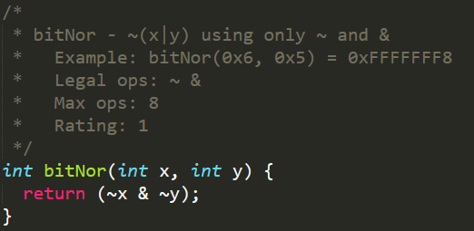
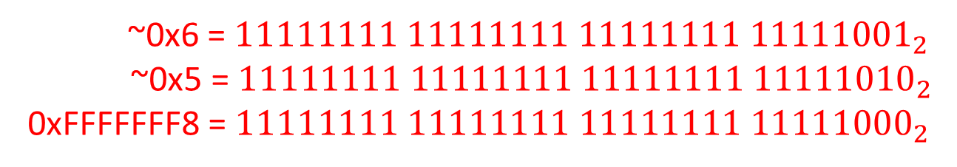
Data Lab 1. bitNor
0x6 = 110₂
0x5 = 101₂
0x7 = 111₂
|)
~)
0x7 = 00000000 00000000 00000000 00000111₂
0xFFFFFFF8 = 11111111 11111111 11111111 11111000₂
DeMorgan’s Law
neg (a or b) -> (neg a) and (neg b)
~(x|y) = (~x & ~y)
~0x6 = $11111111 11111111 11111111 {11111001}_{2}$
~0x5 = $11111111 11111111 11111111 {11111010}_{2}$
0xFFFFFFF8 = $11111111 11111111 11111111 {11111000}_{2}$
&)

Slide 4
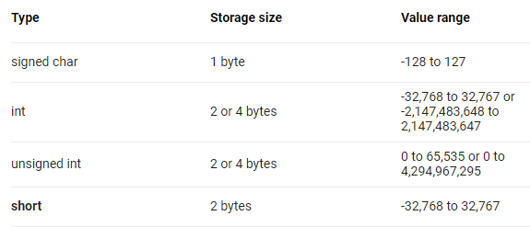
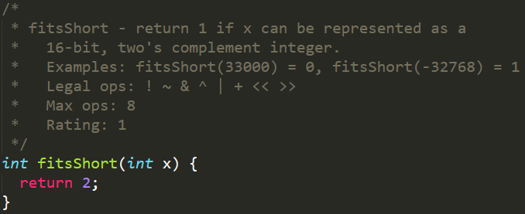
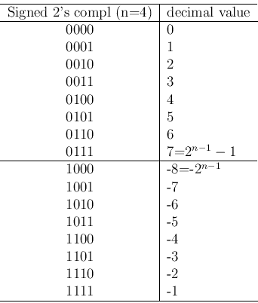
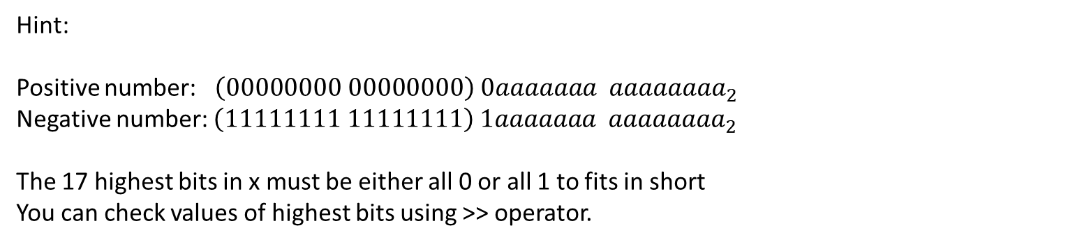
Data Lab 2. fitsShort
Hint:
Positive number: $\left(00000000 00000000\right) 0aaaaaaa aaaaaaaa_{2}$
Negative number: $\left(11111111 11111111\right) 1aaaaaaa aaaaaaaa_{2}$
The 17 highest bits in x must be either all 0 or all 1 to fits in short
You can check values of highest bits using >> operator.

Slide 5
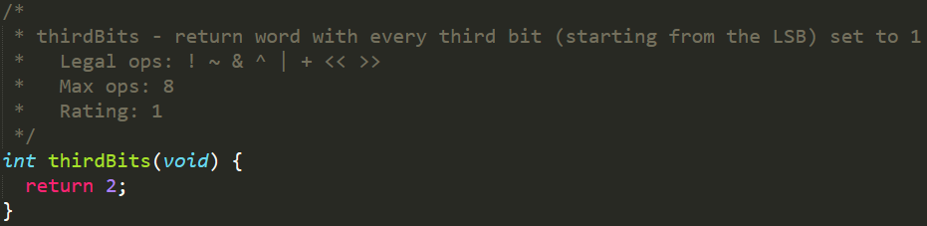

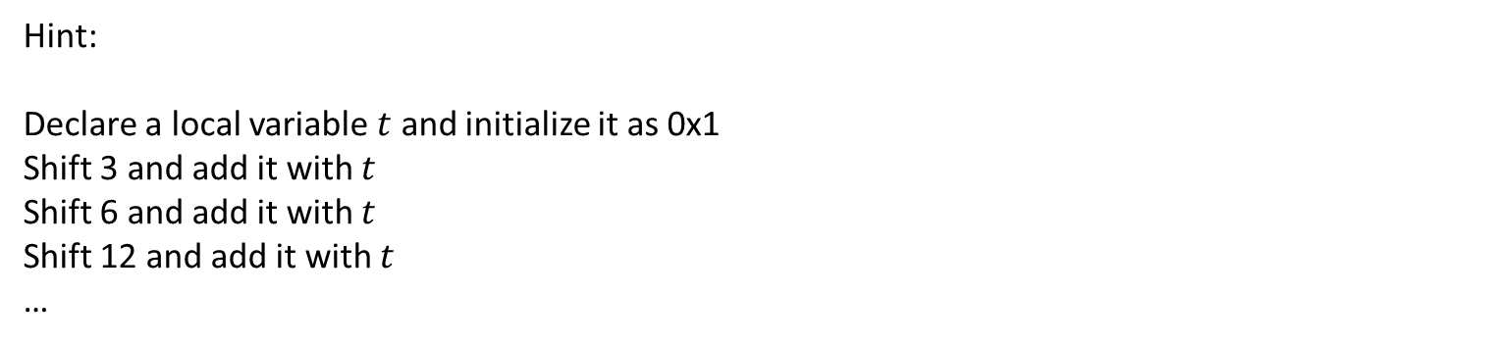
Data Lab 3. thirdBits
Hint:
Declare a local variable $t$ and initialize it as 0x1
Shift 3 and add it with $t$
Shift 6 and add it with $t$
Shift 12 and add it with $t$
…
$$1_{2}$$
$${1001}_{2}$$
$${1001001001}_{2}$$
$${1001001001001001001001}_{2}$$
$$…$$

Slide 6
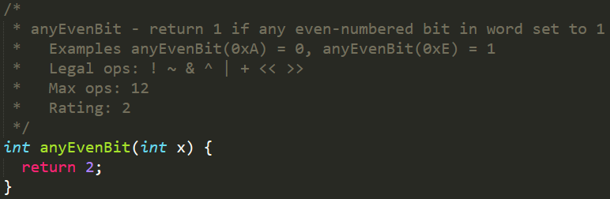
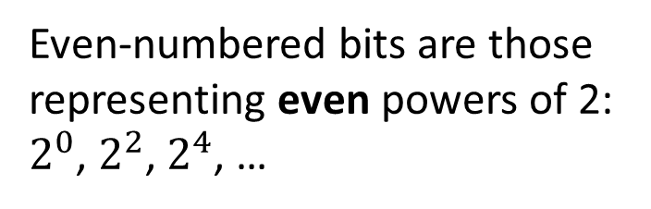
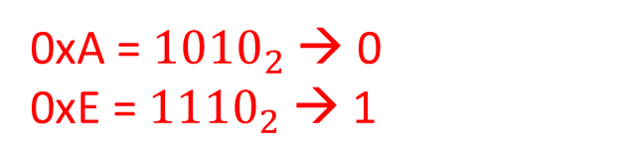
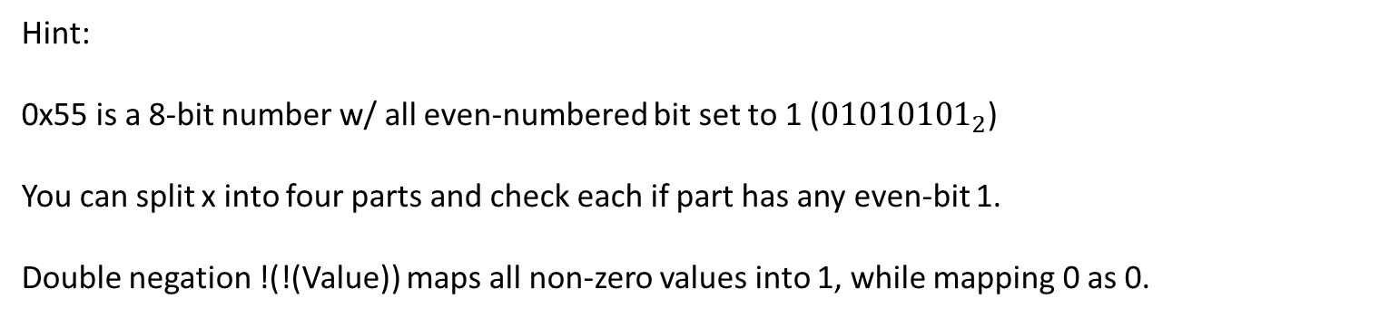
Data Lab 4. anyEvenBit
Even-numbered bits are those representing even powers of 2: $2^{0}$, $2^{2}$, $2^{4}$, …
0xA = ${1010}_{2}$ → 0
0xE = ${1110}_{2}$ → 1
Hint:
0x55 is a 8-bit number w/ all even-numbered bit set to 1 (${01010101}_{2}$)
You can split x into four parts and check each if part has any even-bit 1.
Double negation !(!(Value)) maps all non-zero values into 1, while mapping 0 as 0.

Slide 7
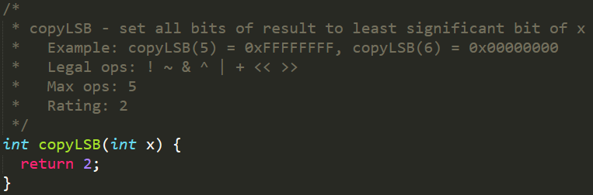
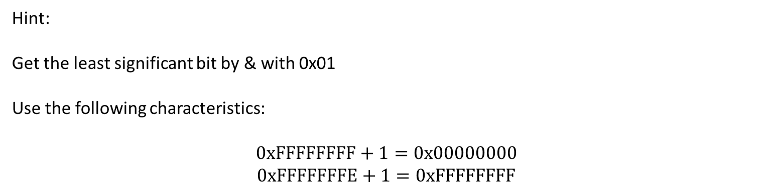
Data Lab 5. copyLSB
Hint:
Get the least significant bit by & with 0x01
Use the following characteristics:
$$0xFFFFFFFF+1=0x00000000$$
$$0xFFFFFFFE+1=0xFFFFFFFF$$

Slide 8
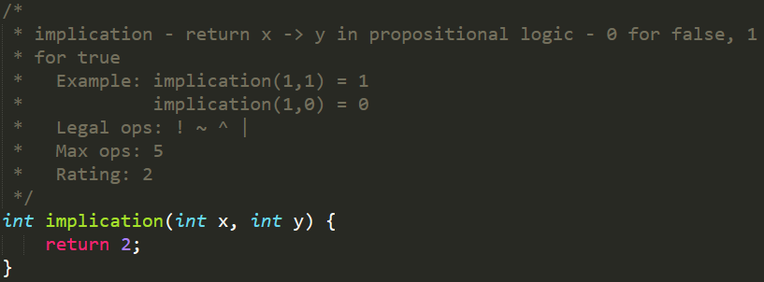
Data Lab 6. implication
? -> True : returns True
True -> False : returns False
False -> False: returns True

Slide 9
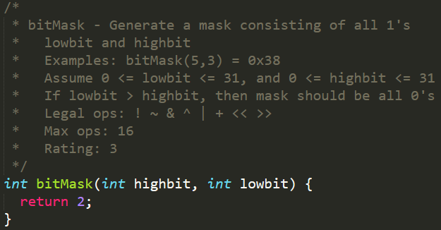
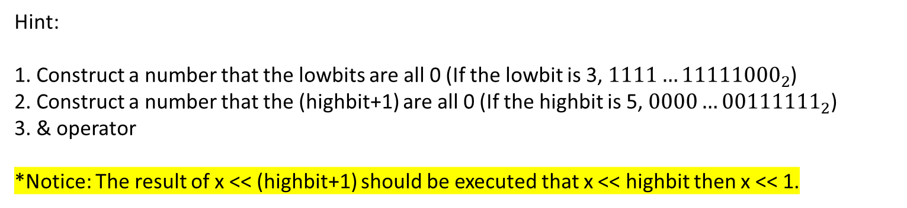
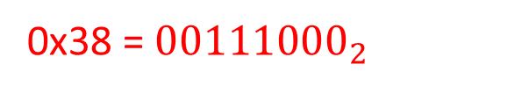
Data Lab 7. bitMask
(highbit) 5 3 (lowbit)
0x38 = ${00111000}_{2}$
Hint:
1. Construct a number that the lowbits are all 0 (If the lowbit is 3, $1111…{11111000}_{2}$)
2. Construct a number that the (highbit+1) are all 0 (If the highbit is 5, $0000…{00111111}_{2}$)
3. & operator
*Notice: The result of x << (highbit+1) should be executed that x << highbit then x << 1.

Slide 10
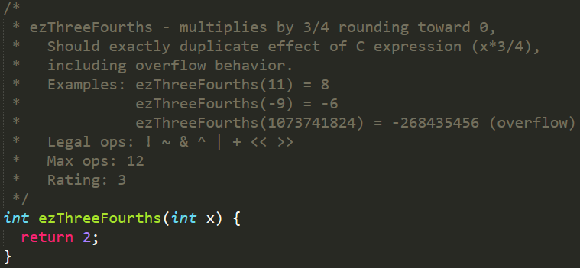
Data Lab 8. ezThreeFourths
Hint:
(x+x+x)>>2 is equal to (x*3/4).
All positive results are okay, but you need to think more for negative results.

Slide 11
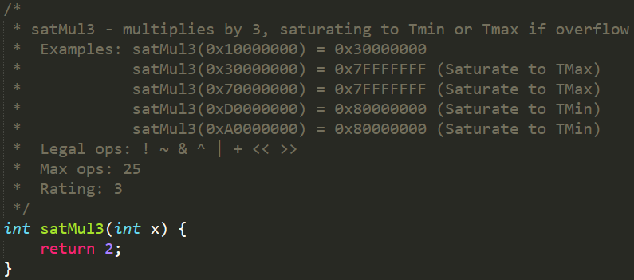
Data Lab 9. satMul3
Hint:
Detect if the signbit changes (Compare x w/ (x+x), Compare x w/ (x+x+x))
If the signbit changes, overflow happens. (Mask = 0xFFFFFFFF (overflow), 0x00000000 (otherwise))
Separate three cases: 1) return x+x+x, 2) return Tmax, 3) return Tmin

Slide 12
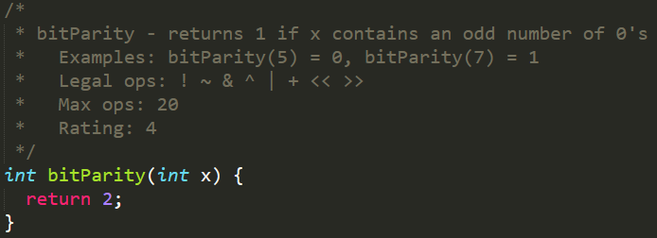
Data Lab 10. bitParity
Hint:
If we XOR all bits in x, we will get bitparity
Compare the first half with the second half recursively
aaaaaaaa aaaaaaaa aaaaaaaa aaaaaaaa
bbbbbbbb bbbbbbbb
aaaaaaaa aaaaaaaa
->
bbbbbbbb
->
…
^
aaaaaaaa aaaaaaaa
^
bbbbbbbb
bbbbbbbb bbbbbbbb
cccccccc

Slide 13
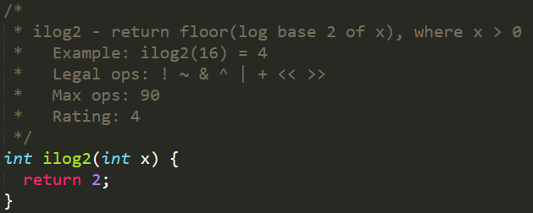
Data Lab 11. ilog2
result=0
16 0
24 16 8 0
28 24 20 16 12 8 4 0
…
Hint:
Find the leftmost 1. Use a method that is similar to binary search

Slide 14
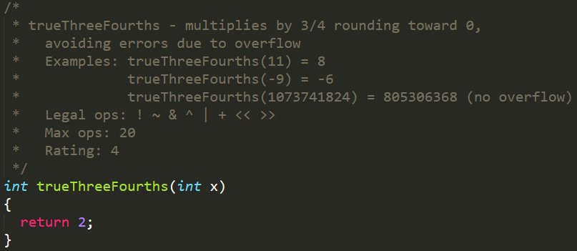
Data Lab 12. trueThreeFourths
Hint:
To avoid overflow, we should proceed division first.
Consider the case that the summation of fraction parts is more than or equal to 1.
(e.g., x=7, (x>>2) + (x>>1) = 4, but x*(3/4) = 5)
Make variables to cover the positive case and the negative case.

Slide 15
Extra credit
Try to solve by yourself
Contact TA during office hours.
Usually extra credits should be solved by students with self interest and taking help

