Slide 1

RETAIL SALES FORECASTING
Leveraging Advanced Algorithms for Accurate Sales Predictions
GROUP B:
ISHIKA SUKHIJA
NIPUN GULATI
AAKASH PATEL
SHREYA DAWAR
MANAN KAPADIA

Slide 2
01
02
INTRODUCTION
METHODOLGY & EXECUTION
TABLE OF CONTENTS
03
04
RESULTS & ANALYSIS
CONCLUSION
Overview of our Project
Step by Step demonstration of the processand methods used
Summary of the Project’s impact and future potential improvements
Showcasing the outcomes, data analysis, and findings

Slide 3

01
INTRODUCTION

Slide 4

The retail industry is highly dynamic, with sales patterns influenced by various factors such as seasonality, promotions, economic conditions, and consumer behavior. Accurate sales forecasting is essential for effective inventory management, ensuring that the right products are available at the right time without overstocking or stockouts. Traditional forecasting methods, such as time series analysis, often struggle to capture the complex patterns and interactions within retail data.
The primary challenge in retail sales forecasting is the ability to accurately predict future sales by capturing trends, seasonality, and other influential factors. The goal is to build a machine learning model that can learn from historical data and provide reliable forecasts, thereby enabling better decision-making for inventory management and sales strategies.

Slide 5

METHODOLOGY & EXCECUTION
02

Slide 6
DATA COLLECTION & PREPROCESSING
DATA SOURCE | Data source: GitHub Description of the data: Historical sales, product details, store information, holidays, promotions.
DATA CLEANING | Addressing outliers and inconsistencies.
DATA TRANSFORMATION | Scaling numerical features and encoding categorical features
FEATURE ENGINEERING | Creation of moving averages, lagged variables, binary indicators for holidays/promotions.
HANDLING MISSING VALUES | Dropping the null values
FEATURE SELECTION | Utilization of correlation analysis and feature importance scores to identify relevant features.

Slide 7
ALGORITHMS AND TECHNIQUES
Random Forest
XGBoost
Linear Regression
Robust to overfitting, handles large datasets well
High accuracy, handles complex patterns, requires fine-tuning
Used as a baseline model to demonstrate limitations

Slide 8
ALGORITHMS AND TECHNIQUES
Decision Tree
Support Vector Machine
Captures non-linear relationships and provides easy-to-interpret decision rules
Finds the optimal boundary for class separation

Slide 9
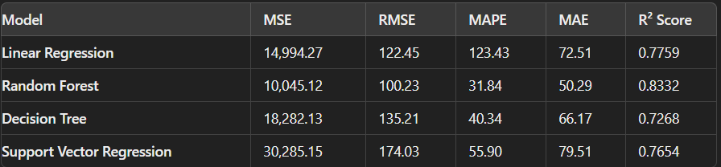
MODEL TRAINING AND EVALUATION
K Fold Cross-Validation: 10-fold cross-validation to ensure model robustness.
Evaluation Metrics: Glimpse of Evaluation Metrics
Parameter Tuning: Hyperparameter optimization using grid search and random search techniques.

Slide 10

RESULTS
Linear Regression
Random Forest
Decission Tree
Support Vector
Struggled with data complexity and had higher error metrics
Outperformed other models with the lowest error metrics
Less effective with higher error metrics and lower R² score
Good R² score but had higher error metrics

Slide 11
03
RESULTS & ANALYSIS

Slide 12
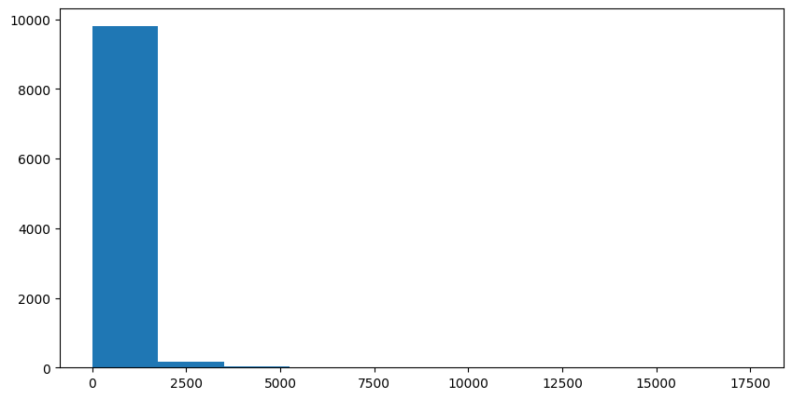
The histogram shows a highly skewed distribution of sales, where the majority of sales values are concentrated at lower ranges, with a few outliers extending to higher sales figures. This indicates that most sales transactions fall within a lower range, with very few instances of significantly higher sales.

Slide 13
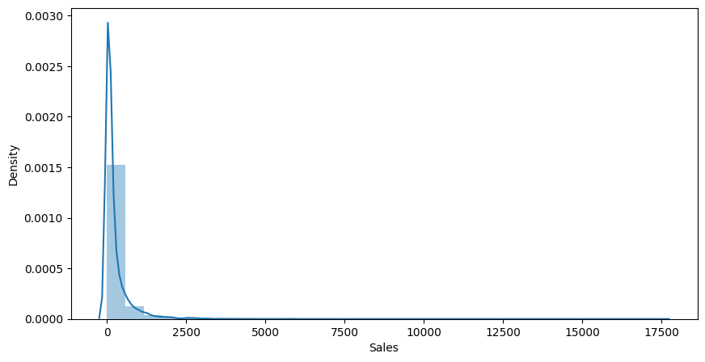
The density plot of sales data, shown here, further illustrates the skewed distribution with a sharp peak at lower sales values, followed by a long tail towards higher values. This confirms that the majority of sales are clustered around lower amounts, while higher sales are much less frequent.

Slide 14
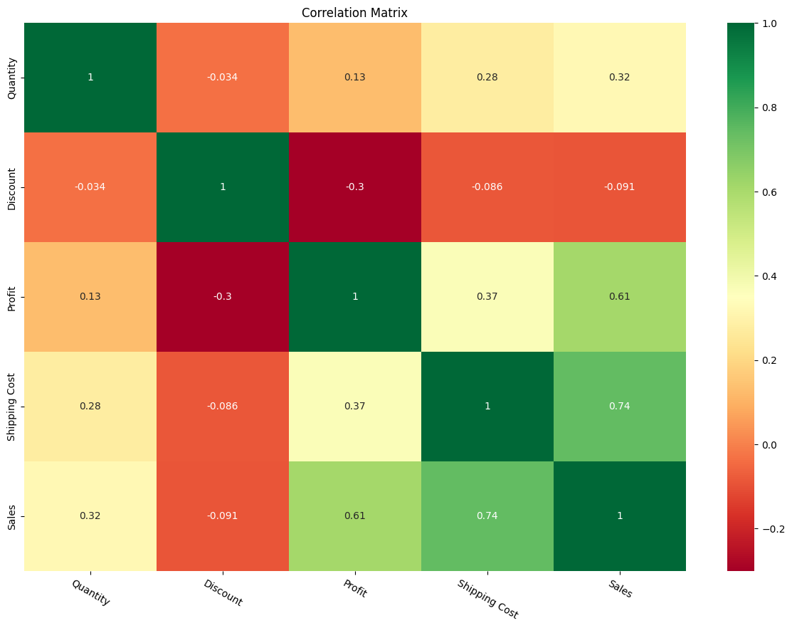
As we can observe above,we can state following points
Shipping cost and Sales are Maximum correlated(0.74)
next are Profit and Sales are correlated(0.61)
Discount and Sales has valuec closer to 0,so almost there is no correlation between them
Apparently, Profit and Discount are negatively coorelated

Slide 15
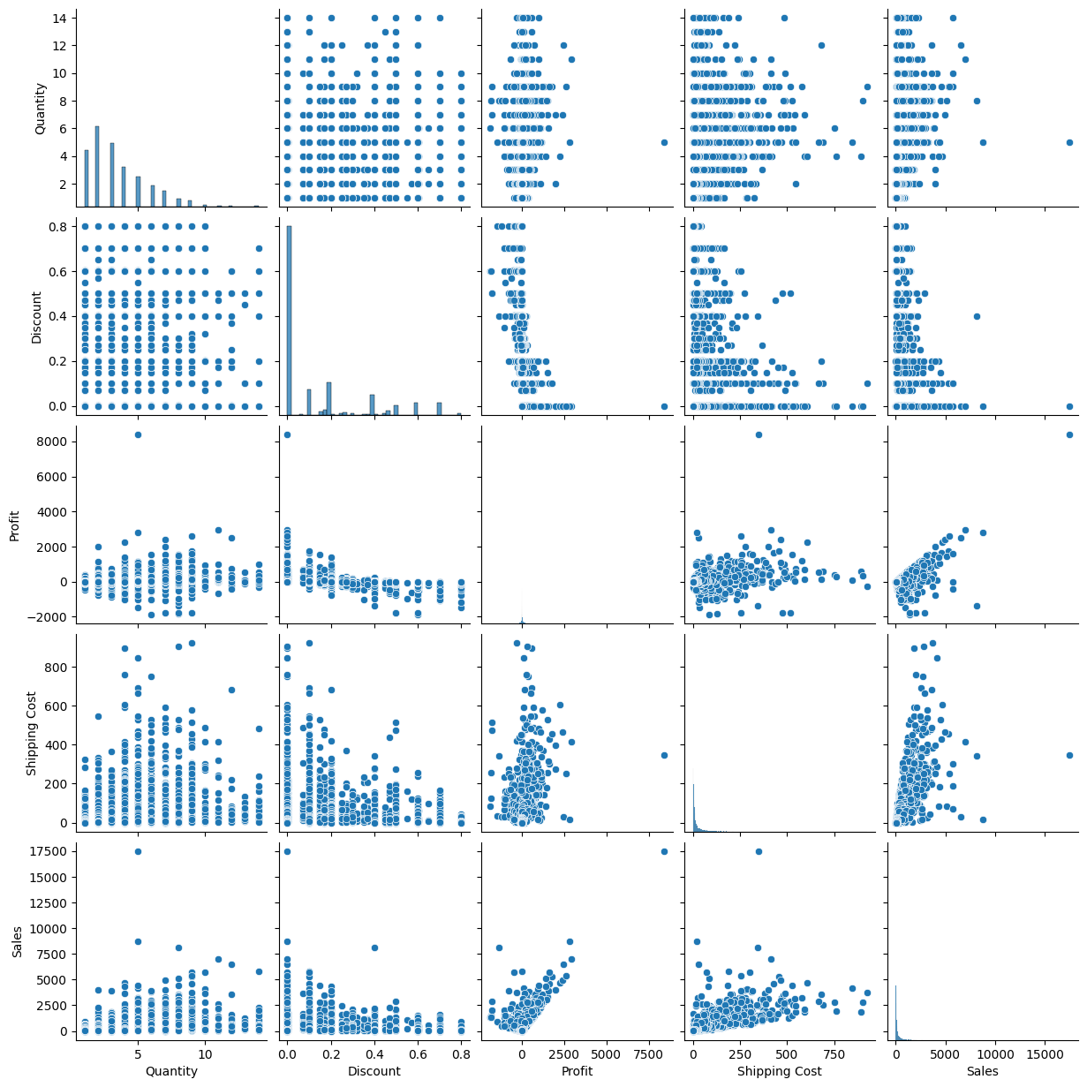
This pair plot visualizes the relationships between several variables, including Quantity, Discount, Profit, Shipping Cost, and Sales. The scatter plots reveal potential correlations between pairs of variables, such as a positive relationship between Sales and Profit. The diagonal histograms illustrate the distribution of individual variables, showing, for example, that Quantity has a right-skewed distribution and Discounts are often clustered around certain values.

Slide 16
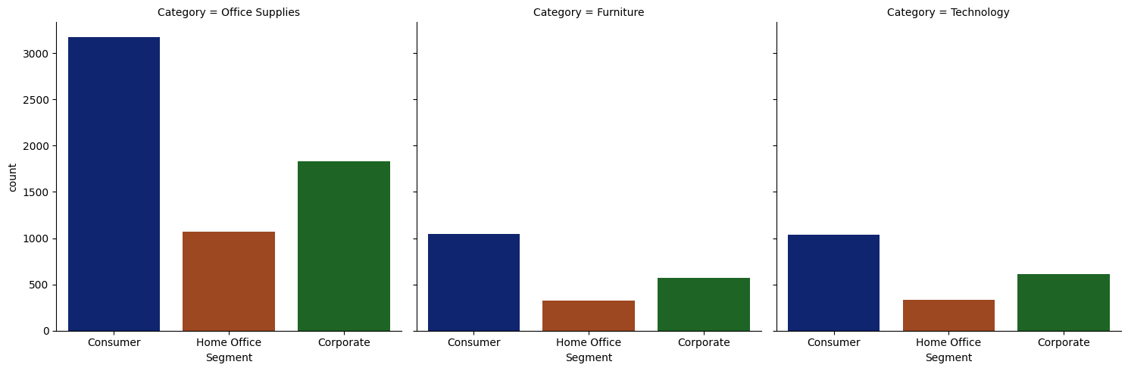
This plot showcases the distribution of customer segments across three product categories: Office Supplies, Furniture, and Technology. In each category, the 'Consumer' segment has the highest count, particularly in Office Supplies, while 'Home Office' and 'Corporate' segments have significantly lower counts across all categories. The plot highlights the dominance of consumer purchases, especially in the Office Supplies category.

Slide 17

04 CONCLUSION
Key Findings:
Random Forest was identified as the most effective model for retail sales forecasting.
The project achieved its objectives and developed a deployable model.
Recommendations:
Explore integration of additional external data sources for further improvement.

Slide 18

FUTURE WORK
Further Improvements:
Integration of economic indicators and social media trends.
Exploration of alternative algorithms and ensemble techniques.

Slide 19

THANK YOU!

