Slide 1
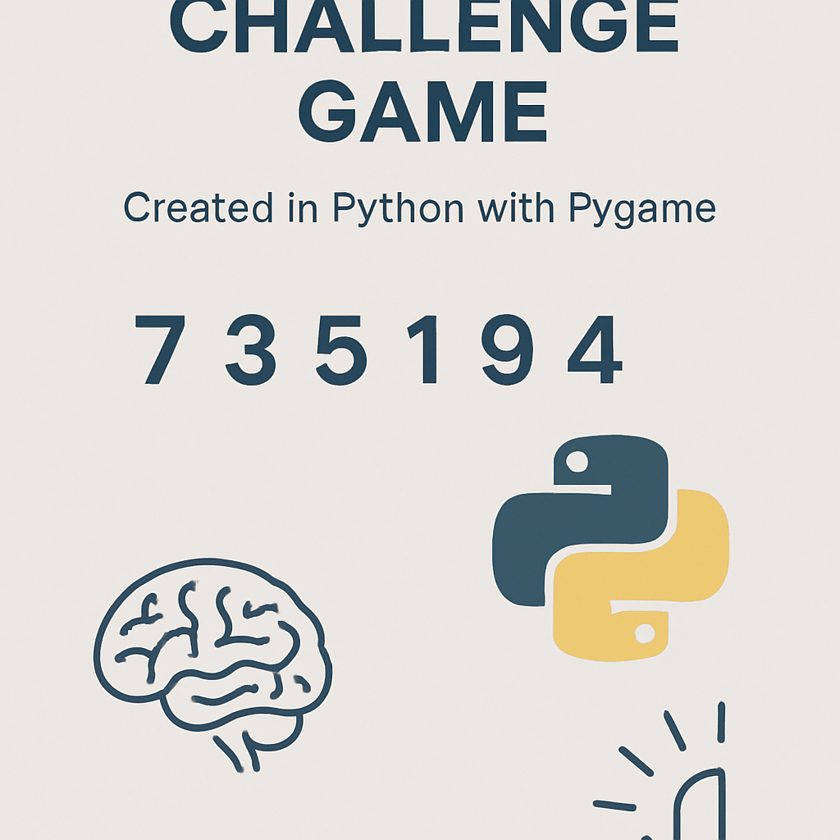
Subbmitted by: Ishika Agarwal
PROJECT REPORT

Slide 2
.......Introduction.......
Human memory is important in daily decision-making and cognitive performance. Testing and improving one's memory through gamified applications has been on the rise, especially with the advent of simple programming libraries such as Pygame.
This is a Memory Challenge Game created in Python using the Pygame library. The user will view a series of generated digits on the screen, which the user must remember and enter correctly. Every level increases the number of digits that have to be memorized, therefore challenging more of the user's memory.
This showcases a project that utilizes Python's graphical capabilities, event handling, and sound systems in concert, while introducing key programming concepts such as loops, functions, lists, and user interaction.t

Slide 3
Problem Description
The challenge is to design a simple, yet engaging memory-based game using Python. It has to:
Flash a sequence of numbers to the user for a brief period of time.
Then, hide the sequence and prompt the player to enter the same digits.
Validate correctness and automatically increase difficulty level.
The game should end if the player enters an incorrect sequence.
Show the achieved level and offer replay.
Include attractive visuals and optional sound effects.
This problem combines several factors in programming:
Random number generation
Timers and delays
Event-driven programming
GUI rendering
Game loop handling
User feedback and scoringxt

Slide 4
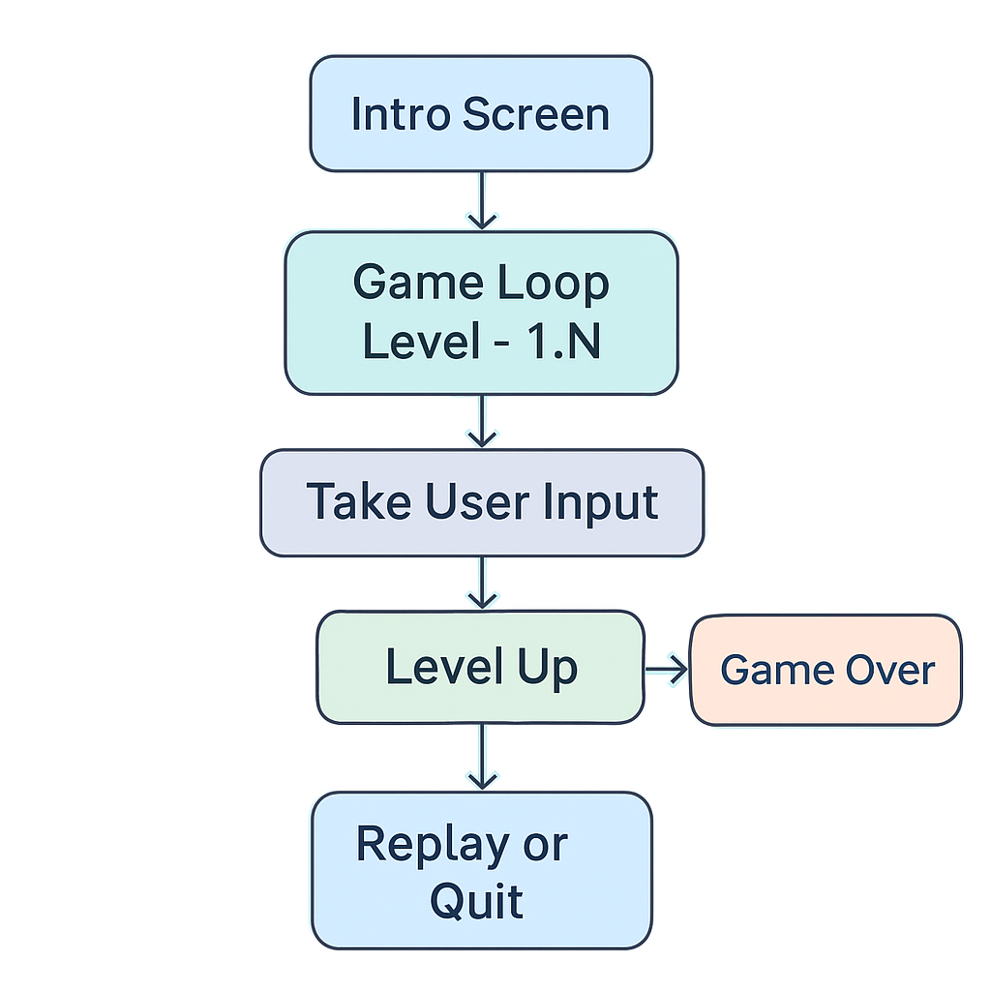

Slide 5
Proposed Approach
STEP 01:
Initialize the Pygame Environment
Setup window size
Initialize fonts, colors, and clock
Load sounds
Step 02:
Show an Intro Screen
Welcome message
Instruction to start
Flow
STEP 03:
Game Loop for Multiple Levels
Level starts with a sequence length of 4
Sequence increases by 1 every level
STEP 04:
: Number Display Phase
Boxes are filled with random digits
After 3 seconds they disappear

Slide 6
Proposed Approach
STEP 05:
Step 06:
Validation
Compare user input with actual sequence
If correct → show success message
If wrong → game over screen
Instruction to start
: Input Phase
User types digits
The typed digits appear in designed i
nput boxes.
Flow
STEP 08:
Press ENTER → restart
Press ESC → exit
This will keep the game flow clean,
modular, and readable.
STEP 07:
Game Over and Replay
Final score is shown

Slide 7
.............CODE OVERVIEW...........
Game Phases
Intro
Instructions
Display no. sequence
Input sequence
Validate
Feedback(Correct / Wrong)
Game Over + Replay
Display Utilities
Functions to draw centered text
Functions to draw beautiful boxes for numbers
Functions to display title windows

Slide 8
User-Defined Functions
draw_text: Creating a text box and writing text in it.
show_window: Display window with title and subtext.
draw_boxes: Draw number boxes horizontally.
intro_screen: Use above defined functions.
show_instructions:
show_numbers: Show random numbers for 3 seconds.
get_user_input: Ask user to type numbers shown earlier.
feedback_screen:Checks whether sequence entered is right
game_loop: Defined on next slide....
main :intro_screen(), game_loop()
Chromium One

Slide 9
........CONCLUSION.........
This project successfully implements a clean, interactive memory challenge game using Python and Pygame. It demonstrates several programming principles including event handling, GUI rendering, modular design, and data structure usage.
The game is simple yet effective at testing short-term memory and offers a polished user experience.
The modular nature also makes it easy to add new features, store high scores, or change the theme entirely.
Chromium One

