Slide 1

Silicon Valley Immersion Program
Round 2 Submission
Submitted by:
Ishika
Dr.B.R. Ambedkar National Institue of Technology
2025

Slide 2

Problem Statement
The company aims to develop and refine its content recommendation algorithm to ensure that users are presented with the most relevant and engaging content. The goal is to improve user satisfaction, increase time spent on the platform, and foster a more active and engaged user community.
Key areas of focus include:
User Behavior Analysis: Understanding user behavior and preferences to accurately predict and recommend content that users are likely to engage with.
Algorithm Performance: Enhancing the performance of the recommendation algorithm to deliver real-time, personalized content without compromising on speed or accuracy.
Content Diversity: Ensuring a diverse range of content is recommended to prevent echo chambers and promote a balanced user experience.
Key Challenges
Data Volume and Variety: Handling large volumes of diverse data from different sources, including user interactions, content metadata, and social connections.
Real-Time Processing: Developing an algorithm that can process data and deliver recommendations in real-time, maintaining high performance even during peak usage times.
Balancing Personalization and Diversity: Finding the right balance between highly personalized content and ensuring exposure to diverse viewpoints and content types.
Avoiding Bias: Mitigating potential biases in the recommendation algorithm to ensure fair and unbiased content delivery.
Notes:
Ascend screenshot

Slide 3
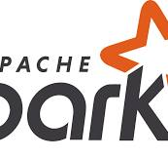








Proposed Solution
Objective 1: Candidate Sourcing To identify relevant and engaging content for users, we propose three techniques: the Real Graph Model (In-Network), GraphJet (Out-Network), and K-Nearest Neighbors (KNN). The Real Graph Model utilizes historical interactions like likes and comments to predict user engagement, facilitating efficient identification of relevant content within a user's network. GraphJet maintains a real-time interaction graph to discover engaging content beyond immediate connections, thereby expanding the content pool. K-Nearest Neighbors employs collaborative filtering to recommend content based on user similarity, ensuring personalized recommendations that enhance user satisfaction.
Objective 2: Ranking To rank content based on relevance and engagement potential, Machine Learning Algorithms such as Gradient Boosting Machines (GBM) and Neural Networks (including models like DeepFM and Two Tower Neural Networks) will be employed. GBM will be trained using metrics such as content popularity, recency, and user preferences, while Neural Networks will handle complex user-content interactions. Additionally, SimClusters Integration will incorporate community-driven engagement patterns to further enhance relevance, resulting in improved ranking accuracy and higher engagement with recommended content.
Objective 3: Filtering To ensure diversity and quality in recommended content, Content Diversity Filters and Quality and Relevance Filters will be implemented. Content Diversity Filters will use metrics to assess topic, source, and format diversity, ensuring a balanced content mix and preventing echo chambers. Quality and Relevance Filters will apply metrics such as user ratings and contextual relevance, ensuring higher quality and relevance of recommended content.
Tech Stack
1. User Behavior Analysis - Hadoop, Google Cloud Storage, Apache Spark, Apache Kafka, Google Analytics
2. Algorithm Performance - TensorFlow / PyTorch, XGBoost / LightGBM
3. Content Diversity - Scikit-learn, SimClusters
Notes:
Ascend screenshot

Slide 4
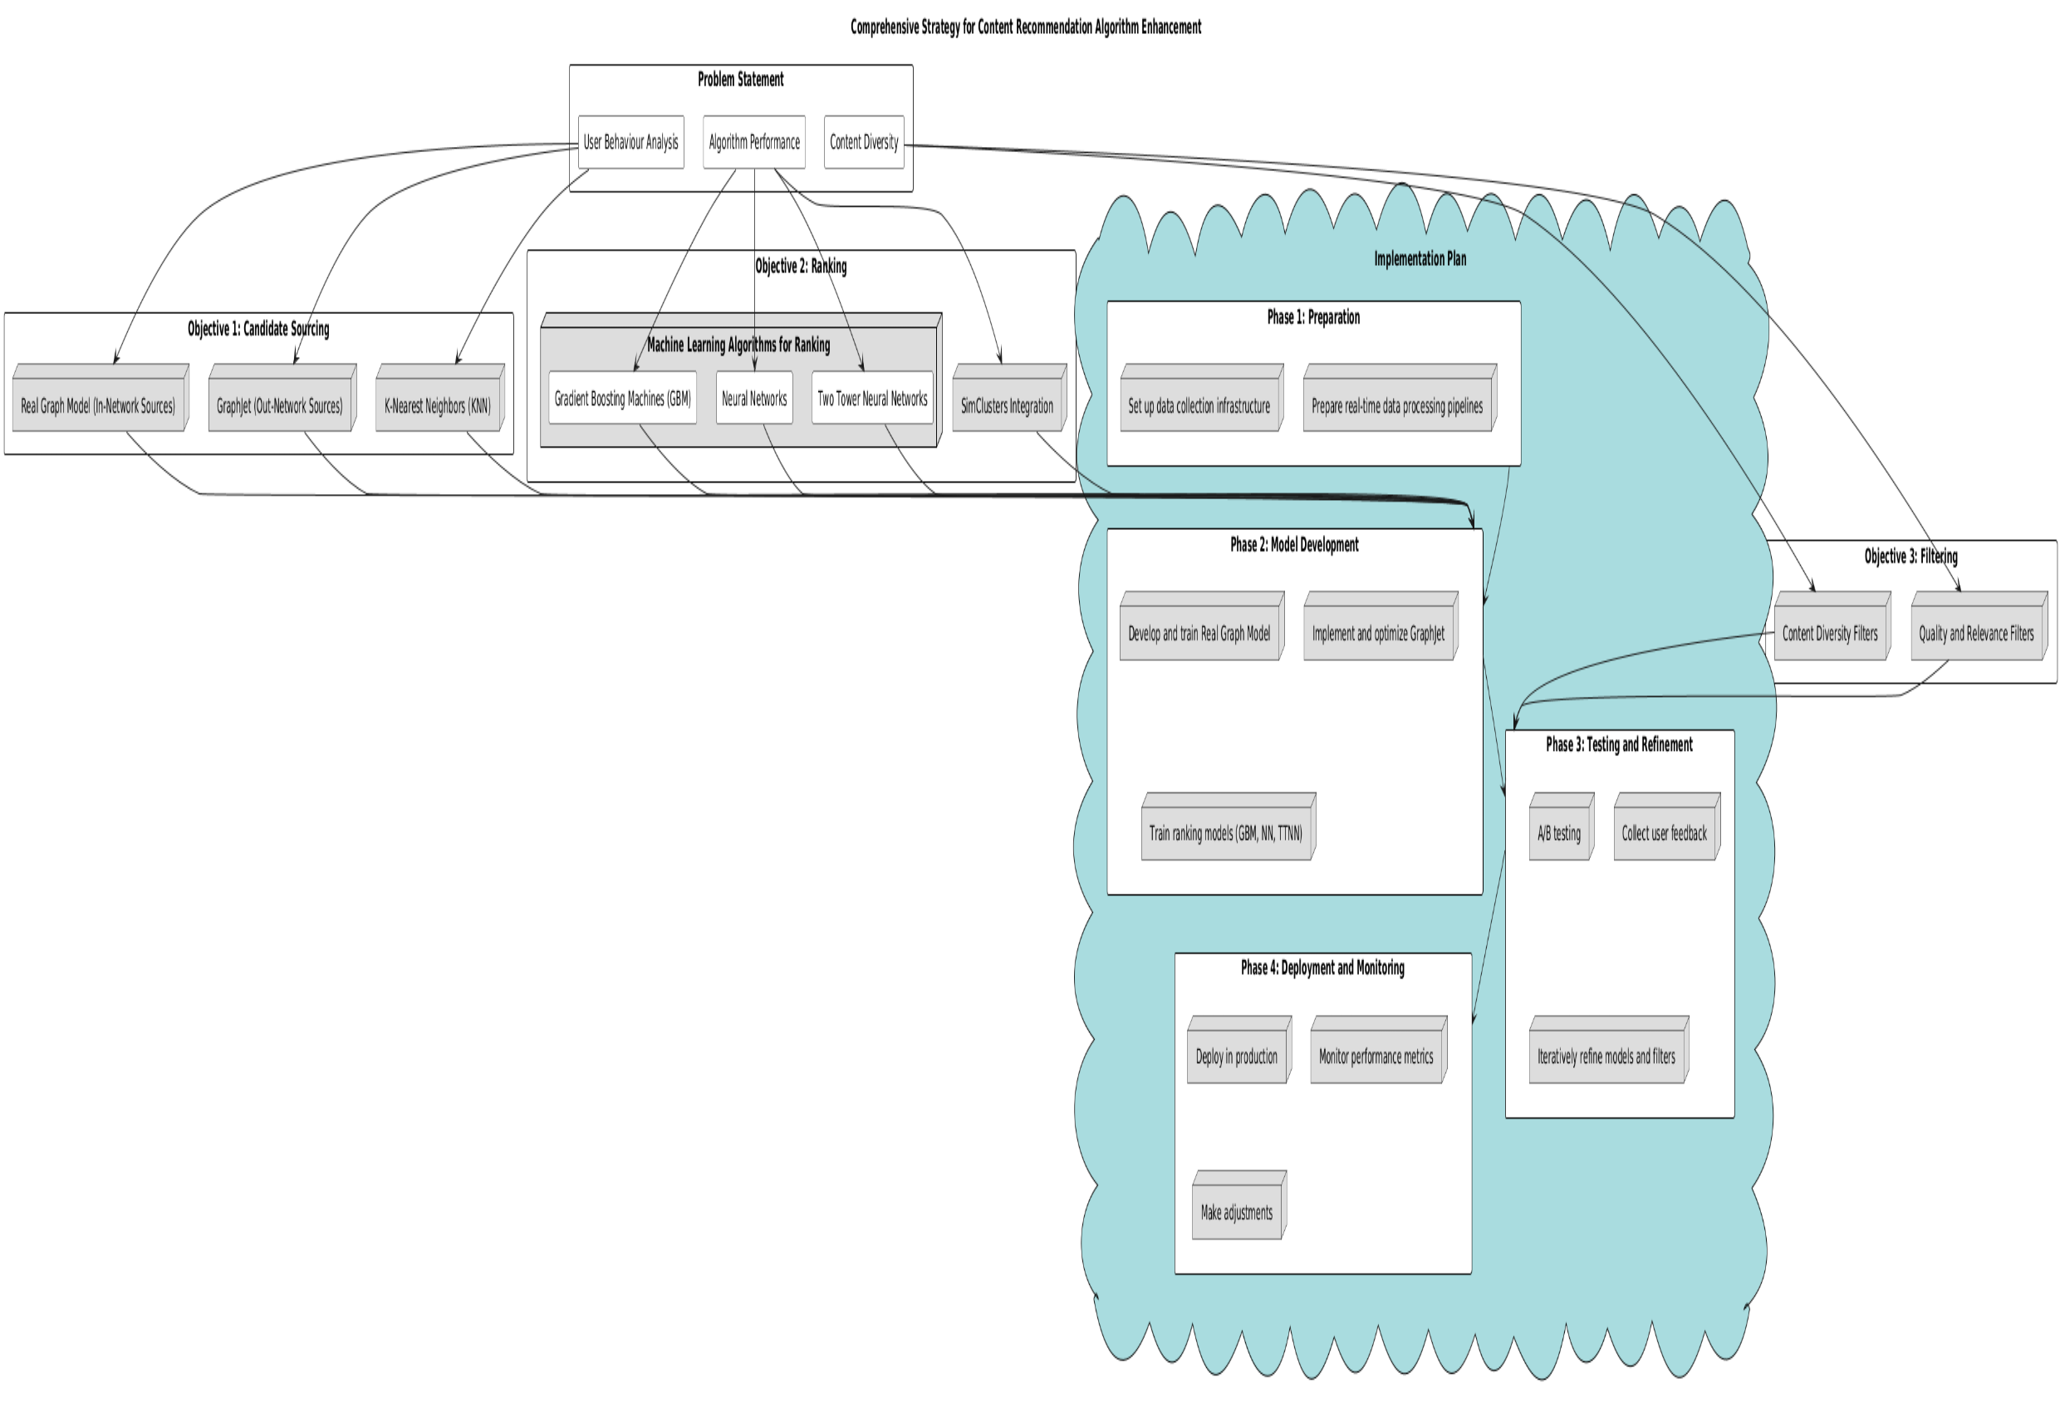
Techniques Used
The techniques applied include the Real Graph Model (In-Network), which predicts user engagement based on historical interactions. GraphJet (Out-Network) maintains a real-time interaction graph to discover compelling content beyond immediate connections. K-Nearest Neighbors (KNN) employs collaborative filtering for personalized recommendations. For ranking, methods include Gradient Boosting Machines (GBM), Neural Networks such as DeepFM and Two Tower Neural Networks, and integration of SimClusters for community-driven engagement patterns. Filtering strategies encompass Content Diversity Filters and Quality and Relevance Filters to ensure a varied and high-quality content selection.
Notes:
Ascend screenshot

