Slide 1

OBJECTIVES:
1. See maximum how much accuracy you can get.
2. What do you say about residuals i.e. what could compose of.
3. Compare it to RNA half life.
Predict expression of genes using histone modification level at promoters (1Kb upstream-2Kb downstream).
Agenda
INTRODUCTION
PROCEDURE
CORRELATION AMONG THE FEATURES AND FPKM
CORRELATION AMONG PREDICTED AND ACTUAL FPKM VALUES
CORRELATION AMONG LOG OF RESIDUAL AND LOG OF RNA HALF LIFE
GROUP-10
ISHIKA GUPTA(MT25180)
SUNANDINI CHOWDHURY(MT25187)
GUIDE: DR. VIBHOR KUMAR

Slide 2
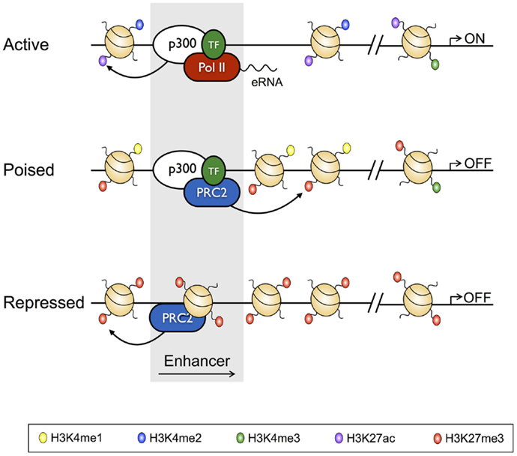
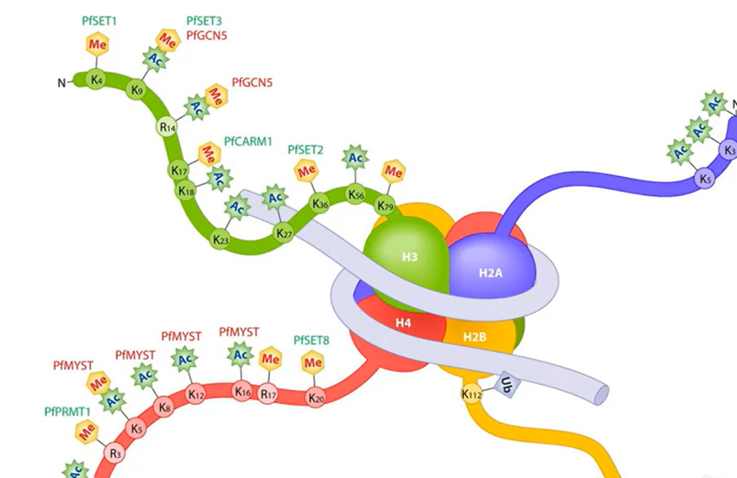
INTRODUCTION
GM12878 Cell Line
🔹 Human lymphoblastoid (B-cell–derived) cell line
🔹 Widely used in transcriptomic research
🔹 Ideal for studying chromatin architecture, gene regulation & immune pathways
HISTONE MODIFICATION AT THE PROMOTER REGION
H3K4me3
Histone Mark | Function | Impact at Promoter
H3K4me3 | Active transcription | Marks active promoters
H3K27ac | Enhances transcription | Signals strong promoter activity
H3K27ac

Slide 3
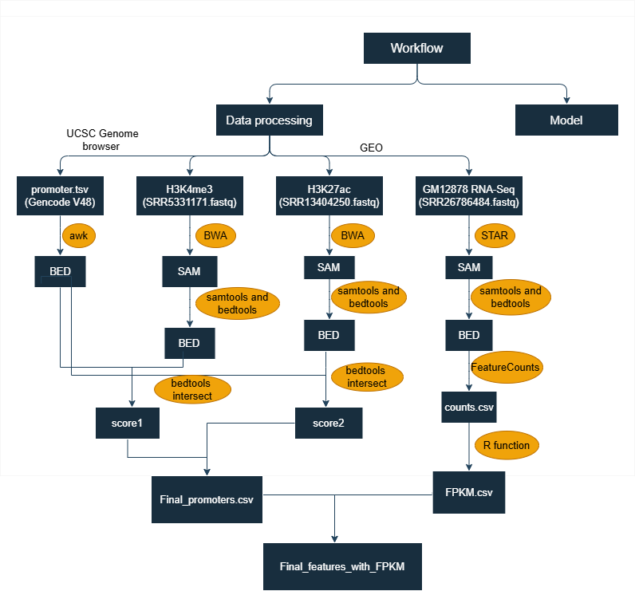
PROCEDURE: DATA PREPROCESSING
(next slide)

Slide 4
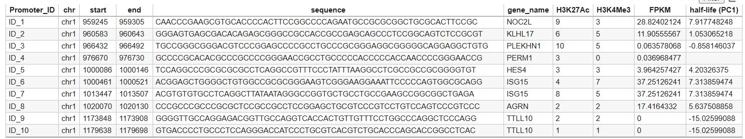
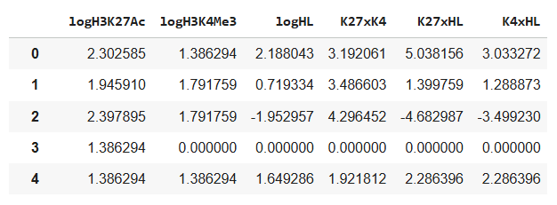
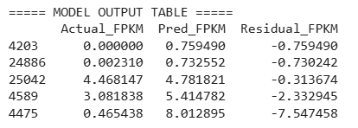
PROCEDURE: MODEL
Understand the data
Log transformation of scores and half life
Feature generation
Train test split
(train 90%, test 10%)
Random forest
Residual calculation
Performance metrics
29,598 samples

Slide 5
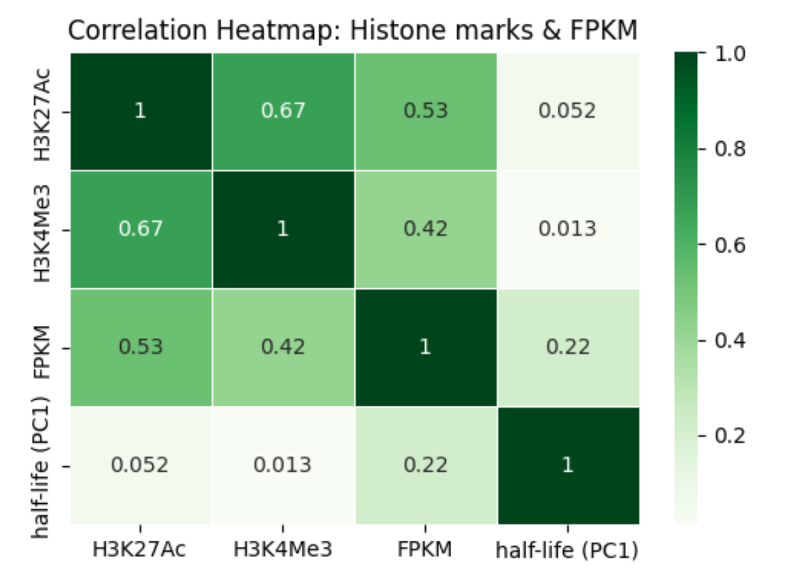
Correlation Heatmap : Histone Marks, FPKM, RNA Half-Life

Slide 6
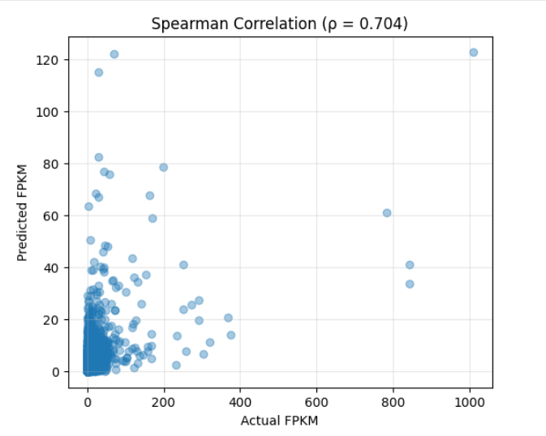
Scatter Plot: Predicted vs Actual FPKM
validation of the predictive utility of histone modifications for FPKM Calculation

Slide 7
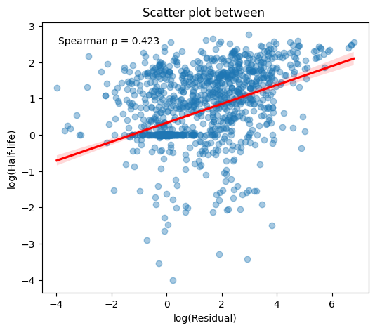
Scatter Plot: log(Residual) vs log(Half-Life)
RNA decay features account for a substantial portion of gene expression variability that promoter histone marks alone cannot explain.

Slide 8
THANK YOU
REFERENCES:
https://pubmed.ncbi.nlm.nih.gov/23770639/
https://pmc.ncbi.nlm.nih.gov/articles/PMC9684954/
http://hgdownload.cse.ucsc.edu/goldenPath/hg19/encodeDCC/wgEncodeCaltechRnaSeq/
https://trace.ncbi.nlm.nih.gov/Traces/sra-reads-be/fastq?acc=SRR13404250
https://trace.ncbi.nlm.nih.gov/Traces/sra-reads-be/fastq?acc=SRR5331171
The complete project—including all CSV files, R scripts, Jupyter notebooks, and R Markdown documents—is available in the GitHub repository linked below:
https://github.com/sunandini333/Predict-expression-of-genes-in-GM12878-cell-line-using-histone-modification-level-at-promoters/
ACKNOWLEDGEMENT:
DR. VIBHOR KUMAR
JAIDEV SHARMA

