Slide 1
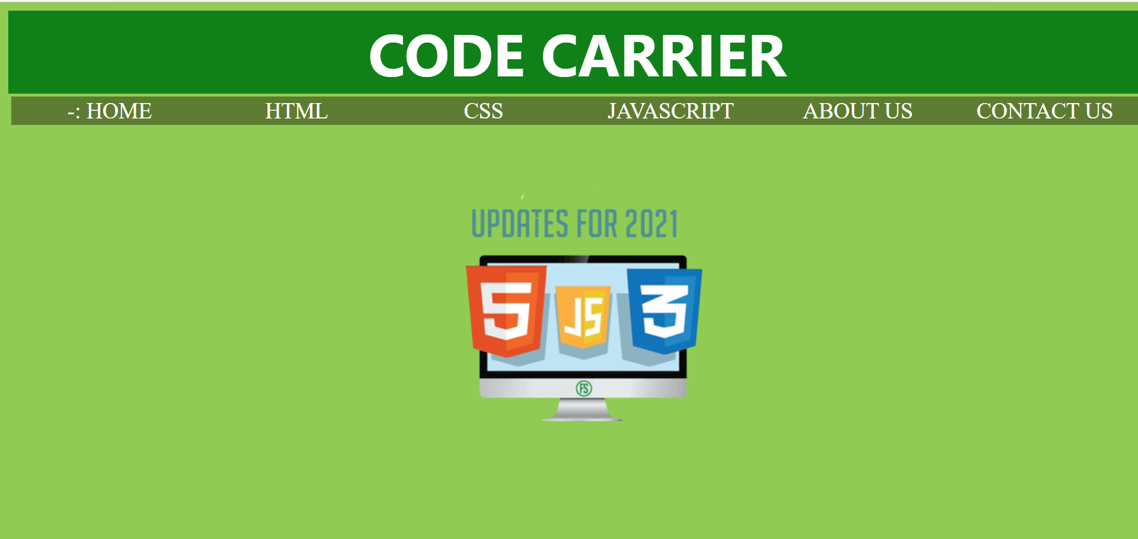

Slide 2
Introduction
HOME HTML CSS JAVASCRIPT ABOUT US CONTACT US
HTML Tags :–
Anchor tag
Anchor tag define a hyperlink that links one page to another page.
Program 1:
Program 2:
Paragraph tag
Image tag
List tag
Form tag

Slide 3
PROGRAM 1:
<html> <body> <p>welcome to HTML</p> <a href =“second.html”> on click</a> </body> </html> | welcome to HTML click

Slide 4
THANK YOU

